Slide 1
Lab / Pathology
Managers Meeting
October 2020

Slide 2

Patient and Family Promise

Slide 3
Serious Safety Events
*Days since last SSE:
WFB: 134
BCH: 102
DMC: 509
HPMC: 85
LMC: 157
WMC: 205
*Current as of 10/13/2020

Slide 4
Lab Pathology Deviations
Sept: 52
Average: 72

Slide 5
Top Deviations in September
#1
#2

Slide 6
Top Deviations in September
#3

Slide 7
Lab Pathology Deviations by Section
September 2020

Slide 8
RL6 Closing the Loop Compliance

Slide 9
RL6 Closing the Loop Compliance by
Section

Slide 10
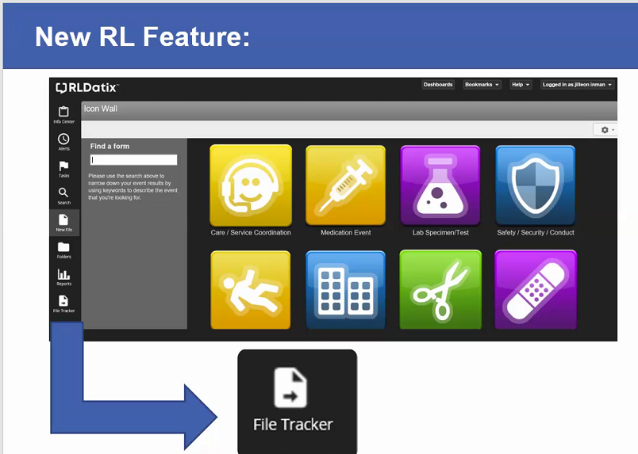

Slide 11
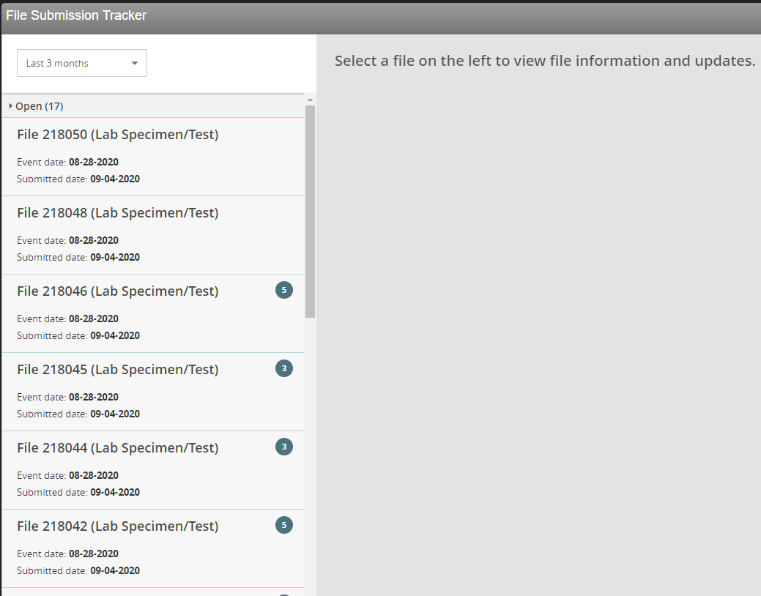
File Tracker

Slide 12
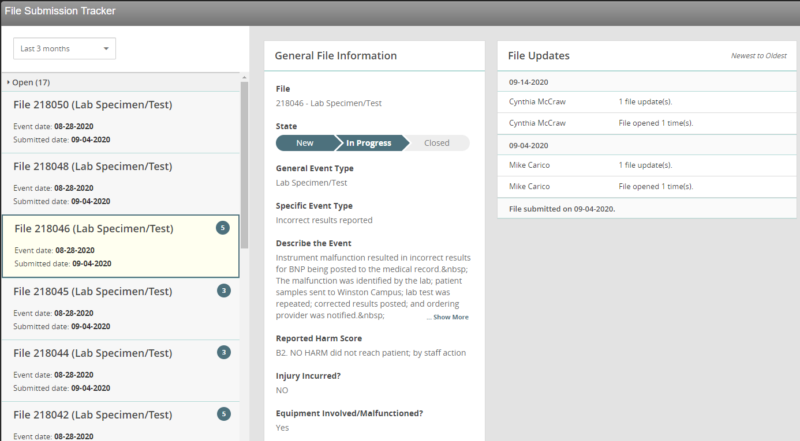
File Tracker

Slide 13
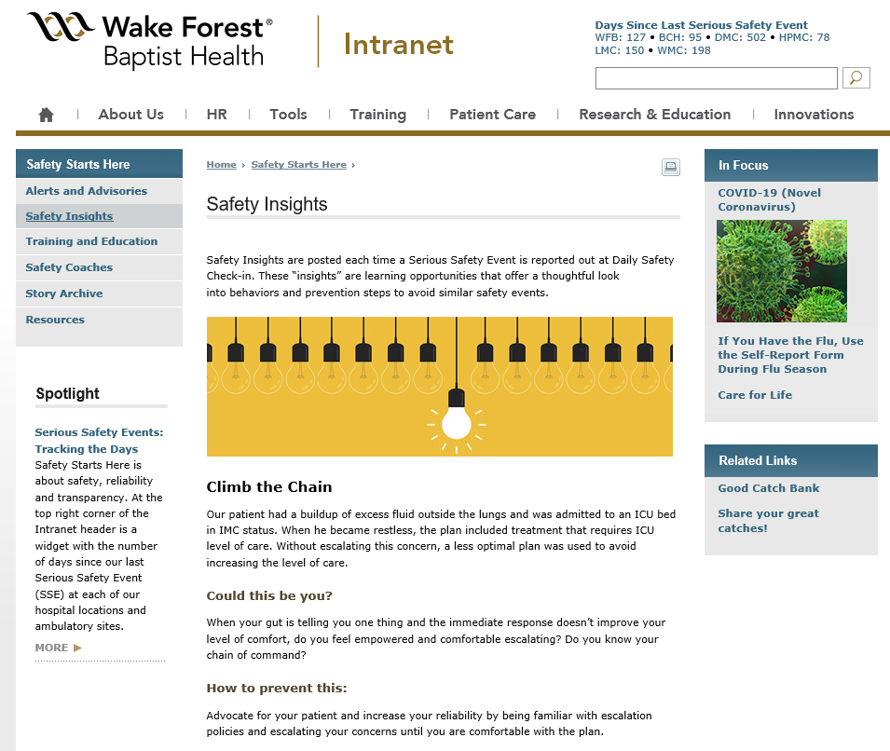
Safety Insights
Safety Insights are posted each time a Serious Safety Event is reported out at Daily Safety Check-in.
These “insights” are learning opportunities that offer a thoughtful look into behaviors and prevention steps to avoid similar safety events.

Slide 14

Please use this template as provided. Do not modify the font, bullets, border or background.
Use this for orange text
Use this for blue text
Or this if you need red
Safety First – ALWAYS!
Use this safety tool to escalate concerns!
A- Ask a question R- Make a Request C- “I have a Concern” C- Chain of Command
“What you permit, you promote” Start with the lightest touch Especially helpful when we are hesitant or intimidated | Point out unsafe conditions If you hear someone say “I have a concern” stop and address this genuine worry that we may cause harm
Notes:
Empower you to escalate a concern: Examples: 1. PM on equipment in lab expired 2 months ago; lab team aware; had notified Trimedx numerous times and ways and still the task has not been completed – escalate. 2. Inappropriate behavior/attitude in the work environment – everyone knows, always been this way; scared to make him/her mad, we just avoid him/her when they are having a bad day. Do you know your chain of command? Are you comfortable escalating

Slide 15
Safety Starts Here Section Compliance 2020

Slide 16


Slide 17

3rd Qtr Safety Audits
Two Lab Sections with NO deficiencies:
  Cancer Center Lab
  Electron Microscopy

Slide 18

3rd Qtr Safety Audits
Lab sections using ONLY in-date products:
  Blood Bank/BMT
  Cancer Center Lab
  Central Processing
  Chemistry
  Critical Care Lab
  Electron Microscopy
  HLA
  Molecular Diagnostics/PCR
Notes:
9 sections utilizing expired products – will need CAPA

Slide 19
3rd Qtr Safety Audits
Deficiencies found in lab sections:
Incomplete, illegible or incorrect reagent labeling (8 labs)
PPE not used per hazard risk assessment (5 labs)
Research reagents not labeled as such
PM or calibrations overdue
Cardboard boxes on the floor
Weekly shower/eyewash checks not documented
Full thermos in testing area
Storage in front of electrical panels

Slide 20

Good Catch
Celebrate our successes!
Ways to report good catches:
  RL6 using the Good Catch Icon – preferred method of reporting
  Email Shelley with good catches
  Report good catches at Lab Manager’s Huddle; Safety Coach’s Meeting or Laboratory Safety Meeting
All of the good catches will be submitted for a drawing. At the beginning of the next month a winner will be pulled from all submissions.
The good catch winner will be recognized at that month’s Safety Governance Committee, presented with a certificate, given a good catch pin and a gift card.
The good catch submitter will be also be recognized at that month’s Safety Governance Committee and will be presented with a gift card.

Slide 21
Daily Safety Check In
Every day, 7 days a week @ 0905

Slide 22

Next Lab Huddle: November 10th, 2020

