Slide 1
Lab / Pathology
Managers Meeting
November 2020

Slide 2

Patient and Family Promise

Slide 3
Serious Safety Events
*Days since last SSE:
WFB: 39
BCH: 130
DMC: 110
HPMC: 113
LMC: 185
WMC: 233
*Current as of 11/10/2020

Slide 4

Good Catch
Celebrate our successes!
Ways to report good catches:
  RL6 using the Good Catch Icon – preferred method of reporting
  Email Shelley with good catches
  Report good catches at Lab Manager’s Huddle; Safety Coach’s Meeting or Laboratory Safety Meeting
All of the good catches will be submitted for a drawing. At the beginning of the next month a winner will be pulled from all submissions.
The good catch winner will be recognized at that month’s Safety Governance Committee, presented with a certificate, given a good catch pin and a gift card.
The good catch submitter will be also be recognized at that month’s Safety Governance Committee and will be presented with a gift card.

Slide 5
Good Catches in October

Slide 6
Good Catches in October

Slide 7
Good Catches in October

Slide 8

Good Catch Winner for October
Cathy Gilkey

Slide 9
Lab Pathology Deviations
October: 56
Average: 72

Slide 10
Top Deviations in October
#1

Slide 11
Top Deviations in October
#3

Slide 12
Lab Pathology Deviations by Section
September 2020

Slide 13
RL6 Closing the Loop Compliance

Slide 14
RL6 Closing the Loop Compliance by Section

Slide 15
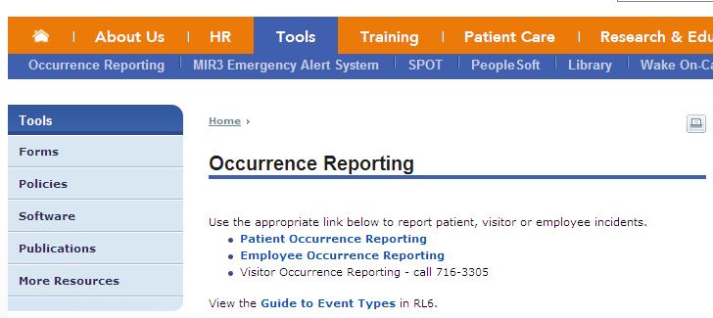
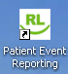
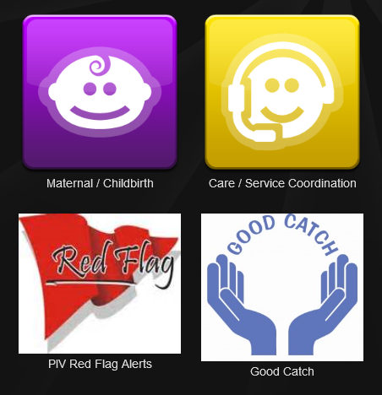
Please use this template as provided. Do not modify the font, bullets, border or background.
Use this for orange text
Use this for blue text
Or this if you need red
Safety First – ALWAYS!
Reporting
Who can report? Anyone! Anything that harms a patient or employee Anything that threatens to harm a patient or employee Anytime something unexpected happens | Celebrate our successes! Recognize great catches and reporting with a Good Catch report, Shout Out or e-card.
Notes:
Maybe November

Slide 16
Safety Starts Here Section Compliance 2020

Slide 17


Slide 18
Trimedx Meeting
Second Thursday of every month @ 0830
Email me any concerns or issues you have using the excel spreadsheet by end of day on the second Monday of each month.

Slide 19
Reagent Labeling Policy
8 Lab Sections had a deficiency in this area at the 3rd quarter safety inspections
Opportunities for Improvement:
1. Reagent Labeling
Primary Container:
1. Content and quantity
2. Concentration or titer
3. Storage requirements
4. Date filtered or aliquoted, reconstituted
5. Expiration date
6. Preparer’s initials
7. Safety/Hazard information (GHS)
Secondary Container:
1. Identity/description of contents
2. Quantity/concentration or titer if applicable
3. Storage requirements
4. Date prepared, filtered, aliquoted, reconstituted, etc.
5. Expiration date
6. Lot # if applicable
7. Preparer’s initials
8. Safety/Hazard information (GHS)

Slide 20
Reagent Labeling Policy
Opportunities for Improvement:
2. Labeling Legibility
Sections are responsible for ensuring that all primary and secondary container labels are neat and legible at all times.
Sections are responsible for replacing labels when they become stained, faded or begin to peel.
Labels that are not legible are safety issues that could lead to harm to employees and/or patients

Slide 21
Reagent Labeling Policy
Opportunities for Improvement:
3. Expiration Dates
If there is no expiration date given on the primary container, use 12 months from the date opened as the expiration date.
If the expiration date on the primary container changed after opening then the expiration date for the aliquot will follow suit and use the same expiration date that was used for the primary container.

Slide 22

Next Lab Huddle: December 8th, 2020

