Slide 1
i-STAT Testing: EG7
Prepared by Laboratory Compliance, Quality, Safety, and Point-of-Care Testing Team Updated November 2020

Slide 2
i-STAT Support: Contact Information
Kelly Leiner 781-2421
Trish Sorensen 713-4136
Liz Gregory 713-0377
Refer to the i-STAT System Manual and medical center specific i-STAT policies

Slide 3
Only Authorized Users May Perform i-STAT Testing: Training and Competency Requirements
Initial training and evaluation for proper test performance
6 month competency assessment-NEW users
On-going Annual competency assessment
Must meet all 6 points of competency assessment, as defined by CLIA
Failure to maintain competency will result in loss of testing privileges
Competency observation may only be completed by an authorized staff member
Written exams 80% correct or remediation will be required (All necessary exams must be complete PRIOR to competency observation)

Slide 4
i-STAT Access (Operator ID)
Training=i-STAT access
Employee ID=operator ID
Do NOT share your employee/operator ID
Do NOT enter your ID into analyzer and allow testing by another individual

Slide 5
Safety
Always wear gloves
Patient testing
Performing/handling Quality Controls (QC)
Disinfecting analyzer
Disinfect analyzers
When contaminated with blood AND
Between EACH patient
Follow medical center policies

Slide 6
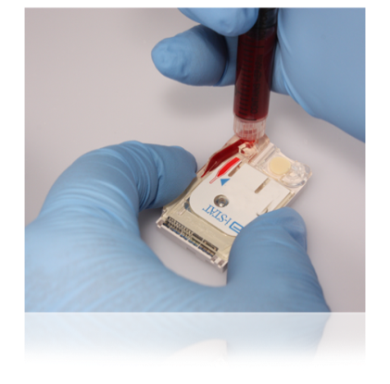
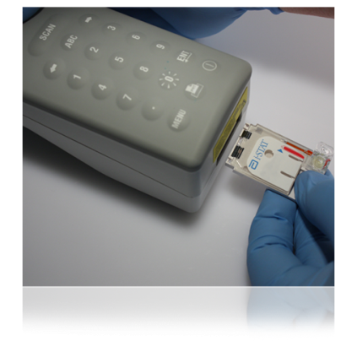
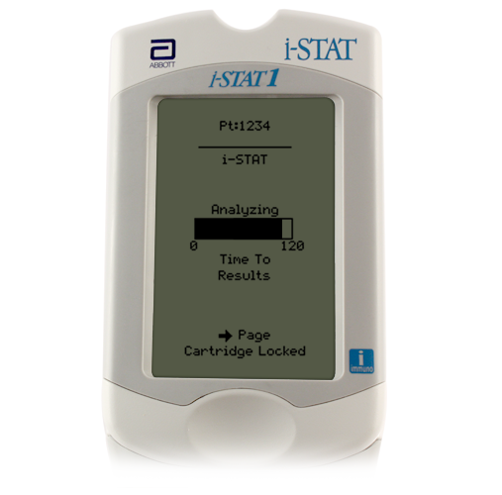
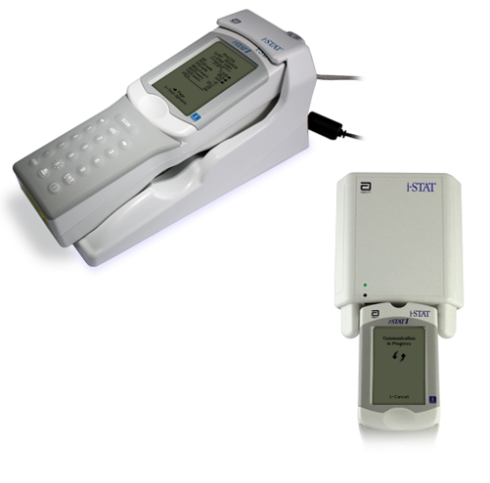
Quick Overview: The i-STAT System Testing Process
Enter information into handheld
Obtain the blood specimen and fill cartridge
Insert cartridge; results will appear within minutes
Download results

Slide 7
i-STAT Analyzer
Turns off after 2 minutes of non-use
Can be turned on by pressing the on/off keypad—circle with line
If operator, patient, and cartridge information has been entered, the analyzer will remain on for 15 minutes

Slide 8
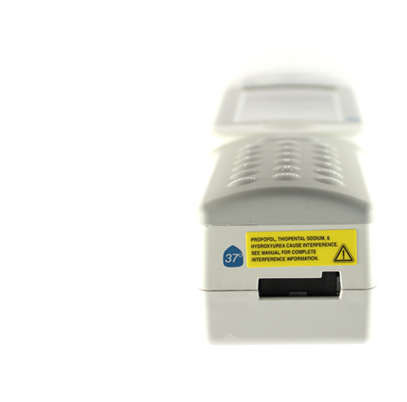
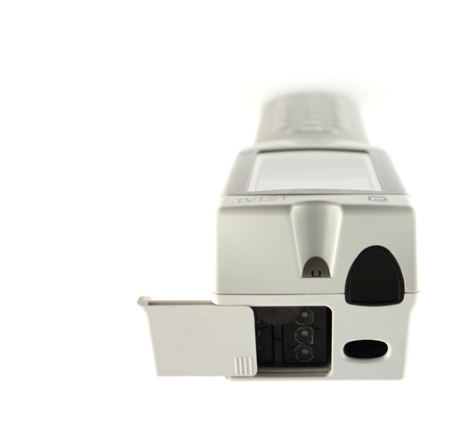
Handheld External Components
Infrared eye
Cartridge port
Battery
compartment
Barcode scanner

Slide 9
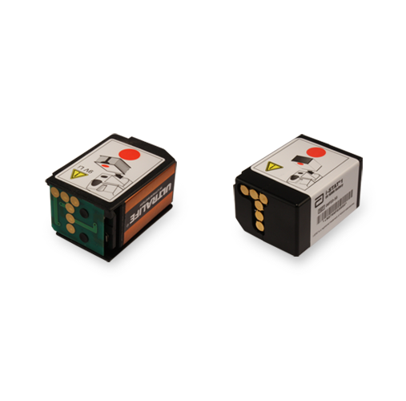
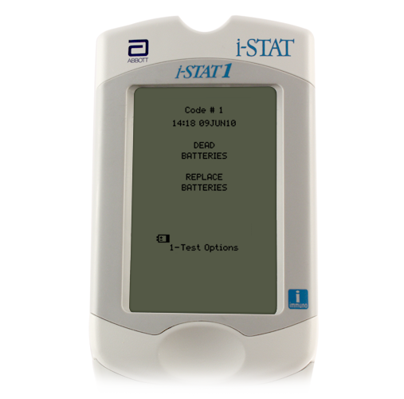
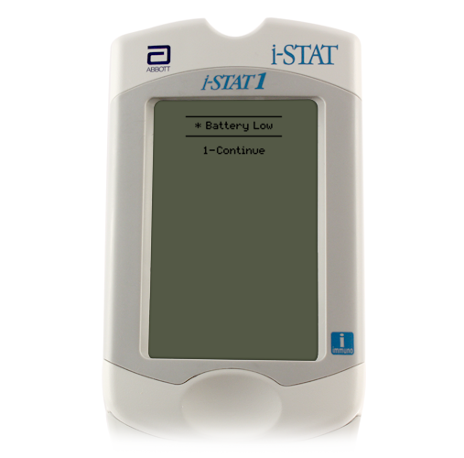
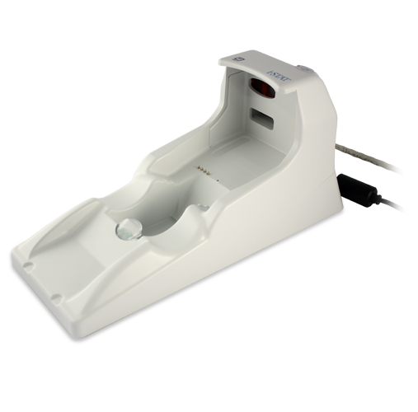
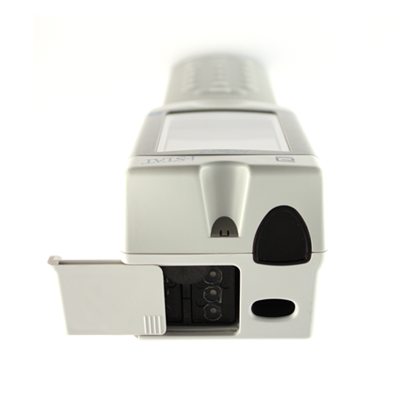
Batteries: Hands On
9-volt lithium disposable batteries
9-volt lithium disposable batteries or battery pack
Change/charge the batteries:
Flashing battery icon
“Battery Low ” message
Do not discard rechargeable batteries
Green light will be on if battery in compartment is seated properly and charging
Abbott rechargeable battery pack
Battery
compartment
Battery
compartment

Slide 10
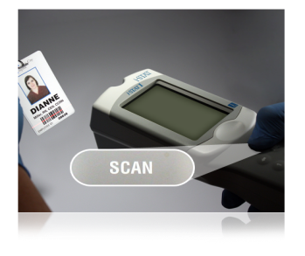
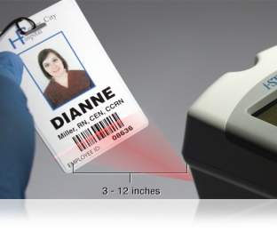
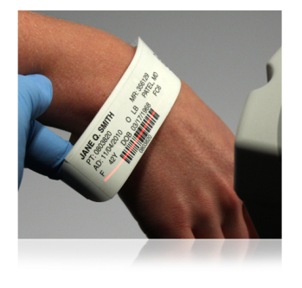
The Barcode Scanner
To scan
Hold 3 to 12 inches away from the barcode
Press and hold down the SCAN key
Laser beam must cover the entire length of the barcode
Wait for the beep or for laser beam to disappear
Release the SCAN key
Barcode scanner
The barcode scanner is a class II laser device. Momentary exposure is not known to be harmful—however you should never point the scanner at anyone or look into the laser beam.

Slide 11
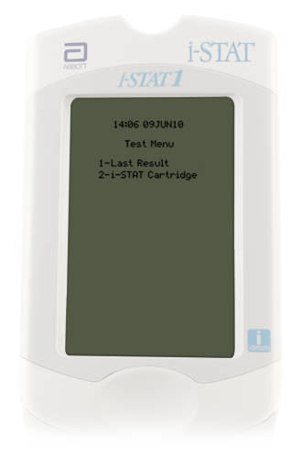
Handheld Test Menu—Hands On
Test Menu
First menu to appear
Important Note:
This menu is used for patient
tests only!
Cartridge Test Menu options
1 = Last Result
2 = i-STAT Cartridge (for a patient test)

Slide 12
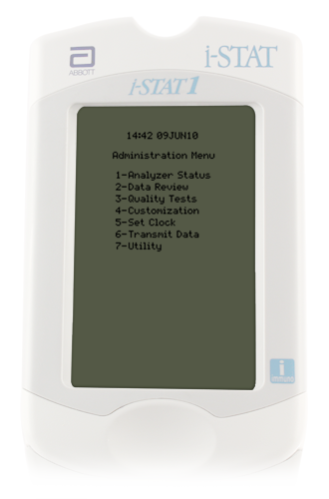
Administration Menu Options Hands On
1--Analyzer Status
Battery voltage
Shows Total records and Unsent records
2--Data Review
Review/print stored data
#7 – List All Results
3--Quality Tests
Quality control checks

Slide 13
General Cartridge Information
Self-contained lab analyzers
Analysis, sample manipulation, and waste are confined within the cartridge
Single use
25 per box
Requires only a few drops of blood
Cartridges contain biosensors that “measure” the analytes being tested.

Slide 14
i-STAT Cartridge Labeling
Lot number
Panel name
Cartridge barcode
Analytes
Room temperature storage expiration date
Refrigerated expiration date
Cartridges MUST be brought to room temperature
5 minutes for a single cartridge
1 hour for a box of cartridges
Do NOT manipulate the cartridge in any way to bring it to room temperature more quickly.

Slide 15
Cartridge Storage
ALL refrigerated cartridges must be stored 2- 8˚C
Storage environment MUST BE MAINTAINED and monitored 24/7/365
If temperature is ever outside of 2 to 8˚C, contact the POCT office for assistance.
Do NOT use the cartridges for patient testing, until consulting the POCT office.
Cartridges should NOT be returned to refrigerated storage once they reach temperatures above 8˚C.
Do NOT store or expose cartridges to extreme cold or heat such as freezing or stored above lights or computers

Slide 16
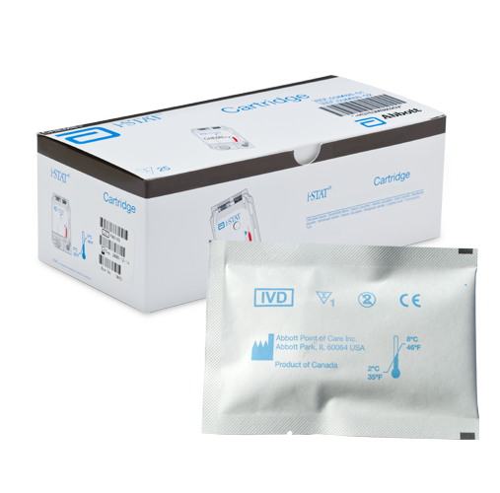
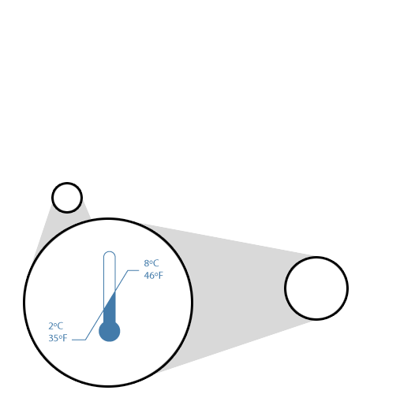
Cartridge Storage (continued)
Room temperature (RT) storage
2 months for EG7 cartridges
Room temperature expiration should NEVER exceed manufacturer expiration date
RT 18°C - 30°C (64-86°F)
Do NOT use past manufacturer’s expiration date or past room temperature expiration date.

Slide 17
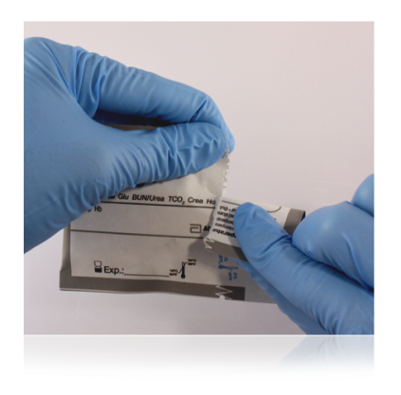
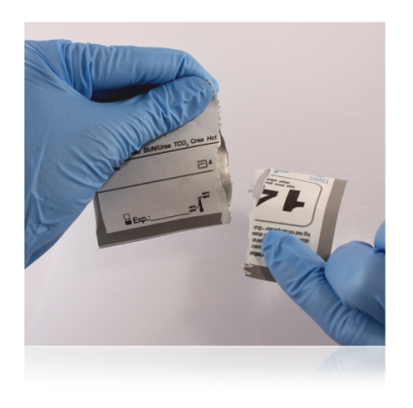
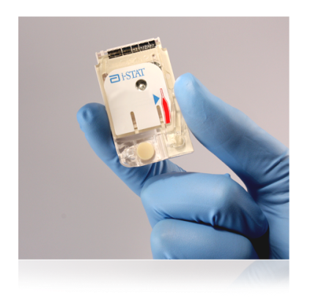
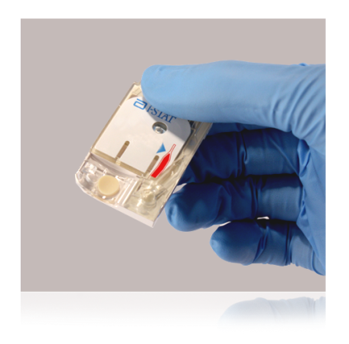
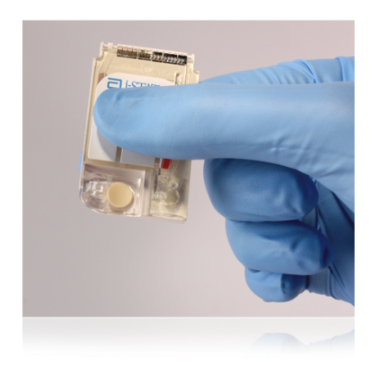
i-STAT Cartridge Handling
Do NOT reuse cartridges
Open cartridge pouch IMMEDIATELY prior to use.
Carefully tear open the cartridge pouch where indicated (do NOT leave cartridges exposed to air or moisture)
Hold the cartridge by the sides or the bottom
Do not touch the sensors or apply pressure to the center of the cartridge (be careful when putting room temperature expiration date on cartridges – write or apply sticker at line on bottom – not in the middle)

Slide 18
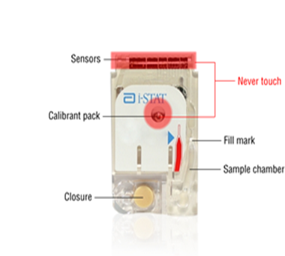
i-STAT Cartridge Components

Slide 19
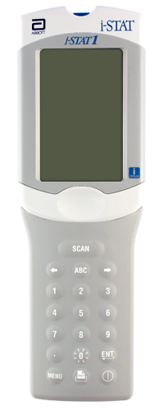
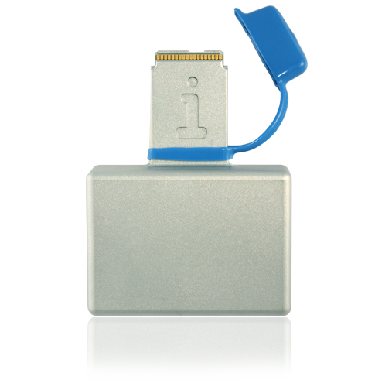
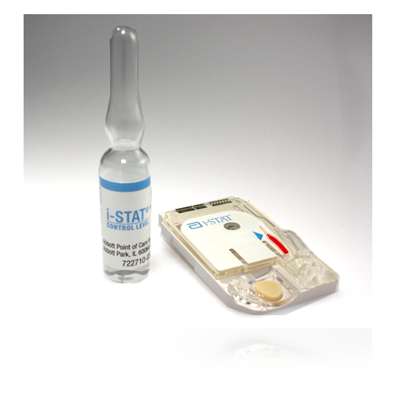
i-STAT System Quality Control
i-STAT System Quality Control
Internal Electronic Simulator
External Electronic Simulator
Liquid Quality Controls

Slide 20
Simulators
Electronic Quality Control
Validates i-STAT analyzer
Pass or Fail
QC results automatically documented when analyzer downloaded

Slide 21
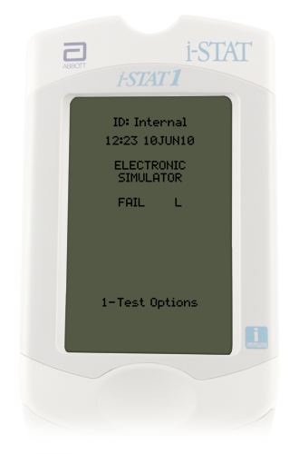
Internal Electronic Simulator
Internal checks ensure proper and accurate functioning
Performed automatically
Every 8 hours of patient use
If simulator passes, testing proceeds/patient results will be displayed
Results will not be given if the simulator fails.
If the “Electronic Simulator Fail” message appears,
Do Not proceed with patient testing until issue is resolved.
Test external electronic simulator

Slide 22
External Electronic Simulator--Hands On
Same as the internal simulator but is an external device and can be tested upon demand.
Simulator is performed if:
Handheld is dropped
Internal Electronic Simulator failure
Error code occurs that indicates the simulator should be tested
Questionable analyzer performance
External Electronic Simulator
Do not remove simulator when “Simulator Locked” is displayed

Slide 23
Liquid Quality Control
Validates performance of test cartridges
Consists of multiple levels—test specific
Should be performed:
Each new cartridge shipment
Monthly—by testing site staff
Questionable performance cartridges/analyzer

Slide 24
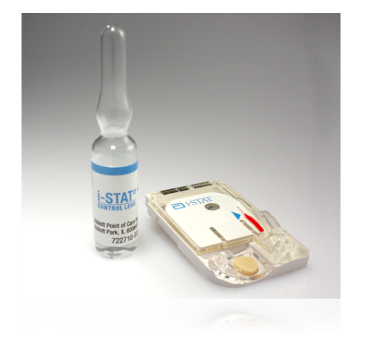
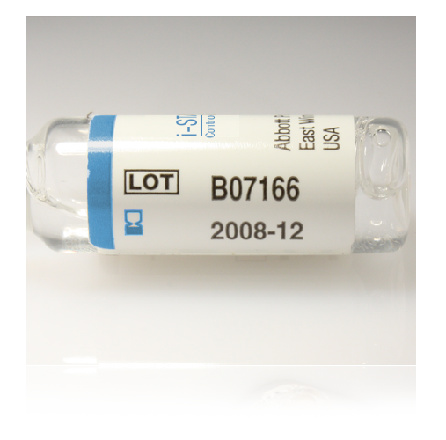
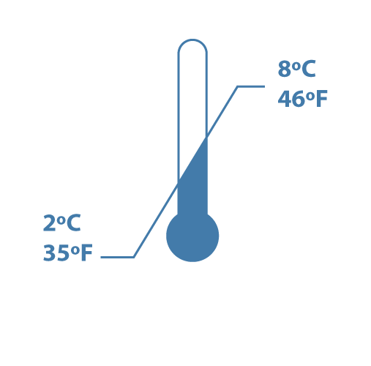
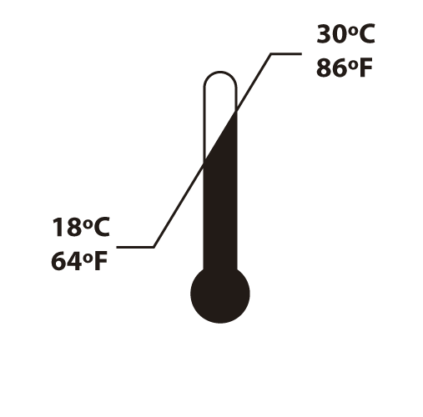
Liquid Quality Controls for EG7
3 levels
Monitors cartridge performance
Store 2°C to 8°C
Room temperature for 4 hours before testing
Expiration Date

Slide 25
Liquid QC Important Notes/Reminders
Analyzers programmed with QC ranges for the liquid QC.
Pass or Fail will display
If liquid QC fails, a comment code and corrective action is required:
Use comment code 5—recheck/confirm
Repeat liquid QC
Creates a STOP point for the testing staff member
Patient testing lockout does NOT occur
Staff MUST ensure QC results are within acceptable limits PRIOR to proceeding with patient testing.

Slide 26
Process Flow
Ensure documented physician order or documented protocol before performing i-STAT testing.
Patient ID:
CSN for that specific date of service or current admission CSN
After testing is completed, analyzer should be downloaded.
If ID match is found, results post to Wake One and billing occurs, regardless of provider order

Slide 27
Patient identity
Follow medical center policy for verification of patient identity—
2 patient identifiers at the patient side (name and Date of Birth (DOB))
Scan patient ID DIRECTLY from the patient armband attached to the patient
If an ID barcode is scanned that is not physically attached to the patient, 4 identifiers (name, DOB, MRN, CSN) MUST be verified.
Include label/armband verification in the procedure time-out.
Ensure sample identity throughout entire testing and reporting process.
Verify patient ID again on analyzer display.

Slide 28
Sample Collection/Considerations:
ONLY whole blood should be tested on the i-STAT
Arterial
Venous
Important notes:
Make sure to follow medical center procedures for proper sample collection.
Always correlate results with the status of the patient!

Slide 29
In-Dwelling Line
Adequately ‘clear’ line
Inaccurate results will be given if samples are contaminated.
Saline Contamination can cause:
Falsely elevated sodium
Falsely decreased potassium, hemoglobin, hematocrit, pCO2,
Contamination with potassium-containing fluids can cause:
Falsely elevated potassium
i-STAT Recommendation:
Five to six times the volume of the catheter, connectors, and needle should be collected as ‘waste’

Slide 30
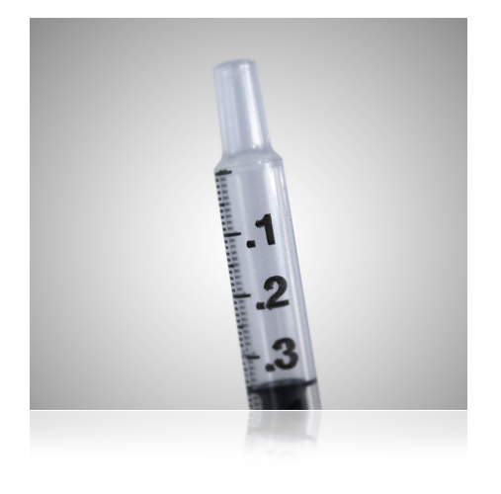
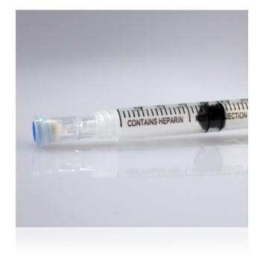
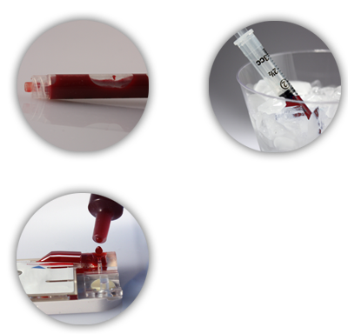
Blood Gas Cartridges— EG7
Use a syringe
Seal sample with cap IMMEDIATELY after collection.
Do not contaminate with air
pO2 will be falsely increased if air contamination occurs
Heparinized samples, test within 10 minutes
Non-heparinized samples, test immediately
EG7 (ionized calcium) use balanced heparin

Slide 31
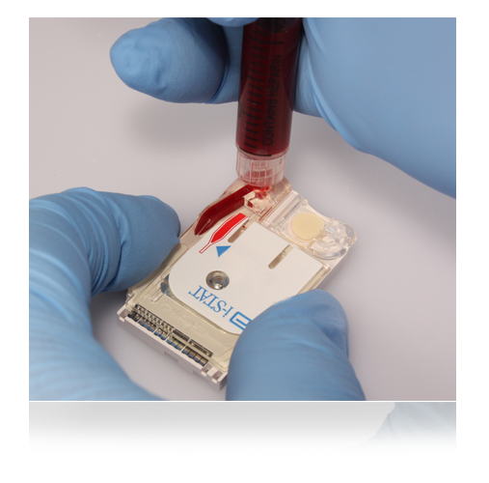
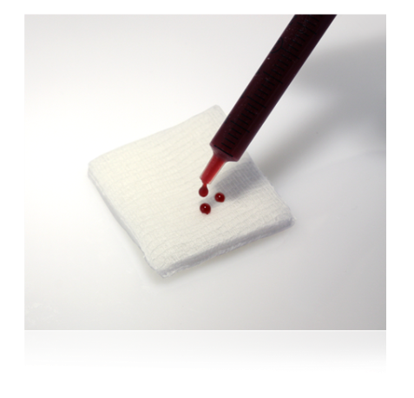
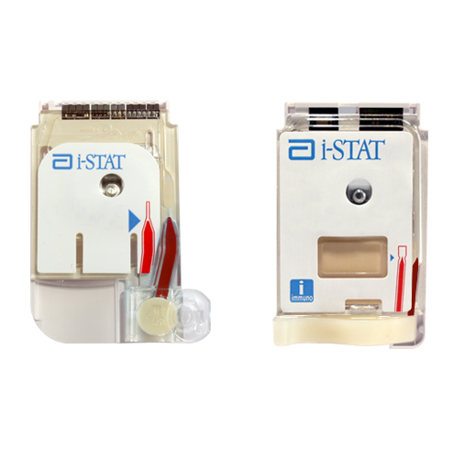
Cartridge Filling Overview
Mix the sample thoroughly and gently for 15 seconds
Hematocrit is most affected by an improperly mixed sample
Discard first few drops to check for clots and to get rid of any micro air bubbles
NEVER test a sample that has or has had a clot. Inaccurate results may be obtained.
Fill to the fill mark and close the closure to seal
Insert IMMEDIATELY into the analyzer
Do not move analyzer after cartridge has been inserted
Fill mark
closure is closed

Slide 32
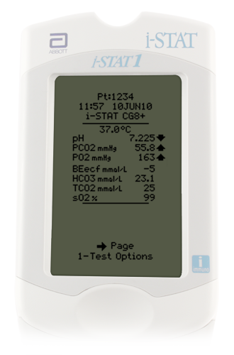
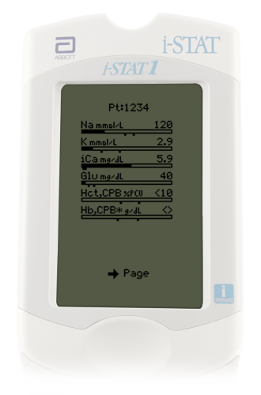
Interpreting Test Results: The Results Screen
Patient ID
Time and date of test
Type of cartridge
Test results
EG7 results appear on 2 pages
Use right Arrow key to navigate

Slide 33
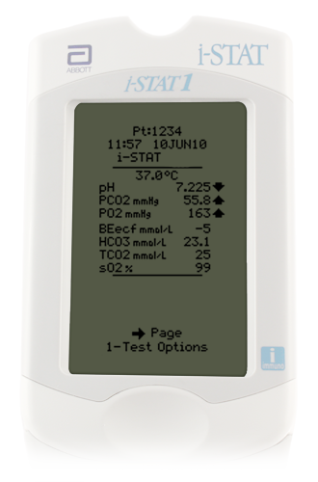
Interpreting Test Results: Critical Value Alerts
Indicated by up or down arrows
Evaluate with patient’s clinical symptoms
As appropriate, perform repeat testing
Values not consistent with patient symptoms --repeat and validate by an alternate test method
Follow medical center policy for handling critical results

Slide 34
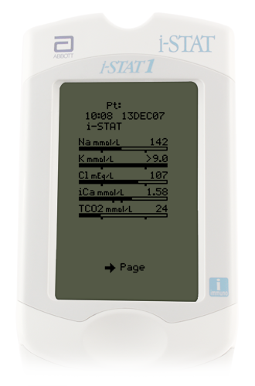
Interpreting Test Results: Out of Reportable Range Flags
Out of Reportable Range flag
Indicated with a <xxx or >xxx
Suppressed Result Flag <>
Result dependent on the out of reportable range result

Slide 35
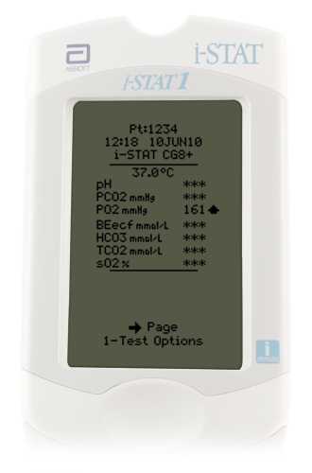
Interpreting Test Results: Star Outs (***)
*** appears in place of the test result
Sensor on the cartridge is unable to report a result
Use comment code 0 (zero) to prevent result from posting to the patient record
Failure to enter comment code 0 into the i-STAT handheld at the time of testing=results post to Wake One
The star out result will report as INSTRUMENT ERROR.
ACTION REQUIRED:
Retest the sample
If star out values continue, send the sample to the Clinical lab for testing.

Slide 36
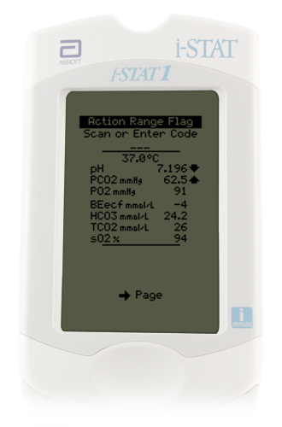
Responding to Patient Tests: Comment Codes
Numeric codes
‘Automates’ result hold or posting of result to the patient record
Affects patient billing for testing
Comment field--top of the first page of the results screen
MUST be entered at the time of testing AND before the analyzer powers down
Question: What can you do if you realize that you have misidentified a patient sample immediately after inserting the cartridge?
Code | Translation | Result Post to Wake One | Allows charge to patient | Use
0 (zero) | Procedure Error | NO | NO | Star out Questionable Results Error in testing
5 | Recheck/Confirm | Yes | NO | Result may be accurate and test will be repeated
6 | To Notify Provider | Yes | Yes | Documents intent to notify provider of result
123 | Lab Confirmation to Follow | Yes | NO | Use when sending repeat testing to the laboratory

Slide 37
Result Considerations: Effects of Hemolysis on Potassium Result (Hemolysis is the destruction of red blood cells, caused by disruption of the cell membrane, and results in the release of hemoglobin)
i-STAT tests whole blood. Hemolysis can NOT be determined.
Potassium values will be falsely increased
DO NOT report/treat high potassium results until verified via an alternate method.

Slide 38
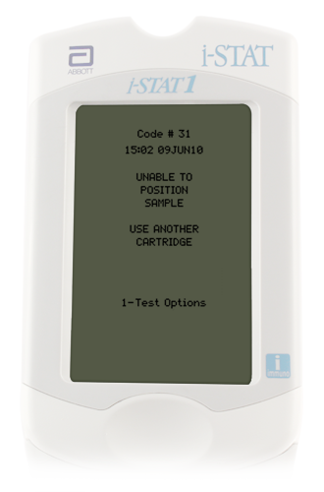
Quality Check Codes:
i-STAT Quality System
Numerous quality checks during patient test cycle
Failed quality check
Cause message— pay attention to the code number
Action message
Quality Check Code
Do NOT continue with testing until the cause of the error is clearly understood
If the same error code occurs multiple times with no apparent cause, notify the POCT office
Consider using a different analyzer and a different batch of test cartridges

Slide 39
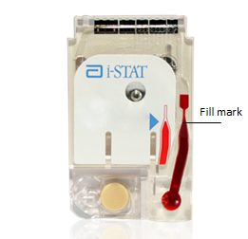
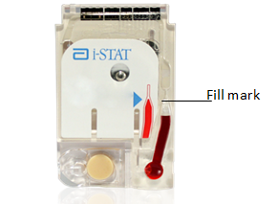
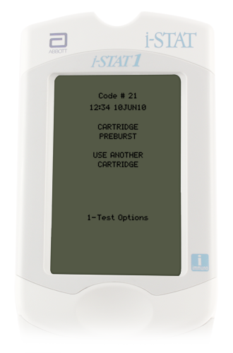
Quality Check Codes

Slide 40
Quality Check Codes

Slide 41
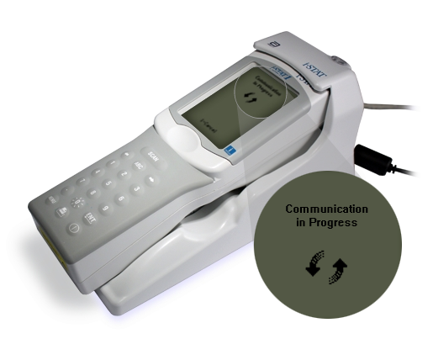
Transmitting Results: Downloader
Transmit results after each test/case:
Turn handheld off
Place handheld in the Downloader
Look for display screen to show arrows and the message “Communication in Progress”
When transmission is complete:
Screen goes blank
Handheld turns off

Slide 42
Transmitting Results: Troubleshooting
If the downloader does Not display “Communication in Progress” or an error message appears
Check for a green power light
Check all cord/cable connections to the down loader
Try unplugging and re-plugging the cables
If troubleshooting does not resolve problem, report problem to the Help Desk (Call 6-HELP)

Slide 43
Congratulations
This concludes the i-STAT education module.
Please note that this power point does not replace the i-STAT policies and procedures.
The presentation only gives highlights of i-STAT information.
Please complete the on-line i-STAT exams within 1 week of training.

