Slide 1
Nova Stat Sensor Creatinine/eGFR Testing
HPRLABSSC20

Slide 2
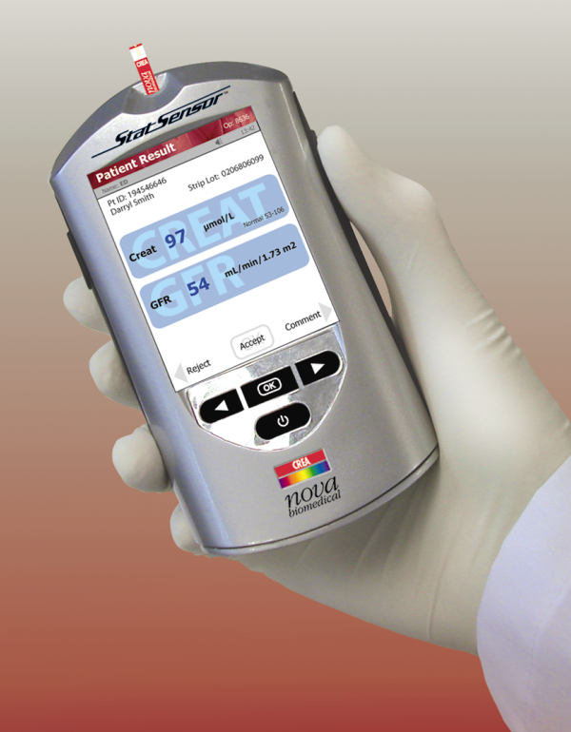
Learning Objectives
This training module provides a comprehensive overview of the StatSensor® meter features and operating procedures including:
System Overview
Quality Control
Participant Testing
Cleaning
Troubleshooting Tips and
Support

Slide 3
System Overview
StatSensor® is a handheld analyzer for whole blood creatinine testing.
Provides an accurate measurement of kidney function by finger stick capillary blood sampling.
StatSensor® calculates glomerular filtration rate (eGFR) using the MDRD equation.
Creatinine with eGFR is a more accurate and sensitive assessment of kidney function than creatinine alone.

Slide 4
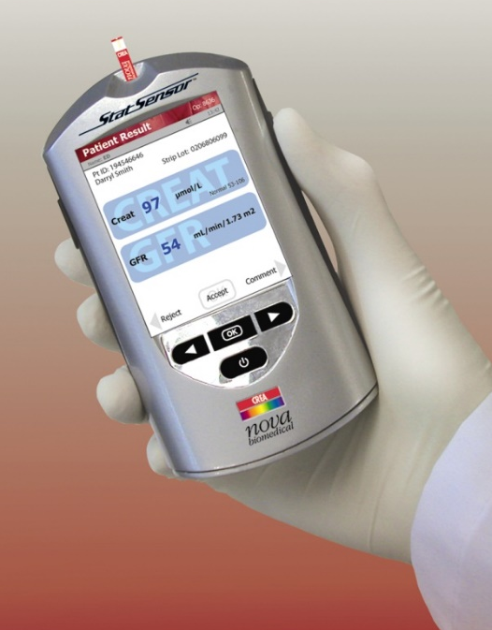
System Overview
Product Features
Accuracy comparable to hospital laboratory testing.
Results reported in 30 seconds.
Uses only 1.2 uL of sample.
END fill test strip.
Reportable range 0.3 – 12.0 mg/dL (27µmol/L – 1,050 µmol/L).
Color touch screen.
Rechargeable battery.
Barcode scanning for control lot numbers.
Notes:
For use with Articulate 2013
This explains how learner will navigate through the course and explains where and how buttons work in the module.

Slide 5
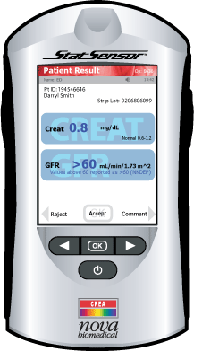
System Overview
The StatSensor® Device
Strip port
Screen title
Touch screen Keypad
Back Button
Forward Button
OK/Enter button default action
Sleep Mode Button Laser Barcode Scanner

Slide 6
System Overview
Docking Station
When the meter is not in use, place it into the Docking Station.
Enables the meter to stay fully charged.
Battery
Rechargeable Lithium Polymer battery.
Typical life of a fully charged battery is
8 hours or 40 tests (when not docked).
Notes:
Blank template

Slide 7
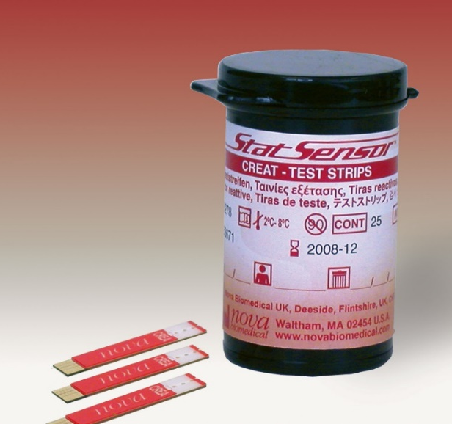
Creatinine Test Strip
Always Date Vials Once Opened!
10 strips per vial
Keep tightly closed when not in use.
Store strips in their original vial in the refrigerator at 2 – 8°C (36° – 46°F).
Expiration date is printed on the vial of test strips.
Once opened, test strips are stable for 90 days.
Write the Date Opened and Discard Date on the vial.
Best practice: Remove the number of strips you need for the day and return vial back to refrigerator.
Notes:
Blank template

Slide 8
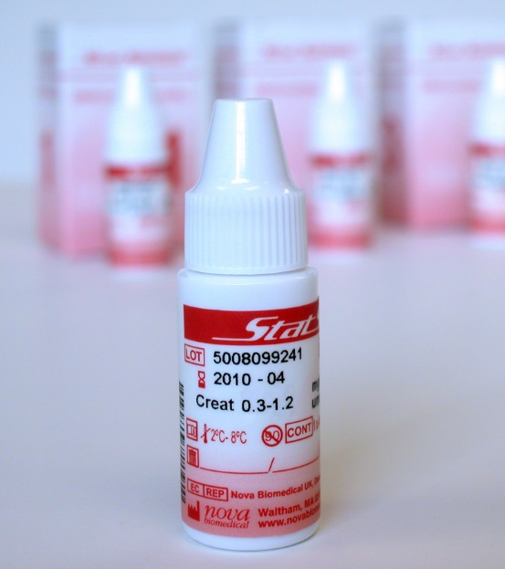
Quality Control Solutions
Always Date Vials Once Opened!
IMPORTANT: Daily routine when conducting patient testing:
Conduct two levels of Quality Control testing (requires 2 strips) once the patient visit is confirmed for that day.
Patient testing is valid for 24 hours following Quality Control.
Repeat Quality Control on next confirmed patient visit day.
Store controls refrigerated at 2° – 8°C (36° – 46°F).
Keep the vials tightly closed when not in use.
Expiration date is printed on the control vials.
Once opened, Quality Control is stable for 90 days.
Write the Discard Date on the vial and cover with scotch tape to prevent it from wearing off.
Lot number
Notes:
Blank template

Slide 9
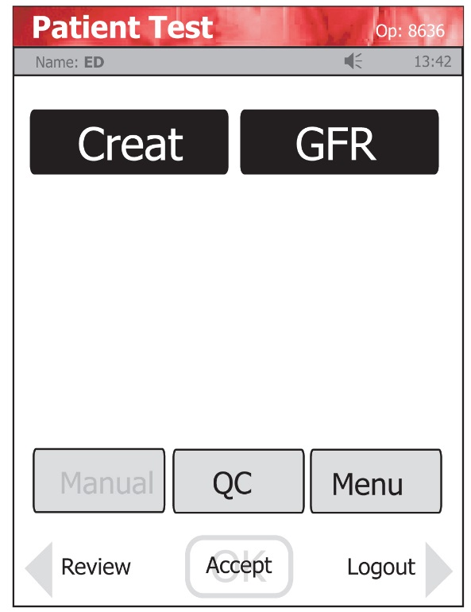
Conducting Quality Control
Press the “OK” button on the device to power on.
Press “OK” again to log in.
Enter “Operator ID”:
Enter your by scanning barcode (preferred) on badge or manually entering your employee ID
Press “OK”
The screen which follows is shown:
4. Press “QC”

Slide 10
Conducting Quality Control
At the “Enter Strip Lot” screen, scan the barcode on the vial of test strips and press accept or ok
At the “Enter QC Lot” screen, scan
the liquid quality control bottle
to capture the lot number
Press Accept or OK

Slide 11
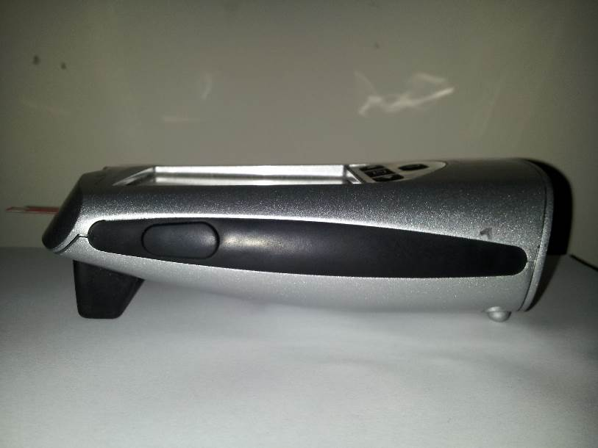
Conducting Quality Control
Lay the Statsensor® on a flat surface
The Insert Strip screen displays.
Insert a Test Strip as shown on the screen.
Once inserted, the Apply Sample screen displays.
Gently mix the QC control vial before each use.
Place a drop of QC at the end of the test strip until the solution is drawn into the test strip.
When enough sample has been drawn into the strip, the analysis countdown begins.

Slide 12
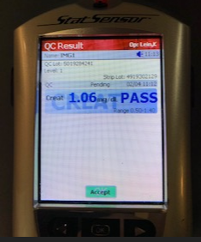
Conducting Quality Control
Quality Control Analysis
The Testing Sample screen displays during QC.
The QC result will display in 30 seconds with a “Creat” value.
If the QC is acceptable, PASS should appear with the result and the acceptable range will display
To accept the result, Press the Accept or OK

Slide 13
Quality Control Tips
Quality Control Analysis
Always hold the meter level or pointed slightly downward with the test strip when dosing.
Proper orientation prevents control solution from running down the strip into the meter.
Allowing liquid to run into the meter may damage the meter!

Slide 14
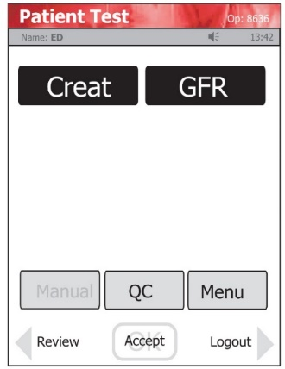
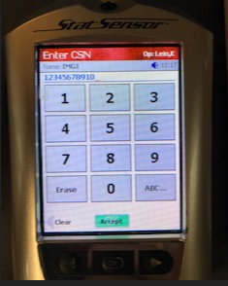
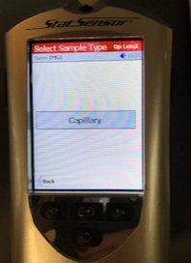
Conducting A Test
Press the “OK” button on the device to power on.
Press “OK” again to log in.
Enter “Operator ID”:
Enter your employee ID number by scanning badge barcode (preferred) or manually entering using touchscreen
Press “OK”
4. IMPORTANT: Press GFR button, then press “OK”
To get both Creatinine and GFR values, both boxes must be black.
If you forget to press GFR, the result will not flow to the chart. Site staff will have to manually determine GFR via the MDRD equation (located on http://mytrial.info) and enter in chart using enter/edit.
Scan the strip lot number and press accept or OK
Scan (preferred) or manually enter the patient’s CSN number and press
Accept or OK
Select Capillary and press Accept or OK
Enter the appropriate patient information using the touch screen keypad
and press Accept.
Patient Age
Male/Female
African American OR All Other Races

Slide 15
Conducting A Test
The Insert Strip screen displays.
Insert a test strip as shown on the screen.
Clean the patient’s finger with alcohol swab.
Allow to dry thoroughly.
Perform a finger stick using a lancet

Slide 16
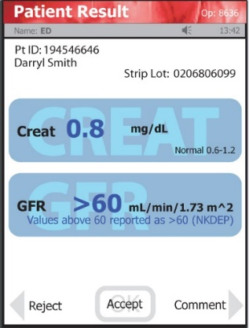
Conducting A Test
Lay the device on a flat surface as pictured.
The Apply Sample screen displays.
When the blood drop appears, touch the end of the test strip to the blood drop.
The test strip is full when the countdown begins.
Results appear in 30 seconds

Slide 17
Conducting A Test
When the patient result appears:
Press the Accept Soft Key
Immediately remove and discard strip in biohazard container
Dock the device to send results to the patient’s chart

Slide 18
Testing Tips
The test strip must fill completely upon touching the blood drop.
Do not touch the strip to the blood drop a second time. Discard the test strip and repeat the test with a new strip.
Testing will not begin until enough blood has been added to the strip
Do not let blood run down into the meter.
Do not apply sample to the top of the strip. Sample is applied to the edge of the strip
Blood fills the strip from the end by capillary action.
Always lay device down on a flat surface.

Slide 19
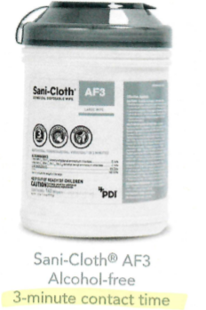
Cleaning and Disinfecting
To avoid transmission of infectious diseases, clean and disinfect device after every use
Cleaning:
Use a fresh germicidal wipe and clean the external surface of the meter
Properly discard the soiled wipe into an appropriate biohazard container.
Disinfecting:
1. Use a fresh germicidal wipe, thoroughly wipe the surface of the meter (top, bottom, left, and right sides) a minimum of 3 times horizontally and 3 times vertically.
IMPORTANT: Avoid the meter’s port, bar code scanner, and electrical connector.
Gently wipe the surface area of the test strip port making sure that no fluid enters the port.
Contact time for disinfection is 3 minutes for alcohol free wipes, and 4 minutes for bleach wipes
Dispose of any used wipes and gloves in an appropriate biohazard container.
Wash your hands thoroughly with soap and water.

Slide 20
Troubleshooting
Flow Error
Insufficient sample
Sample was applied incorrectly to the
test strip.
Do not pull the test strip away from the
finger until the countdown begins.
Battery Low
Place the meter into the Docking Station to recharge.

Slide 21
Thank you for taking time to complete “NOVA Stat Sensor”. This information can help us better care for our patients and their families. For more information about this course, e-mail Kelly.Leiner@wakehealth.edu

