Slide 1
cGMP Compliance Training

Slide 2
History
In 1962, Congress instructed the FDA to require that all drugs be produced according to Good Manufacturing Practice (GMP) which should be compliant to FDA 21 CFR Part 210-211. The move was in response to concerns about substandard drug manufacturing practices at the time, such as the use of thalidomide, a drug used in Europe to treat morning sickness, which was found to cause birth defects. The 1962 Drug Amendments brought modern quality assurance and control principles to drug manufacturing. The word "current" was later added to make it "CGMP" (or cGMP) to imply that the regulation allows for changing technology in attaining GMP.

Slide 3
21 CFR 210/21 CFR 211
Part 210 outlines minimum Good Manufacturing Practices (GMP) in manufacturing, processing, packing or holding of all drugs or medicated articles under the purview of the FDA
Part 211 refers specifically to the GMP requirements of finished pharmaceuticals
The onus is placed firmly on the manufacturer to prove that they have adhered to all these regulations. This is largely because although much of what is required for GMP compliance is specified, the how is primarily left to the manufacturer to determine. This necessitates the extensive development of validation methods and product-specific procedures.

Slide 4
What are cGMPs?
Good Manufacturing Practices
cGMP refers to the Current Good Manufacturing Practice regulations enforced by the FDA (21CFR 210 and 21CFR 211)
Provide for systems that assure proper design, monitoring, and control of manufacturing processes and facilities.
Adherence to these assures the identity, strength, quality, and purity of drug products by requiring that manufacturers of medications adequately control manufacturing operations. This includes establishing strong quality management systems, obtaining appropriate quality raw materials, establishing robust operating procedures, detecting and investigating product quality deviations, and maintaining reliable testing laboratories.

Slide 5
Why GMP?
Regulatory requirement
Ensures public safety
  Identity, safety, purity, efficacy, potency, stability, consistency
  GMP regulations are in place to help us comply with a certain level of quality.

Slide 6
cGMP Key Required Elements
Management Commitment
Organizational Structure and Quality System
Qualified Personnel and Continuous Training
Facility and Equipment Design and Maintenance
Vendor Qualification
Laboratory Testing
Proper Labeling
Documentation and Recording
Validation
Self-Inspection and Continuous Improvement
Complaints/Recalls (CAPA)

Slide 7
How?
It all starts with Quality….

Slide 8
What is Quality?
Products or services whose measurable characteristics satisfy a fixed set of specifications that are usually numerically defined.
Products and services that satisfy customer expectations.
Quality Excellence approach strives for no defects, no problems, essentially working towards perfect processes

Slide 9
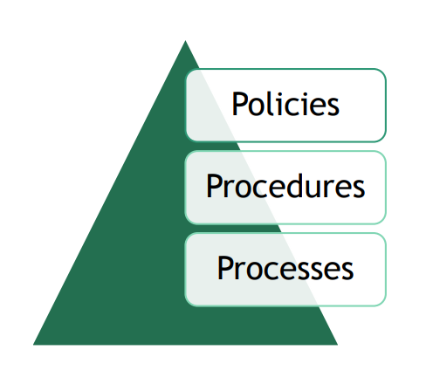
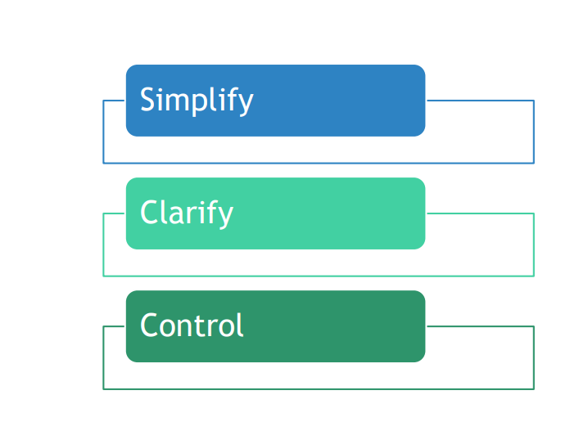
Quality Management System (QMS)
A quality management system (QMS) is a set of policies, processes and procedures required for planning and execution (production/development/service) in the core business area of an organization (i.e., areas that can impact the organization's ability to meet customer requirements).
Notes:
Standardized structure makes things simple
Clearly written procedures with input from staff performing the tasks provides clarification
Monitoring of processes allows control

Slide 10

https://www.youtube.com/watch?v=wKsdMenonLw
Video

Slide 11
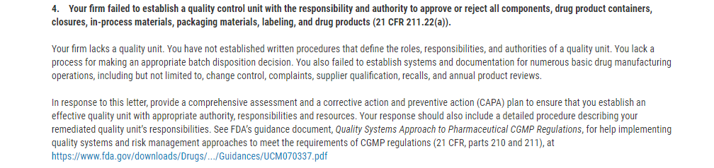
How to comply with cGMP?
Formation of a Quality Unit
  Must be separate from Production Department
  Responsibility and authority to approve/reject product, procedure, materials, etc.
Warning Letter July 2018

Slide 12
Considerations
The Quality Unit is the only job description that appears in the Code of Federal Regulations; the Quality Unit ensures that the various operations associated with all systems are appropriately planned, approved, conducted and monitored.
Are we reporting key metrics to management?
On what are we basing approval/rejection?
How do we ensure the quality system is compliant with regulatory requirements?

Slide 13
How do we comply in the BPF?
QM:P006 Quality Management Plan

Slide 14
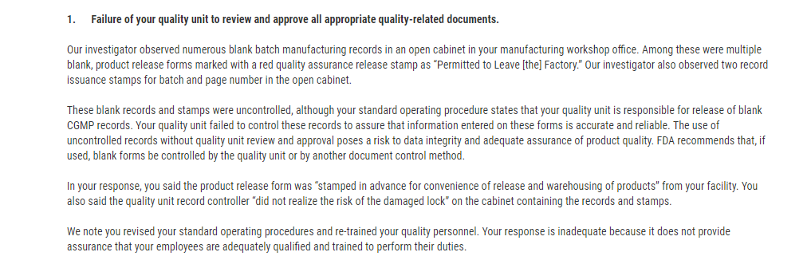
Manage written procedures and controls (Document Control)
  Document Creation, Review and Approval, Revisions, Publishing (where housed and who has access), Obsoleting
  Warning Letter June 2018:

Slide 15
Considerations
“Controlled Locations” for documents?
How are they maintained?
How do we know that we are using the most current version of a form, SOP, batch record, etc?

Slide 16
How do we comply in the Lab?
QM:C004 Document Control Management
QM:A023 Change Management

Slide 17
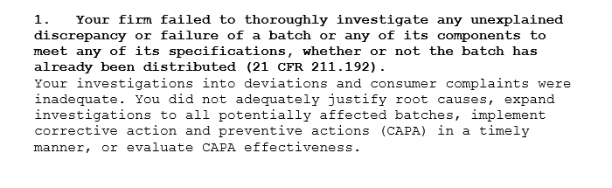
Deviations (CAPA/Complaints)
  Non-conformities requiring CAPA can arise from various situations and can include, but are not limited to, internal audits, external audits, regulatory inspections, customer complaints, staff observations, trending data risk assessments, process performance monitoring, management review, etc.
  Minimum requirements are root cause analysis, corrective action, verification of effectiveness of corrective action.
    Warning Letter August 2018:

Slide 18
Considerations
Are we conducting robust root cause analyses?
Are corrective actions effective?
Do we trend recurrent issues?
Do we verify effectiveness? And what do we do when a corrective action is NOT effective?

Slide 19
How do we comply in the Lab?
QM:A023 Occurrence Management

Slide 20
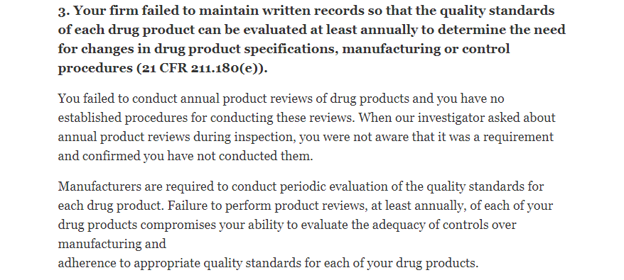
Self-Inspection and Continuous Improvement
  Comprehensive system of planned and documented internal quality audits to determine whether quality activities comply with planned arrangements and the effectiveness of the quality management system.
  Audits should be scheduled on the basis of the status and importance of the activity.
  Audits and follow-up actions should be carried out in accordance with documented procedures.
  Warning Letter May 2019

Slide 21
Considerations
How is the audit schedule developed?
Can we demonstrate auditors are properly trained?
How are we using internal self-inspection to continuously improve?

Slide 22
How do we comply in the Lab?
QM:A030 Internal Audits
QM:P014 Audit Policy

Slide 23
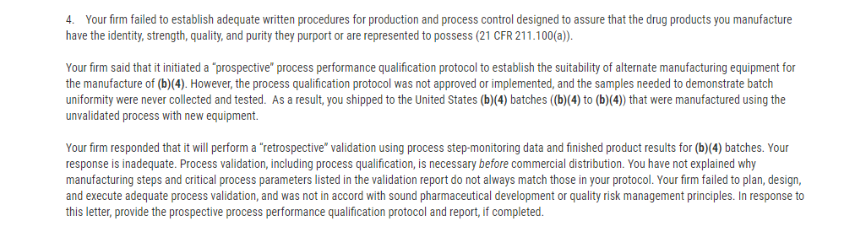
Production and Process Controls
  Ensure that products are consistently produced and controlled according to quality standards
  There must be systems to provide documented proof that correct procedures are consistently followed at each step in the manufacturing process - every time a product is made
  Warning Letter April 2016

Slide 24
Considerations
Do we have validation data for all critical processes?
Do we validate new processes prior to execution?
How can we demonstrate that our products meet the internal and external requirements of potency, efficacy, safety, quality?

Slide 25
How do we comply in the Lab?
QM:A034 SOP Validation
GP:C014 Process Validation
CT:A087 Processing Cellular Therapy Products

Slide 26
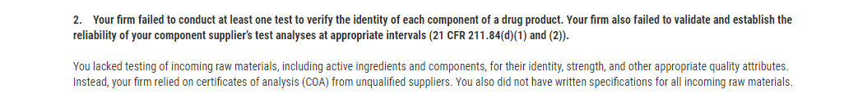
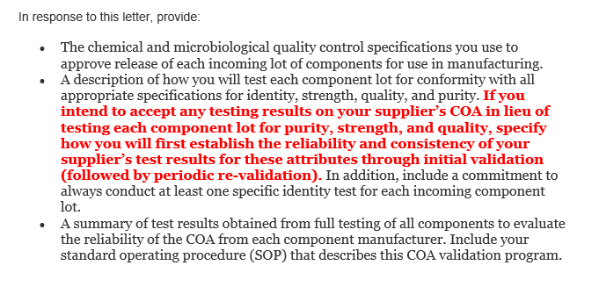
Supplier Controls
  Should provide an appropriate level of confidence that suppliers, vendors and contractors are able to supply consistent quality of materials, components and services in compliance with regulatory requirements, as well as our requirements.
  Warning Letter July 2018:

Slide 27
Considerations
Have we identified critical suppliers?
How do we ensure that supplies meet our requirements?
Recalled items
Substitute items sent
What does our Supplier Qualification process look like?

Slide 28
How do we comply in the Lab?
QM:C001 Vendor Qualification
QM:A024 Quality Management of Materials
QM:A025 Recall of Equipment, Supplies, and Reagents

Slide 29
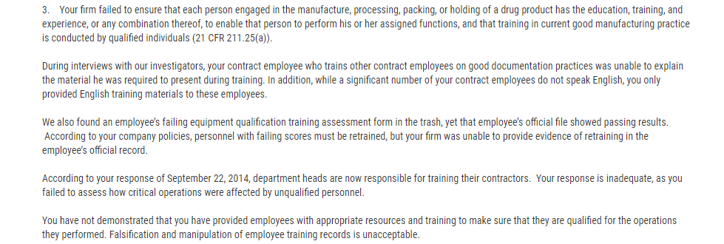
Training
  Companies must ensure that their personnel have the education, training, and experience to perform their assigned duties.
  Warning Letter 2015

Slide 30
Considerations
What is our training process?
Is there a proficiency determination?
How can we demonstrate that staff is trained to perform functions related to their job?

Slide 31
How do we comply in the Lab?
QM:C015 Training Development and Assessment Protocol
QM:A002 Competency Assessment

Slide 32
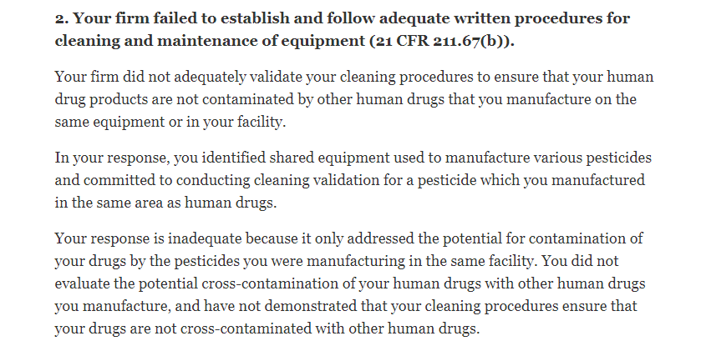
Facilities and Equipment
  The design and construction of facilities and equipment used should align with the company’s goal of achieving quality products and securing employee safety
  Warning Letter April 2018

Slide 33
Considerations
Cleaning validation/instruction for each piece of equipment?
Facility cleaning effectiveness?
How can we demonstrate assurance that cleaning methods are effective?

Slide 34
How do we comply in the Lab?
QM:P013 Equipment Policy
GP:C013 Equipment Management Program (EMP)
QM:C005 Equipment Qualification
Procedures specific to care of various equipment

Slide 35
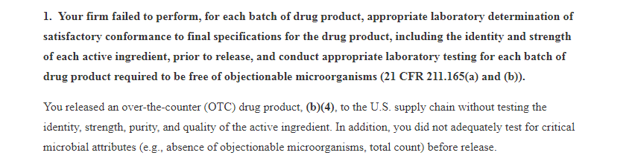
Laboratory Testing
  Determination of whether or not the product/sample has met manufacturing specifications
  Quality Control Unit has responsibility and authority to approve or reject all procedures and aspects of testing/manufacturing
  Warning Letter May 2019

Slide 36
Considerations
Internal/external laboratory controls?
Are critical data reviewed prior to approval/rejection of results?
Who is qualified to review lab results?
Do we have CLIA/CMS/FDA registration on file for labs that do testing for us?
How can we demonstrate that the laboratory results are accurate and sufficient to ensure release criteria are met?

Slide 37
How do we comply in the Lab?
CT:A081 Infectious Disease Agents
CT:A084 Infectious Disease Agents (NMDP)
CT:C023 Stability Assessment of CTPs
GP:A014 USP Water System Sampling
CT:A015 Sterility Cultures
Do we audit the labs that perform critical testing for us?

Slide 38
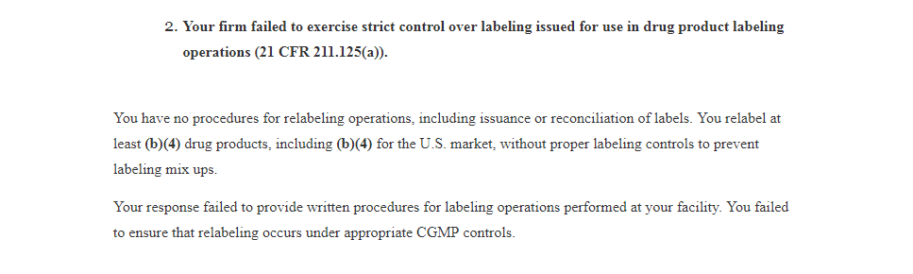
Labeling
  Labeling materials issued for a batch should be examined (Identity)
  Conformity to labeling specified in master or batch production record
  Label reconciliation (quantities used/returned)
  All excess labeling with lot or control numbers shall be destroyed
  Returned labeling shall be maintained in a manner to prevent mix-ups
  Warning Letter November 2018

Slide 39
Considerations
Labeling controls?
Validation of labeling process/software?
Are labels compliant with cGMP regulations?
Labeling throughout the process (raw materials/in-process/final product)
What risks do we face if labeling is inadequate?

Slide 40
How do we comply in the Lab?
GP:A016 Labeling Cellular Therapy Products
GP:A002 Lab Simple
CT:A077 Labeling NMDP Products for Outgoing Shipments

Slide 41
Takeaways
Validate processes
Write good procedures and follow them
Identify who does what
Keep good records
Train and develop staff
Maintain facilities and equipment
Build quality into the whole product lifecycle
Perform regular audits

Slide 42
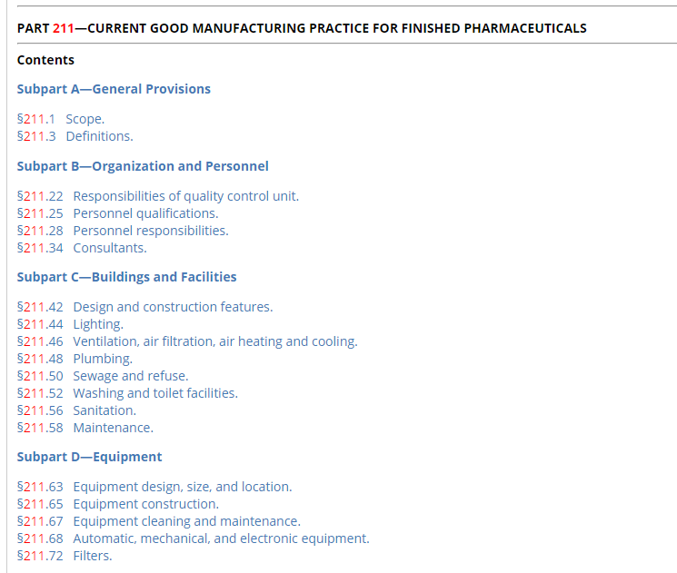
References

Slide 43
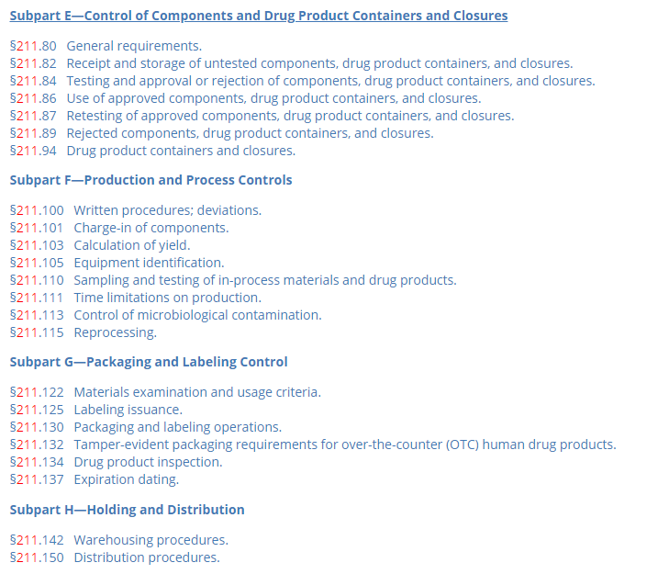
References

Slide 44
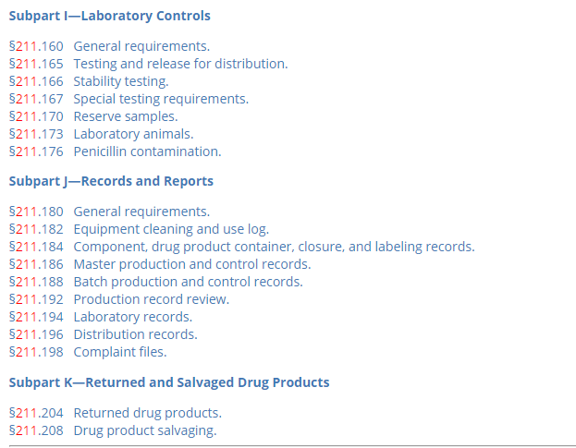
References

