Slide 1
cGTP Compliance Training

Slide 2
History
Good Tissue Practice (GTP) is one of the requirements derived from Good Manufacturing Practice (GMP). The rule was written and is enforced by the U.S. Food and Drug Administration (FDA), specifically the Center for Biologics Evaluation and Research.
FDA finalized its proposed requirements (final rule) for current good tissue practice for establishments that manufacture human cell, tissue, and cellular and tissue-based products (HCT/Ps) on May 25, 2005. These requirements were put in place to increase the safety of HCT/Ps, and public confidence in their safety, by preventing the introduction, transmission and spread of communicable disease.
Prior to this ‘final rule’, FDA regulated human tissue intended for transplantation (e.g., musculoskeletal, skin, and ocular tissues) under 21 CFR part 1270. Part 1270 contains requirements for determining the suitability of a donor of human tissue intended for transplantation, as well as requirements for written procedures, (including written procedures that have been prepared, validated, and followed for prevention of infectious disease contamination and cross-contamination by tissue during processing), record keeping, and inspection.

Slide 3
21 CFR 1270/21 CFR 1271
Part 1270 has been the basic regulation governing tissue products for more than a decade. The superseding Part 1271 requirements only apply to tissue procured on or after May 25, 2005. Part 1270 will be revoked when FDA is confident that no more tissue procured prior to May 25, 2005 is available for distribution.
Part 1271 requirements are aimed at preventing the spread of communicable disease.
21 CFR 1271 (cGTP) and 21 CFR 211(cGMP) regulations work together under the authority of the Public Health Service Act (PHSA).
GTP products are typically referred to as ‘361’ products
GMP products are typically referred to as ‘351’ products

Slide 4
What are cGTPs?
Good Tissue Practices
cGTP refers to the Current Good Tissue Practice regulations enforced by the FDA (21CFR1270 and 21CFR 1271)
HCT/Ps are Human Cells, Tissues, and Cellular and Tissue-Based Products
cGTP requirements govern the methods used in, and the facilities and controls used for, the manufacture of HCT/Ps in a way that prevents the introduction, transmission, or spread of communicable diseases by HCT/Ps
Manufacture as defined by the regulations means, but is not limited to, any or all steps in the recovery, processing, storage, labeling, packaging or distribution of any human cell or tissue, and the screening or testing of the cell or tissue donor.

Slide 5
Why GTP?
Regulatory Requirement
To prevent the introduction, transmission, or spread of communicable diseases by HCT/Ps
cGTP regulations require a quality program with validated written procedures for the prevention of infectious disease and contamination during processing.
The cGTP regulations do not require that HCT/Ps be processed in an aseptic manner, but any claims that a tissue processor's methods reduce the risk of infection or contamination must be validated
Environmental monitoring
Cleaning validation (specifically that residual cleaning solutions are removed from the product post –processing)

Slide 6
cGTP Required Elements
• Quality Program
• Facilities
• Environmental control
• Equipment
• Supplies and reagents
• Records
• Processing and process controls
• Labeling controls
• Storage
• Receipt, predistribution shipment, and distribution of an HCT/P
• Donor eligibility determinations, donor screening, and donor testing

Slide 7
How?
It all starts with Quality….

Slide 8
What is Quality?
Products or services whose measurable characteristics satisfy a fixed set of specifications that are usually numerically defined.
Products and services that satisfy customer expectations.
Quality Excellence approach strives for no defects, no problems, essentially working towards perfect processes

Slide 9
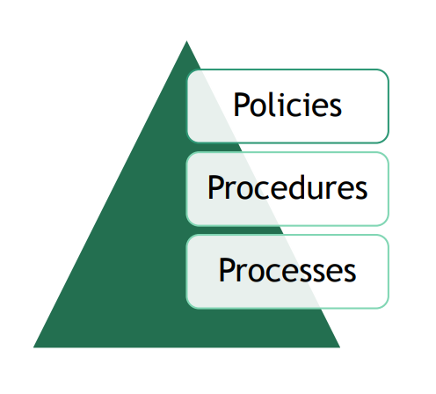
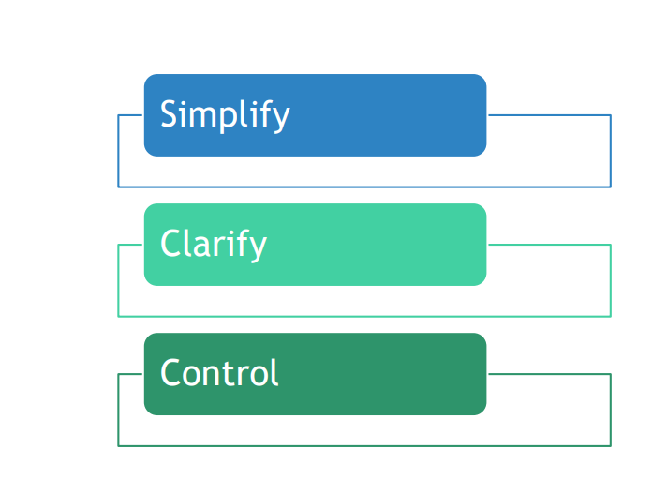
Quality Management System (QMS)
A quality management system (QMS) is a set of policies, processes and procedures required for planning and execution (production/development/service) in the core business area of an organization (i.e., areas that can impact the organization's ability to meet customer requirements).
Notes:
Standardized structure makes things simple
Clearly written procedures with input from staff performing the tasks provides clarification
Monitoring of processes allows control

Slide 10
Pharmaceutical company made drugs without FDA oversight - YouTube
Video

Slide 11
How to comply with cGTP?
Formation of a Quality Program
Establish and maintain a quality program intended to prevent the introduction, transmission, or spread of communicable disease agents
“quality program” refers to the set of activities, including management review, training, audits, and corrective and preventive actions, that represent a commitment on the part of an establishment's management to the quality of its products.
Required procedures are established and maintained
Appropriate analysis and sharing of information that could affect the integrity and function of a human cellular or tissue-based product, possible contamination of the product, or the potential transmission of communicable disease by the product
Appropriate corrective actions are taken and documented
Proper training and education of personnel
Establish and maintain appropriate monitoring systems
Establish and maintain a system for maintaining records
Investigate and document product deviations/report if needed (BPDs)
Conduct evaluations, investigations, audits, and other actions necessary to ensure compliance with the regulations.

Slide 12
During an Inspection….
Establishment and maintenance of SOPs that are designed to prevent circumstances that would increase the risk of introduction, transmission, or spread of communicable diseases through the use of the HCT/P.
Are SOPs reviewed and approved, and readily available to the personnel that need them?
Are procedures adopted from another organization verified to meet the requirements of the cGTPs and appropriate for the step(s) they are intended to cover?
Do procedures exist for receiving, investigating, evaluating, and documenting information relating to the core cGTP requirements? (This would include complaints and sharing any information pertaining to the contamination of the HCT/P)
Are corrective actions related to core cGTP requirements taken and documented?
Is the effectiveness of a corrective action verified? Do corrective actions include both short-term actions taken to address an immediate problem and long-term actions to prevent recurrence?
Does a program exist that ensures all personnel involved in activities that relate to the core cGTPs requirements are properly trained and educated to perform their job?
Are trends of HCT/P deviations investigated and documented?
How are deviations reported for distributed HCT/Ps? Investigations should include a review and evaluation of the deviation, any efforts to determine the cause, and any corrective action(s) taken.

Slide 13
Donor eligibility determinations and donor screening
Donor eligibility determinations are performed by a responsible person who has the professional training to recognize risk factors for and clinical evidence of communicable disease agents by review of symptoms, signs and clinical laboratory results
Donor screening procedures are part of the donor eligibility determination and are intended to establish that the donor:
Is free from risk factors for, and clinical evidence of, infection due to relevant communicable disease agents and diseases (IDMs)
Is free from communicable disease risks associated with xenotransplantation (How?)

Slide 14
During an Inspection…..
Determine the procedures in place to perform donor screening
Determine if each donor has a separate and complete record of all relevant medical records
Are the records available for review?
Verify that the medical records reviewed for donor screening are adequate to determine that the HCT/P is free of risk factors for communicable disease
Are the results and interpretation of the donor screening for communicable disease in compliance with 21 CFR 1271.75?
Is there documentation of the responsible individual performing the screening?

Slide 15
Donor Testing
To adequately reduce the risk of transmission of relevant communicable disease all donors of HCT/Ps must be tested and found negative or nonreactive for the following:
HIV 1; HIV 2
HBV
HCV
Treponema pallidum (syphilis)
Donors of viable, leukocyte-rich cells or tissues (such as hematopoietic stem/progenitor cells) must also be tested for the following:
HTLV-I/II
CMV (cytomegalovirus)

Slide 16
During an Inspection…..
Determine that testing is performed using FDA-licensed, approved, or cleared donor screening tests
Verify the laboratory performing the testing is certified under CLIA or has met equivalent requirements
Determine that adequate samples are used for testing
Verify that test results are interpreted according to the manufacturer’s instructions
Observe actual testing or verify through record review that appropriate controls are used in testing, samples and controls are diluted properly, that the time and temperature of incubation are accurate and that instrument and equipment settings are correct during testing
Verify that equipment maintenance is performed according to the manufacturer’s directions and the internal SOP(s)
Confirm that all testing problems are adequately investigated, resolved and documented
Determine if all laboratory equipment is qualified, calibrated and maintained as required by user manuals, maintenance manuals and SOP(s)
Ensure sample requirements specified in the product insert are met including: anticoagulant, age of sample, quantity, type of sample tube and storage temperature
Verify that positive or reactive test results for relevant communicable disease agents are handled appropriately, and that HCT/Ps from ineligible donors are handled in accordance with regulations.

Slide 17
Facilities
Any facility used in the manufacture of HCT/Ps must be of suitable size, construction, and location to prevent contamination of HCT/Ps with communicable disease agents and to ensure orderly handling of HCT/Ps without mix-ups.
You must maintain the facility in a good state of repair.
You must provide lighting, ventilation, plumbing, drainage, and access to sinks and toilets that are adequate to prevent the introduction, transmission, or spread of communicable disease.

Slide 18
During an Inspection….
Does the facility offers a suitable size, location, and is constructed so that an aseptic activity can be successfully performed?
Is the site in a good state of repair?
Is there adequate lighting and space?
Are ventilation and airflow adequate (e.g., no open windows, vent is not located directly above the processing operations)?
Is there access to a sink?
Are all working surfaces used for the processing operations cleaned with verified cleaning agent and the cleaning documented before processing event?
Can aseptic technique be adequately performed?

Slide 19
Environmental Controls
Determine if the proper environmental controls and monitoring are in place to prevent contamination or cross contamination of HCT/Ps or equipment
Temperature and humidity controls
Ventilation and air filtration
Cleaning and disinfecting of rooms and equipment to ensure aseptic processing operations
Maintenance of equipment used to control conditions necessary for aseptic processing operations

Slide 20
During an Inspection….
Review the specific procedure(s) for the manufacturing process selected and the methods for controlling and monitoring the process. Verify that the process is controlled and monitored.
Verify there are documented inspections of these environmental controls that demonstrate the environmental control systems are properly functioning. Review of microbiological test results for air, water and surfaces are indicators on how well the environment is being controlled (fluctuating results, or periodic spikes may indicate problems).
Is validation data available to support existing environmental controls are adequate?
Are there written cleaning procedures and schedules adequate to prevent contamination of equipment or product by substances that could reasonably be expected to have an adverse effect on product quality?
Are clean dressing rooms provided for personnel?
Are there procedures designed to prevent contamination of equipment?

Slide 21
Equipment
Determine whether equipment is appropriately designed, located, installed, maintained, and cleaned to prevent the introduction, transmission, or spread of communicable diseases.
Equipment in use must be capable of producing valid and consistent results.
Calibration/PM Records
IQ/OQ/PQ Records

Slide 22
During an Inspection….
Where maintenance of equipment is necessary to assure manufacturing specifications are met, verify there is a written procedure/schedule for maintenance and written documentation showing the scheduled maintenance activities are performed.
Where a piece of equipment has inherent limitations or allowable tolerances, verify they are visibly posted on or near each applicable piece of equipment or is readily available to personnel responsible for performing maintenance on or operating that piece of equipment.
Verify periodic inspections are being performed per written procedures to assure the applicable maintenance schedules are being adhered to.

Slide 23
Supplies and Reagents
You must not use supplies and reagents until they have been verified to meet specifications designed to prevent circumstances that increase the risk of introduction, transmission, or spread of communicable diseases.
Verification may be accomplished by the establishment that uses the supply or reagent, or by the vendor of the supply or reagent.
Reagents used in processing and preservation of HCT/Ps must be sterile, where appropriate.
You must validate and/or verify the processes used for production of in-house reagents.
You must maintain the following records:
Receipt of each supply or reagent, including the type, quantity, manufacturer, lot number, date of receipt, and expiration date
Records of the verification of each supply or reagent (including test results), or in the case of vendor verification, a CoA from the vendor
Records of the lot numbers of supplies or reagents used in the manufacture of each HCT/P.

Slide 24
During an Inspection….
Determine if all supplies and reagents have been verified to meet specifications designed to prevent conditions that increase the risk of introduction, transmission, or spread of communicable disease.
Are reagents used in the processing /preserving of HCT/Ps sterile when appropriate?
Do storage areas prevent the mix-up, contamination, cross contamination of supplies and reagents?

Slide 25
Records
The HCT/P establishment must maintain records concurrently with the performance of each required step in determining donor eligibility and following cGTPs for each HCT/P so that all steps can be clearly traced.
All records shall be legible and indelible and shall identify the person performing the work, including dates of the various entries; and shall be as detailed as necessary to provide a complete history of the work performed.
Each donor must have a separate and complete record of test results as well as interpretation of the result that is cross-referenced to the HCT/P collected from the donor.
Records pertaining to a particular HCT/P must be retained at least 10 years after the date of its administration, or if the date of administration is not known, then at least 10 years after the date of the HCT/P’s distribution, disposition, or expiration, whichever is latest.

Slide 26
During an Inspection….
Does the facility have relevant manufacturing records such as:
a. Equipment logs?
b. Labeling records?
c. Packaging records?
Are the records maintained, well organized, and readily available for review?
If records are stored electronically, how are they backed up?
Does the record identify the person performing the work?
Are entries dated and signed?
Are the records detailed enough to provide a complete history of the work performed?
Can the record be related to the particular HCT/P manufactured?

Slide 27
Processing and Process Controls
Processing is defined as any activity performed on an HCT/P, other than recovery, donor screening, donor testing, storage, labeling packaging, or distribution, such as testing for microorganisms, preparation, sterilization, steps to inactivate or remove adventitious agents, preservation for storage and removal from storage.
If you are an establishment that processes HCT/Ps, you must process each HCT/P in a way that does not cause contamination or cross-contamination during processing, and that prevents the introduction, transmission, or spread of communicable disease through the use of the HCT/P.
Human cells or tissue from two or more donors must not be pooled (placed in physical contact or mixed in a single receptacle) during manufacturing.
In-process control and testing: You must ensure that requirements for in-process controls are met, and that each in-process HCT/P is controlled until the required inspection and tests or other verification activities have been completed, or necessary approvals are received and documented.
Sampling of in-process HCT/Ps must be representative of the material to be evaluated.
When you use a published validated process, you must verify such a process in your establishment.

Slide 28
Process Validation
Where the results of processing cannot be fully verified by subsequent inspection and tests, you must validate and approve the process according to established procedures. The validation activities and results must be documented, including the date and signature of the individual(s) approving the validation.
Any written representation that your processing methods reduce the risk of transmission of communicable disease by an HCT/P, including but not limited to, a representation of sterility or pathogen inactivation of an HCT/P, must be based on a fully verified or validated process.
Any change to a process must be verified or validated to ensure that the change does not create an adverse impact elsewhere in the operation, and must be approved before implementation by a responsible person with appropriate knowledge and background. You must communicate approved changes to the appropriate personnel in a timely manner.

Slide 29
During an Inspection….
Determine which processes have been validated and which have been verified.
Review process validation documentation and verification data
In the testing for microorganisms, review the documentation of the sampling and testing methods
Have changes to any validated processes been made?
Was the change documented?
Was the process revalidated?
Does evidence support that the process produces consistent results and ensures that the HCT/P meets its predetermined specifications?

Slide 30
Labeling Controls
You must establish and maintain procedures to control the labeling of HCT/Ps. You must design these procedures to ensure proper HCT/P identification and to prevent mix-ups.
Procedures must include verification of label accuracy, legibility, and integrity.
Procedures must ensure that each HCT/P is labeled in accordance with all applicable labeling requirements, including those in the following regulations:
Records accompanying an HCT/P (§ 1271.55)
HCT/Ps in quarantine (§ 1271.60)
Storage and use of HCT/Ps from a donor determined to be ineligible (§ 1271.65)
HCT/Ps from donors excepted from the donor eligibility requirements (§ 1271.90)
Tracking of HCT/Ps (§ 1271.290)
Labeling (§ 1271.370)
Controls:
Identify dedicated work areas and control separation of activities
Enclose an extra label in the processing record as evidence of the actual label used (or for electronic systems you could retain an electronic copy)
Label the HCT/Ps from one donor at a time
Confirm that all extra labels or pre-labeled containers issued for HCT/Ps obtained from a specific donor have been reconciled and removed from the work area

Slide 31
During an Inspection….
Determine the different circumstances under which the establishment has distributed HCT/Ps and determine if labeling procedures exist for each requirement and that the procedures are being followed
Determine that HCT/Ps are labeled with:
The identification code on the container
A description of the HCT/P
An expiration date if applicable
Any warning statements required.
Does the procedure indicate the container label or the information accompanying the HCT/P includes:
The name and address of the establishment that determined the HCT/P met release criteria and made it available for distribution
Storage temperature
Other appropriate warnings
Any instructions for use related to spread of communicable disease
A statement indicating if the donor is eligible or ineligible

Slide 32
Storage
You must control your storage areas and stock rooms to prevent:
Mix-ups, contamination, and cross-contamination of HCT/Ps, supplies, and reagents
An HCT/P from being improperly made available for distribution.
You must store HCT/Ps at an appropriate temperature.
Where appropriate, you must assign an expiration date to each HCT/P based on the following factors:
HCT/P type;
Processing, including the method of preservation;
Storage conditions
Packaging.
You must take and document corrective action whenever proper storage conditions are not met.
You must establish acceptable temperature limits for storage of HCT/Ps at each step of the manufacturing process to inhibit the growth of infectious agents.
You must maintain and record storage temperatures for HCT/Ps.
You must periodically review recorded temperatures to ensure that temperatures have been within acceptable limits.

Slide 33
During an Inspection….
You should identify and design areas used for storage of HCT/Ps to facilitate monitoring of temperature and locating in-process HCT/Ps, quarantined HCT/Ps, and HCT/Ps that have been made available for distribution. Each storage area should have signs indicating the types of supplies, reagents, and HCT/Ps contained in that area, and should be organized to prevent mix-ups, cross-contamination, and improper release of HCT/Ps.
Are quarantined HCT/Ps easily distinguishable from HCT/Ps that are available for release and distribution?
Temperature excursions – disposition of HCT/Ps; investigation; corrective actions?

Slide 34
Receipt, Pre-Distribution Shipment, Distribution
Receipt: You must evaluate each incoming HCT/P for the presence and significance of microorganisms and inspect for damage and contamination. You must determine whether to accept, reject, or place in quarantine each incoming HCT/P, based upon pre-established criteria designed to prevent communicable disease transmission.
Pre-distribution shipment: “Pre-distribution shipment” is the conveyance or shipment of an HCT/P within your establishment or between establishments before it has met its release criteria (i.e., it is not available for distribution). If you ship an HCT/P within your establishment or between establishments and the HCT/P is not available for distribution you must first determine and document whether pre-established criteria designed to prevent communicable disease transmission have been met, and you must ship the HCT/P in quarantine.
Availability for distribution: Before making an HCT/P available for distribution, you must review manufacturing and tracking records pertaining to the HCT/P, and, on the basis of that record review, you must verify and document that the release criteria have been met. A responsible person must document and date the determination that an HCT/P is available for distribution.
You must not make available for distribution an HCT/P that is in quarantine, is contaminated, is recovered from a donor who has been determined to be ineligible or for whom a donor-eligibility determination has not been completed (except as provided under requirements for urgent medical need) or that otherwise does not meet release criteria designed to prevent communicable disease transmission.
You must not make available for distribution any HCT/P manufactured under a departure from a procedure relevant to preventing risks of communicable disease transmission, unless a responsible person has determined that the departure does not increase the risk of communicable disease through the use of the HCT/P. You must record and justify any departure from a procedure at the time of its occurrence.
You must establish and maintain procedures, including release criteria, for the above activities. You must document these activities. Documentation must include:
Identification of the HCT/P and the establishment that supplied the HCT/P
Activities performed and the results of each activity
Date(s) of activity
Quantity of HCT/P subject to the activity

Slide 35
Packaging and Shipping
Packaging and shipping containers must be designed and constructed to protect the HCT/P from contamination. For each type of HCT/P, you must establish appropriate shipping conditions to be maintained during transit.
The HCT/P should be transported in a shipping container that is capable of maintaining the desired temperature during transport and that is capable of withstanding physical stress.
Since packaging and shipping are not part of processing, they are not required to be validated or verified.
For each type of HCT/P, you must establish appropriate shipping conditions to be maintained during transit. You could use industry standards, if available, or establish internal temperature and time limits during shipping

Slide 36
During an Inspection….
How does the facility:
Receive incoming HCT/Ps and how they are evaluated?
Make pre-distribution shipments of HCT/Ps within their own facility or to outside establishments
Document that HCT/Ps have met release criteria and are available for distribution?
Package and ship HCT/Ps to prevent contamination?
How are appropriate shipping conditions maintained during transit?
How are shipping conditions developed within the facility (temperature and time limits)?

Slide 37
Takeaways
Validate processes
Write good procedures and follow them
Identify who does what
Keep good records
Train and develop staff
Maintain facilities and equipment
Build quality into the whole product lifecycle
Perform regular audits

Slide 38
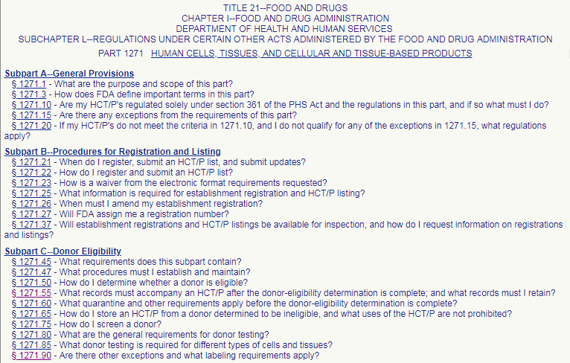
References

Slide 39
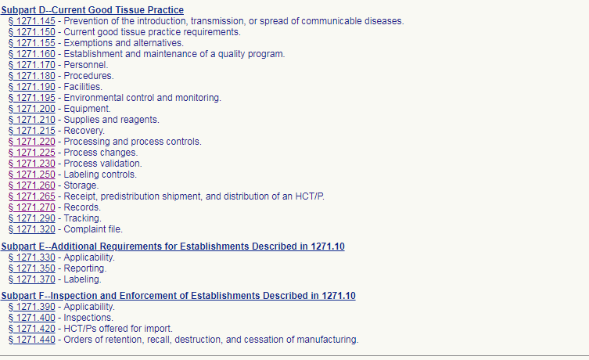
References

