Slide 1
Lab / Pathology
Managers Meeting
February 2021

Slide 2

Patient and Family Promise

Slide 3
Serious Safety Events
*Days since last SSE:
WFB: 64
BCH: 41
DMC: 201
HPMC: 36
LMC: 276
WMC: 95
*Current as of 2/9/2021

Slide 4

Good Catch
Celebrate our successes!
Ways to report good catches:
  RL6 using the Good Catch Icon – preferred method of reporting
  Email Shelley with good catches
  Report good catches at Lab Manager’s Huddle; Safety Coach’s Meeting or Laboratory Safety Meeting
All of the good catches will be submitted for a drawing. At the beginning of the next month a winner will be pulled from all submissions.
The good catch winner will be recognized at that month’s Safety Governance Committee, presented with a certificate, given a good catch pin and a gift card.
The good catch submitter will be also be recognized at that month’s Safety Governance Committee and will be presented with a gift card.

Slide 5
Good Catches in January

Slide 6
Good Catches in January

Slide 7
Good Catches in January

Slide 8
Good Catches in January

Slide 9
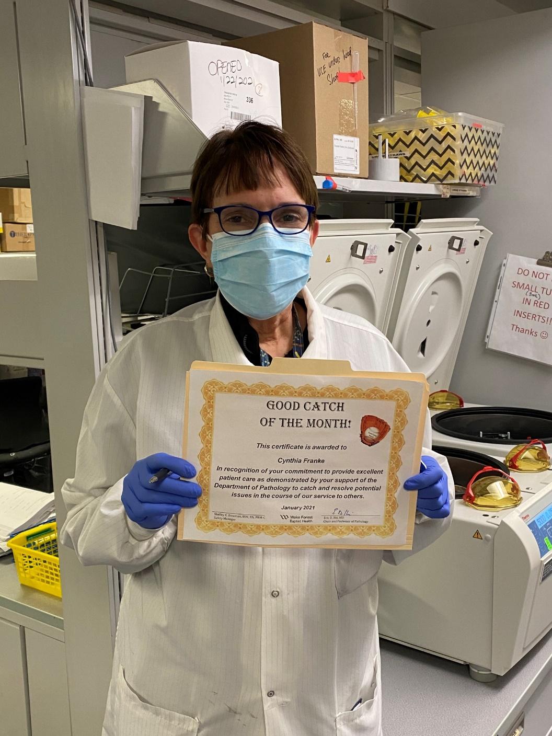
Good Catch Winner
Cindy Franke

Slide 10
Lab Pathology Deviations
January: 76
Average: 66

Slide 11
Top Deviations in January
#1

Slide 12
Top Deviations in January
#2
#3

Slide 13
Lab Pathology Deviations by Section
January 2021

Slide 14
RL6 Closing the Loop Compliance
Jan: 66/76

Slide 15
RL6 Closing the Loop Compliance by Section

Slide 16
Please use this template as provided. Do not modify the font, bullets, border or background.
Use this for orange text
Use this for blue text
Or this if you need red
Communicate Clearly
Ask Clarifying Questions Any time you are in a high-risk situation Any time the information is incomplete Any time the information is not clear
The purpose is to make sure that you really understand what is being communicated… so that you don’t make a decision based on a wrong assumption. Asking 1 or 2 clarifying questions can reduce your chances of making a wrong assumption by 2 ½ times. | Clarifying questions can be asked by the sender or receiver – we want to improve communication for everyone involved. Support and encourage asking clarifying questions in your department.
Notes:
February

Slide 17
Daily Lab Huddle
Implementation Date: February 15th
Days: Monday – Friday; no weekends or holidays
Time: 0845 – 0855
Intent of Huddle: Improve communication across the system of operational, safety and compliance concerns
Manager responsibility:
    Ensure your Associate Director is aware of concerns or events to report/escalate.
    Participation of daily huddle is strongly encouraged but not required.

Slide 18
Patient Safety Awareness Week
March 8th – 12th
System-wide challenge each day of the week that supports high-reliability principles to keep patients safe.
Challenge – go one day, then another day, and hopefully 5 days without a specimen having to be recollected
Ask – Tips/tricks to share to minimize the risk of specimens needing to be recollected, email them to Shelley

Slide 19
Safety Starts Here
Section Compliance
2021

Slide 20
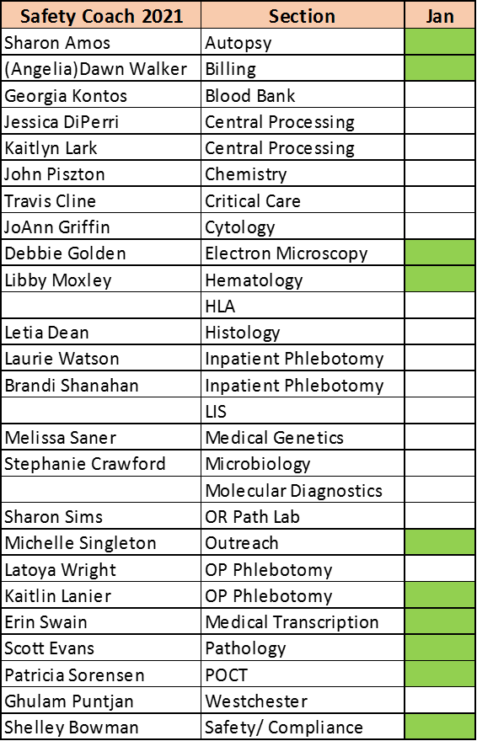
Safety Coach Monthly Compliance 2021

Slide 21
Reminders
Title 21
      Email employee changes (new hires, resignations, transfers) to Danielle Bancroft
Safety Inspections
      February 2021
      May 2021
      August 2021
      November 2021
Trimedx
      Email Trimedx concerns or questions to Shelley. Next meeting Thursday, Feb 11^{tt}

Slide 22

Next Lab Huddle: March 9th, 2021

