Slide 1
Lab / Pathology
Managers Meeting
March 2021

Slide 2

Patient and Family Promise

Slide 3
Serious Safety Events
*Days since last SSE:
WFB: 20
BCH: 70
DMC: 21
HPMC: 25
LMC: 305
WMC: 124
*Current as of 3/10/2021

Slide 4
Good Catches in February

Slide 5
Good Catch Winner
Katie Koontz
Hematology

Slide 6
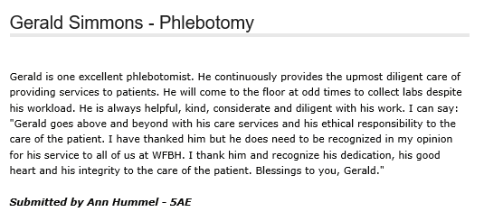
Shout Out!

Slide 7
Lab Pathology Deviations
February: 90
Average: 67

Slide 8
Top Deviations in February
#1

Slide 9
Top Deviations in February
#2
#3

Slide 10
Lab Pathology Deviations by Section
February 2021

Slide 11
RL6 Closing the Loop Compliance
Jan: 85/90

Slide 12
RL6 Closing the Loop Compliance by Section

Slide 13
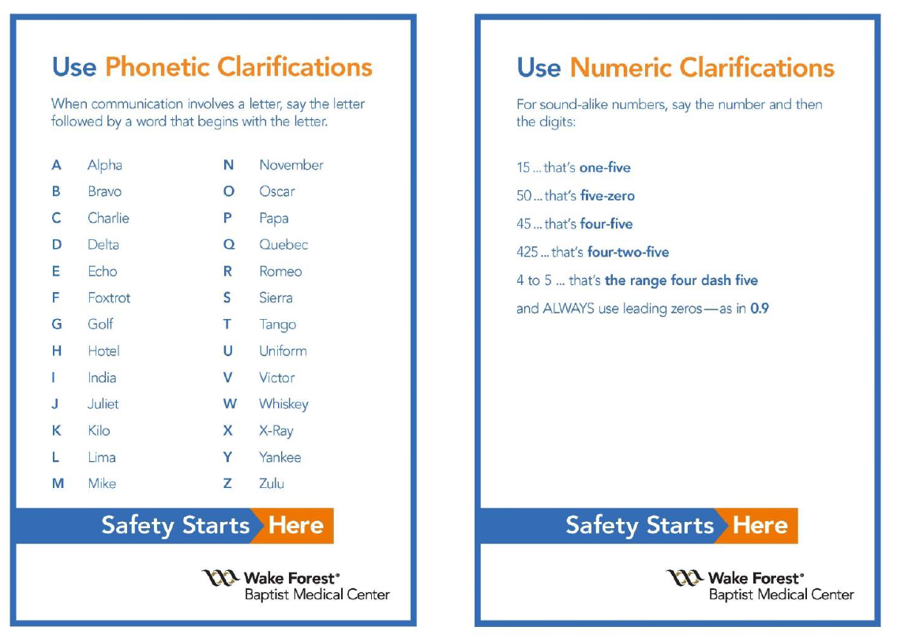
Notes:
April

Slide 14
Patient Safety Awareness Week
March 15th – Lab Challenge
System-wide challenge each day of the week that supports high-reliability principles to keep patients safe.
Challenge – go one day, then another day, and hopefully 5 days without a specimen having to be recollected

Slide 15
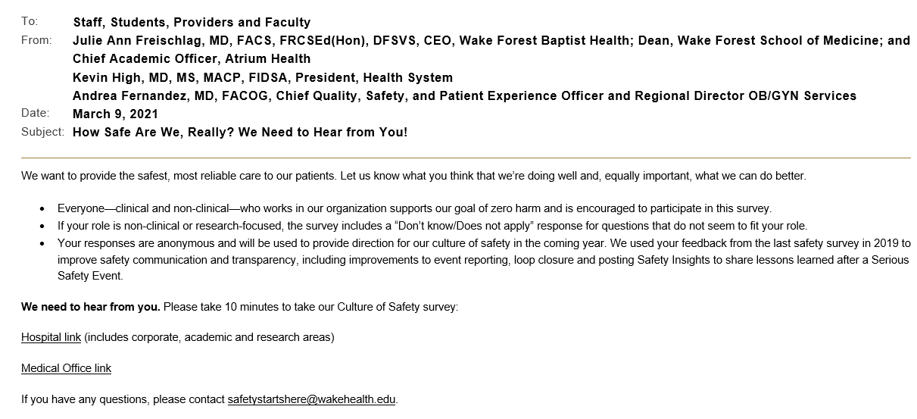
Culture of Safety Survey

Slide 16
NIST Thermometers
Where to store them?
Check out process?

Slide 17
Safety Starts Here
Section Compliance
2021

Slide 18
Safety Coach Monthly Compliance 2021

Slide 19
Reminders
Title 21
      Email employee changes (new hires, resignations, transfers) to Danielle Bancroft
Safety Inspections
      February 2021 – COMPLETED
      May 2021
      August 2021
      November 2021
Trimedx
      Email Trimedx concerns or questions to Shelley.

Slide 20

Next Lab Huddle: April 8th, 2021

