Slide 1
Security and Safety

Slide 2
Blood Bank/BMT Safety Representative
Georgia Kontos

Slide 3
Security Phone Number
Dial 6-9111 if you need Security
State your location: BLOOD BANK or BMT Lab
The security phone number can be found on the “Badge Buddy”. Take a minute to find it now!

Slide 4
Let Me In!
DO NOT buzz anyone into the Blood Bank/BMT Lab, even if they have a badge.
If you do not know the person requesting access to the BB:
Handle the customers at the window requesting blood products FIRST
Ask the person their business
Do not let the person in unless you establish their business, even if a physician
Management should tell you if they are expecting an appointment
If unsure, call Management, Charge Tech, Security.

Slide 5
Feeling Unsafe…
If, at any time, for any reason you feel unsafe in the department…notify someone that can help you
NOTIFY MANAGEMENT IMMEDIATELY
NOTIFY LAB ADMINISTRATION IF YOU WANT
NOTIFY SECURITY IF NEEDED
MAKE APPOINTMENT WITH EAP IF YOU CANNOT TALK TO ANYONE.
The Blood Bank / BMT departments that you work in should be a safe environment for you!

Slide 6
Panic Buttons
There are two panic buttons in the Blood Bank that, if pressed, will automatically call security / police to the Blood Bank.
There are five panic buttons in the BMT Lab
Panic Buttons should be used when you feel threatened or trapped by an individual while in the Blood Bank.

Slide 7
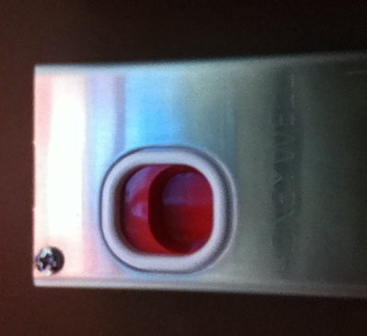
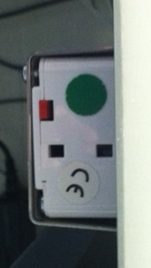
Blood Bank Panic Buttons
Front Desk:
Under FD desk, BBMONITOR side, to
right of door button
To activate: Reach under box, place finger into depression, pull forward
Front View
Underside View

Slide 8
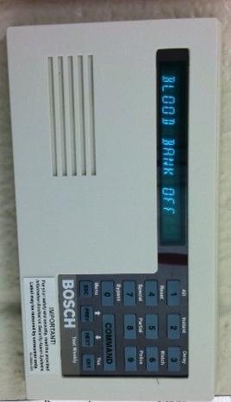
Blood Bank Emergency Key Pad
Outside Irradiator Room
Key pad above badge scanner
Key in the numbers 2 5 8 0 as if part of the normal access procedure to the irradiator room
Keying in this code will activate an alarm in security
Swipe badge, push door open as usual.

Slide 9
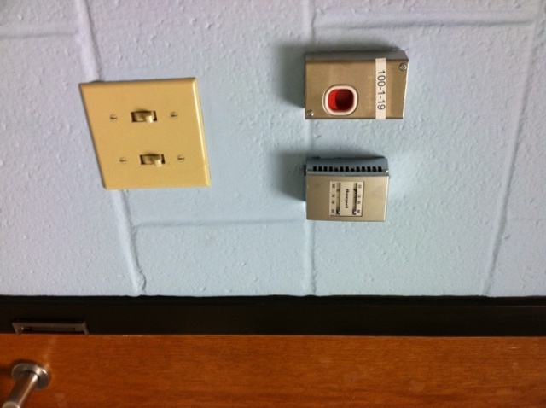
Blood Bank Panic Buttons
Inside Irradiator Room
The Irradiator Room is considered a “Safe Room”
Security cameras are in place to monitor the
activity inside the room
Directly to your right as you enter is a panic button that can be activated should you be caught in the irradiator room with an assailant.
To activate:
Place finger in depression
Push down on red button

Slide 10
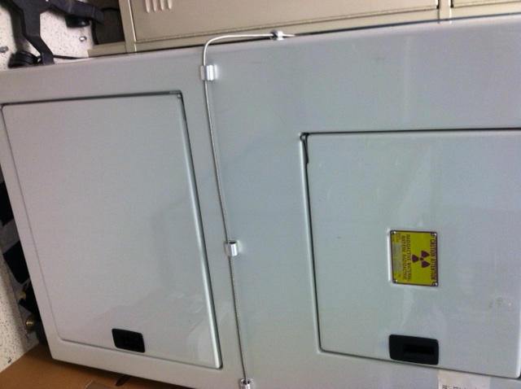
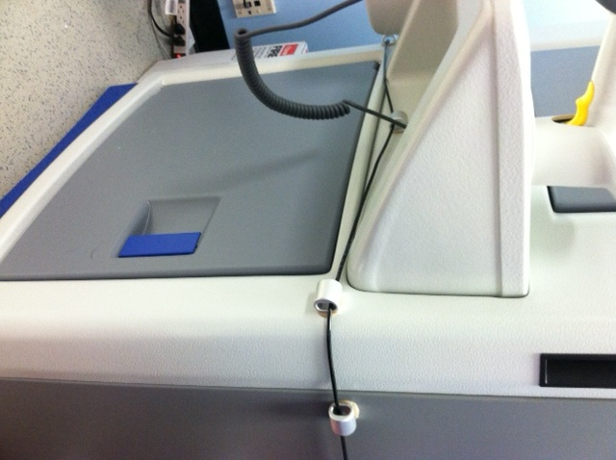
Blood Bank Panic Cords
Inside Irradiator Room
Around each irradiator is a panic cord
If you are caught in the irradiator room with an assailant and cannot get to the panic button, fall to the ground or lean forward and catch the panic cord. This will alert security.

Slide 11
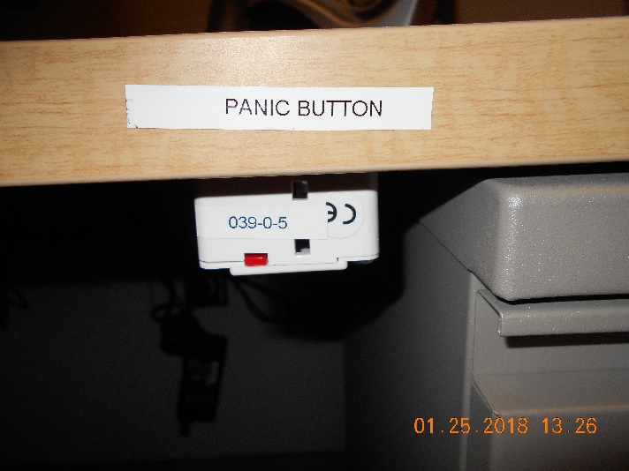
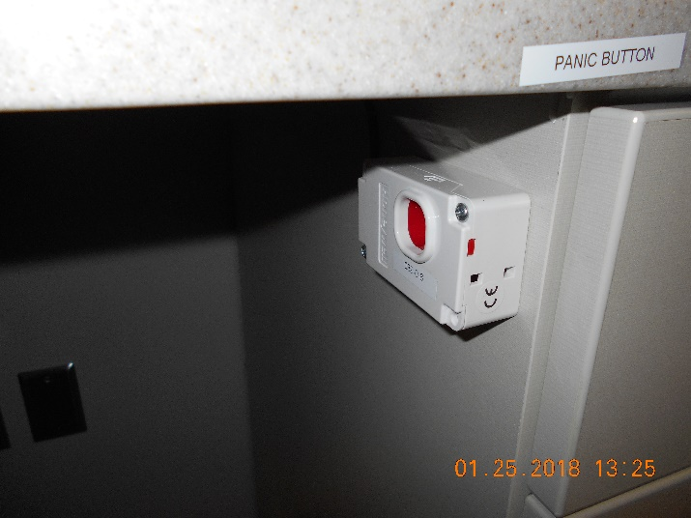
BMT Panic Buttons
BMT Office
Under the desk that is next to the door.
Specimen Receipt Area
Under the middle computer opposite the courier window.

Slide 12
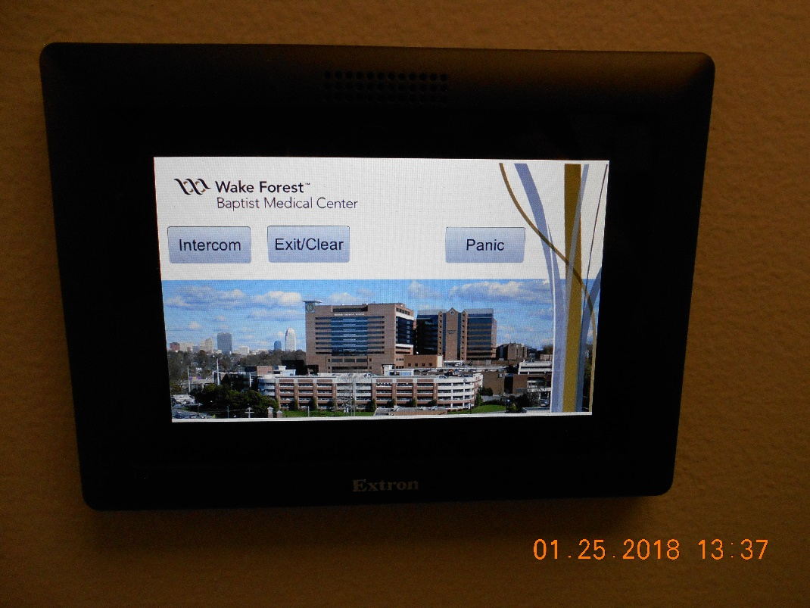
BMT Panic Buttons
Intercom system
There are also panic buttons on each of the 3 intercom systems located:
Hall
Cryo Room
Processing room

Slide 13
Blood Bank Key: Loss of Power
When there is a loss of electricity, the BB main door and the door to the irradiator room will not function.
An emergency key to access these doors is available in a lock box on the wall behind the Education Coordinator’s desk, to the left of the doorway that leads out into the hall.
Open the Safety envelope next to the lock box
Remove the code to unlock the lock box
Lock box contains key to access main door and irradiator room
Notify management if envelope security seal is broken

Slide 14
Blood Bank Key: Loss of Power
Security envelope containing
lockbox code
Lockbox containing
key to access BB
main door and
irradiator room

Slide 15
Irradiator Room Access
GammaCell irradiators contain CS137 as their radiation source which can be used by terrorists to make “dirty bombs”
The Radiation Officer of WFBH has mandated persons who access the irradiator room be cleared by background checks from various security databases. (Homeland, FBI, etc)
Process begins with fingerprints and complete background check of the person requiring access.
Fingerprints are sent to governmental databases for checking
Process takes approximately 6 weeks
Once cleared, employee badge will open irradiator room

Slide 16
Irradiator Room Access
Persons with valid security can take other UNCHECKED persons into the irradiator room. Under NO circumstances should the unchecked person BE LEFT IN THE IRRADIATOR ROOM ALONE.
Remember, you are on camera inside and outside the irradiator room security is not always watching. Using the panic button, pushing violently on the door or pulling the panic cords on the irradiators will alert security to action.

Slide 17
Fire and Code Triage

Slide 18
Fire Alarms
ANY time a fire alarm sounds you should
Look for smoke or fire
Smell for smoke
Listen for announcement over PA system
Share information with management and co-workers

Slide 19
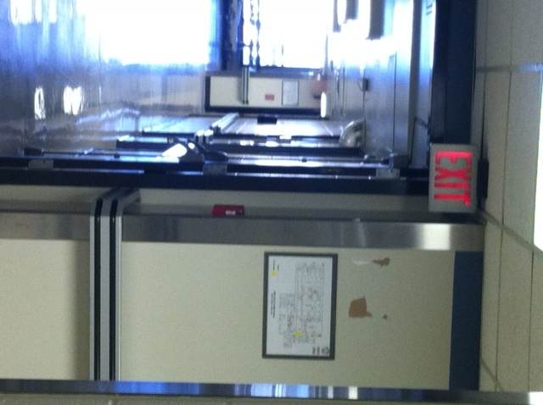
Fire Alarms
If you smell or see smoke or see fire:
DIAL: 6-9111 or
Blood Bank location: BB / 1st Floor NT / Room 1B074
ACTIVATE NEAREST FIRE ALARM BOX
LOCATION:
Out main BB door
Turn right
At elevator well
Fire box is on right directly under red EXIT sign
Elevators

Slide 20
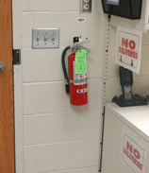
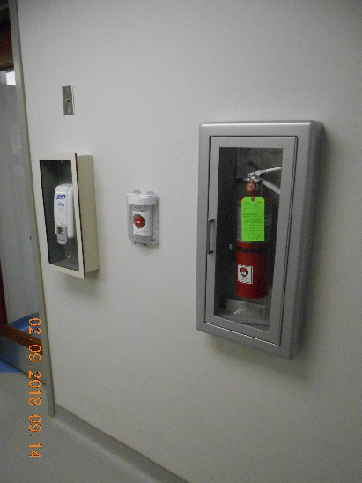
Fire Alarms
Fire Extinguisher Locations
In Blood Bank
Beside door at Front Desk
In BMT Lab
In the processing room next to the specimen receipt door
P.A.S.S.
When using a fire extinguisher remember:
Pull extinguisher pin
Aim extinguisher at base of flames
Squeeze extinguisher handle
Sweep extinguisher from side to side until flames are extinguished
Blood Bank
BMT Lab

Slide 21
R. A. C. E.
Rescue any persons in immediate fire area without endangering yourself
Alarm: sound the alarm by calling 6-9111 or activating the nearest fire alarm box
Contain the fire by shutting doors and windows, and put wet towels under the door, etc.
Extinguish if the fire is small and localized, and you are familiar with the use of a fire extinguisher, use it to put out the fire – otherwise
Evacuate: use posted evacuation route.
Turn off gas, electrical machinery, close doors, windows as you leave.
Primary Blood Bank Evacuation Route
Turn right out of main BB
door into hallway.
Walk to end of hallway
Take stairs to bottom
Meet in street in front of power
plant

Slide 22
BMT Evacuation Route
Primary
Exit BMT through either door. Turn right. Turn right again after the North tower elevators if you exited BMT from the cryo room. Go Down North tower stairway at the end of the hall. Exit to meet at the front of the power plant.
Secondary
Exit BMT lab through the cryo room. Turn Left. Proceed to Gray building. Turn right down first hallway. Go through double doors. Go down stairway on left and exit building.
BMT Evacuation Route
Second Floor North Tower
 |  |  |  |  |  |  |  |  |  |  |  | Stair Well
 |  |  |  | North Tower Elevators |  |  |  |  | BMT Office and Specimen Receipt |  |  | Service Elevators
 |  |  |  |  |  |  |  |  | BMT Processing and Cryo Rooms
 |  | Stair Well
Primary
Secondary

Slide 23
R. A. C. E.

Slide 24
Emergency Alert Plain Text Matrix
Facility Alerts
Event | Recommended Plain Language
Evacuation / Relocation | Facility Alert + Relocation/Descriptor + Location
Fire / Alarm | Facility Alert + Fire or type of Alarm + Descriptor/Location
Medical Surge (Phase 1, Phase 2) Phase 3 – Mass Casualty event) | Facility Alert + Medical Surge Plan Activated + Location
Utility Failure | Facility Alert + Type of Utility Failure / Location
Dangerous weather (Tornado, etc.) | Facility Alert + Dangerous Weather Alert / Descriptor

Slide 25
Emergency Alert Plain Text Matrix
Security Alerts
Event | Recommended Plain Language
Missing Infant / Child | Security Alert + Missing Person (Infant or Child) + Last Known Location
Missing Person > 18yoa | Security Alert + Missing Person (Adult) + Last Known Location
Armed Intruder / Active Shooter / Hostage Situation | Security Alert + Special Instructions + Descriptor (Type of Threat) + Location

Slide 26
Emergency Alert Plain Text Matrix
Medical Alerts
Event | Approved Code
CPR Involving a Patient | Code Blue + Location

Slide 27
Code Triage
Blood Bank staff will be notified by the Incident Command Center (ICC) when Code Triage Plan is activated
Activate Telephone Call List immediately
Notify management / medical director immediately (24h / 7d)
Staff lab with minimum of 6 employees
Print inventory (RC, PLSMA,PLT) Give to medical director.
Medical Director / Path Resident will report to ICC.
Notify blood supplier of disaster situation

Slide 28
Code Triage
Virtual Personnel Pool
Assess the number and capabilities of the employees present and report personnel available to the Virtual Personnel Pool.
See step by step instructions on how submit a Virtual Personnel Pool
Lab Safety Manual / Code Triage section

Slide 29
Severe Weather
Tornado Approaching
Listen for ECC announcement
Evacuate to areas without exterior windows
Central, new renovated space / storage area
BMT office, conference room, breakroom
Interior stairwell, basement, sub-basement
Hurricane Procedure
Report damages or outage of service immediately to the Service Response Center using 6-9111, option 3.

