Slide 1
Blood Bank / BMT General Safety, Power Failure, Chemical Hygiene

Slide 2




Emergency Phone Numbers
Fire
Call
6-9111
Chemical Spill
Sudden Illness
Security
Call 6-3305

Slide 3
Where to find important information
Hospital Fire/Disaster/Safety Manual
  Infinet > Tools > Publications > Fire/Disaster/Safety
Infection Control
  Infinet > Tools > Policies > Patient Care > Infection Control > BBP Exposure Control Plan (WFBMC 142)
Chemical Safety
  Chemical Hygiene Plan, Lab Safety Manual in laboratory and Title 21

Slide 4
Blood and Body Fluid Spill
When treating any blood and body fluid
  Wear gloves
  Wear protective eye wear / mask if splashing to face is possible
  Wear protective clothing (barrier gown, apron, coveralls) if splashing onto the body is possible.

Slide 5
Blood and Body Fluid Spill
Blood spills <20mL
  Mop with Approved disinfectant (i.e. dilute bleach, etc.)
Blood spills >20mL
  Place wet floor signs in area
  Utilize towels to prevent spreading
  Cover blood spill with Dilute bleach or approved disinfectant, mop up
  Sanitize floor with new mop head and approved disinfectant
  Place saturated linen in soiled linen bin.
  Disinfect equipment / remove PPE
  Or Call Housekeeping at 64901

Slide 6
Blood Bank/BMT Task List
Review the Blood Bank and Bone Marrow Transplant Lab Task that follow to familiarize yourself with the required PPE for the tasks listed.

Slide 7
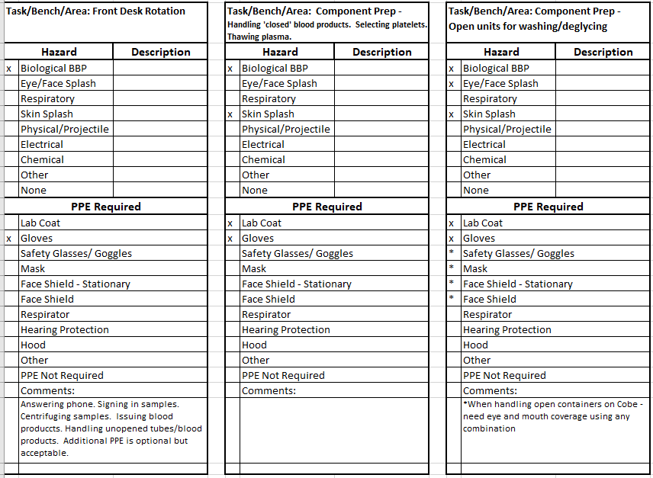

Slide 8
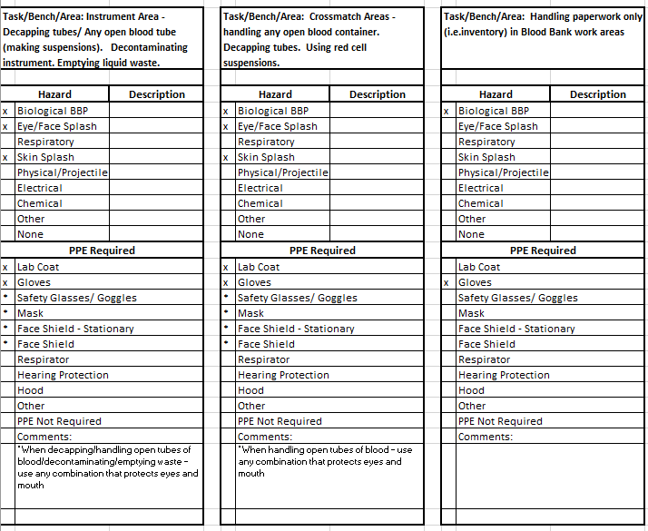

Slide 9
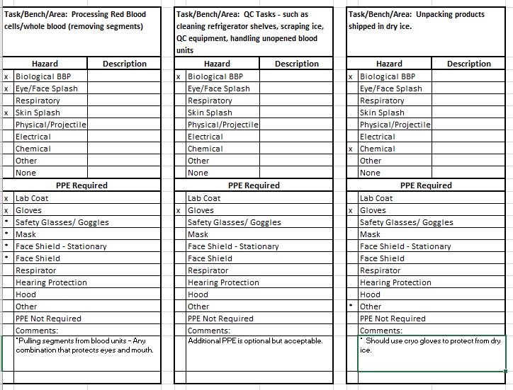

Slide 10
Laboratory Chemicals
Review the list of chemicals found in Section 4 of the Laboratory Safety Manual.
  Annual Chemical Review: Attachment A
  Familiarize yourself with the Chemical Names, Common Names, Exposure Limits and Toxic / Carcinogenic nature of the chemicals found in the BB and BMT.

Slide 11

Hand Hygiene
WFBH adheres to the Center for Disease Control and Prevention’s “Guideline for Hand Hygiene in Health Care Settings”
  Implements procedures to remove transient microbial flora and reduce transmission of microorganisms in the health-care setting

Slide 12
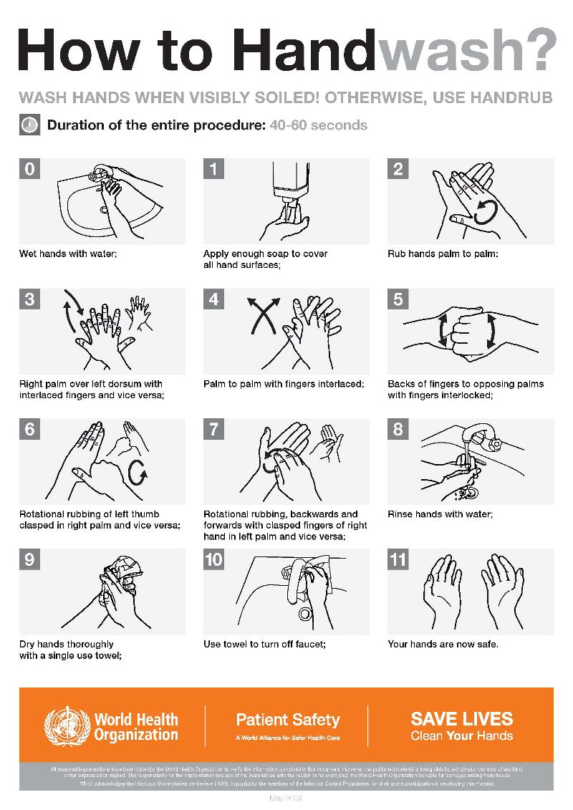
Follow CDC Guidelines for Handwashing with Soap and Water

Slide 13
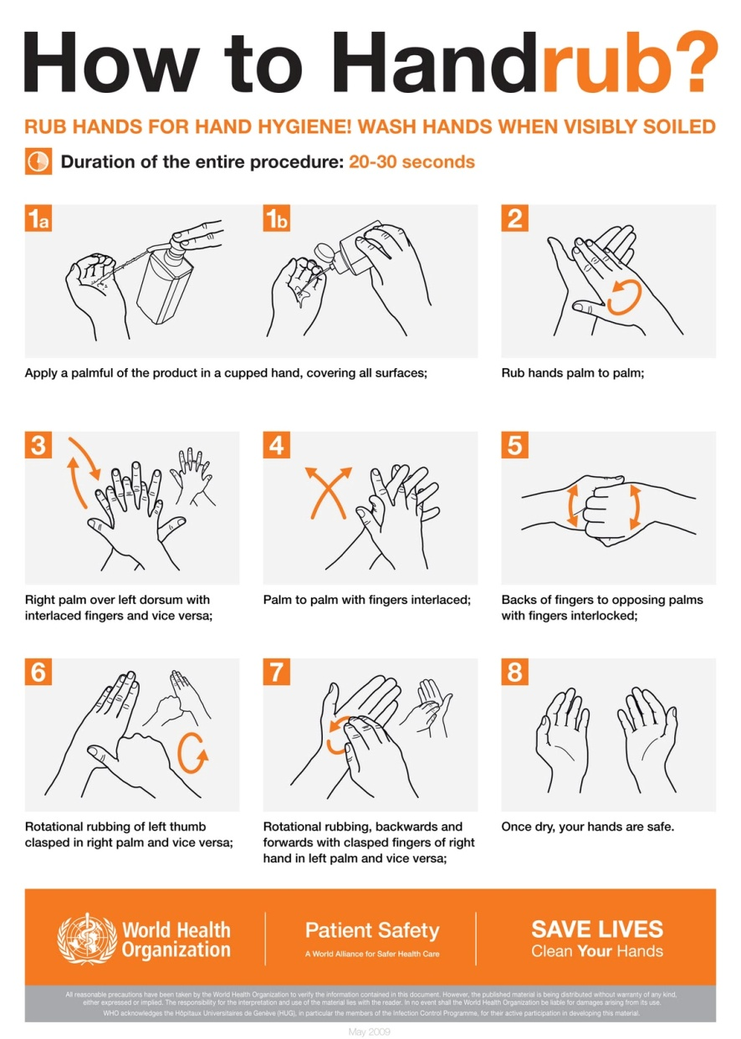
Follow CDC Guidelines for Hand Hygiene using Alcohol Based Waterless Antiseptic Agent

Slide 14
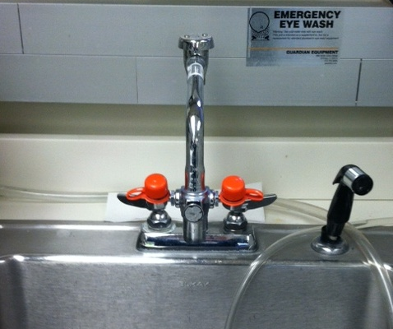
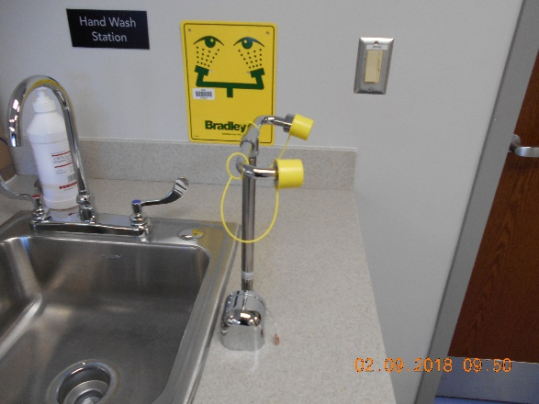
Eye Wash Stations
Eye wash stations are available for use when caustic material is splashed into the eye
Blood Bank: at CP sink
BMT: at hand washing sink in the processing room

Slide 15
Employee Occurrence Reporting
An employee occurrence is any undesirable incident an employee experiences while at work. Examples include, but are not limited to:
  Injury on the job
  Inadvertent exposure to biohazardous materials
To Report an Employee Occurrence Incident:
  Infinet > Tools > Occurrence Reporting > Employee Occurrence Reporting

Slide 16
BMT Oxygen Sensor
    There are two Oxygen sensors in the BMT cryo room. One on each side of the middle dividing wall.
    This sensor is monitored by the Rees system node number 89 and 92.
    There will be an audible alarm from the sensors themselves when the Oxygen is to low in the cryo room.
    When you hear the alarm exit the cryo room immediately.
    You can monitor the Oxygen levels in the cryo room from the Rees system.
    You can safely check the reservors for LN2 leaks by observing the video monitoring system which shows both sides of the cryo room
    Do not enter the cryo room until the Rees detects Oxygen levels of >19%.

Slide 17
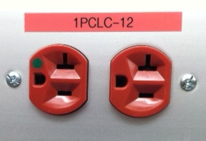
Hospital Power Failure Policies
In the event of a power failure, any equipment plugged into a red outlet should continue to function.
  Refer to Lab Safety Manual / Power Failure section / Power Failure Policies for Hospital wide guidelines on how to handle specific power failure problems.

Slide 18
BB/BMT Power Failure Policies
Blood Bank/BMT Specific Power Failure Policies
  Blood Bank Protocol Manual/ BMT Miscellaneous Manual or Title 21
    Section 15: BB.Policies.1034
    Section 1018: BMT.Misc.1018
  Refrigerators and freezers on red emergency power outlets
  Workstations, Instrumentation on emergency power

Slide 19
BB/BMT Power Failure Policies
3 categories of power loss
  Some emergency power outlets in BB / BMT failed
    Call Engineering (6-4841) and On Call BB Mgmt
  Most of the outlets in BB / BMT failed but other areas of Med Ctr operable
    On Call BB Mgmt, Manager, Medical Director, Call Engineering (6-4841)
  Total Med Ctr wide power failure
    On Call BB Mgmt, Manager, Medical Director, Call Engineering (6-4841)

Slide 20
Chemical Hygiene Plan
All employees should review the Chemical Hygiene Plan
  Refer to: Lab Safety Manual / Chemical Safety Chemical Hygiene Plan section for specific information pertaining to:
    General Operations
    Lab section operations
    Training
    Labeling of hazardous chemicals
    Storage
    Equipment inspection and maintenance
    PPE
    Chemical and Contaminated waste removal and disposal

Slide 21
SDS Sheets
SDS (Safety Data Sheets) are accessible via the Infinite
  Infinet > Tools > Software > SDS
    You will be prompted for your Med Center username and password before you can access the form.
    Enter the product name for which you desire the SDS sheet into the electronic form.
  SDS sheets are also available in the SDS notebooks in the Blood Bank and BMT Lab.

Slide 22
Blood Bank Irradiation Safety
“The Gammacell Irradiator uses caesium-137 as a radiation source. The two types of ionizing radiation emitted by the decay of unstable atoms of caesium-137 are Beta and Gamma radiation. The encapsulation of the caesium-137 in the Gammacell Irradiator prevents the Beta radiation from reaching the sample. However, the Gamma radiation emitted is very penetrating and does reach the sample. Gamma radiation is composed of electromagnetic waves that travel much like light, x-rays or microwaves. It is important to recognize that when a sample receives Gamma radiation, no transfer of radioactive material takes place. Your sample does not become radioactive”

Slide 23
Blood Bank Irradiation Safety
The Gammacell Irradiator protects the user through the use of the steel-encased lead shield that reduces the radiation levels to acceptable levels for those working around the unit. When compared with typical radiation fields found in day-to-day life, the levels emitted from the Gammacell Irradiator, values are comparable.
  Review section 18 of the Laboratory Safety Manual

Slide 24
A few noteworthy names….
WFBH Safety Program Manager
  Feodor Bijkersma
    716-5576
Laboratory Compliance, Safety and Quality Manager
  Melanie Haire
    713-4285
Blood Bank / BMT Safety Representative
  Georgia Kontos

Slide 25
BB / BMT/New Office and Bathroom Fire Escape Routes

Slide 26



FIRE!!!
For full instructions on fire safety, see
Quarter 2 safety presentation: Fire and Code Triage
In Review:
In the event of a fire alarm:
  Look for smoke or fire
  Smell for smoke
  Listen for information over public address system
Report All Fires
  Call 6-9111
Activate the nearest pull station
Notify all BB / BMT staff
  When evacuation required – XM1 person should grab schedule so all employees can be accounted for.

Slide 27
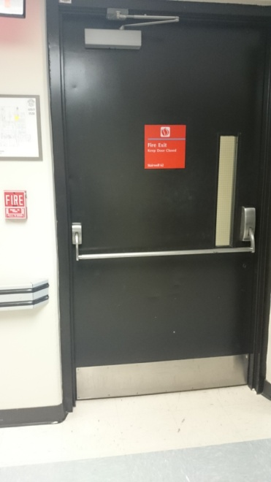
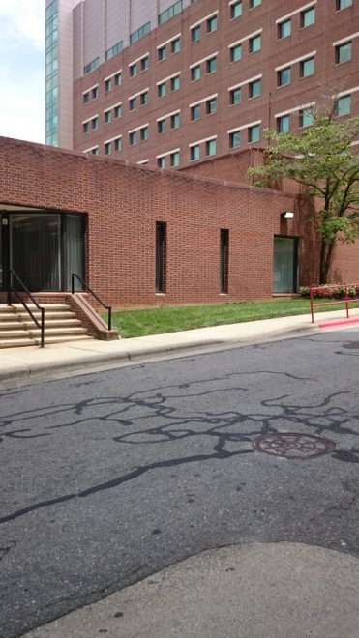
Blood Bank: Primary
Escape Route
Exit main Blood Bank door, turn right
Continue down hallway past elevators to door at end
Open door, continue forward through 2 more doors to downward stairs.
Go down stairs to bottom
Exit door to outside
Meet in front of power plant

Slide 28
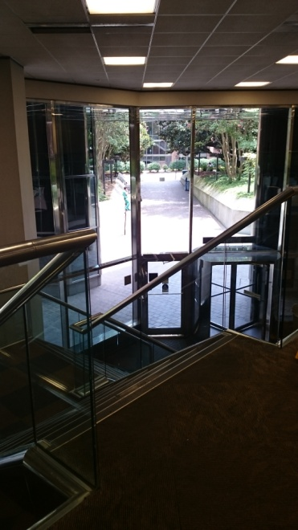
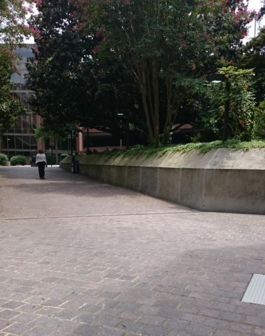
Blood Bank: Secondary Escape Route
Exit main Blood Bank door, turn left
At end of hallway, turn left
At end of hallway “Zig-Zag” right,
then left,
Continue down hallway – staying on the carpeted floor.
Enter Watlington Hall open area
Take steps down
Exit door in front of you
Meet outside Watlington Hall

Slide 29
Blood Bank Offices / Bathroom: Primary Escape Route
Exit door by bathroom
Take a few steps forward then turn left down hallway
Continue down hallway – staying on the carpeted floor.
Enter Watlington Hall open area
Take steps down
Exit door in front of you
Meet outside Watlington Hall

Slide 30
Blood Bank Offices / Bathroom: Secondary Escape Route
Walk through the conference room to the Blood Bank
Continue as for Blood Bank primary escape route

Slide 31
BMT Evacuation Route
Primary
  Exit BMT through either door. Turn right. Turn right again after the North tower elevators if you exited BMT from the cryo room. Go Down North tower stairway at the end of the hall. Exit to meet at the front of the power plant.
Secondary
  Exit BMT lab through the cryo room. Turn Left. Proceed to Gray building. Turn right down first hallway. Go through double doors. Go down stairway on left and exit building.
BMT Evacuation Route
Second Floor North Tower
 |  |  |  |  |  |  |  |  |  |  |  | Stair Well
 |  |  |  | North Tower Elevators |  |  |  |  | BMT Office and Specimen Receipt |  |  | Service Elevators
 |  |  |  |  |  |  |  |  | BMT Processing and Cryo Rooms
 |  | Stair Well
Primary
Secondary

