Slide 1
Lab / Pathology
Managers Meeting
April 2021

Slide 2

Patient and Family Promise

Slide 3
Serious Safety Events
*Days since last SSE:
WFB: 20
BCH: 99
DMC: 50
HPMC: 54
LMC: 334
WMC: 153
*Current as of 4/8/2021

Slide 4
Good Catches in February

Slide 5
Good Catches in February

Slide 6
Good Catches in February

Slide 7
Good Catch Winner
Sublena Simpson
OP Phlebotomy

Slide 8
Lab Pathology Deviations
March : 105
Average: 69

Slide 9
Top Deviations in March
#1

Slide 10
Top Deviations in March
#2
#3

Slide 11
Lab Pathology Deviations by Section
March 2021

Slide 12
RL6 Closing the Loop Compliance

Slide 13
RL6 Closing the Loop Compliance by Section

Slide 14
Safety Starts Here
Section Compliance
2021

Slide 15
Safety Coach Monthly Compliance 2021

Slide 16
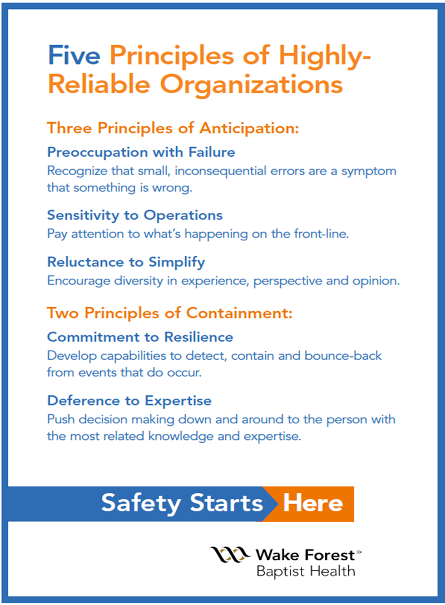
Journey to Reliability

Slide 17
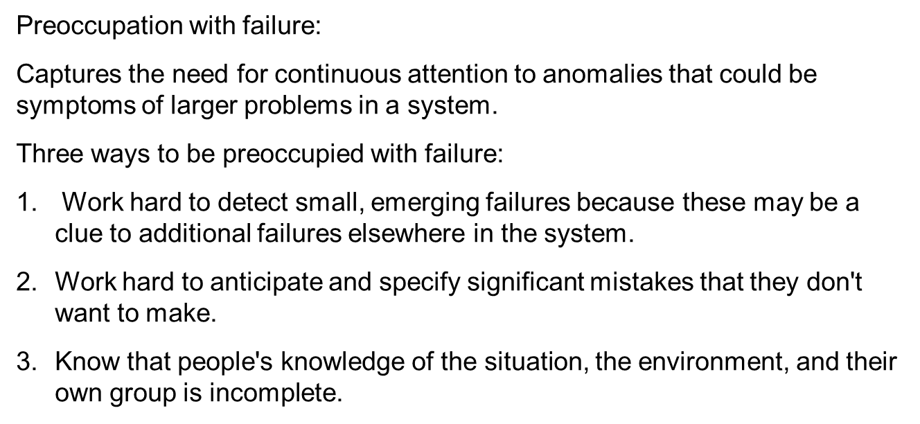

Safety Focus of the Month
Preoccupation with Failure
Managing the Unexpected
https://doi.org/10.1002/9781119175834.ch03

Slide 18

Lab Employee Hazard Awareness
April’s Focus:
      Slips
      Trips
      Falls

Slide 19
Slips
Look out for small amounts of liquid on the floor that are not easily visible:
      Leaks – Sinks, Equipment waste and reagent containers.
      Drips – Condensation drips, drips from moving containers of liquid or ice.
      Spills – When refilling equipment containers.
      Completely dry areas of Leaks, Drips and Spills

Slide 20
Trips
Look out for:
      Cords – Equipment that is not against a wall may have cords stretched across walkways.
      Raised Floor – Floor transitions, matts on the floor.
      If trip hazard is unavoidable, create awareness with signage if possible

Slide 21
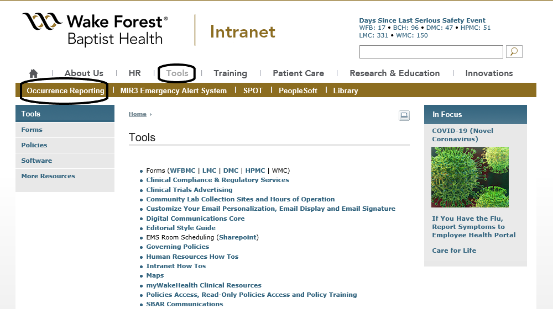
Falls
All job related falls and other injuries need to be reported by using the Occurrence Reporting form, found on the Intranet under the Tools tab.

Slide 22
Reminders
Title 21
      Email employee changes (new hires, resignations, transfers) to Danielle Bancroft
Safety Inspections
      February 2021 – COMPLETED
      May 2021
      August 2021
      November 2021
Trimedx
      Email Trimedx concerns or questions to Shelley.

Slide 23

Next Lab Huddle: May 11th,2021

