Slide 1
Staff Meeting
April 30, 2021 0630
May 3, 2021 1100/1400

Slide 2
Panel QC – Any Issues

Slide 3
MAX Q Floor Coolers
How are the Ziploc freezer bags working?

Slide 4
Davie Medical Center
Call ALL Rees alarms.

Slide 5
Emerge Fridge Alerts
Please call if you get a door open alert at the fridges or any type of alert that does not have a patient scan.
Several whole bloods – had to resolve manually.

Slide 6
AABB Inspection
AABB Standards:
.
5.14.1 ABO Group
The ABO group shall be determined by testing the red cells with anti-A and anti-B reagents and by testing the serum or plasma for expected antibodies with A1 and B reagent red cells. If a discrepancy is detected and transfusion is necessary before resolution, only Group O Red Blood Cells shall be issued.
5.14.5 Pretransfusion Testing for Allogeneic Transfusion of Whole Blood, Red Blood
Cell, and Granulocyte Components.
There shall be two determinations of the recipient’s ABO group as specified in Standard 5.14.1. The first determination shall be performed on a current sample and the second determination by one of the following methods:
Comparison with previous records
Testing a second sample collected at a time different from the first sample, including a new verification of patient identification.
Retesting the same sample if patient identification was verified using a validated electronic identification system.
Standards 5.11 and 5.27.1 apply.
5.27.1 Recipients whose ABO group is not known or has not been confirmed shall receive Group O Red Blood Cells or low-titer group O Whole Blood.

Slide 7
Flow Chart
Notes:
Patient Recheck

Slide 8
Flow Chart
Notes:
Patient Recheck

Slide 9
Flow Chart
Notes:
Patient Recheck

Slide 10
Flow Chart
Notes:
Patient Recheck

Slide 11
‘New’ Emergency Release

Slide 12
‘New’ Blood Product Release
Notes:
Do NOT call this emergency release.

Slide 13
Forward/Reverse
5.14.1 ABO Group: The ABO group shall be determined by testing the red cells with anti-A and anti-B reagents and by testing the serum or plasma for expected antibodies with A1 and B reagent red cells. If a discrepancy is detected and transfusion is necessary before resolution, only Group O Red Blood Cells shall be issued.
Required for all pediatric/adult patients >6 months of age
Neonates – may still perform forward (only getting O red cells).
Two new ABO rechecks have been built:
ABO2 (Use the stamp to help track the status)
ABOEO
Notes:
Will explain the difference

Slide 14
New ABO Rechecks ABO2
TSX specimens: Recipients who type Group O, A, B, or AB on the first sample AND are collected by INPATIENT phlebotomist may have the current sample repeated by a second technologist or other instrument with a different suspension since they are collected using an electronic identification system.
GTX/DATX specimens (other specimens not for transfusion of products requiring crossmatch) may have the current sample repeated by a second technologist or other instrument with a different suspension since they are not receiving red cells, whole blood or granuloctyes.

Slide 15
ABO2
Select appropriate sample
SS: Same Sample – use when collected by inpatient phlebotomy or when not a TSX sample
NS: New Sample – notified nursing that another sample was needed and placed the order for PRCEXM in Beaker.
CS: Core Sample – obtained an acceptable sample from Core Lab. (Collected ± 30 minutes of current specimen.)
EXPIRE the ABO2 test.

Slide 16
PRCEXM Order in WakeOne
Notes:
Once you select the order, it appears as 2nd ABO – Additional sample needed by Blood Bank. Do NOT remove current BBID armband.
The order on the nurse’s worklist – you can now see the in-line instruction to not remove the current BBID armband.

Slide 17
Specimens (Crossmatched products)
Enter in SCC antibody <ABO2.
When selecting and issuing units, will get flagged that Group O red cells, whole blood MUST be issued until 2nd specimen is received and tested.
Require the Blood Product Release form to be signed.

Slide 18
Specimens (Crossmatched products)
Remove SCC antibody <ABO2 once an acceptable 2nd ABO is received and resulted.

Slide 19
Delayed XMs with No History
Always perform ABOEO to avoid delay on Day of Surgery and allow electronic XM
ABO2 should be ordered for collection on DOS for main campus by PREOP.
Use same email group that is notified of disqualification.
Message should read: Please order the following test to be collected on day of surgery: PRCEXM. Need additional specimen for Blood Bank. Current BBID is acceptable. Do NOT change BBID.
ABO2 will be requested for ROUTINE Davie Medical Center transfusions. If not possible – then crossmatch Group O.
Blood Product release is NOT required at DMC.

Slide 20
ABOEO (ABO for Electronic XM of Group O)
Temporarily used to allow electronic crossmatch of Group O units until an acceptable 2nd specimen is received and tested.
Only option when you result is SS: Same Sample.
ALWAYS order/result for Davie Medical Center patients (if no history)
HemONC patients – may need to give Group O if at Clemmons or a hard stick.
They have been told they can send a second sample collected at with a separate patient identification…..but need to communicate this to Blood Bank.

Slide 21
Audit
Emergency Release audit has been revised slightly.

Slide 22
Go-Live
Tentative Date: May 4, 2021
Will begin using new forms this day.
Will begin using ABO2 and ABOEO with forward and reverse.
Still working with Pre-op on notification for Delayeds without history that are having surgery at Main Campus.
For DMC surgeries – just order and complete the ABOEO.

Slide 23
Charts in ED and L&D
Discontinued using charts on April 12, 2021.
Make sure that there is a chart in the chart recorder box……just in case – like in Blood Bank.

Slide 24
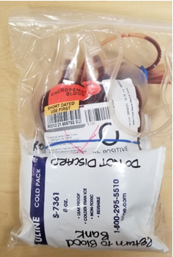
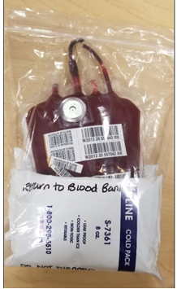
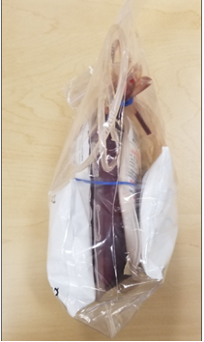
Whole Bloods/Packed Cells Adult ED
Package all whole bloods to ED with gel packs. (8 to 10)
Package 2-4 of the O negative packed cells with gel packs.
This will give them an hour to return units.
They can return these to the ‘Return’ shelf.
Use Safe-T-Vues.

Slide 25
Whole Bloods/Packed Cells Adult ED
Need a container beside refrigerator to return gel packs to if units are received.
Need to reposition shelves/re-label shelves.
Go LIVE May 10, 2021.
Will discontinue the MTP packs in ED.

Slide 26
Max Q inserts
Please put in order of expiration in freezer.

Slide 27
