Slide 1
Lab / Pathology
Managers Meeting
May 2021

Slide 2

Patient and Family Promise

Slide 3
Serious Safety Events
*Days since last SSE:
WFB: 33
BCH: 37
DMC: 84
HPMC: 20
LMC: 37
WMC: 187
*Current as of 5/12/2021

Slide 4
Good Catches
April

Slide 5
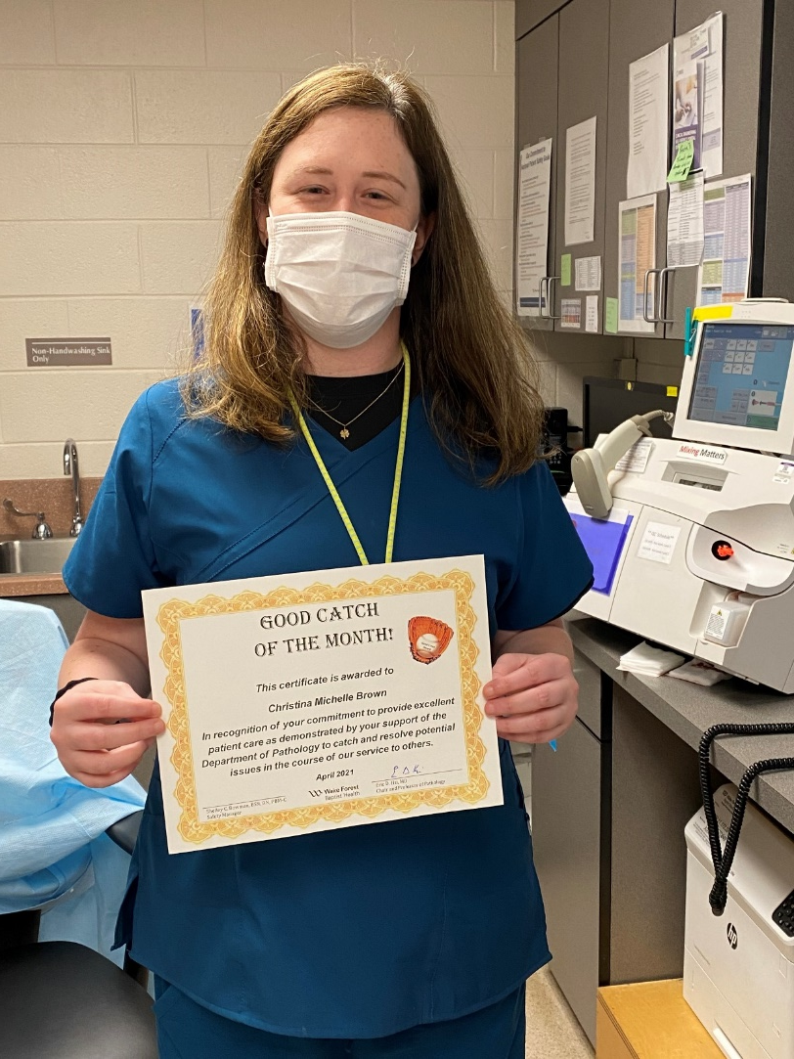
Good Catch Winner
Michelle Brown

Slide 6
Lab Pathology Deviations
April : 101
Average: 71

Slide 7
Top Deviations in April
#1

Slide 8
Top Deviations in April
#2
#3

Slide 9
Lab Pathology Deviations by Section
April 2021

Slide 10
RL6 Closing the Loop Compliance

Slide 11
RL6 Closing the Loop Compliance by Section

Slide 12
Safety Starts Here Section Compliance
2021

Slide 13
Safety Coach Monthly Compliance 2021

Slide 14
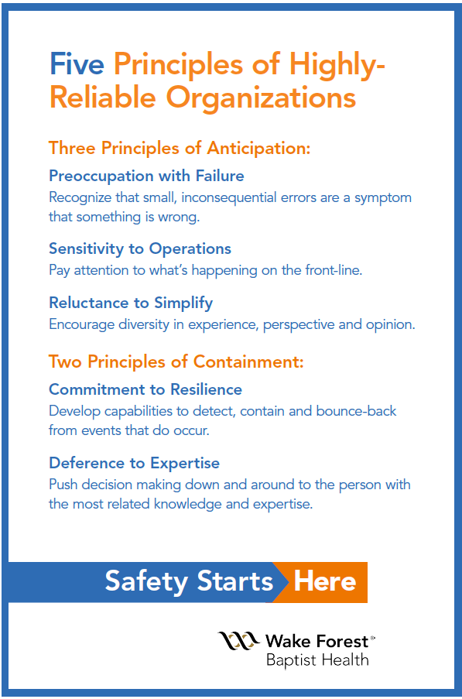
Safety Focus of the Month:
Five Principles of Highly – Reliable Organizations

Slide 15

Sensitivity to Operations
Sensitivity to Operations (Situational Awareness):
Cultivate an understanding of the context of the current state (what’s happening on the front-line) and how the current state might support or threaten safety. (AHRQ)
Proactive and real-time identification and prevention of deviations and harm (RL6 reporting)
Correct errors before they reach a patient; proactive rather than reactive
Continuous and prompt feedback to resolve issues or concerns

Slide 16
SPOT Safety Alert
May 10th, 2021

Slide 17
Lab Operations System Delay Notification Procedure
Step 1: Lab Staff Member
Identifies an unplanned delay in testing
Immediately notifies the Lab Section Manager, Lab Manager on-call or delegate if after hours or on weekends. A Lab Section Manager must be notified in order to initiate the system notification process.
NOTE: In some situations, the initiation of the system notification process may be delegated by the Section Manager or Section Medical Director to a laboratory staff member meeting CLIA and CAP’s personnel standards as a Technical Supervisor. This is at the discretion of the Lab Manager and/or Section Medical Director

Slide 18
Step 2: Lab Section Manager/Assistant Lab Manager or Delegate
The Lab Section Manager or their delegate will verbally notify the lab section Medical Director. If the Lab Section Medical Director cannot be reached, the Clinical Pathologist on-call should be notified.
The Lab Section Manager will email the following script to the Lab Medical Director or the Clinical Pathologist on-call with the blanks completed as soon as possible.
*Laboratory Delay* WINSTON Campus: Results of (affected test) will be delayed (time frame).

Slide 19
Step 3: Lab Section Manager/Assistant Lab Manager
Communicate the delay in testing to Charge Nurses, Nursing Operations Supervisors and the Network group (if applicable).
Charge Nurses:
    Go to the Net Page link (http://netpage.wakehealth.edu) to send a message to all Charge Nurse ASCOM’s, to include the Adult/Pediatric Emergency Departments.
    Click “send message”
    Click “Use Group” and choose “All CHG/RES RN’s” in the common group list.
    Type this message in the “message test” box:
**Laboratory delay** Results of (affected test) will be delayed (time frame).
Nursing Operations Supervisors:
    Page the Nursing Operations Supervisor (NOS) at 336-806-9647 and/or 336-806-9648. Tell them of the delayed tests and an estimation of how long.
    Email the Nursing Operations Supervisors with this message:
**Laboratory delay** Results of (affected test) will be delayed (time frame).
Email: nur_house_supervisor_wfbmc_dl@wakehealth.edu
Network
    If the testing involved in the delay will affect others in our Network, send an email to the Network group. Network_Pathology_Laboratory_Leaders_DL@wakehealth.ed
u

Slide 20
Step 4: Lab Section Medical Director or Clinical Pathologist on-call
At the discretion of the laboratory medical director, notify CMO on-call and request approval for the Message of the Day and for the Intranet post. Email this script with the blanks completed. Alternate notifications may be utilized as determined by the lab medical director.
*Laboratory Delay* WINSTON Campus: Results of (affected test) will be delayed (time frame).
Step 5: Delay Resolved
When the delay in testing has been corrected and tests are being processed according to the expected TAT, the Lab Manager/Assistant Manager or a lab delegate should call the help desk @ 6-HELP (6- 4357) and request the Wake One team to deactivate the Laboratory Message of the Day.
The timeframe of the delay is determined based on the Lab Section Manager’s best estimate of the situation. Messages and time frames will be updated as changes or new information is learned. If updates are needed, the Lab Section Manager will provide the update to the Lab Section Medical Director or the Clinical Pathologist on-call until the issue has been resolved

Slide 21
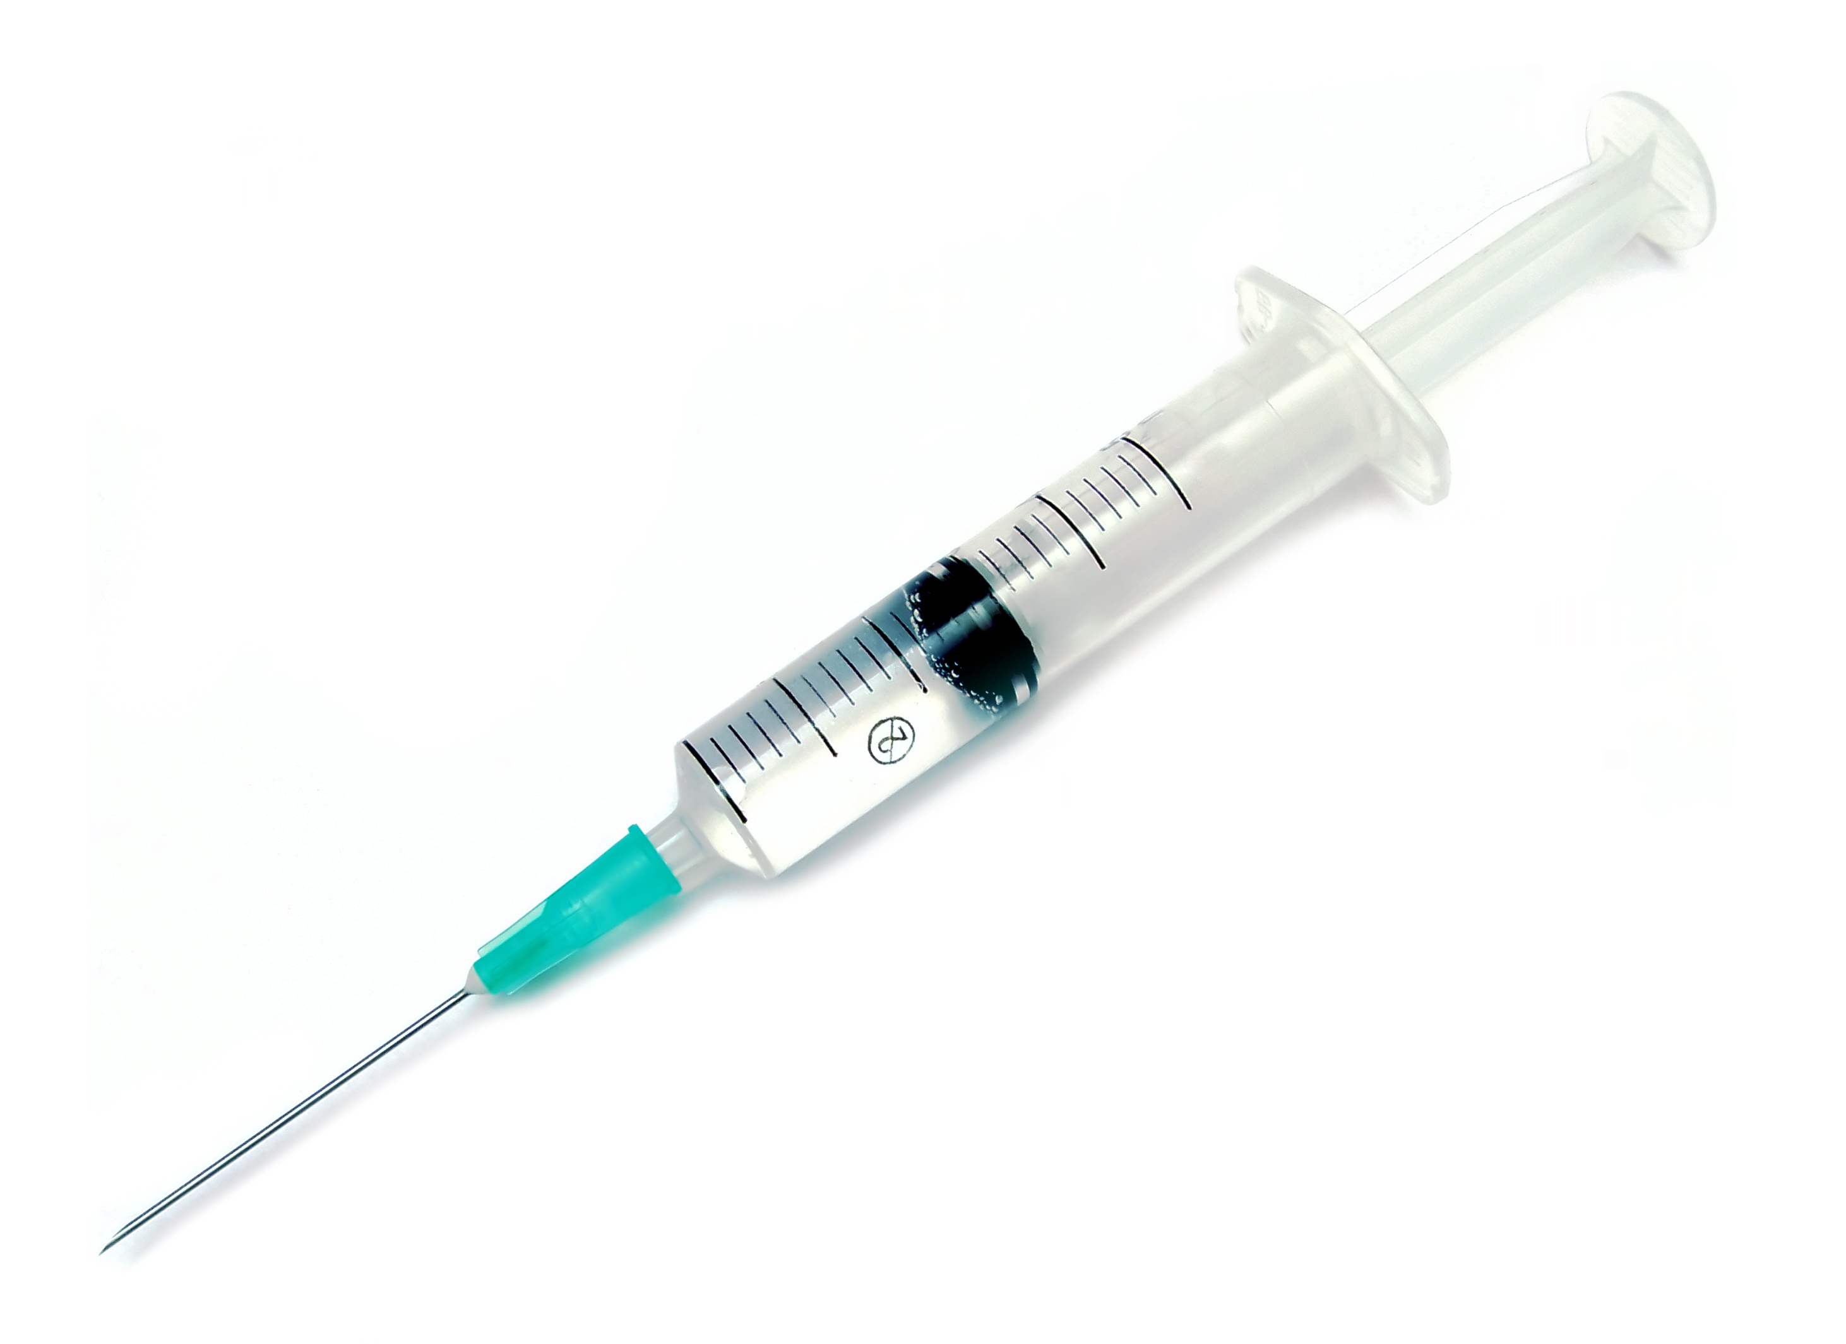
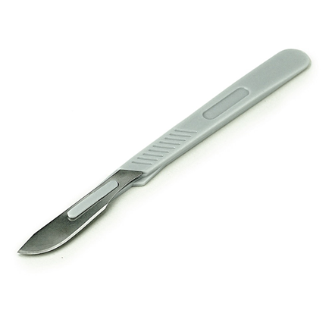
Lab Employee Hazard Awareness
May’s Topic – Sharps Safety
Needles and Scalpels

Slide 22
Needles
Do not recap
Do not bend
Do not remove needles from syringes with your hands
Dispose of immediately after use

Slide 23
Scalpels
      When possible…
        Use disposable blades
        Use a fixed blade with a handle
        Do not use excessive force or sawing motions

Slide 24
Things to think about
Check fullness of sharps disposal containers frequently
      If container is too full employees could be punctured or cut by protruding sharps
Keep sharps disposal containers close to areas where sharps are used
Use sharps in processes only when absolutely necessary
      Is there a feasible alternative?

Slide 25
Care Tower: Project EAST
Project EAST Work Groups

Slide 26
Reminders
Title 21
      Email employee changes (new hires, resignations, transfers) to Danielle Bancroft
Safety Inspections
      February 2021 – COMPLETED
      May 2021 – in process
      August 2021
      November 2021
Trimedx
      Email Trimedx concerns or questions to Shelley.

Slide 27

Next Lab Huddle: June 10th, 2021

