Slide 1
Client Services Huddle
May 28, 2021

Slide 2
Requests for sample tubes
To reduce wait and repeat calls:
Record tube type needed and tube station number
Take note to tube room staff
Tube room person will send tube(s) to floor
Try out starting June 2 – paper form template saved in shared folder

Slide 3
Staffing
Drone pick-ups – thank you for your help with these

Slide 4
Outreach
Sherrie L.
Michelle
Thank you for documenting outreach issues in daily emails. All issues are good to record.

Slide 5
Phone
Still on the list
Still behind because of COVID
??Record calls – separate license (recording calls is an option; few locations use this feature and it requires additional cost.)

Slide 6
Cancelling or Redrawing Clinic Labs
Providers using the Epic Ambulatory are not able to cancel or redraw labs that have been Collected in Beaker.
If clinics call to request cancelling or recollecting, please do this. Record who requested in the comments.
Keep a log of what clinic and dates this happens. Torie will follow up.

Slide 7
Questions?
What are guidelines for OP Phlebotomists when drawing blood – what are they looking for to know what to collect? –checking with Sandra Johnston
Atrium requisitions – One Click registration
General rule: if in doubt, do a One Click
Mia will compile a list of common issues seen on weekends to help train future weekend client services coverage
For example, Sendouts has a Quest pickup on Saturdays around 4:30pm – if Quest req/blood samples come here in error, they can be sent with Quest courier

Slide 8
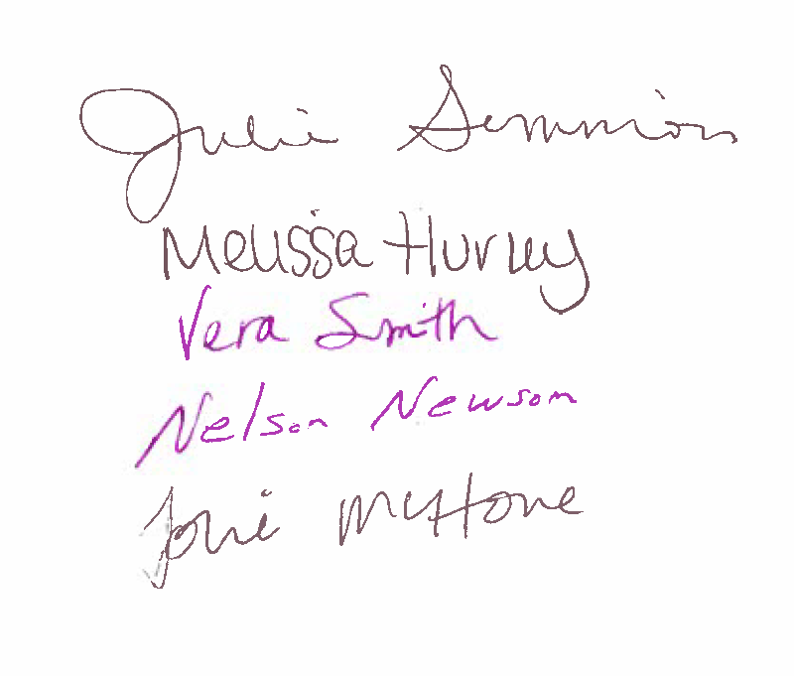
Attendance: Mia Reich

