Slide 1
Lab / Pathology
Managers Meeting
June 2021

Slide 2

Patient and Family Promise

Slide 3
Serious Safety Events
*Days since last SSE:
WFB: 12
BCH: 40
DMC: 113
HPMC: 49
LMC: 66
WMC: 216
*Current as of 6/10/2021

Slide 4
Good Catches
May

Slide 5
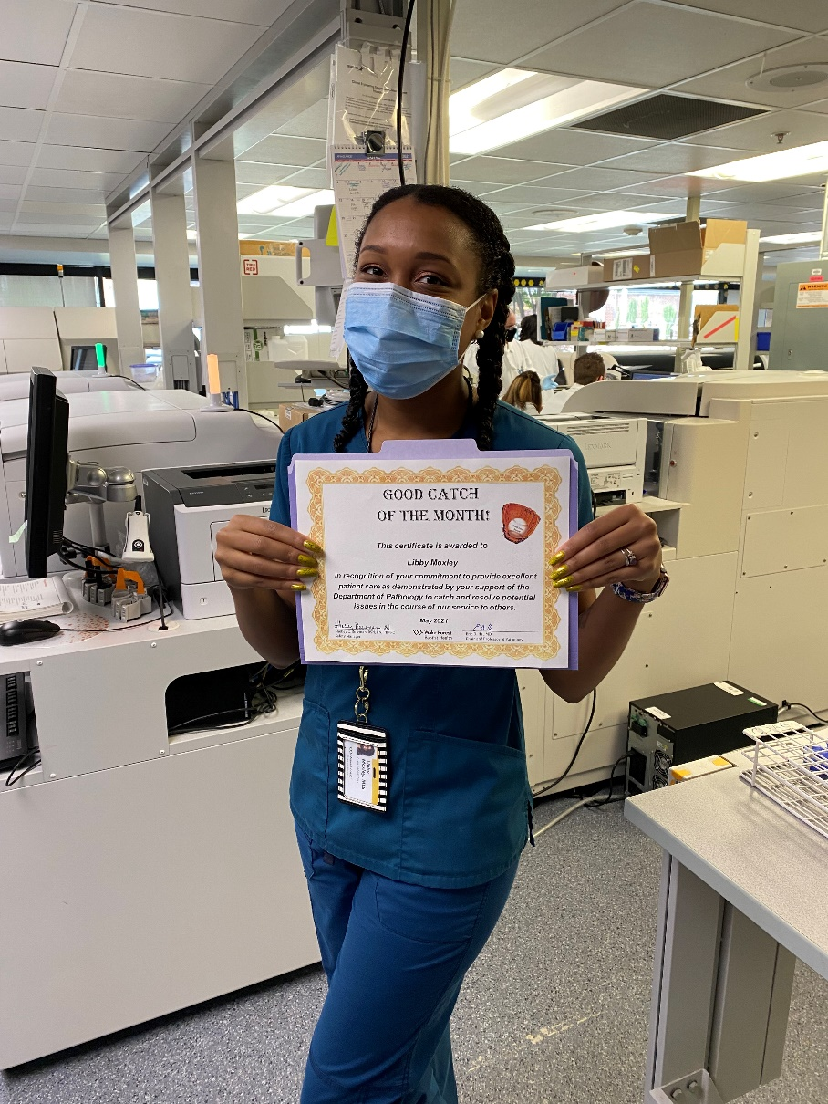
Good Catch Winner
Libby Moxley

Slide 6
Lab Pathology Deviations
May 96 RLs

Slide 7
Top Deviations in May
#1

Slide 8
Top Deviations in May
#2

Slide 9
Lab Pathology Deviations by Section
May 2021

Slide 10
RL6 Closing the Loop Compliance

Slide 11
RL6 Closing the Loop Compliance by Section

Slide 12
Safety Starts Here Section Compliance
2021

Slide 13
Safety Coach Monthly Compliance 2021

Slide 14
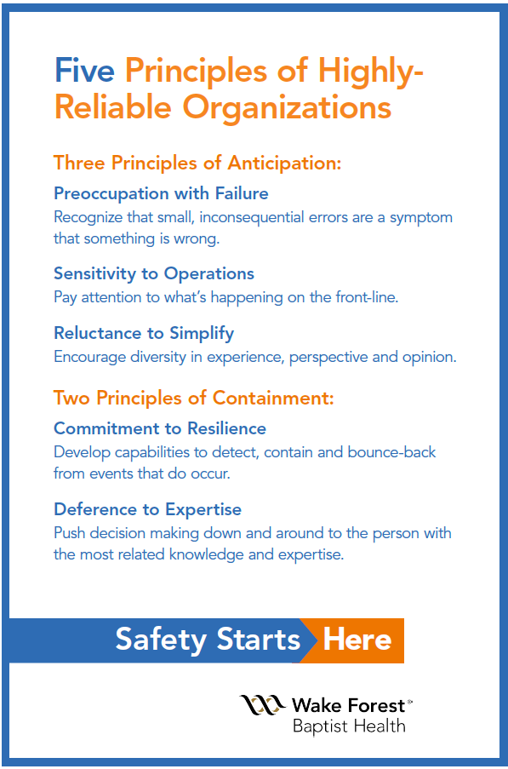
Safety Focus of the Month:
Five Principles of Highly – Reliable Organizations

Slide 15

Reluctance to Simplify
Reluctance to Simplify means we don’t jump to quick fixies when gaps are identified, but instead we constantly seek new information that might challenge our current beliefs as to why the gap/problem exists.
Simplification obscures unwanted, unanticipated, unexplainable details and in so doing, increases the likelihood of unreliable performance.
How do systems and processes contribute to errors?
How can system and processes support delivering the best care possible?
Goal: Think differently, paying attention to even the smallest details to make changes that are effective, reliable and sustainable.

Slide 16

Lab Employee Hazard Awareness
June’s Topic – Ergonomic Injuries
      Heavy Lifting
      Repetitive Motions
      Posture

Slide 17
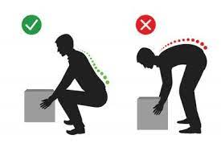
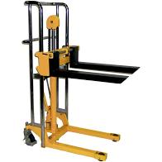
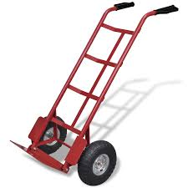
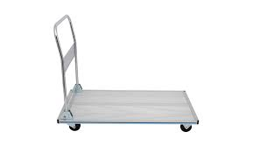
Heavy Lifting
Lift with legs not back
Keep weight close to your body
Utilize any assisting equipment provided

Slide 18
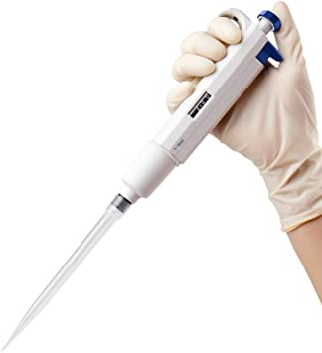
Repetitive Motions
When using pipettes or syringes
    Take periodic breaks
    Attempt to alternate left and right
    Experiment with different types of pipettes available in your lab
        Some types may cause less strain on your joints and feel more comfortable than others

Slide 19
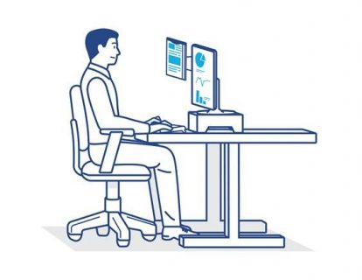
Posture
When sitting at your work station
    Ensure your arms are supported
    Adjust your computer screen to eye level
    Keep frequently needed objects within arms reach

Slide 20
Expired Reagents & Supplies Prize

Slide 21
Reminders
Title 21
      Email employee changes (new hires, resignations, transfers) to Danielle Bancroft
Safety Inspections
      February 2021 – COMPLETED
      May 2021 – COMPLETED
      August 2021
      November 2021
Trimedx
      Email Trimedx concerns or questions to Shelley.

Slide 22

Next Lab Huddle: July 8th, 2021

