Slide 1
Lab / Pathology
Managers Meeting
July 2021

Slide 2

Patient and Family Promise

Slide 3
Serious Safety Events
*Days since last SSE:
WFB: 40
BCH: 68
DMC: 141
HPMC: 22
LMC: 94
WMC: 244
*Current as of 7/8/2021

Slide 4
Good Catches
June

Slide 5
Good Catch Winner
Tricia Sorensen

Slide 6
Safety Starts Here Section Compliance
2021

Slide 7
Safety Coach Monthly Compliance 2021

Slide 8
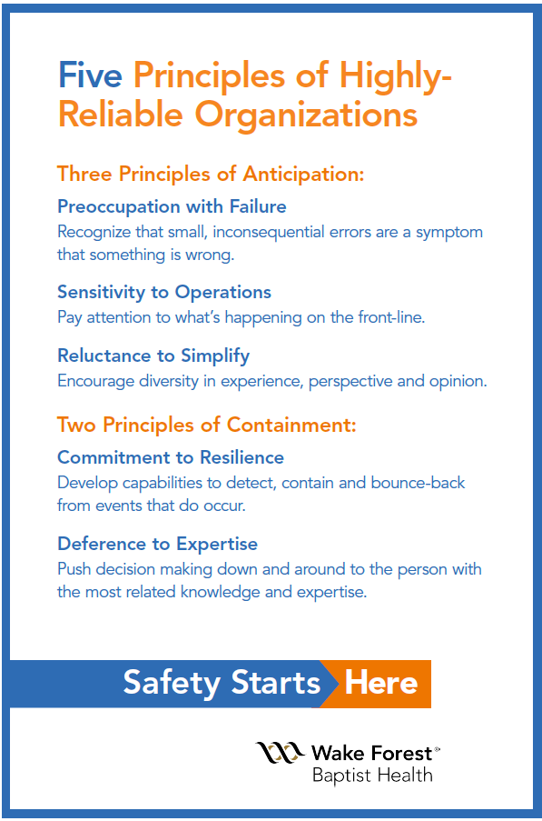
Safety Focus of the Month:
Five Principles of Highly – Reliable Organizations

Slide 9

Commitment to Resilience
Commitment to resilience is when we detect, contain and bounce back from events that do occur.
Resilience is a combination of keeping the errors small, of improvising workarounds that keep the system safely functioning and of absorbing change while persisting.
An attitude of resilience requires elasticity and recovery
We continue to generate the main outcomes of our mission despite failures.

Slide 10
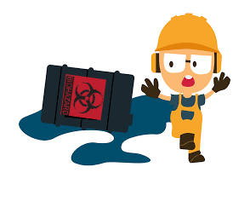
Lab Employee Hazard Awareness
July’s Topic – Chemical Spills
        >300 ml
        <300 ml
        Spill Kits

Slide 11
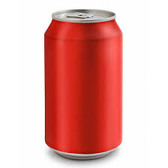
Chemical Spill Volume >300 ml
Call 6-9111
Do not attempt to clean it up
How do I approximate spill volume?
      A can of soda contains 355 ml
      Picture what it would look like if you spilt a soda can
      How does your spill compare? Is it more or less?

Slide 12
Chemical Spill Volume <300 ml
If chemical is non-toxic contact EH&S at 6-9375 and clean it up using a spill kit
While cleaning be sure to use the appropriate PPE for the chemical
Contact Environmental Services at 6-1111 for a final clean

Slide 13
Spill Kits
Each lab needs to have ready access to a spill kit
EH&S will provide spill kits for your lab upon request
Periodically check that the contents are free flowing (not clumped) by shaking
Replace spill kit once opened

Slide 14
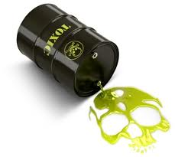
Chemical Spills
If the chemical is a Carcinogen, Reproductive Toxin or Highly Toxic: Call 6-9111 and evacuate immediately regardless of spilt volume

Slide 15
Expired Reagents & Supplies Prize

Slide 16
Reminders
Title 21
      Email employee changes (new hires, resignations, transfers) to Danielle Bancroft
Safety Inspections
      February 2021 – COMPLETED
      May 2021 – COMPLETED
      August 2021
      November 2021
Trimedx
      Email Trimedx concerns or questions to Shelley.

Slide 17

Next Lab Huddle: August 12th, 2021

