Slide 1
July 27-28, 2021
Staff Huddle:
Forsyth EMS
Pediatric Patients

Slide 2
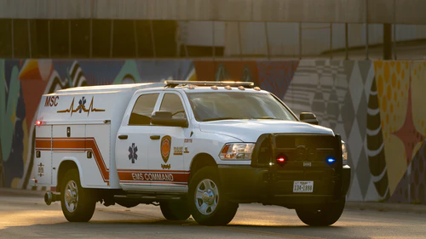
Forsyth EMS
3 Supervisors that will carry blood
Start with 1
Go live August 1st
5 day AirCare Coolers
One unit of Whole Blood (O pos/neg)—Protocol in T21 for approval
Usage criteria: Adults
Locations in SCC: FEMS1/FEMS2
Soon: Stokes EMS

Slide 3
Pediatric Patients
16 year olds in activated traumas are considered adults per trauma team
Updating protocols to match
‘Adult’ Pediatric population (≥ 50 kg; 110 lbs.)
May arrive in Adult or Peds ED
If in Adult ED—treat as adults
If in Peds ED—we will supply AB liquid plasma (1st week in August)
Protocols to be updated
New quick reference guide to be posted in multiple locations in lab

Slide 4
Questions during meeting:
Procedure in T21 for Dr. Fadeyi approval
If no AB liquid plasma:
Thaw 2 additional AB plasma (FP24 not FFP) so that 4 are available (1 in Ped ED, 1 thawed AB FFP in BB box, 2 additional set aside for pedi trauma)
Need to determine how FEMS crews will be designated 1/2/3
3rd FEMS “location” needs to still be built in SCC.
New signs being ordered for Adult ED fridge
16 year olds may end up in Peds ED—treat as adults per new policy (if females: O neg) but they can get A liquid plasma (treat as adult female)

