Slide 1
Central Processing/Client Services Huddle

Slide 2
Schedule Items
Meal breaks are encouraged.
Call outs – require a phone call to lab and to manager or assistant manager
PTO requests or changes – email Torie
  Don’t enter these in Kronos

Slide 3
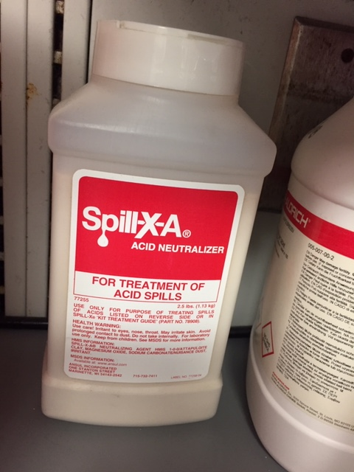
Joint Commission Visit
Inspectors asked where the spill kit is located. It is on the spin counter next to the hydrochloric acid container.
Could you locate the fire extinguisher?
Pull station?
Fire blanket?
Eye wash?

Slide 4
Staffing
Billie Shoffner – Part time – starts this week.

Slide 5
Employees in Training
Employees cannot complete tasks until they are checked off as competent.
They can do it if someone that is proficient observes them.
PRNs (Olga/Sherryl) will NOT be trained in body fluids/CareEvolve

Slide 6
Job Aides
Binders with Job Aides will be located at each accessioning bench – please use them

Slide 7
New Processes
New Autopsy number formats:

Slide 8
New Processes
New cytology order name: Cytology, Non-Gynecological
Cytology orders aren’t consistently available in Order Inquiry – Current Orders
For body fluids be sure to look in Chart Review – Labs tab to search for cytology orders
A Beaker ticket has been entered for this issue.
A Beaker ticket has also been entered for Flow Cytometry orders – unable to Collect in Order Inquiry

Slide 9
New Processes
New Urinalysis/Urine Culture Reflex Order set went live on 7/21/21.
Will see two labels or samples: Urinalysis and Hold for UC
Hold for UC goes to micro, processed same way as urine culture
For short samples, give both labels to micro first, let them know it is a shared sample. They’ll take what they need and give sample back to CP for urinalysis.

Slide 10
New Processes
Blood bank requests for hematology samples
Requisition to come in the tube station from blood bank
Tube person will give bag/requisition to hematology
Hematology will retrieve the sample and place in the bag
Hematology will bring the bag with sample and requisition to Tube room to be tubed to blood bank

Slide 11
ALERT - Medical Genetics Test
Cystic fibrosis carrier screen – Do NOT centrifuge. These must remain as whole blood at room temperature.
Email also sent out.

Slide 12
Add-Ons
Cancer Center Lab – Phlebotomists are performing Add-Ons during CC Lab hours (M-F 7a-5p)
After hours, Central Processing should perform CC Lab Add-Ons – procedure is in revision

Slide 13
Care Evolve Orders
Be sure to Change Account when needed between orders
For example, order one patient for XBRSA and the next patient is from XVIST: stop and Change Account to correct location before ordering
Results that go to the wrong location are considered a HIPAA violation

Slide 14
Coworker Reminders
Check bins between shifts to make sure we aren’t missing samples (micro, sendouts, etc.)
Be mindful of changing tube types when indicated (change pedi tube to gold top SST, etc.)
Do not “move tests to specimen” for patients 10 years or younger
Remember to check coag samples (for volume) before sending to the bench
Special hematology samples must be processed for stability after hours and on weekends. Please see the chart on the biosafety cabinet for processing instructions after hours.

Slide 15
Coworker Reminders
If a sample is ordered and labeled as an Extra Tube (Beaker barcoded label) – send the tube to the correct bench.
Initial any labels you place on a sample – remember to stop and verify 2 identifiers (name/DOB/MRN) before labeling.

Slide 16
Reminders
Spin Allergy samples before putting in refrigerator
Procalcitonin cannot be shared with Troponin
Please enter the correct volume for 24-hour urines (in milliliters or mL). Ok to enter a new value when outpatient phlebotomy has entered one already – they do not have a scale and are visually estimating the volume.

Slide 17
Accomplishments
Add on for Cancer Center
Tickets for Label printers

