Slide 1
Lab / Pathology
Managers Meeting
August 2021

Slide 2

Patient and Family Promise

Slide 3
Serious Safety Events
*Days since last SSE:
WFB: 21
BCH: 102
DMC: 175
HPMC: 40
LMC: 128
WMC: 42
*Current as of 8/11/2021

Slide 4
Good Catches
July

Slide 5
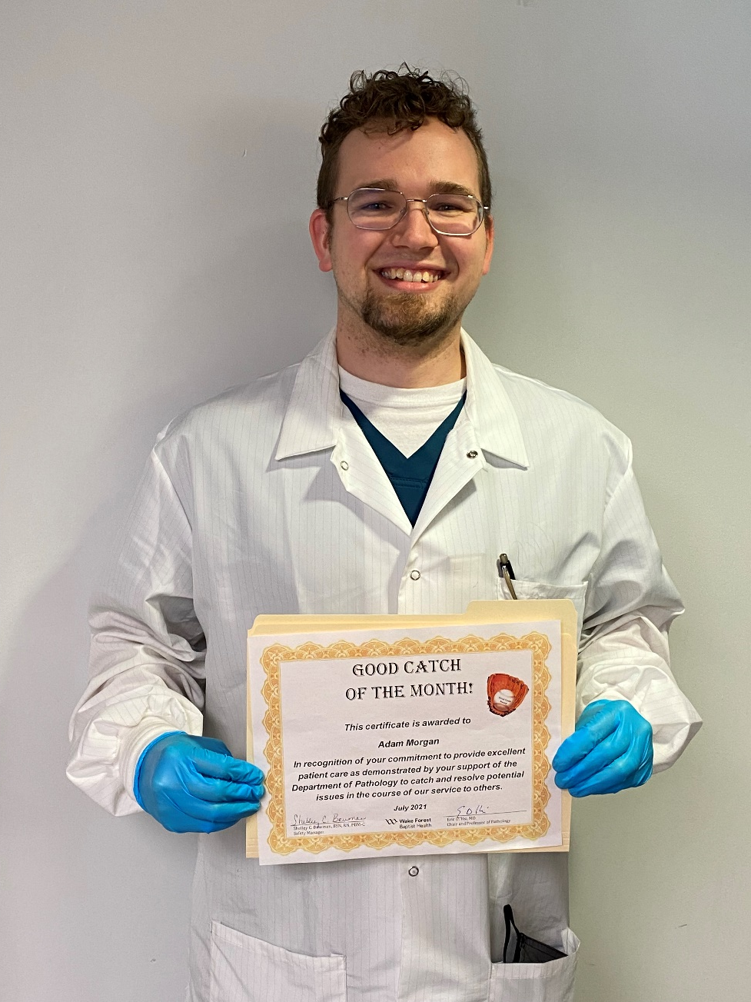
Good Catch Winner
Adam Morgan
Chemistry

Slide 6
Safety Starts Here Section Compliance
2021

Slide 7
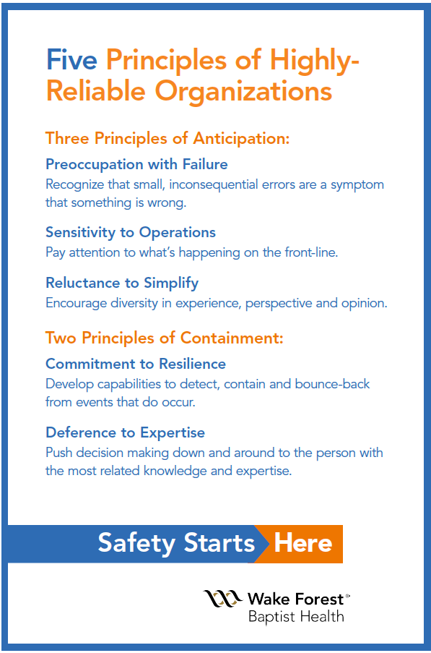
Safety Focus of the Month:
Five Principles of Highly – Reliable Organizations

Slide 8

Deference to Expertise
Deference to expertise means to defer decision making in case of emergencies to individuals with the expert knowledge to deal with the specific problem, irrespective of their status within the organization hierarchy. Managing the unexpected by deferring to experts.
This is demonstrated by a pattern of respectful yielding to:
Domain-specific knowledge
Experience
Expertise
Notes:
When something unexpected happens, we defer to experts. Example – if I am at my PCP and they determine I have had a MI – defer to the experts – cardiology.

Slide 9

Lab Employee Hazard Awareness
  August’s Topic – Eyewashes and Showers
      Why you need them
      How to use them
      Maintenance
      Eyewash Bottles

Slide 10
Why you need them
Even with the best engineering controls, PPE and safety precautions chemical/biohazard exposure can still happen
      They give employees the ability to immediately remove hazardous substances from their body
          Preventing potential harm

Slide 11

How to use them
After exposure it is important to reach the eyewash/shower within 10-15 seconds
The exposed area needs to be flushed/drenched for no less than 15 minutes
Call for immediate medical assistance

Slide 12
Maintenance
Eyewash/shower need to be located such that an exposed employee could reach them within 10 seconds
        or no more than 55 feet from location of exposure
Eyewash/shower should be activated weekly for a period long enough to verify operation and ensure that flushing fluid is available
        This also clears sediment and bacteria from the stagnate water

Slide 13
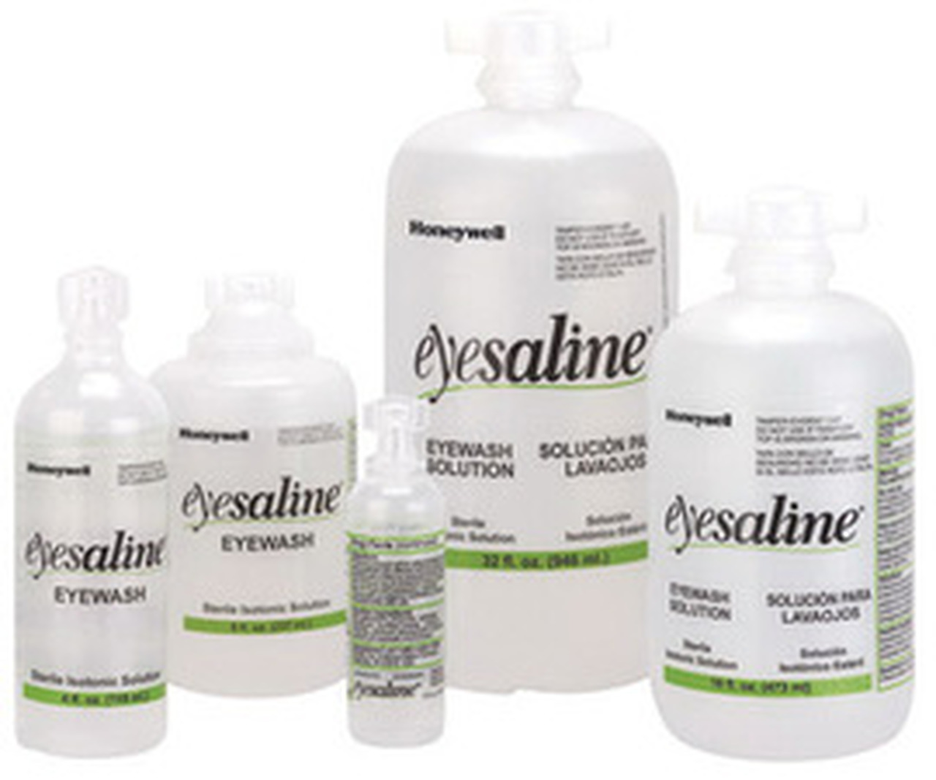
Eyewash Bottles
Eyewash bottles should be examined weekly and should be discarded if...
      Expiration date is exceeded
      Solution is turbid - this could indicate bacterial growth
EH&S will provide replacements upon request

Slide 14
Eyewash Bottles
Eyewash bottles are not to be used as a supplement for flushing your eyes after exposure.
      They are for immediate use in areas that are not able to meet the proximity requirements between the exposure site and the stationary eyewash
      Bottles should be used while in transit to a stationary eyewash where you should then flush your eyes for 15 minutes
ANSI Z358.1-2014

Slide 15
Quality Monthly Meeting Reminders
An updated presentation regarding completing the templates and uploading completed templates to the SharePoint site was emailed out to lab managers on August 10th.
Monthly Quality Reviews (MQR) are due by end of day on the 3rd Friday of each month.
Both AP & CP lab sections should submit MQRs every month even though you will not report each month.
AP Lab Sections will begin monthly submission in September due to AP Beaker implementation.

Slide 16
COVID-19 Vaccine
COVID-19 vaccinations are mandatory for all employees (including those working remotely), volunteers, students, trainees, residents, fellows, medical staff, contractors (vendors).
By Oct 31st, all must comply with either completing the COVID-19 vaccine series or have an approved medical or religious exemption.
Exemptions must be submitted by August 31st.
There will be significant consequences for failure to comply.
All newly hired employees must have the first vaccine within 2 weeks of hire and the second one within 8 weeks of hire, unless they have an approved exemption.

Slide 17
Reminders
Title 21
      Email employee changes (new hires, resignations, transfers) to Danielle Bancroft
Safety Inspections
      February 2021 – COMPLETED
      May 2021 – COMPLETED
      August 2021
      November 2021
Trimedx
      Email Trimedx concerns or questions to Shelley.
4. Monthly Quality Review due 3rd Friday of each month.

Slide 18

Next Lab Huddle: September 9th, 2021

