Slide 1
Lab / Pathology
Managers Meeting
September 2021

Slide 2

Patient and Family Promise

Slide 3
Serious Safety Events
*Days since last SSE:
WFB: 20
BCH: 27
DMC: 204
HPMC: 69
LMC: 157
WMC: 71
*Current as of 9/9/2021

Slide 4
Good Catches
August

Slide 5
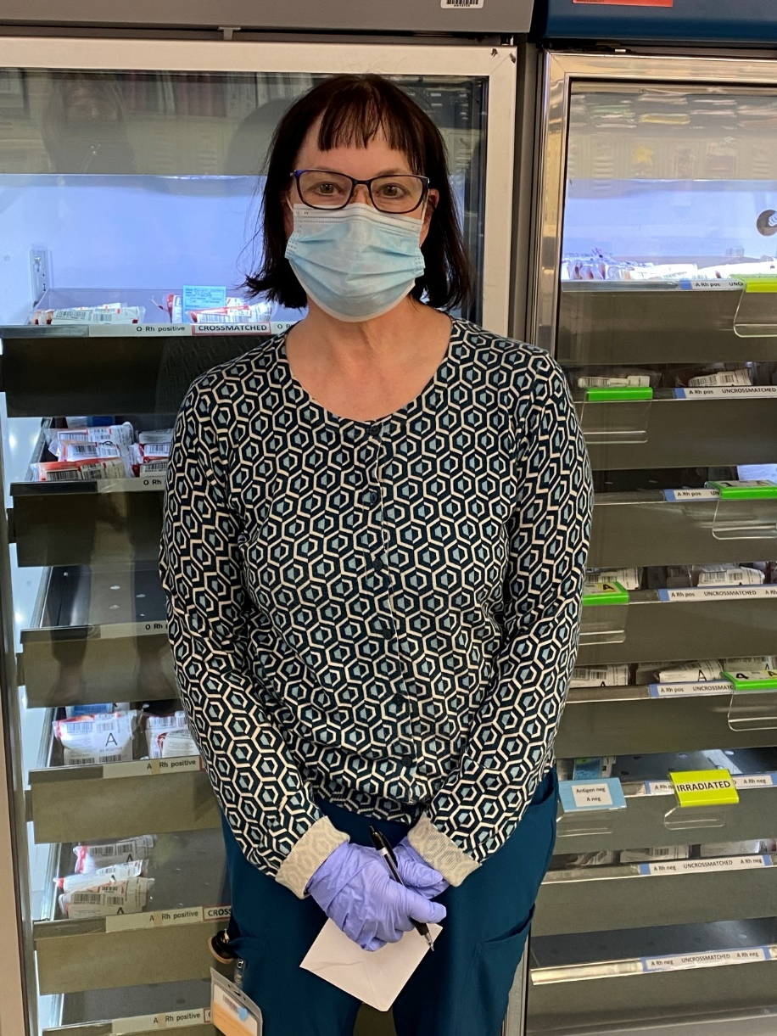
Good Catch Winner
Susan Wright
Blood Bank

Slide 6
Safety Starts Here Section Compliance
2021

Slide 7

Please use this template as provided. Do not modify the font, bullets, border or background.
Use this for orange text
Use this for blue text
Or this if you need red
Practice With & Accept Questioning Attitudes
STOP when you are uncertain
If you have a question about your planned action When you realize that the task does not follow the normal policy, procedure, protocol, plan, etc. | If something just doesn’t feel right If you hear someone say “I have a concern” STOP and address this genuine worry that we may cause harm
Notes:
September

Slide 8

Lab Employee Hazard Awareness
    September’s Topic – Chemical Fumes
      PEL and STEL
      Xylene and Formaldehyde
      Liquid Nitrogen

Slide 9
PEL and STEL
PEL – Permissible Exposure Limit
    Maximum chemical concentration in the air that an employee can be exposed to continuously for 8 hours
STEL – Short Term Exposure Limit
    Maximum chemical concentration in the air that an employee can be exposed to for 15 minutes

Slide 10
Xylene
PEL - 100 ppm (parts per million of air)
STEL - 150 ppm
Symptoms of exposure
    Breathing in small amounts can cause headache, dizziness, drowsiness, and nausea
    Breathing in large amounts can cause sleepiness, stumbling, irregular heartbeat, fainting, or even death

Slide 11
Formaldehyde
Formaldehyde is a carcinogen
PEL - 0.75 ppm
STEL - 2 ppm
Symptoms of exposure
    Long term exposure to low levels can cause respiratory difficulty, eczema, and sensitization
    Short term exposure can be fatal

Slide 12
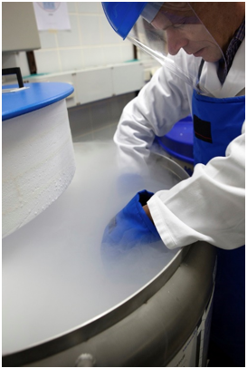
Liquid Nitrogen (LN2)
When vaporized, LN2 can expand to 695 times in volume
The expansion of the gas can replace the Oxygen in the room, causing Asphyxiation
LN2 gas has no color or odor

Slide 13
Liquid Nitrogen (LN2)
Oxygen Monitoring
    19-25% Oxygen in the air is acceptable and safe
    An Oxygen monitoring system must be installed in areas where LN2 is stored
        The system is to alert you when Oxygen levels in the room are less than the acceptable percentage
        If alarm is activated Evacuate IMMEDIATELY

Slide 14
Quality Monthly Meeting Reminders
The September quality meeting has been cancelled.
The next meeting is October 26th, 2021
An updated presentation regarding completing the templates and uploading completed templates to the SharePoint site was emailed out to lab managers on August 10th.
Monthly Quality Reviews (MQR) are due by end of day on the 3rd Friday of each month.
Both AP & CP lab sections should submit MQRs every month even though you will not report each month.

Slide 15
COVID-19 Vaccine
COVID-19 vaccinations are mandatory for all employees (including those working remotely), volunteers, students, trainees, residents, fellows, medical staff, contractors (vendors).
By Oct 31st, all must comply with either completing the COVID-19 vaccine series or have an approved medical or religious exemption.
There will be ‘significant consequences’ for failure to comply.
All newly hired employees must have the first vaccine within 2 weeks of hire and the second one within 8 weeks of hire, unless they have an approved exemption.

Slide 16
Reminders
Title 21
      Email employee changes (new hires, resignations, transfers) to Danielle Bancroft
Safety Inspections
      February 2021 – COMPLETED
      May 2021 – COMPLETED
      August 2021 -COMPLETED
      November 2021
Trimedx
      Email Trimedx concerns or questions to Shelley.
MQR
      Monthly Quality Review due 3rd Friday of each month.

Slide 17

Next Lab Huddle: October 14th, 2021

