Slide 1
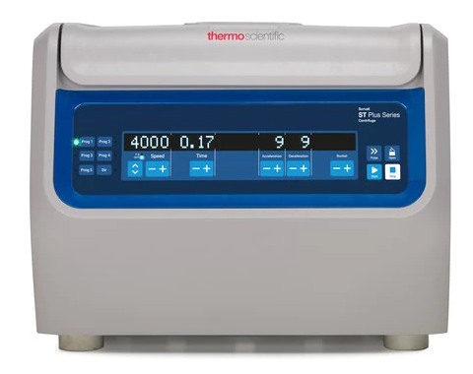
Sorvall ST1 Plus Centrifuge: Power switch

Slide 2
Control Panel
7
6
1
2
3
4
5
1 – Programs
2 – Speed
3 – Time
4 – Acceleration/Deceleration
5 – Start
6 – Stop
7 - Open
Speed units should be kept on rpm
(2)

Slide 3
Open/Close Lid
To open the centrifuge lid:
Press the Lid Open button on the control panel
To close the centrifuge lid:
Close the centrifuge lid by pressing down in it lightly in the middle or on both sides. The locking mechanism engages to close the lid safely. The lid should audibly click into place.

Slide 4
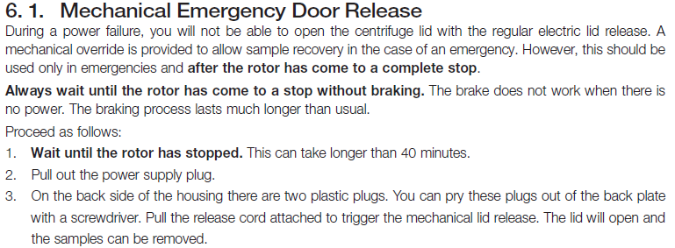
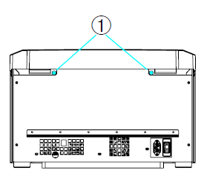
Emergency Door Release

Slide 5
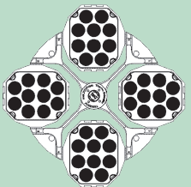
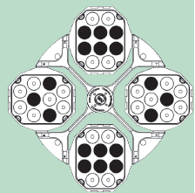
Bucket Inserts
Gray inserts are used for 13x75 (or 13x100) tubes such as gold tops – and any short tubes (lavender, green)
Red inserts are used for 16x100 tubes such as red tops
Balance the buckets opposite each other
Make sure that all buckets are installed correctly
Examples of balanced buckets:

Slide 6
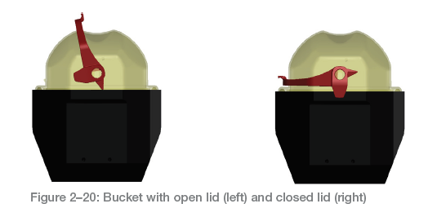
Bucket Covers
Raise the latch. The cap can now be easily placed on the bucket.
Lower the latch to close the bucket aerosol-tight.
Be sure the latch clicks into place
Make sure that both sides of the latch are closed.

Slide 7
Starting and Stopping
Settings for centrifuge are 5000 RPM for 5 minutes (this should not be changed).
Press the Start key to start a centrifugation run. When the centrifuge time has elapsed, the centrifuge will stop automatically.
Press the Stop key if you need to manually end the centrifugation run.

Slide 8
Cleaning
Use warm water with a neutral detergent to clean the centrifuge, buckets, and inserts.
Use a soft cloth for cleaning. Use a soft brush without metal bristles to remove stubborn residue.
Rinse and dry with absorbent towels.

Slide 9
Troubleshooting and Service
See the Instructions for Use for troubleshooting instructions.
Instructions for Use are in the CP Lab Staff – Equipment folder
Contact Trimedx (6-1111, option 7 for clinical engineering) or inform management for further help

