Slide 1
Agglutination Education
Continuing education developed by
Bettina Turner, BSMT(ASCP)SBB^{cm}
for
Atrium Wake Forest Baptist Health Blood Bank Staff

Slide 2
View the following images then proceed to quiz in MedTraining to answer associated questions

Slide 3
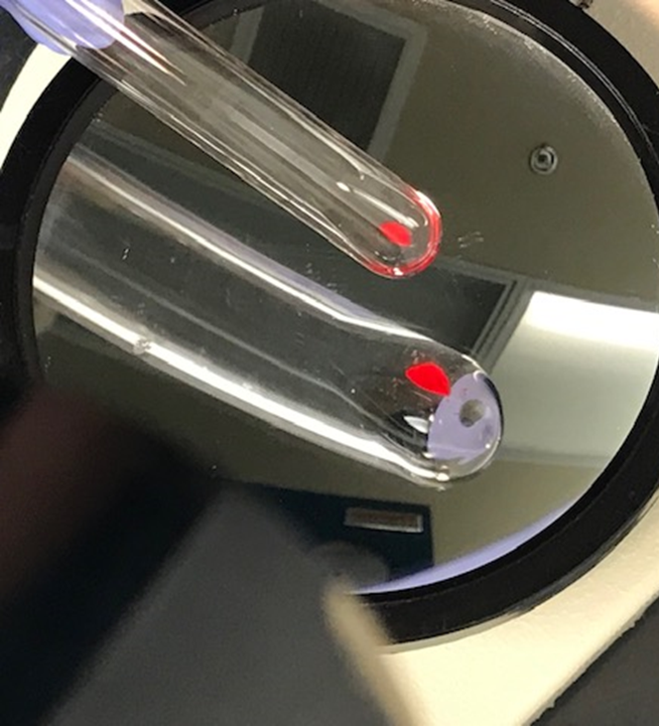
Image 1

Slide 4
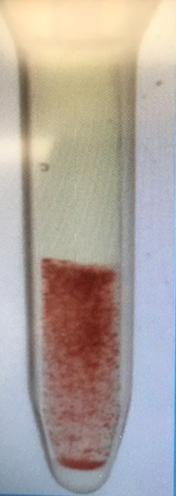
Image 2

Slide 5
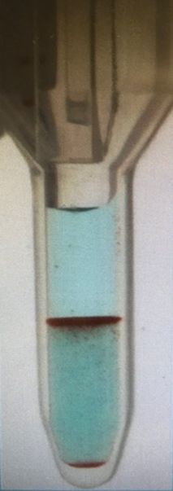
Image 3

Slide 6
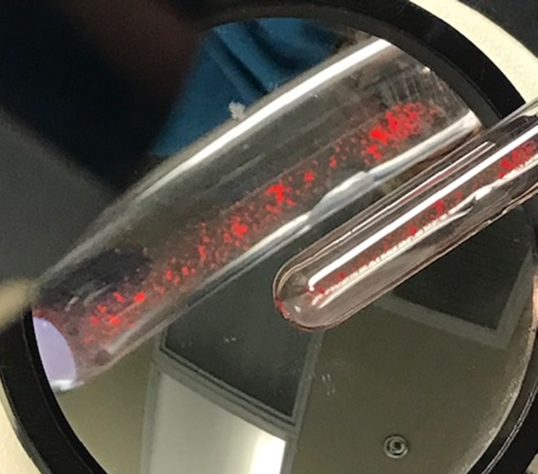
Image 4

Slide 7
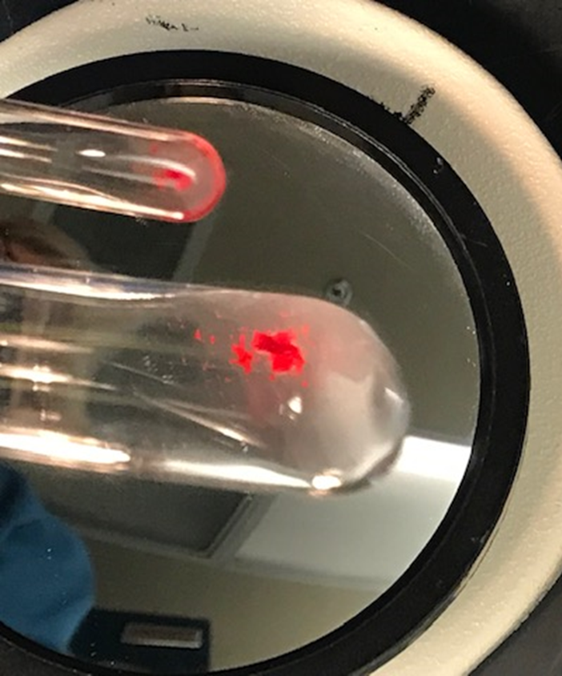
Image 5

Slide 8
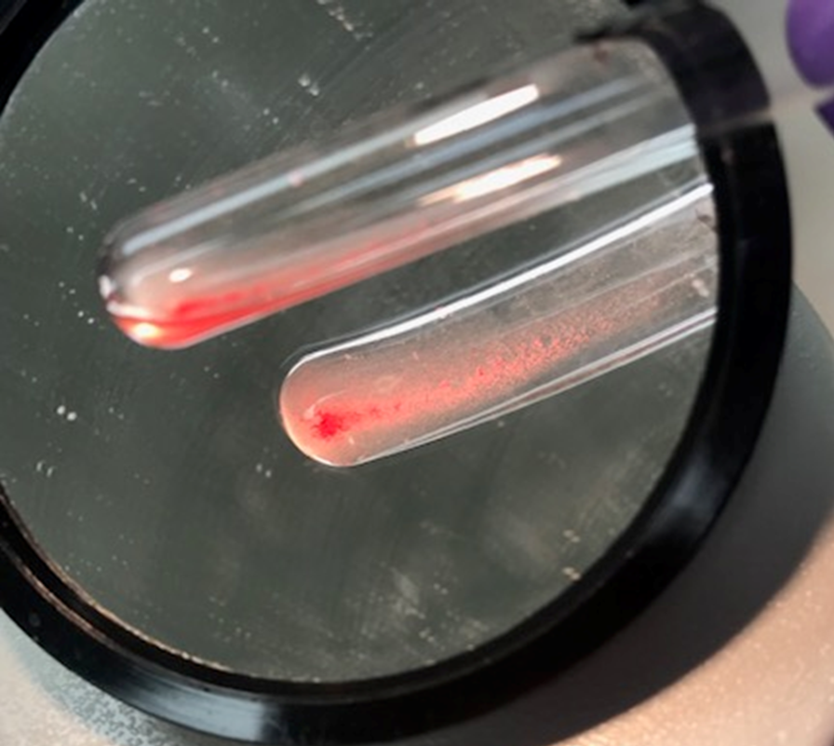
Image 6

Slide 9
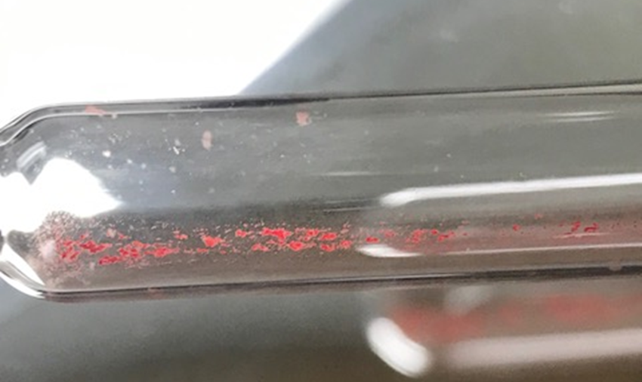
IMAGE 7

Slide 10
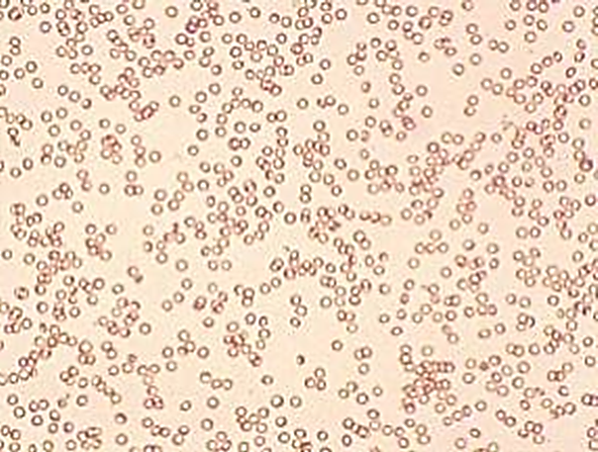
IMAGE 8

Slide 11
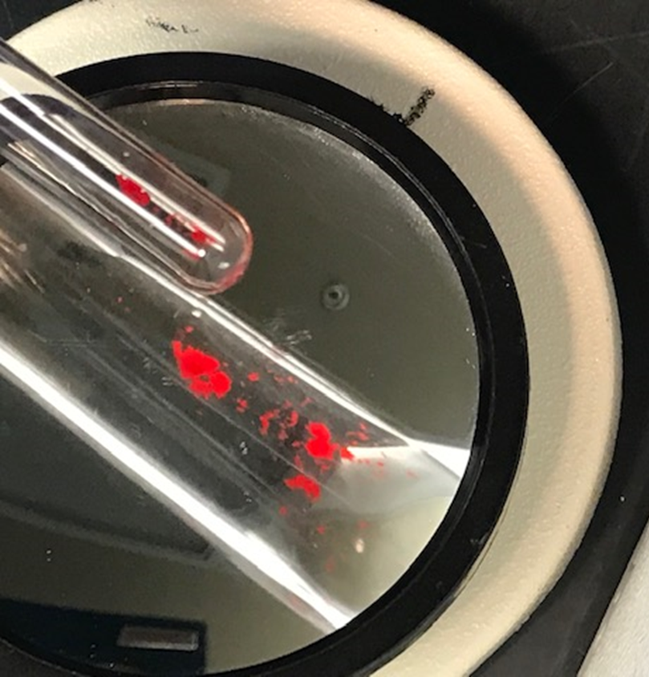
IMAGE 9

Slide 12
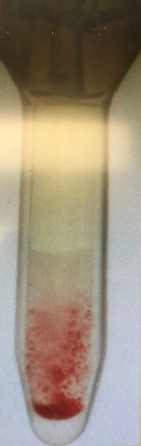
IMAGE 10

Slide 13
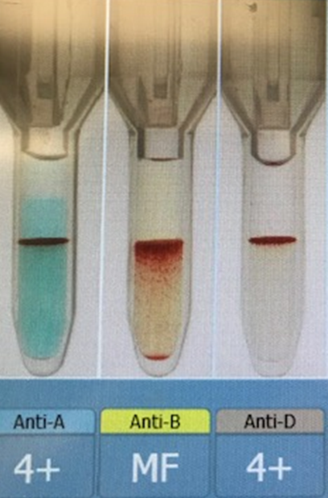
IMAGE 11

Slide 14
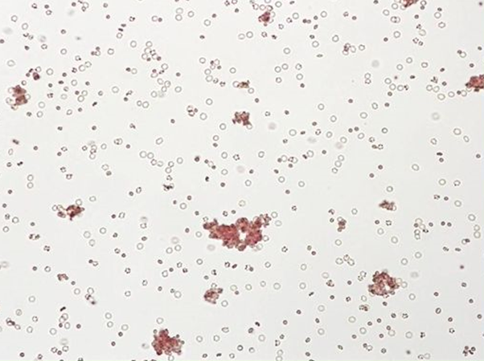
IMAGE 12

Slide 15
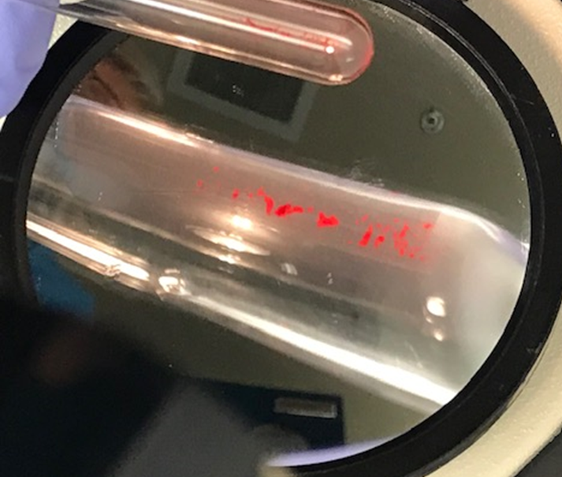
IMAGE 13

Slide 16
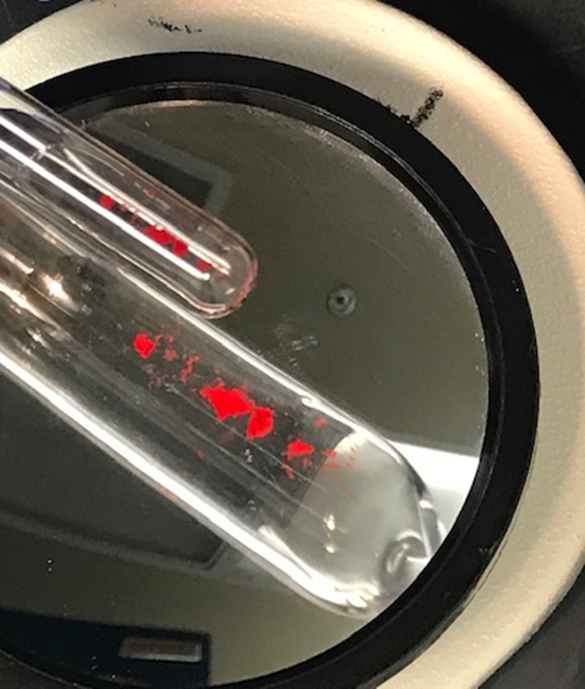
IMAGE 14

Slide 17
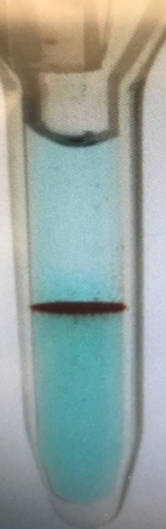
Image 15

Slide 18
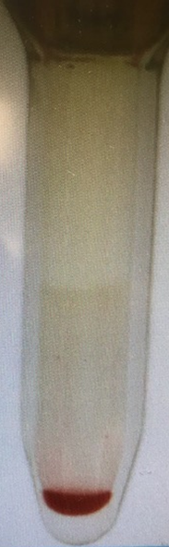
Image 16

Slide 19
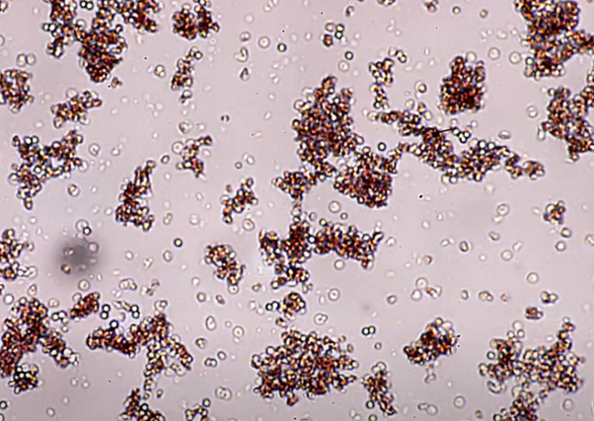
Image 17

Slide 20
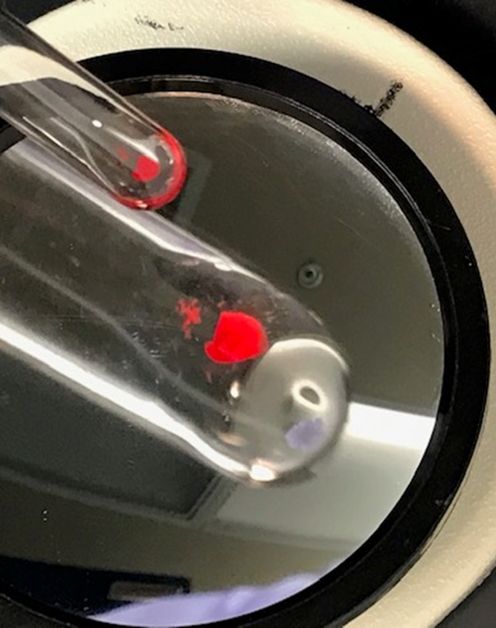
Image 18

Slide 21
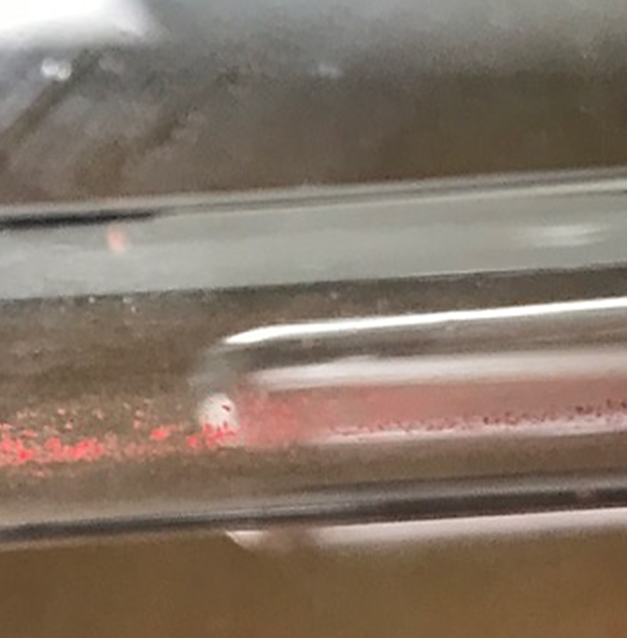
Image 19

Slide 22
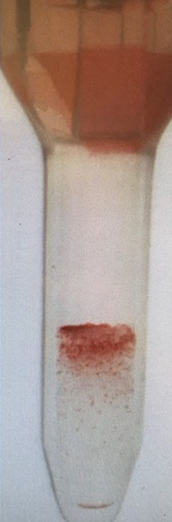
Image 20

Slide 23
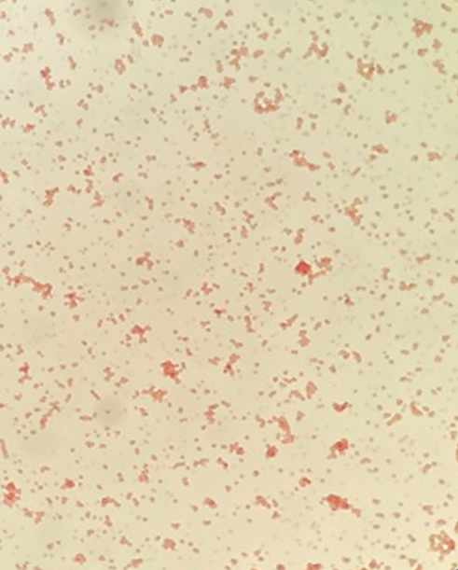
Image 21

Slide 24
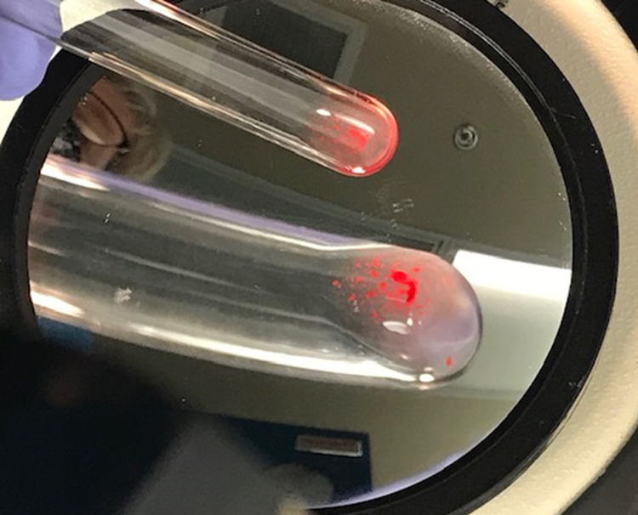
Image 22

Slide 25
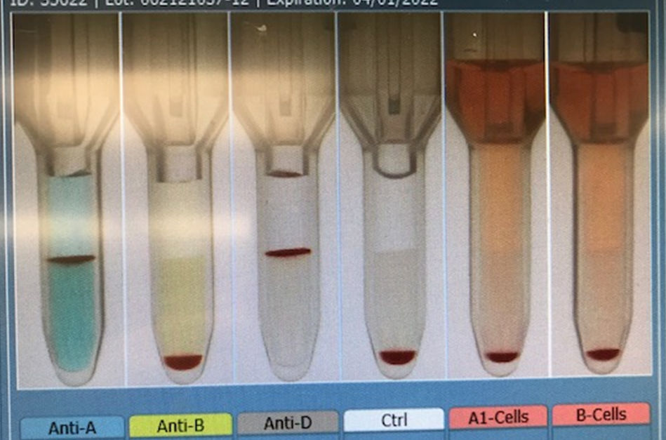
Image 25

Slide 26
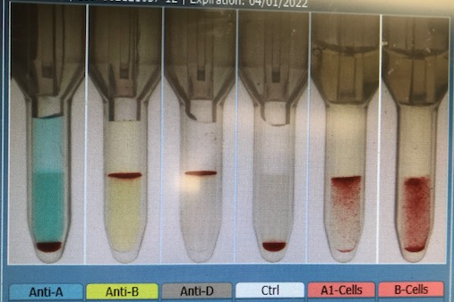
Image 26

