Slide 1
Safety Presentation
October 2021
10.14.2021 | Department of Lab & Pathology

Slide 2

Patient and Family Promise

Slide 3
Days Since Last Serious Safety Event
WFB: 4
BCH: 61
DMC: 238
HPMC: 103
LMC: 191
WMC: 105

Slide 4
Good Catches

Slide 5
Good Catches

Slide 6
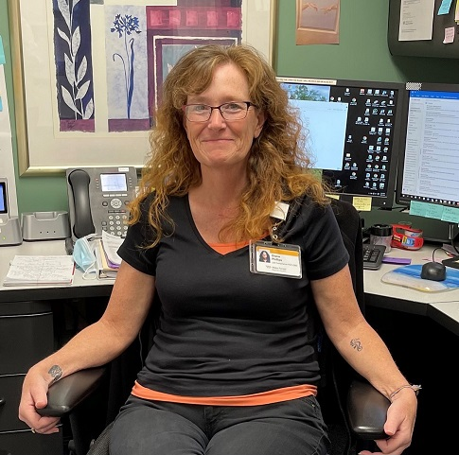
Good Catch Recipient
For September
Diana Phillips
POCT

Slide 7
Safety Focus of the Month
Lab Section Compliance

Slide 8

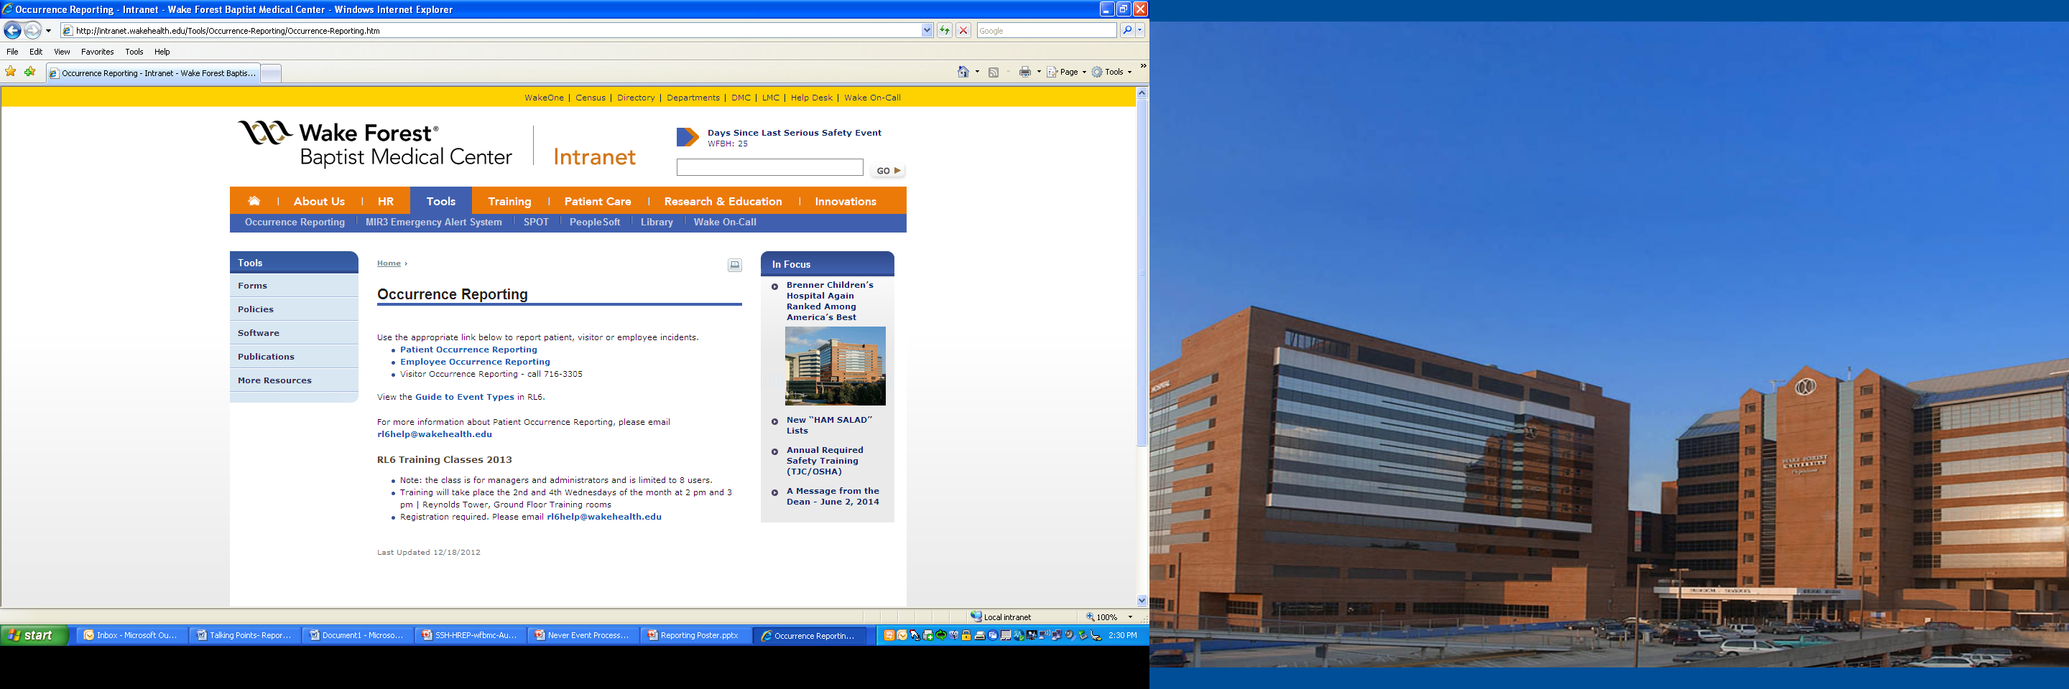
Safety Focus of the Month
Patient Events & Safety Events
Good Catches
Employee Events
Safety First – ALWAYS!
Reporting
Who can report? Anyone! Anything that harms a patient or employee Anything that threatens to harm a patient or employee Anytime something unexpected happens | Celebrate our successes! Recognize great catches and reporting with a Good Catch report, Shout Out or e-card.

Slide 9
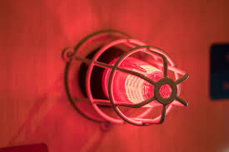
Lab Employee Hazard Awareness
    October’s Topic – Fire Alarms
    Clinical Labs
    Non-clinical Labs
    Tests and Drills

Slide 10
Clinical Labs
Defend in place
    The clinical lab is designed for you to continue to provide patient care in the event of a fire
    Unless the fire is in the immediate area
    Follow your department specific policies

Slide 11
Non-clinical Labs
    Evacuate if possible
        If leaving could negatively affect patient testing two people can remain in the lab
        One person to preform the testing, another person to maintain outside communication and monitor surrounding areas for signs of a fire

Slide 12
Tests and Drills
Tests are performed annually
    Advanced notice will be provided
    Evacuation is not necessary
Drills are conducted annually
    Unannounced
    Respond as you would to any other alarm

Slide 13
Reminders
Title 21
      Email employee changes (new hires, resignations, transfers) to Danielle Bancroft
Safety Inspections
      February 2021 – COMPLETED
      May 2021 – COMPLETED
      August 2021 -COMPLETED
      November 2021
Trimedx
      Email Trimedx unresolved concerns or questions to Shelley.
MQR
      Monthly Quality Review due 3rd Friday of each month.

Slide 14

Next Lab Manager’s Meeting: November 11th, 2021

