Slide 1
October Staff meeting
10/25/21
0700 JC,WC,GK,KP,LW,LG, CSW
1400 AH,CH,LA,DB,SW,JJ,SA,CM,JAB,RB,CSW

Slide 2
Agenda
Staffing Changes
Reminders
Projects/Changes
Education
New hires and resignations
to staff
In the works
Identification of Mixed Field

Slide 3
Staffing Changes
One resignation: Crystal
Thanks to everyone who has covered the gap on 3rd shift!

Slide 4
New Hires and Open positions
Bradley—PRN Start date: November 1st
Shift trade: Kelly P. to 1st, Alexius to 2nd
Weekend trade: Kelly P. and Charles
Assistant Manager: Bettina Turner
Education Coordinator position approved, pending posting
Heather Owens: First shift position
Open positions: 2 3rd, 1 position pending

Slide 5

Projects
Get Visions validated for ISXM
Whole blood to Stokes
WB to Forsyth EMS
Blood Bank at Davie
Conservation of O RBCs

Slide 6

Changes
Goal: Conserve O RBCs!
4 units of WB as 1st round of MTP on eligible cases (Trauma)
Type specific RBCs whenever possible and SAFE to do so!

Slide 7
Our Statistics
Documentation of Calling Critical Values
Goal 100%
Neonate w/Pos DATs
June 57%
July 66%
Aug 89%
Sept 68%
Call to floor AND READ BACK. NOT an option. Mandated by CAP, etc.

Slide 8
Gentle
Reminders
Expired Reagents Audit: have to BOTH flag reagents with pink sticker AND put them on the BB communication calendar
Phenotype on Titrations worksheets is directly related to the titer you are performing. So R1R1 means nothing if you are tittering a Duffy.
Read emails at the beginning of the shift.
Be global. Don’t wait for an invitation (freezer bricks, pipette tips, processing, reagents/supplies, Quarterly QC)
You have forgotten what you didn’t know

Slide 9
Increasing number of Missing Units
Increasing number of units missing from MTP/ER situations
Each shift needs to designate a responsible person (bench, etc.) to ensure proper disposition of all units or handoff to subsequent shift.
You must complete downtime issue form entirely!

Slide 10
Annual Competencies
Blinds
DO
Other
Given by Mgmt.
DO Forms
Green Sheets
ABO/Rh
Screen
DAT
AgTyp
RHIG/FBS
Titer
Mgmt will attempt to note every item you complete when doing ab reviews daily.
Turn in Green sheet for items you want flagged
Manual ABO/Rh, Screen, DAT, AGTYP
Automation ABO/Rh, Screen, DAT, AGTYP
Daily maintenace—visions

Slide 11
Example
Employee
Management
ANNUAL COMPETENCY ASSESSMENT
Employee Name: ________________________________________________________________________________________________________________________ |  |  |  |  |  |  | Date of Hire: _______________
Assessment Year _______________ Period of Assessment: o Annual o Re-Assessment
TEST SYSTEM | 1 | 2 | 3 | 4 | 5 | 6 | S / N | Comments
New Antibody Identification
ABO/Rh | See DO form |  |  | See DO form
Indirect Antiglobulin Testing (Screen/panel/XM)
Antigen Typing
Direct Antiglobulin Testing
Miscellaneous Tasks
Elution
Adsorption
RHIG Candidacy/FBS
Cold/T.amp
Antibody Titer
Blood Products / Component Prep
Receiving / Retyping Blood Products
Issuing Blood Products
MTP / Issuing Products in a cooler
Thawing Plasma
Thaw/Pool Cryo
Aliquoting / Splitting units
Irradiating Products
S - Satisfactory
N - Needs additional training
I have read and understand the standard operating procedures for the tests listed above, and my questions and/or concerns have been sufficiently addressed.
Employee Signature: |  |  |  |  |  |  | Date:
Based upon successful completion of this competency assessment, the employee is deemed to be competent to perform patient testing unsupervised.
Management Signature: |  |  |  |  |  |  | Date:
Competency elements:
1. Direct observations of routine patient test performance, including, as applicable, patient identification and preparation; and specimen collection, handling, processing and testing
2. Monitoring the recording and reporting of test results, including, as applicable, reporting critical results
3. Review of intermediate test results or worksheets, quality control records, proficiency testing results, and preventive maintenance records
4. Direct observation of performance of instrument maintenance and function checks
5. Assessment of test performance through testing previously analyzed specimens, internal blind testing samples or external proficiency samples
6. Evaluation of problem-solving skills
Retraining / Corrective Action
Date: | Comments: |  |  |  |  |  |  | Assessor;
Green Sheet for ABID includes (2, 3, & 6). Blinds (5)
Don’t Worry about this section
Turn in to mgmt. when bottom portion (Blood Products/Component Prep) section is complete. (CSW, BT, LW, AM, KP, JC, GK)
Will assign blinds (anything in column 5)
Will log your progress

Slide 12
Other Tasks
Audits
Cooler
Extra
ER and Exp. Rgt
Validations
Education
1 each w/ green sheet
Health stream
Med Training
4 w/ green sheet

Slide 13
Annual Reviews
Everyone should have been individually emailed their new rate. This went into effect Oct. 10th and will be seen on your Oct 29 paycheck
Reviews:
2021: Cancelled
Goal:
Have one-on-one meeting with every team member by Dec 31.
Contact mgmt. to schedule something that works for you
Bring:
Current projects
Future interests/goals
Ideas for improvement

Slide 14
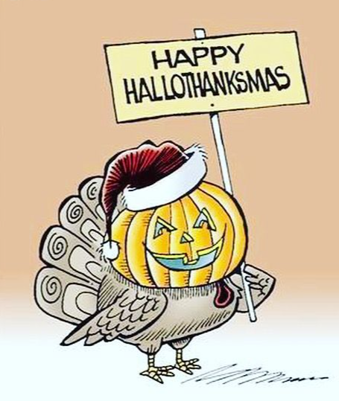
Weekends/Holidays
Thanksgiving 2021 pot-luck…? Third shift?
BT and I will be working on weekend and Holiday rotations and decide on how we want to handle this moving forward (2022-).
Announcement will be made so that staff can plan
Goal is to be fair and make working holidays “worth it”
Send ideas to CSW/BT via email

Slide 15
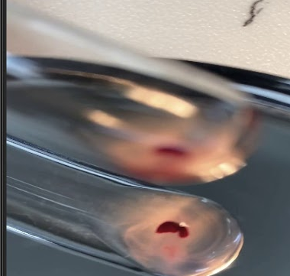
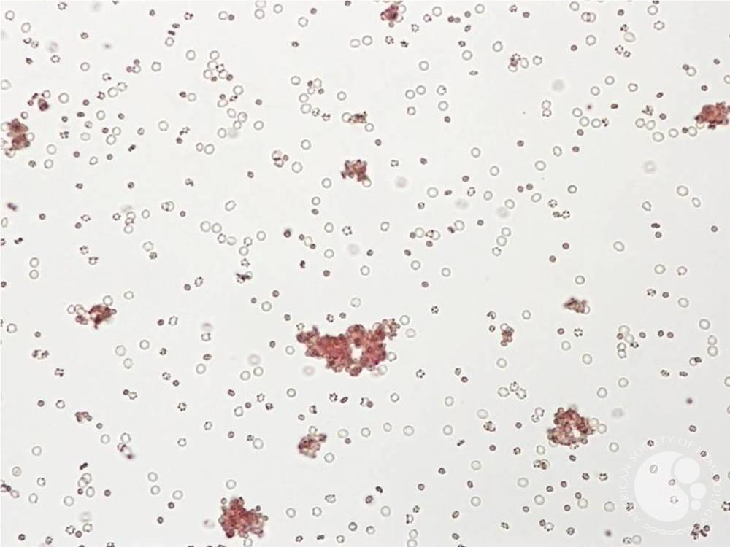
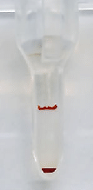
Education: Identification of Mixed Field
One Cell Population
Second Cell Population
Will agglutinate
Clear background
Will NOT agglutinate
Turbid background

Slide 16
—Why is this important?
—What is the real Blood type?
  Has the patient been transfused? (especailly trauma patients)
  Baby (weak ABO ags. Especially A)
  Sample Contamination
  True Chimera: Twins
  BMT patient
  High White Count
  Cord Blood

Slide 17
—Why is this important?
Case Study
Trauma patient types O pos and receives O pos RBCs.
Patient subsequently made anti-D (ID’d in Eluate)
Investigation reveals original typing in SCC is 4+ D
Subsequent typings on 4 specimens type as 3-4+ D
Vision results pulled up from first specimen show results were flagged as MF on original Rh
BB transfused multiple Rh pos RBCs over several XMs
The more Rh pos blood in circulation, the longer and worse the expected hemolysis
But…
The patient has to live to have reaction!

Slide 18
Follow up
No Harm did reach patient
But we can do better. After resolution of MTP patients can be switched back to Rh neg. They may still make Anti-D.
We have to accuratley doccument MF reactions in SCC (M4)

Slide 19
Blind results
75% of staff correctly identified MF reactions
25% of staff either failed to ID MF or failed to result MF correctly in SCC
Subsequent training with required test will be assigned to all staff in medtraining
ID of mixed field will be added to annual competency requirements

