Slide 1
Safety Presentation
November 2021
11.11.2021 | Department of Lab & Pathology

Slide 2

Patient and Family Promise

Slide 3
Days Since Last Serious Safety Event
WFB: 16
BCH: 33
DMC: 267
HPMC: 132
LMC: 51
WMC: 134

Slide 4
Good Catches

Slide 5
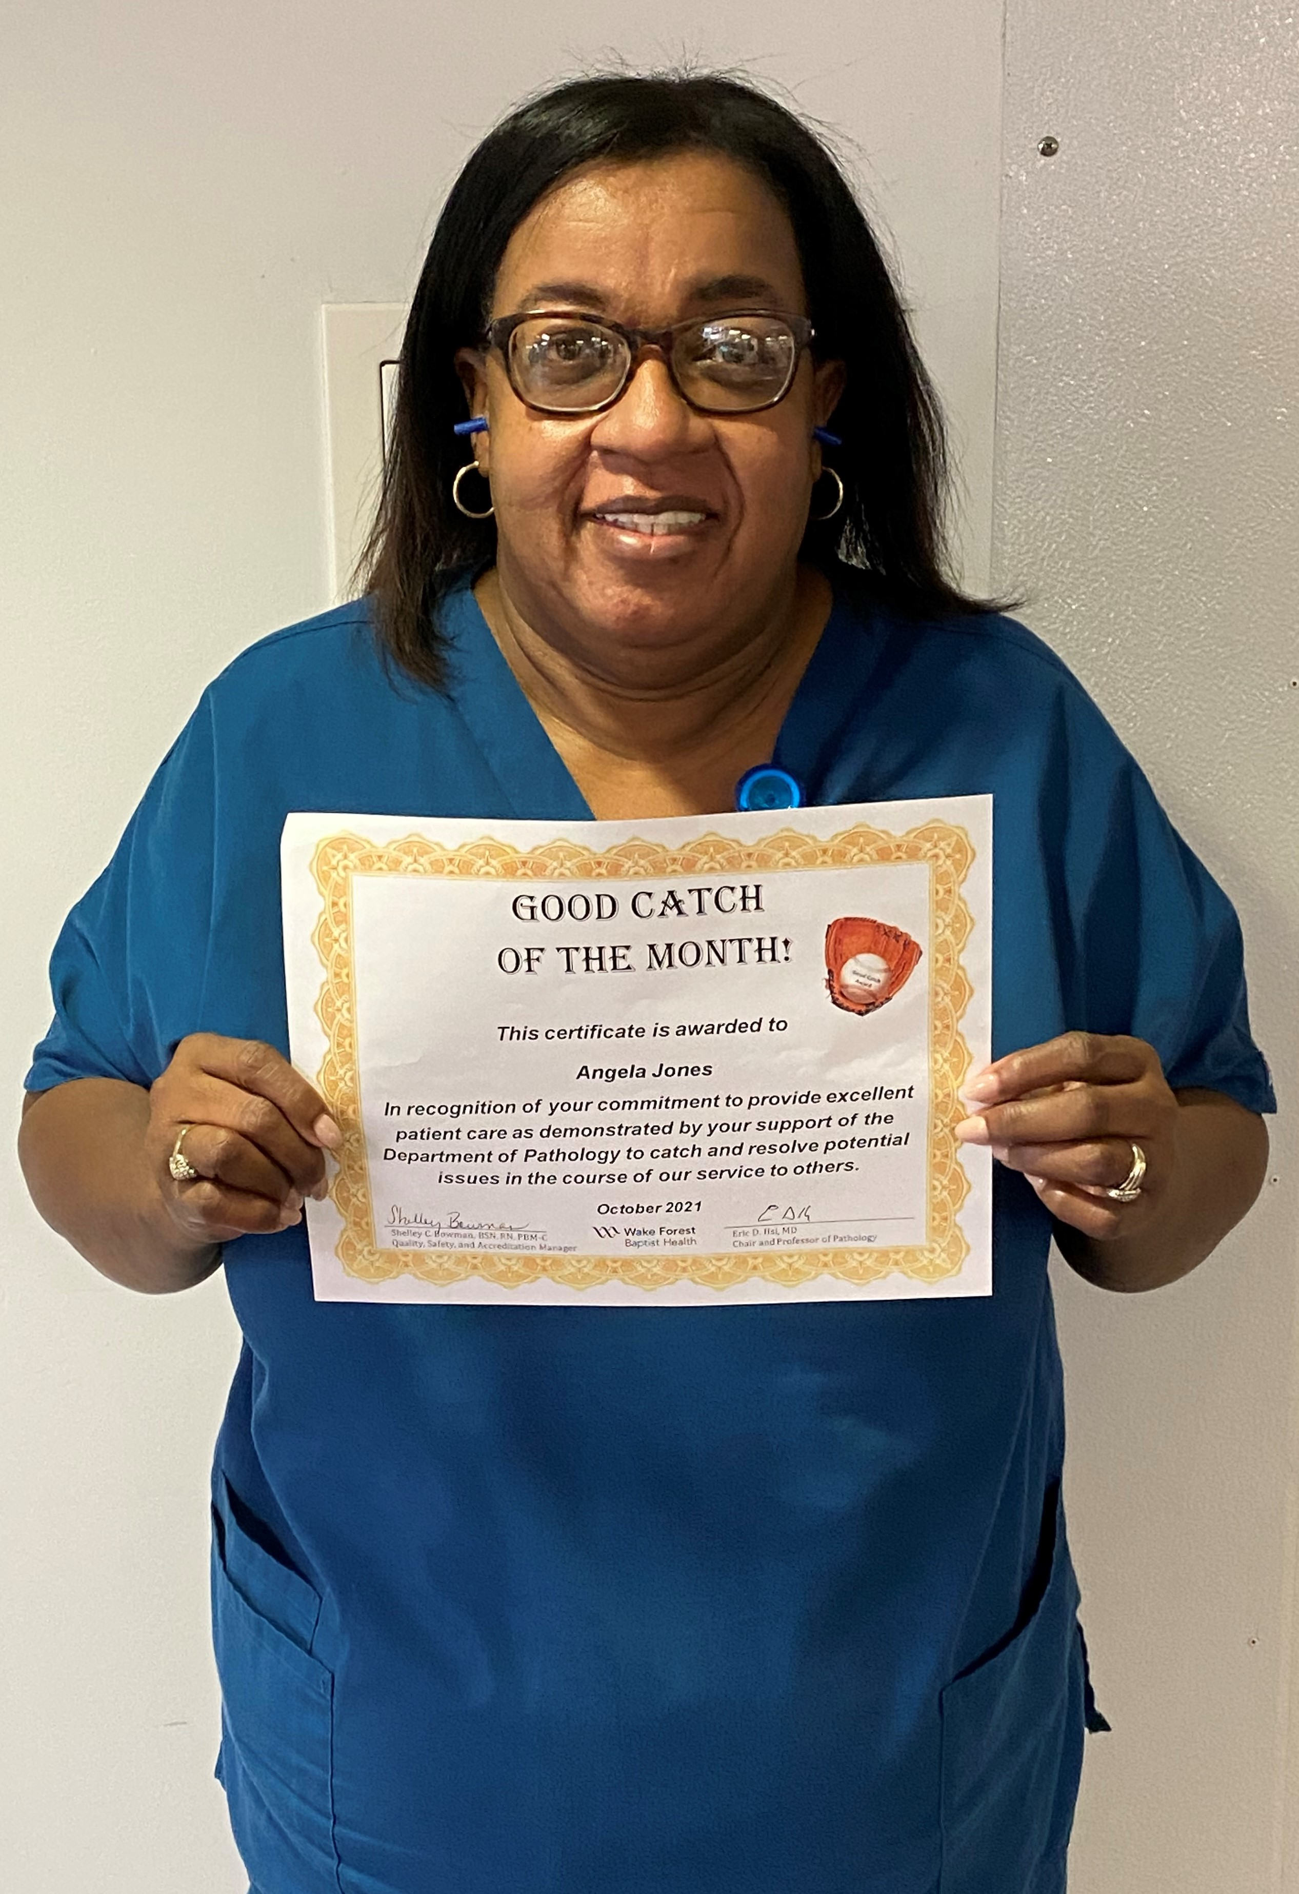
Good Catch Recipient
For October
Angela Jones
Chemistry

Slide 6
Safety Focus of the Month
Lab Section Compliance

Slide 7
Safety Focus of the Month
SBAR
Communicate Clearly
Situation | What is going on now? Concise statement of the problem
Background | How did we get here? Pertinent and brief information related to situation
Assessment | What do you think is going on? Information to support your assessment
Request/ Recommendation | What do you want done? Your suggested method to resolve the problem
Poor communication is seen as a root cause of many adverse events.
SBAR provides the benefit of conveying a complete message in a brief manner.
“SBAR is a powerful tool that is used to improve the effectiveness of communication between individuals” TJC

Slide 8
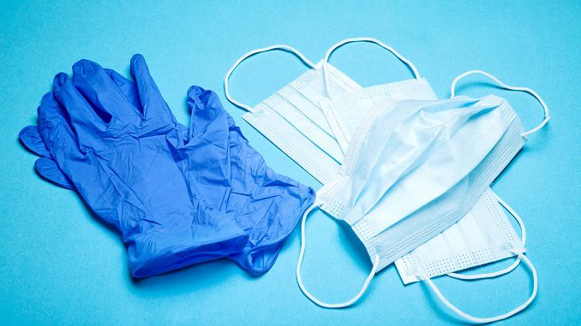
Lab Employee Hazard Awareness
November’s Topic – Personal Protective Equipment

Slide 9
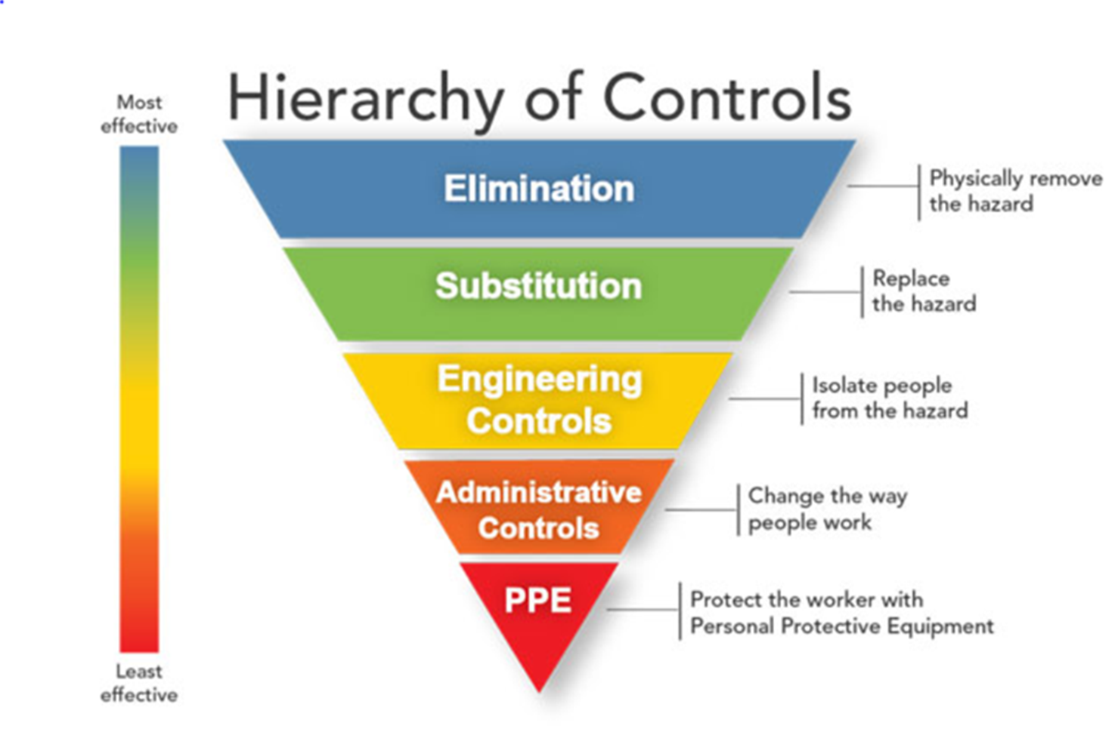
Why do we have PPE?
PPE is chosen as the protective method when all other methods are unsatisfactory

Slide 10
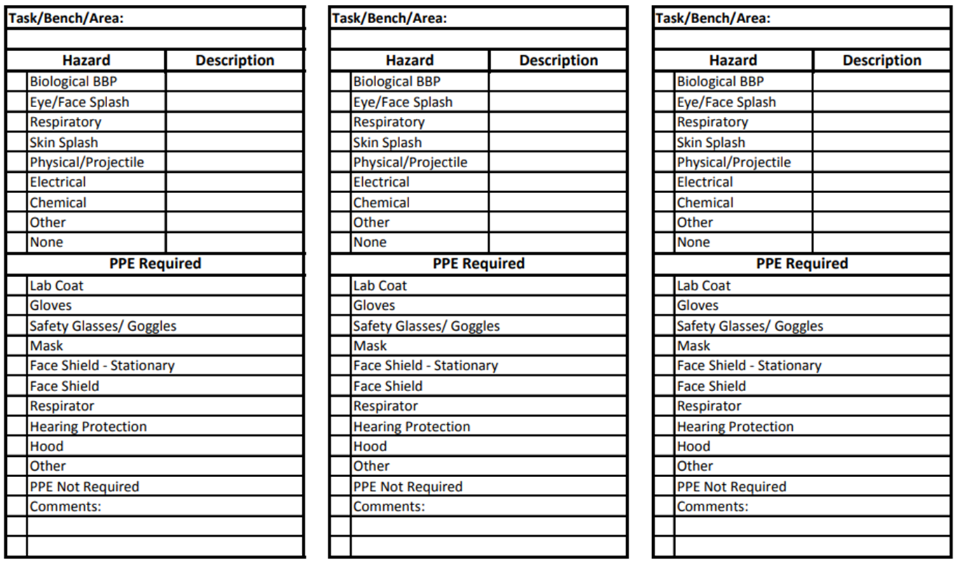
What PPE?
So now that we have decided that PPE is going to be our protective method we need to choose what PPE should be worn for the task
PPE Hazard Risk Assessment

Slide 11
PPE Hazard Risk Assessment
Review annually
Update when a new process is put into place

Slide 12
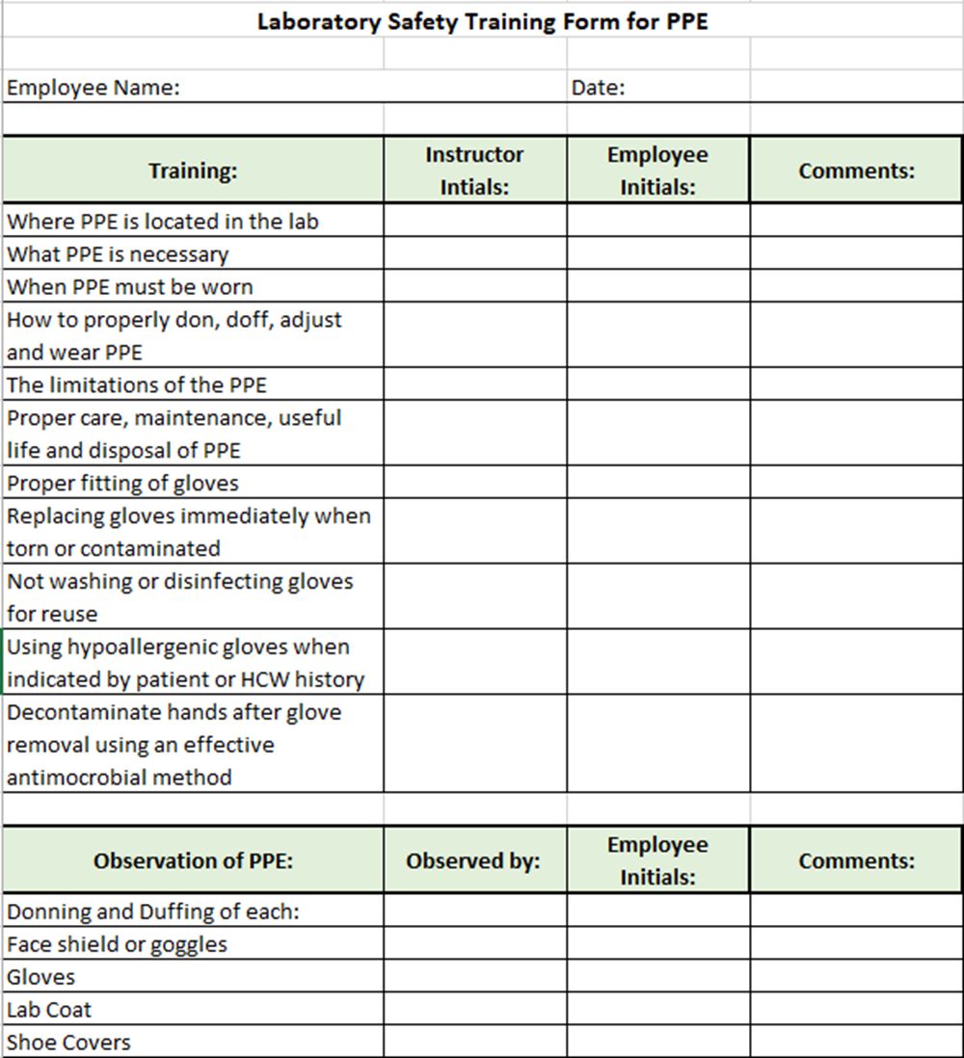
Training
All employees should be trained on the PPE required for each task/bench and how to use it

Slide 13
Now that you know why, what and how…..
Make sure to use your PPE

Slide 14
Combining Safety Forces
Current State:
Lab Safety Coach’s Meeting
  30 minute every month
  Focus on preventing patient harm
Lab Safety Team
  30 minutes every month
  Focus on preventing employee harm

Slide 15
Combining Safety Forces
Future State beginning January 2022:
Combined Safety Meeting
  1st Thursday of every month in CR 2108
  1-2pm
  You may have one person as the “Safety” person for your lab section or as many as you would like
  Recommend bench techs as the participant
  Let Shelley or Hannah know by Dec 1st who your safety representative will be.

Slide 16
Reminders
Title 21
      Email employee changes (new hires, resignations, transfers) to Danielle Bancroft
Safety Inspections
    February 2021 – COMPLETED
    May 2021 – COMPLETED
    August 2021 -COMPLETED
    November 2021
Trimedx
    Email Trimedx unresolved concerns or questions to Shelley.
MQR
      Monthly Quality Review due 3rd Friday of each month.
  Safety Focus of the Month
      Submit compliance by 15th of the next month

Slide 17

Next Lab Manager’s Meeting: December 9th, 2021

