Slide 1
Lab Safety Presentation
December 2021
12.9.2021 | Department of Lab & Pathology

Slide 2

Patient and Family Promise

Slide 3
Days Since Last Serious Safety Event
WFB: 19
BCH: 29
DMC: 294
HPMC: 26
LMC: 78
WMC: 161

Slide 4
Good Catches

Slide 5
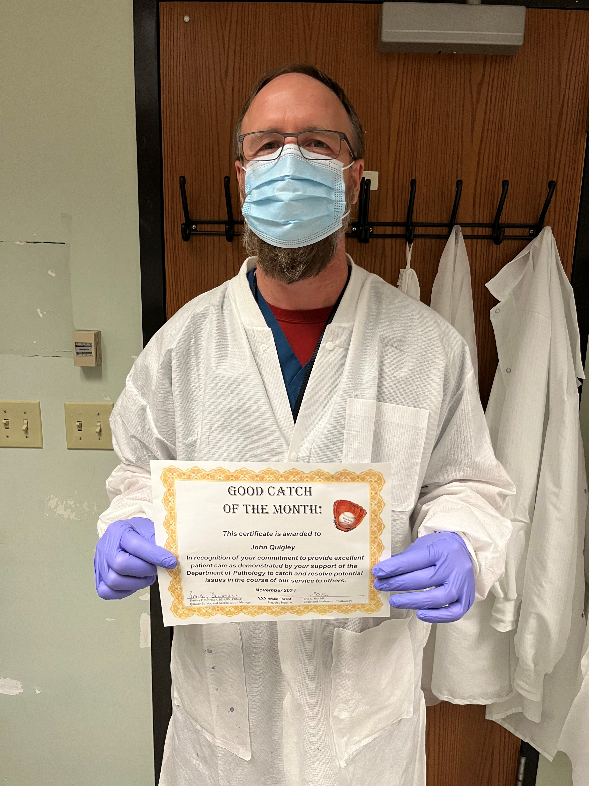
Good Catch Recipient
For November
John Quigley

Slide 6
Safety Focus of the Month
Lab Section Compliance

Slide 7
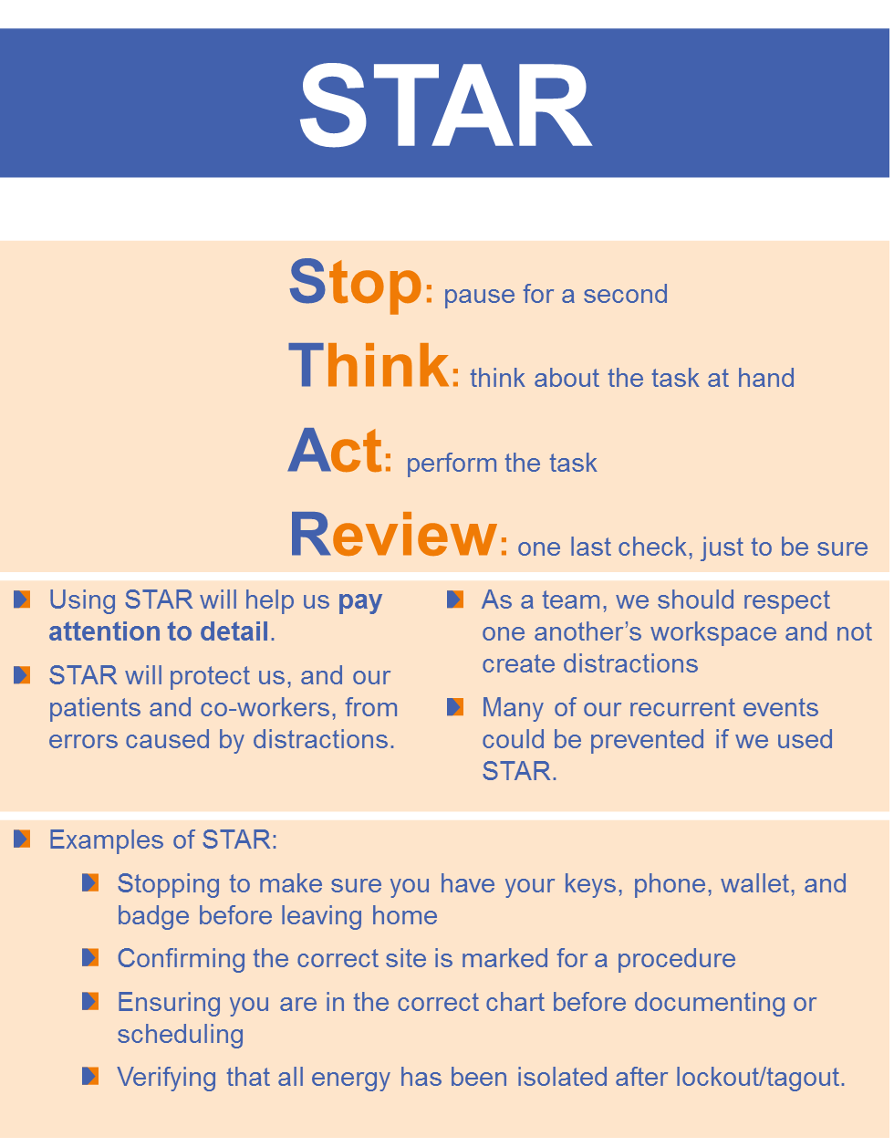
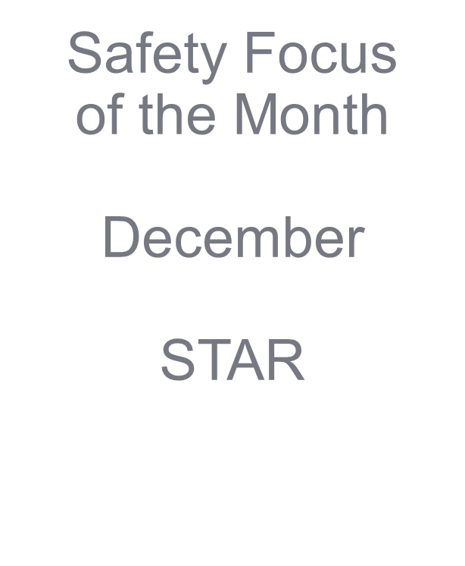

Slide 8
Lab Employee Hazard Awareness
December’s Topic
– Employee Occurrence Reporting

Slide 9
Get Medical Assistance
Employee Occurrence would be an exposure or injury that occurred in the lab
After an occurrence the first step is to Get Medical Assistance
Call or visit Employee Health (336–716–4801)
Or visit the Emergency Department

Slide 10
Report the Occurrence
The next step you should take is to report the occurrence using the Employee Occurrence Reporting tool
This is found on the intranet

Slide 11
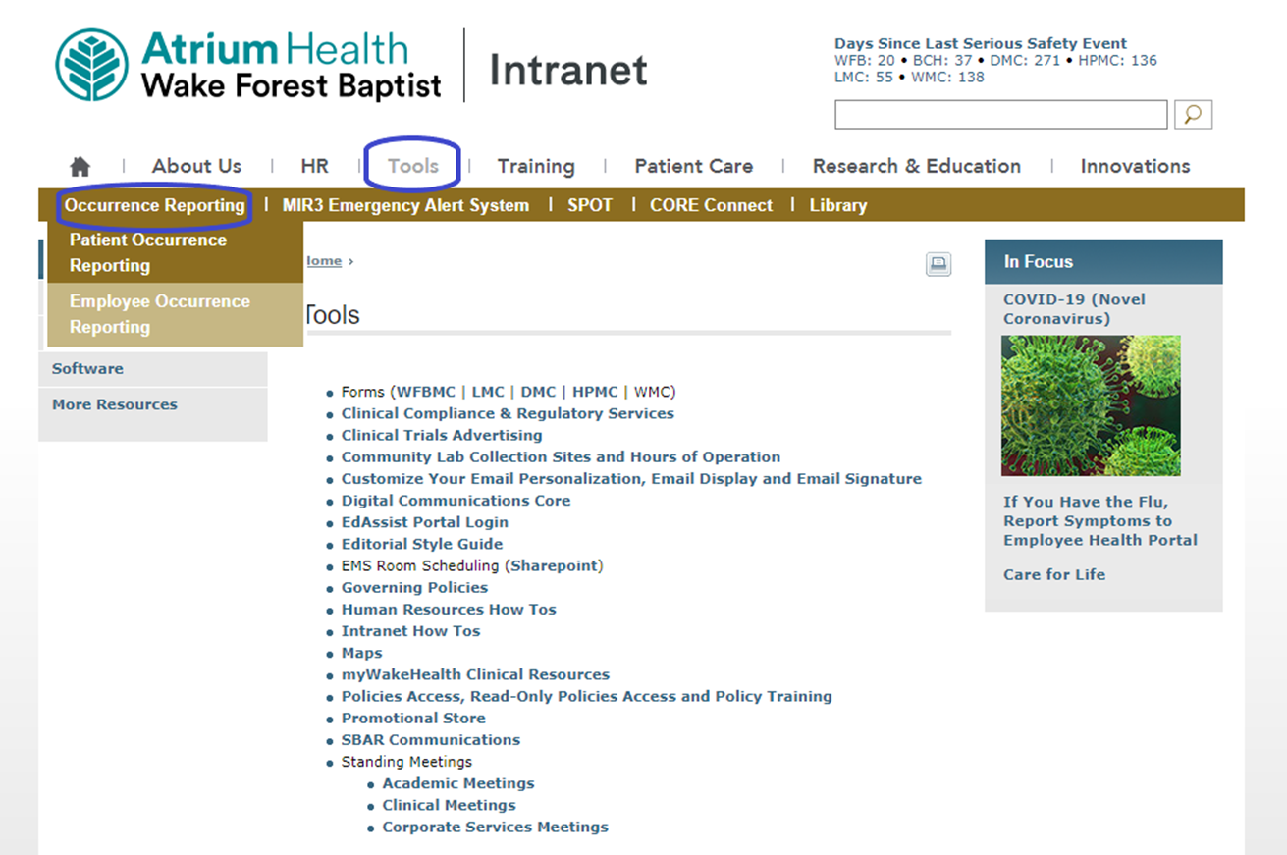
Occurrence Reporting

Slide 12
Why do we report?
Tracking occurrences allows us to:
  Recognize common injury types
  Improve processes
  Help eliminate future injury

Slide 13
Product Recalls
Please do not reset the ECRI
password
  This is a group account with one
  password for the entire group

Slide 14
Product Recalls
Our contract with ECRI ends on December 31st
Starting January 1st we will be using a new system – MD Buyline
  More information to come
We are using ECRI for the remainder of December

Slide 15
Combining Safety Forces
Current State:
Lab Safety Coach’s Meeting
  30 minute every month
  Focus on preventing patient harm
Lab Safety Team
  30 minutes every month
  Focus on preventing employee harm

Slide 16
Combining Safety Forces
Future State beginning January 2022:
Combined Safety Meeting
  1st Thursday of every month in CR 2108
  1-2pm
  You may have one person as the “Safety” person for your lab section or as many as you would like
  Recommend bench techs as the participant
  Let Shelley or Hannah know by Dec 1st who your safety representative will be.

Slide 17
Current Safety Team List

Slide 18
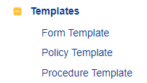
Policy Templates in Title 21
eBinder

Slide 19
CAP Standard COM.10050
The procedure manual includes the following elements, when applicable:
  Principle and clinical significance
  Requirements for patient preparation; specimen collection, labeling, handling, storage, preservation, transportation, processing, and referral; and criteria for specimen acceptability and rejection
  Microscopic examination, including the detection of inadequately prepared slides
  Step-by-step performance of the procedure, including test calculations and interpretation of results
  Preparation of slides, solutions, calibrators, controls, reagents, stains, and other materials used in testing
  Calibration and calibration verification procedures
  The analytic measurement range for test results for the test system, if applicable
  Control procedures
  Corrective action to take when calibration or control results fail to meet the laboratory's criteria for acceptability
  Limitations in the test methodology, including interfering substances
  Reference intervals (normal values) Imminently life-threatening (critical) test results
  Pertinent literature references
  The laboratory's system for entering results in the patient record and reporting patient results including, when appropriate, the procedure for reporting imminently life-threatening (critical) results
  Description of the course of action to take if a test system becomes inoperable
9.22.2021

Slide 20
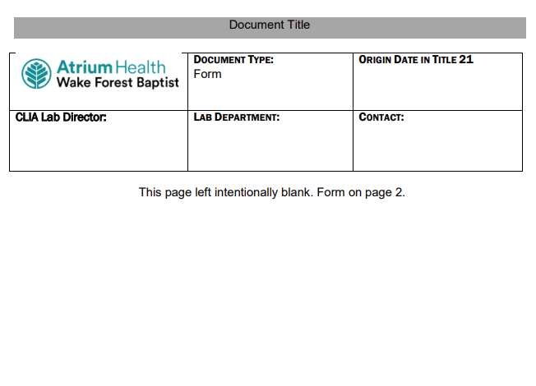
Form Template

Slide 21
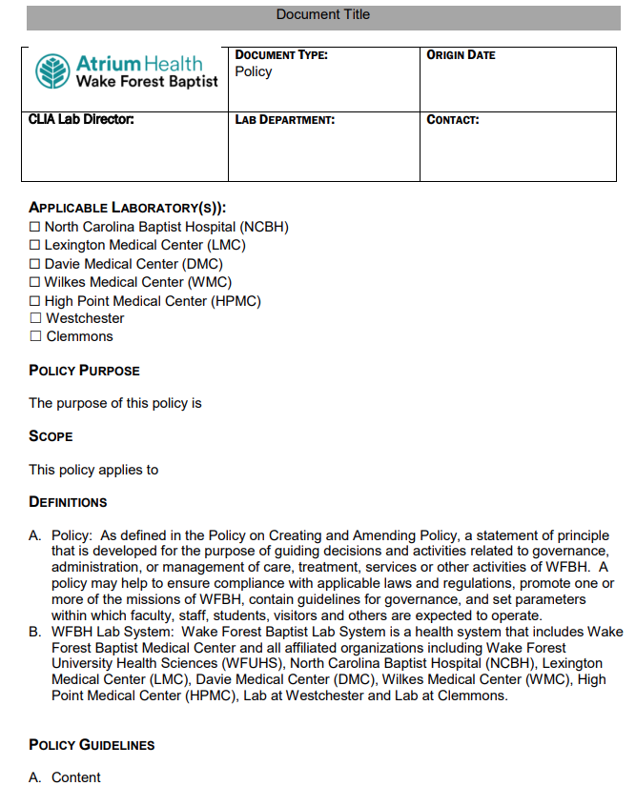
Policy Template

Slide 22
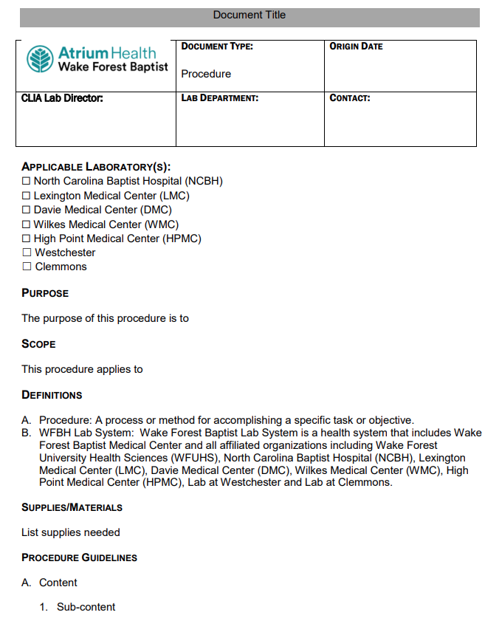
Non-Testing Procedure Template

Slide 23
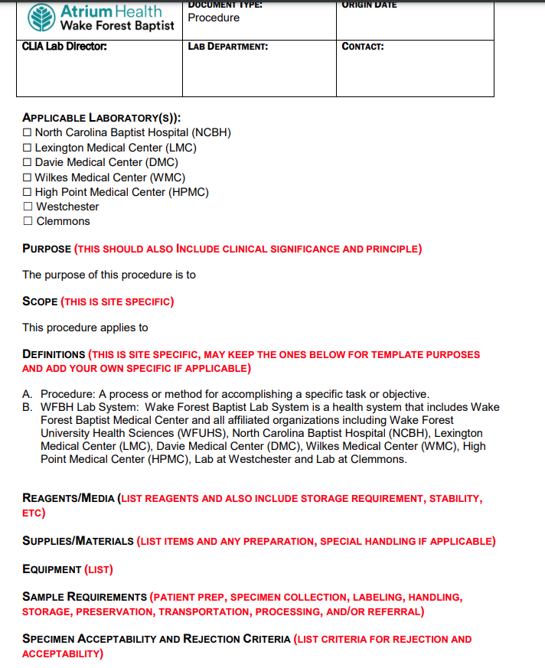
Testing Procedure Template
Page 1 of 2

Slide 24
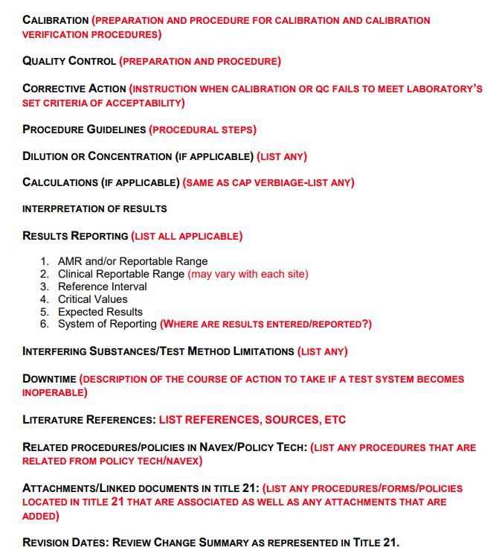
Testing Procedure Template
Page 2 of 2

Slide 25
Reminders
Title 21
      Email employee changes (new hires, resignations, transfers) to Danielle Bancroft
Safety Inspections
    February 2021 – COMPLETED
    May 2021 – COMPLETED
    August 2021 –COMPLETED
    November 2021 - COMPLETED
    February 2022
Trimedx
    Email Trimedx unresolved concerns or questions to Shelley.
MQR
      Monthly Quality Review due 3rd Friday of each month.
  Safety Focus of the Month
      Submit compliance by 15th of the next month

Slide 26

Next Lab Manager’s Meeting:
January , 2022

