Slide 1
CP Staff Meetings
December 2021

Slide 2
Performance Standards Policy

Slide 3
Attendance Policy

Slide 4
Attendance Policy

Slide 5
Attendance Policy

Slide 6
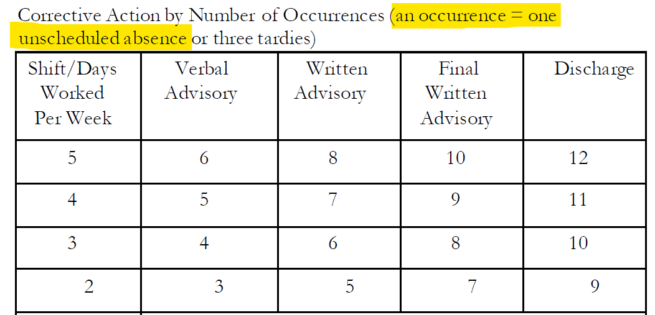
Attendance Policy

Slide 7
Safety
Use PPE when working in the lab.
Wear a lab coat at all times in the lab to protect yourself. A scrub jacket does not replace a lab coat.
Call Linen ascom if you need replacement scrubs: 2-4068
If you can’t remember or find the Linen number, call SRC: 6-1111
No face time/video calls in the lab. This is a HIPAA risk of disclosing patient health information. Take personal calls on breaks.

Slide 8
PREGSORLAB samples
Come to CP in error
Scan and send to Station 12
Lets OR Lab know it’s on the way

Slide 9
Body Fluids
Body Fluid Amylase – Sendout starting 12/22 at 0800.
Amylase, Pancreatic Fluid Only LAB6189 – will be run in chemistry. All other fluids will be sendouts.
Please correct orders when needed. An SBAR is going out to physicians and should help with orders being placed correctly. Table with order codes is in CP Job Aides binders at accessioning bench.
All other Body Fluid chemistry tests – Sendout tests – EACH test requires 1mL fluid:
Albumin, Body Fluid
Protein, Body Fluid
Lactate Dehydrogenase (LDH), Body Fluid
Glucose, Body Fluid
Creatinine, Body Fluid
Lipase, Body Fluid
Bilirubin, Body Fluid
Triglycerides, Body Fluid
Give to Sendouts – they will write SO on label if it needs to be spun – Not all are spun!
Collection time is important for sendout tests. Please enter correct collection time if you have it.

Slide 10
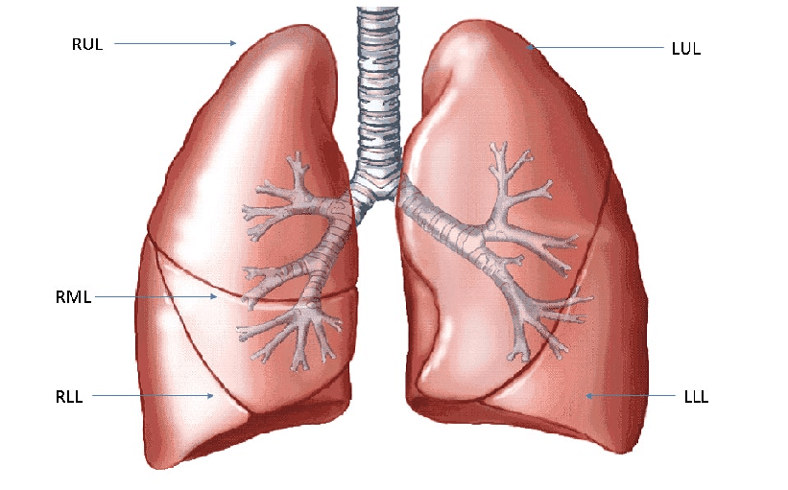
BAL Samples – when multiple sets on one patient
Lung Anatomy – Sample Types listed on BAL samples:
BAL Sample Abbreviation | Site
RUL | Right Upper Lobe
RML | Right Middle Lobe
RLL | Right Lower Lobe
LUL | Left Upper Lobe
LLL | Left Lower Lobe
Lingula | Lingula site in left lung
Multiple samples on one patient may be collected from different lung sites.
Pay attention to the label on the BAL sample as well as the specimen comments in the orders.
Lingula

Slide 11
Comment in Beaker for Source example

Slide 12
KidneyIntelx
2 lavender tops with a yellow ring
21X-334KI accession number
Goes to sendouts
Should arrive before 3:30pm Mon-Thurs

Slide 13
DSA
Miscellaneous Test/RTEST order for DSA = same as PRA
Red top
Don’t spin

Slide 14
Urines and Aliquots
When accessioning urines – check the entire cup for test labels. Reprint all test labels for Spin person to pour off required tests.
All aliquots must be initialed by the person aliquoting. This is to show that you verified identifiers on the original sample with the aliquot.
Urine aliquots will be monitored over the upcoming months for compliance.
“Spin 2” person should be designated on first and second shifts to help pour off urines.
Please prioritize STAT (ED) samples.
Accession person or Spin 2 person should help locate missing urine samples

Slide 15
Spin rotation
Spin 1: centrifuges
Please double check all lavender top tubes before centrifuging
Spin 2: urines and routine hematology samples
Ok to put STAT hematology samples in blue racks in accessioning.
Tube room person to take all hematology samples directly to hematology

Slide 16
OP Phlebotomy Samples without Orders
If samples with handwritten labels from OP Phlebotomy come without orders – orders may have been faxed to us
Check the Future Orders folder in the requisitions hanging file bin
OP Phlebotomy has green labels to place on packing list that say “Check Future Orders Folder”

Slide 17
Provider Not in CareEvolve
New Job Aide describes what to do when you have to use “Outreach, Not on Staff” in CareEvolve as the provider (when the provider is not listed in CareEvolve)
Causes billing problems when there is not an actual provider associated with the order
CP processing CareEvolve orders after hours or weekends – follow the Job Aide
If provider is in WakeOne Provider Finder but not in CareEvolve – email Path Tech
If provider is not in WakeOne or CareEvolve – email Path Tech (or Client Services if you don’t have the necessary information)

Slide 18
Add-Ons
Keep an eye on the In Basket through the day
If you need help with how to complete types of Add-Ons, please contact me. We will go through them together.
The procedure has been updated to account for most Add-On scenarios. If you encounter a problem or something not covered by the procedure, let me know.

Slide 19
Shift Communication
Use Tube Communication and Spin Communication sheets to document handoff between shifts
Blank copies are on the bulletin board in Tube Room and on bulletin board by Spin fridge
Completed forms go in Torie’s box in Tube Room please

Slide 20
Filing Requisitions
Manual Reqs folder – file completed manual reqs (X accounts, autopsies, POPL, exposures)
All folders except Helms Reqs folder to be emptied around midnight every night. Place all daily papers from hanging folders in “unsorted” red bin.
Scanned requisitions are kept in a black bin on the top shelf of accessioning after hours/weekends. These are for reference only in case clients call with questions. Please do not file any new requisitions here.

Slide 21
Teamwork
When you get to work, relieve someone from their rotation. Or help with that rotation.
Help each other. Especially if someone asks for help.
Take time to answer each other’s questions.
If you have a question, don’t be afraid to ask!
Be kind to one another.
We are here to provide care to patients. And provide customer service to our clients (nurses, doctors, phlebotomists, etc.).
If you are stepping out of the lab for a few minutes, let your coworkers know.

Slide 22
New employees
Leatha Houston – full time - started 11/1/21
X’zoria Harris – PRN student – started 11/8/21
Nieka Thomas – Assistant Manager – started 11/15/21
Ami Boggs – part time, student – starts 12/20/21

Slide 23
Coworker reminders
Please hand off short blue tops and other problems directly to an accession person. Sitting the bag down by the bins causes a delay in processing and redraw.
Be careful when scanning outreach or POPL samples. We have been missing some of these and they don’t get found until days later when the sample is expired.
STAT and Routine bins in accession take first priority. Then the Outreach bins.
Courier bins: follow first in, first out. Bin order: front to back; left to right; top to bottom
Third shift: place all requisitions from the day in the red bin at/around midnight including manual requisitions.
Process all body fluids from start to finish: fluid worksheet for EVERY body fluid. Aliquot and deliver your own body fluids.

Slide 24
Coworker reminders
Only store fluids in the fluids rack if a freeze and hold is ordered (and sample has already been to sendouts). Store the freeze and hold sample in Container Storage in Beaker.
Watch for upside down labels and fix them before they get to the bench.
If you deal with a problem sample, send a specimen issues email (for outpatient samples) or call the floor (inpatients) and send for redraw as needed.
When a UA vacutainer is received you don’t have to reprint a UA label. If it is shared with other samples, please reprint the UA.
All tubes ordered as Extra Tubes go to the testing area. Do not put them in the spin rack.
Make .2 tubes extra tubes – order as extra tube
Don’t make packing lists on any Miscellaneous Test (MT accession)
Take care of problem samples in CP. Don’t send to other labs if you know it’s the wrong sample type.

