Slide 1
Stokes/Forsyth County EMS
Storage and Handling of Blood Products
Prepared by: Bettina Turner BSMT(ASCP)SBB^{cm}
1.7.2022 | Blood Bank

Slide 2
Storage and Handling of Blood Products from Atrium Health Wake Forest Baptist Blood Bank
After completing this lesson, the learner will be able to:
Identify the Engel DC Refrigerator
State the acceptable temperature range of blood/blood products
Interpret Safe-T-Vue color changes
Fill out an Emergency Release of Blood Products Form
Return or Restock blood products to Blood Bank

Slide 3
Summary of Process
Atrium Health Wake Forest Baptist Blood Bank will
Provide Stokes and Forsyth County EMS units with blood products
Whole Blood (WB)
In times of WB shortages, the following may be substituted
Packed Red Blood Cells (RBC)
Plasma
Prepare products by
Applying a Safe-T-Vue sticker to the back of the unit(s)
Placing each unit between two small, chilled gel packs
Indicating “Return By” date on card placed in bag of unit
Calling specific EMS unit on intended day of return of blood product if not already returned.
Provide “Emergency Blood Products Issued” forms for documentation of transfusion. (1 form per unit)

Slide 4
Engel DC Refrigerator
Each EMS unit participating will
Use their own, validated Engel DC Refrigerator (Model MD14F) located in the EMS vehicle.
Document refrigerator temperatures twice daily to assure unit remains within proper temperature range (1-6°C)
Acknowledge any alarms of the TempTrace system temperature tracking system
Notify the Atrium Health Wake Forest Baptist Blood Bank of any refrigeration unit failure – whether too hot or too cold.

Slide 5
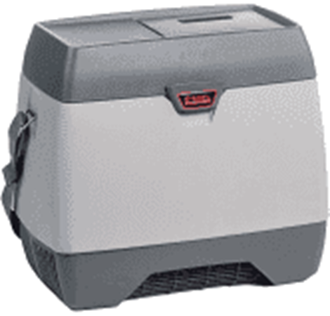
Engel DC Refrigerator Model MD14F
Validated by Blood Bank Management to maintain temperatures between 1-6°C
Temperature data tracked via WiFi and TempTrace temperature monitoring system.
When WiFi connection is lost, temperature data will be stored until connection is restored. Once restored, stored data will download to the TempTrace electronic record.

Slide 6
Preparing the Units for EMS in the BB
When blood is needed by the EMS unit
Notify the Blood Bank at (336)416-8235 that the unit is coming to get blood.(State which EMS unit you are when calling)
Blood Bank will prepare blood for EMS
Each blood / product unit will have a temperature indicator (Safe-T-Vue) placed on it prior to its release from the Blood Bank
The unit will then be packed between two small gel packs and placed in a zip-tight plastic bag.
Validation studies indicate that products will maintain proper temperature for up to 1 hour under these conditions.
A “Return By” card will be placed in the bag indicating by what date the unit should be returned to the BB.
An “Emergency Release of Blood Products” form will also be sent with each unit.

Slide 7
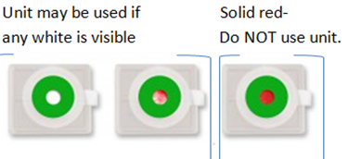
Safe-T-Vue
The Safe-T-Vue sticker is a device that aids in the monitoring of proper blood unit temperature.
If the central window is white or white with
red, the unit temperature has been properly
maintained and can be used for transfusion.
Should the temperature of the unit reach >6°C, the central window will turn completely red indicating unit must not be used.
Of note: Safe-T-Vues will NOT change color if the refrigerator / units get TOO COLD. Therefore, proper maintenance and monitoring of the refrigeration unit temp is crucial.

Slide 8
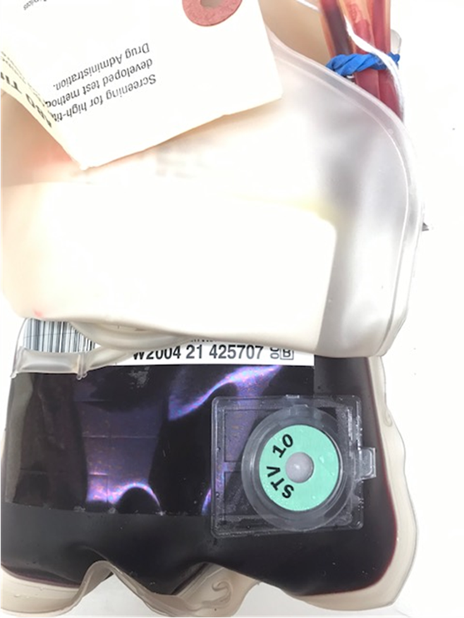
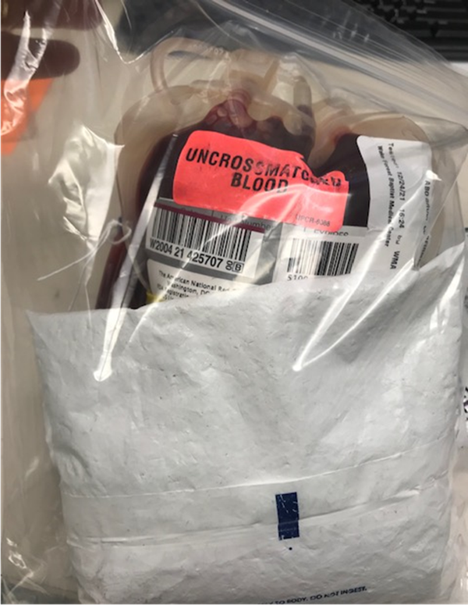
What it will look like
Safe-T-Vue on the unit
Unit of blood in bag with gel packs
2/4/22
1300

Slide 9
Picking up the Blood
EMS personnel will arrive at Blood Bank with a carrying cooler to transport the blood unit(s) from the Blood Bank back to the EMS refrigerator
EMS personnel picking up blood will be asked to sign an “Issue Slip” prepared by BB staff to document who picked up the product.
Once back at the vehicle, unit(s) should be placed in refrigerator immediately.
Store units there until blood is transfused or “Return by” date – whichever comes first.

Slide 10
Documenting a Transfusion
When unit is transfused enroute
Fill out the “Emergency Release of Blood Products” form sent with the blood.
Patient Name: any information available:
Name
MRN and/or CSN – if available
Location: Forsyth or Stokes EMS
Technologist/Date/Time: leave blank
Signatures with Date/Time:
Authorizing ER physician signature and printed name
Date/Time of transfusion
Return the completed form to the BB as soon as possible after the transfusion.

Slide 11
Important Notes
Do NOT store the blood in any refrigerator or freezer other than the validated Engel Refrigerator.
Only blood products supplied by Atrium Health Wake Forest Baptist Blood Bank may be stored in the refrigerator.
The blood MUST remain in the possession of Forsyth/Stokes County EMS personnel at all times
All Stokes/Forsyth County EMS personnel must be properly trained before using the Engel Refrigerator or the blood products stored therein.

Slide 12
Refrigerator Failure
In the event of a refrigerator failure, call the Blood Bank immediately.
Return the unit(s) to the blood bank as soon as possible

