Slide 1
Lab Safety Presentation
January 2022
1.2022 | Department of Lab & Pathology

Slide 2

Patient and Family Promise

Slide 3
Days Since Last Serious Safety Event
WFB: 28
BCH: 64
DMC: 329
HPMC: 61
LMC: 113
WMC: 196
As of 1/12/2022

Slide 4
Good Catches in December
None Reported in December

Slide 5

Good Catch
Did you or someone on your team ‘catch’ an error or mistake before it reached the medical record? If so, that’s a good catch!
Did you or someone on your team identify a safety hazard within your section or anywhere in the medical center before it caused harm to an employee or visitor? If so, that’s a good catch!
Please report good catches!
A drawing will occur each month from all the good catch nominations. The winner will be recognized at the Safety Governance Committee and will receive a Good Catch Certificate, a gift card and their picture will be posted on the Pathology SharePoint site.
How to report:
Submit the good catch in RL using the good catch icon
Email the good catch to Shelley Bowman: shportis@wakehealth.edu
Notify your immediate supervisory

Slide 6
Safety Focus of the Month
Lab Section Compliance

Slide 7
Safety Focus of the Month
January
Repeat-Back Technique
Communicate Clearly
Repeat-Back Technique Sender communicates a request or information to a receiver Receiver repeats back the request or information to the sender Sender acknowledges the accuracy of the repeat-back. If not correct, repeats/clarifies the communication All verbal orders and critical values should be written and read back (see below)
Use when communicating routine but important information Ensures the receiver hears what they are supposed to hear Key: Close the loop with “That is correct!” | Read-Back Technique Sender communicates Receiver writes the order/request/result and reads it back as written to the sender Sender acknowledges accuracy with “That is correct” or makes the correction. MUST BE USED WITH ALL VERBAL ORDERS AND CRITICAL VALUES.

Slide 8
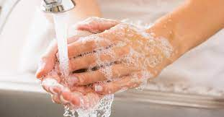
Lab Employee Hazard Awareness
January’s Topic
– Handwashing

Slide 9
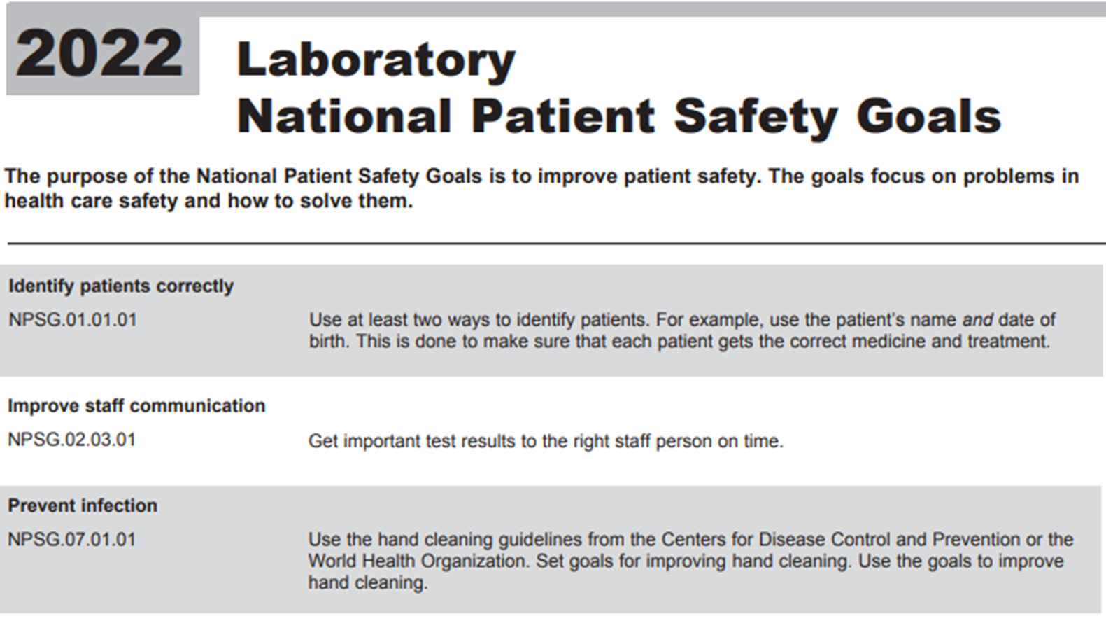

Joint Commission

Slide 10




How to wash your hands
CDC and OSHA handwashing guidelines
Wet Lather Scrub (20 Seconds) Rinse Dry

Slide 11
When to wash your hands
After removing gloves
Before leaving the lab
After patient contact

Slide 12
MD Buyline
Procedure will be updated
ECRI data downloaded

Slide 13
CAP Self-Inspection
April 11th – CAP to mail self-inspection packet
April 18th - Meeting with inspectors to distribute packets; provide instructions
April 25th – inspection week
May 4th – Summation
June 4th – Submit corrective action plans
June 10th – Self-inspection Verification Forms will be submitted to CAP

Slide 14
CAP Self- Inspection
Residents will be inspectors and will be paired up with a lab volunteer.
Need - lab volunteers to serve as an inspector of lab sections other than their own.
  Must be a lab manager, an assistant lab manager or a speciality tech.
  Must complete the Inspection module in CAP to participate.
An email will be forthcoming.

Slide 15
Reminders
Title 21
      Email employee changes (new hires, resignations, transfers) to Danielle Bancroft
Safety Inspections
    February 2022
    May 2022
    August 2022
    November 2022
Trimedx
    Email Trimedx unresolved concerns or questions to Shelley.
MQR
      Monthly Quality Review due 3rd Friday of each month.
  Safety Focus of the Month
      Submit compliance by 15th of the next month
  6. CAP Self-Inspection
      Week of April 25th

Slide 16
Next Lab Manager’s Meeting:
February 10th, 2022

