Slide 1
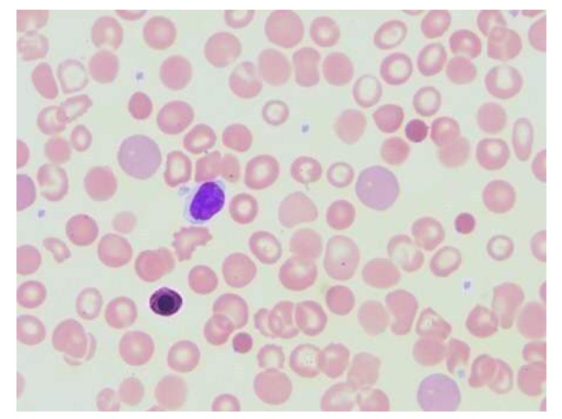
Polychromasia
Current reporting of Red cell morphology for Polychromasia include descriptive terms of Present and Marked. For consistency, the laboratory has a defined, semi-quantitative scheme that dictates how many cells qualify as present or marked.
PCH1 = Polychromasia present
PCH2 = Marked polychromasia
This oil immersion field is representative of the peripheral blood smear. Arrowed object are polychromatic RBC which is consistent with a report of PCH1 (Polychromasia present).

Slide 2
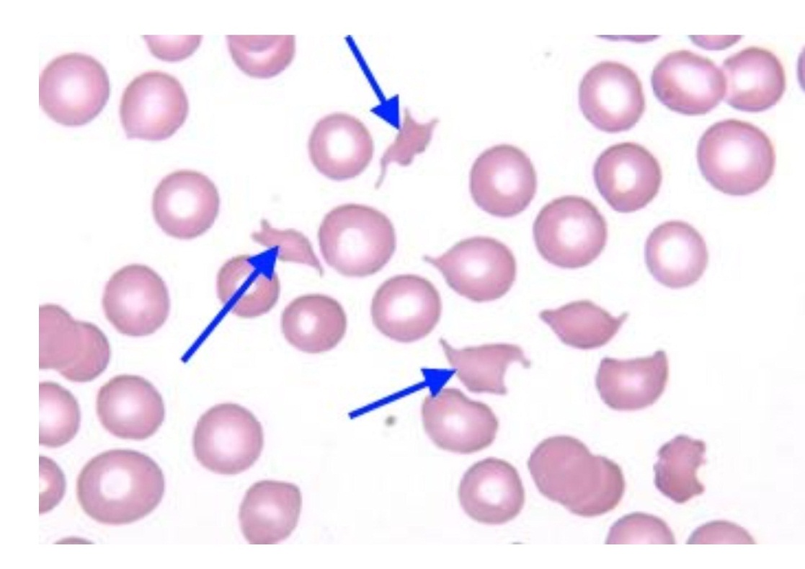
Schistocyte
Current reporting of Red cell morphology for Polychromasia and Schistocytes include descriptive terms of Present and Marked. For consistency, the laboratory has a defined, semi-quantitative scheme that dictates how many cells qualify as present or marked.
SCH1 = schistocytes present (2-10/hpf)
SCH2 = marked schistocytes (>10/hpf)
This oil immersion field is representative of the peripheral blood smear. Arrowed cells are Schistocyte. There are 6 Schistocytes noted in this slide which meets the reporting scheme of SCH1.

Slide 3
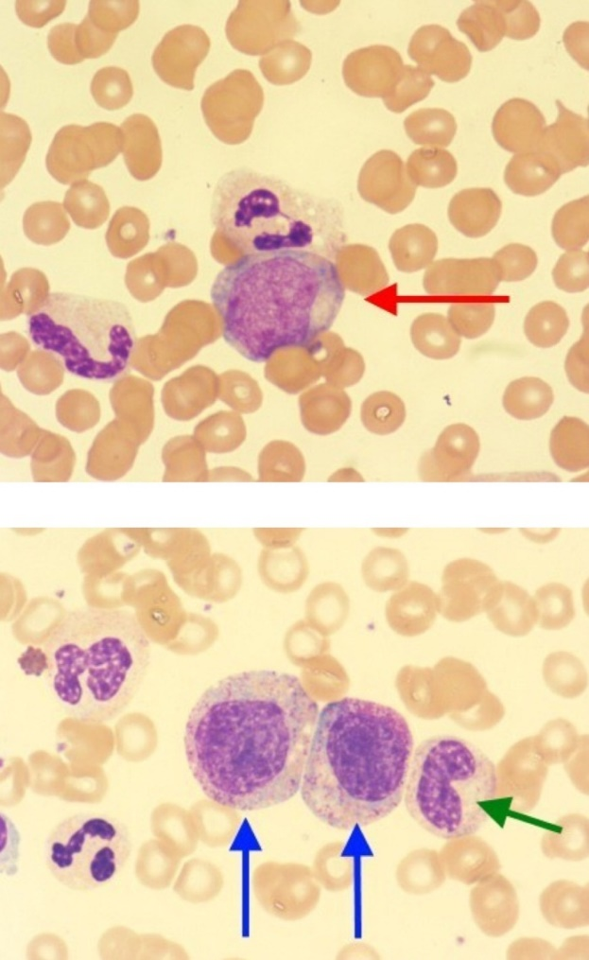
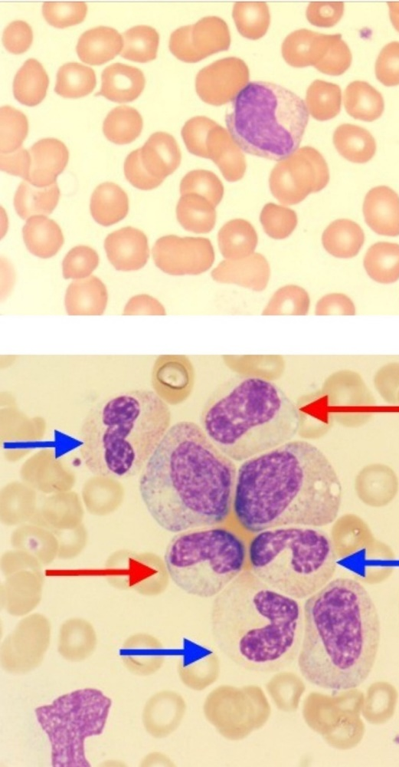
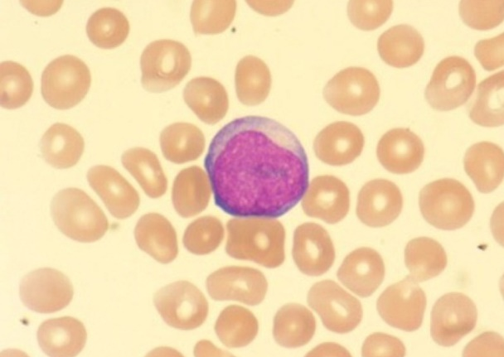
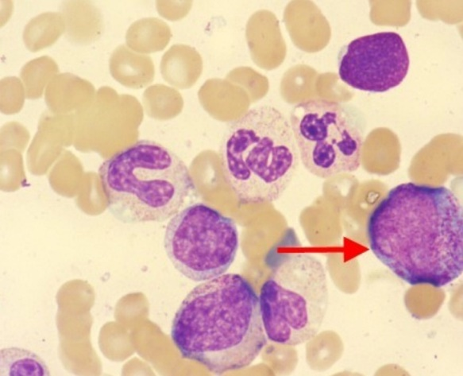
WBC Cell Differential Current reporting of immature white blood cell include descriptive terms of mild, moderate and marked left shift. For consistency, the laboratory has a defined manner of reporting that dictates the type and number of cells that qualify as mild, moderate or marked. LS1 = “Mild left shift” (estimate of 1-5% metas present, with/without bands, occ myelo may be noted) LS2 = “Moderate left shift” (estimate of >5% metas and myelos, occ pro noted) LS3 = “Marked left shift” (estimate of >5% metas and myelos and pros, occ blasts noted) These 6 oil immersion fields are representative of the peripheral blood smear. LS3 is the most appropriate for documentation of the finding of immature WBC using the reporting scheme above.

