Slide 1
February Lab Safety
Team Meeting

Slide 2
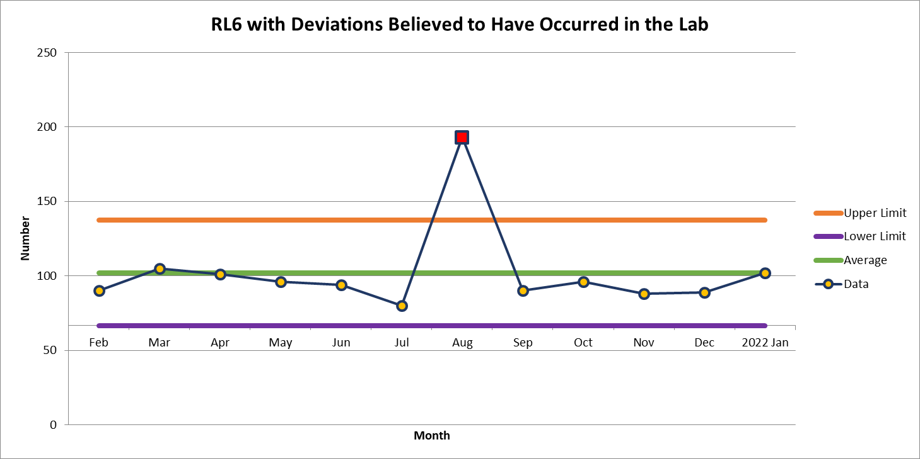
102 Deviations in January

Slide 3
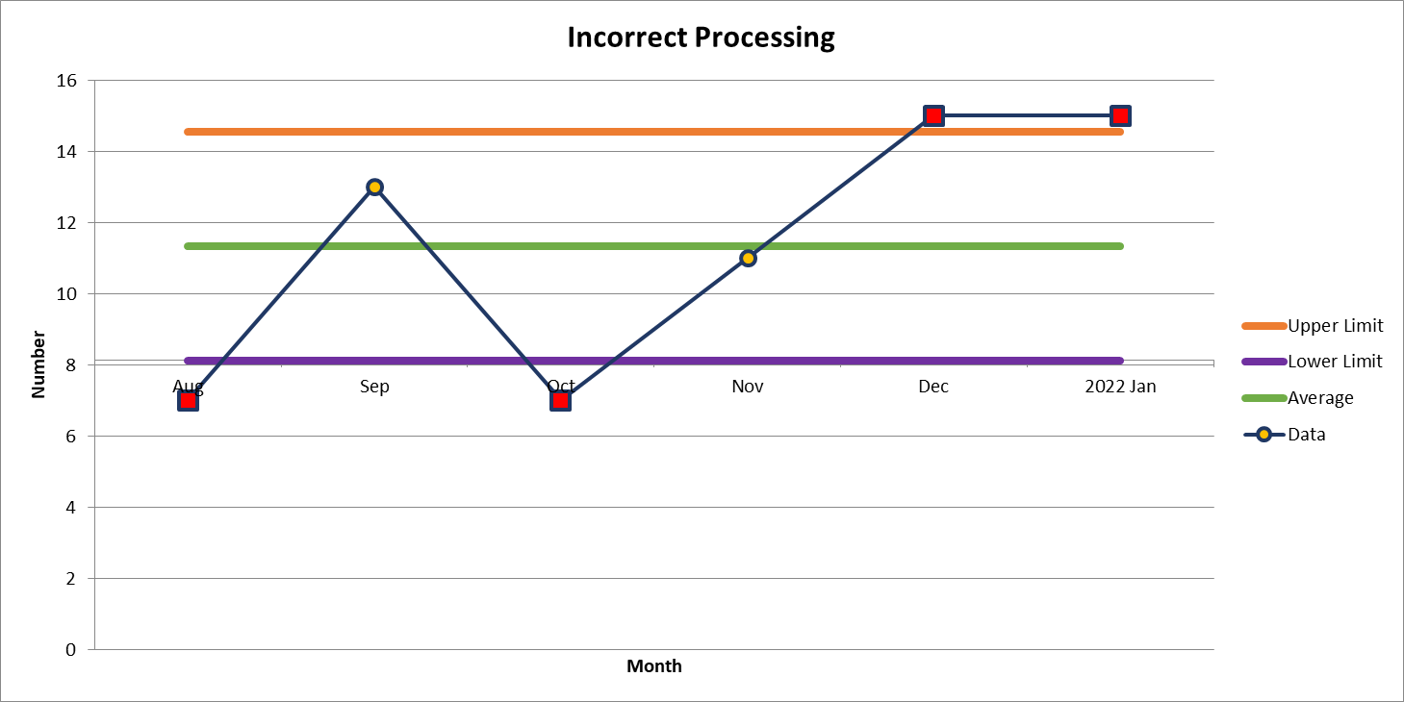
#1
15 Deviations in January

Slide 4
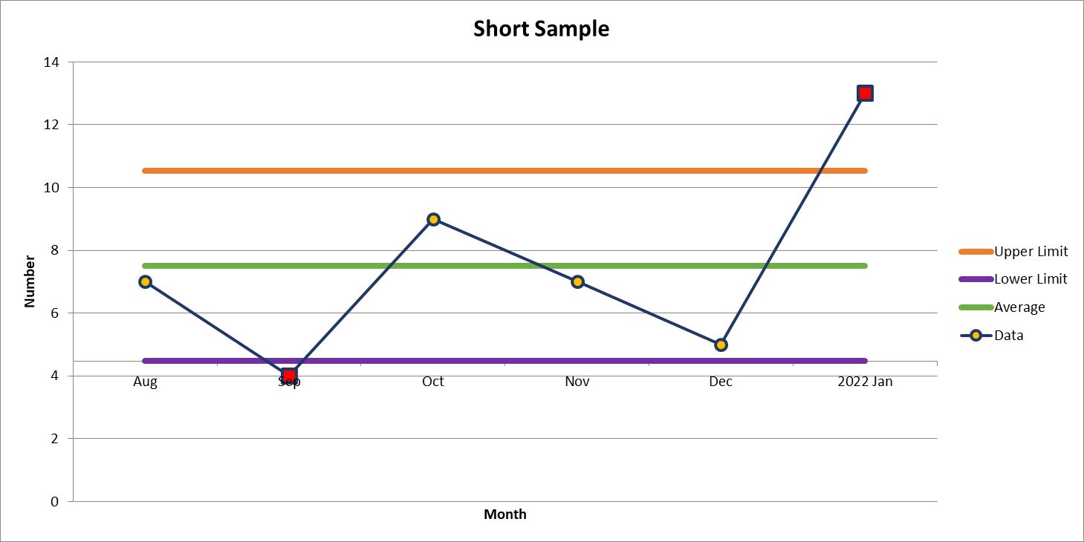
#2
13 Deviations in January

Slide 5
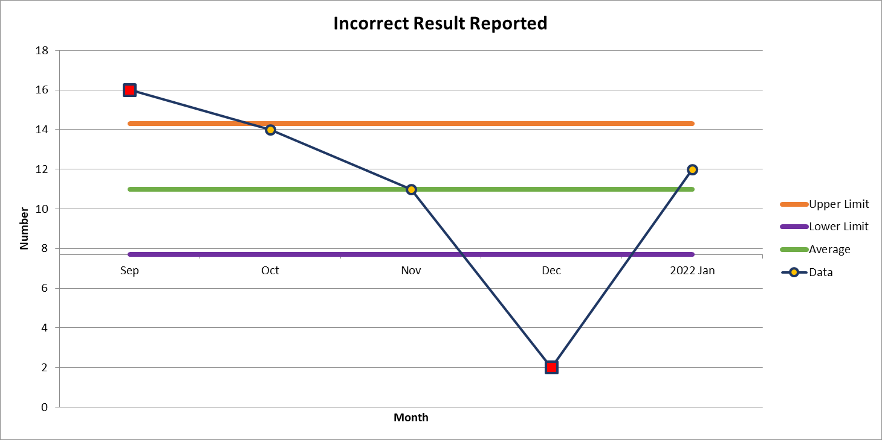
#3
12 Deviations in January

Slide 6
Lab Employee Hazard Awareness
February’s Topic
– Hazard Pictograms

Slide 7


Slide 8

Pictograms for February

Slide 9
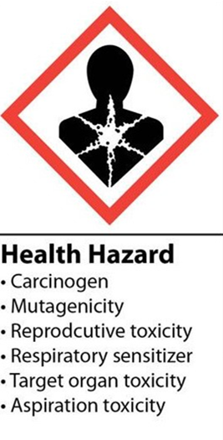

Slide 10
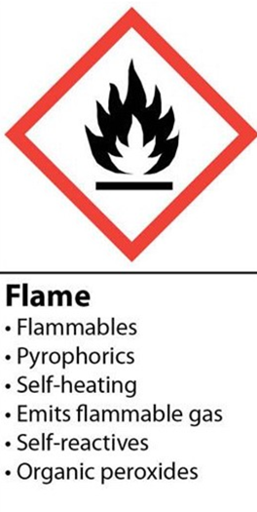

Slide 11
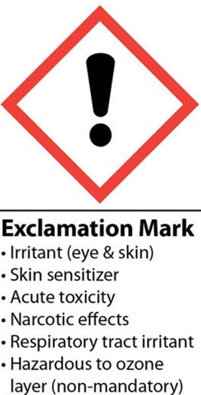

Slide 12
2022 Safety Initiative
Safety topic of the month quiz
5-10 questions
If you get 100% on the quiz, you are entered into a monthly drawing for a prize

Slide 13



Slide 14
Good Catches in January

Slide 15
Good Catches in January

Slide 16
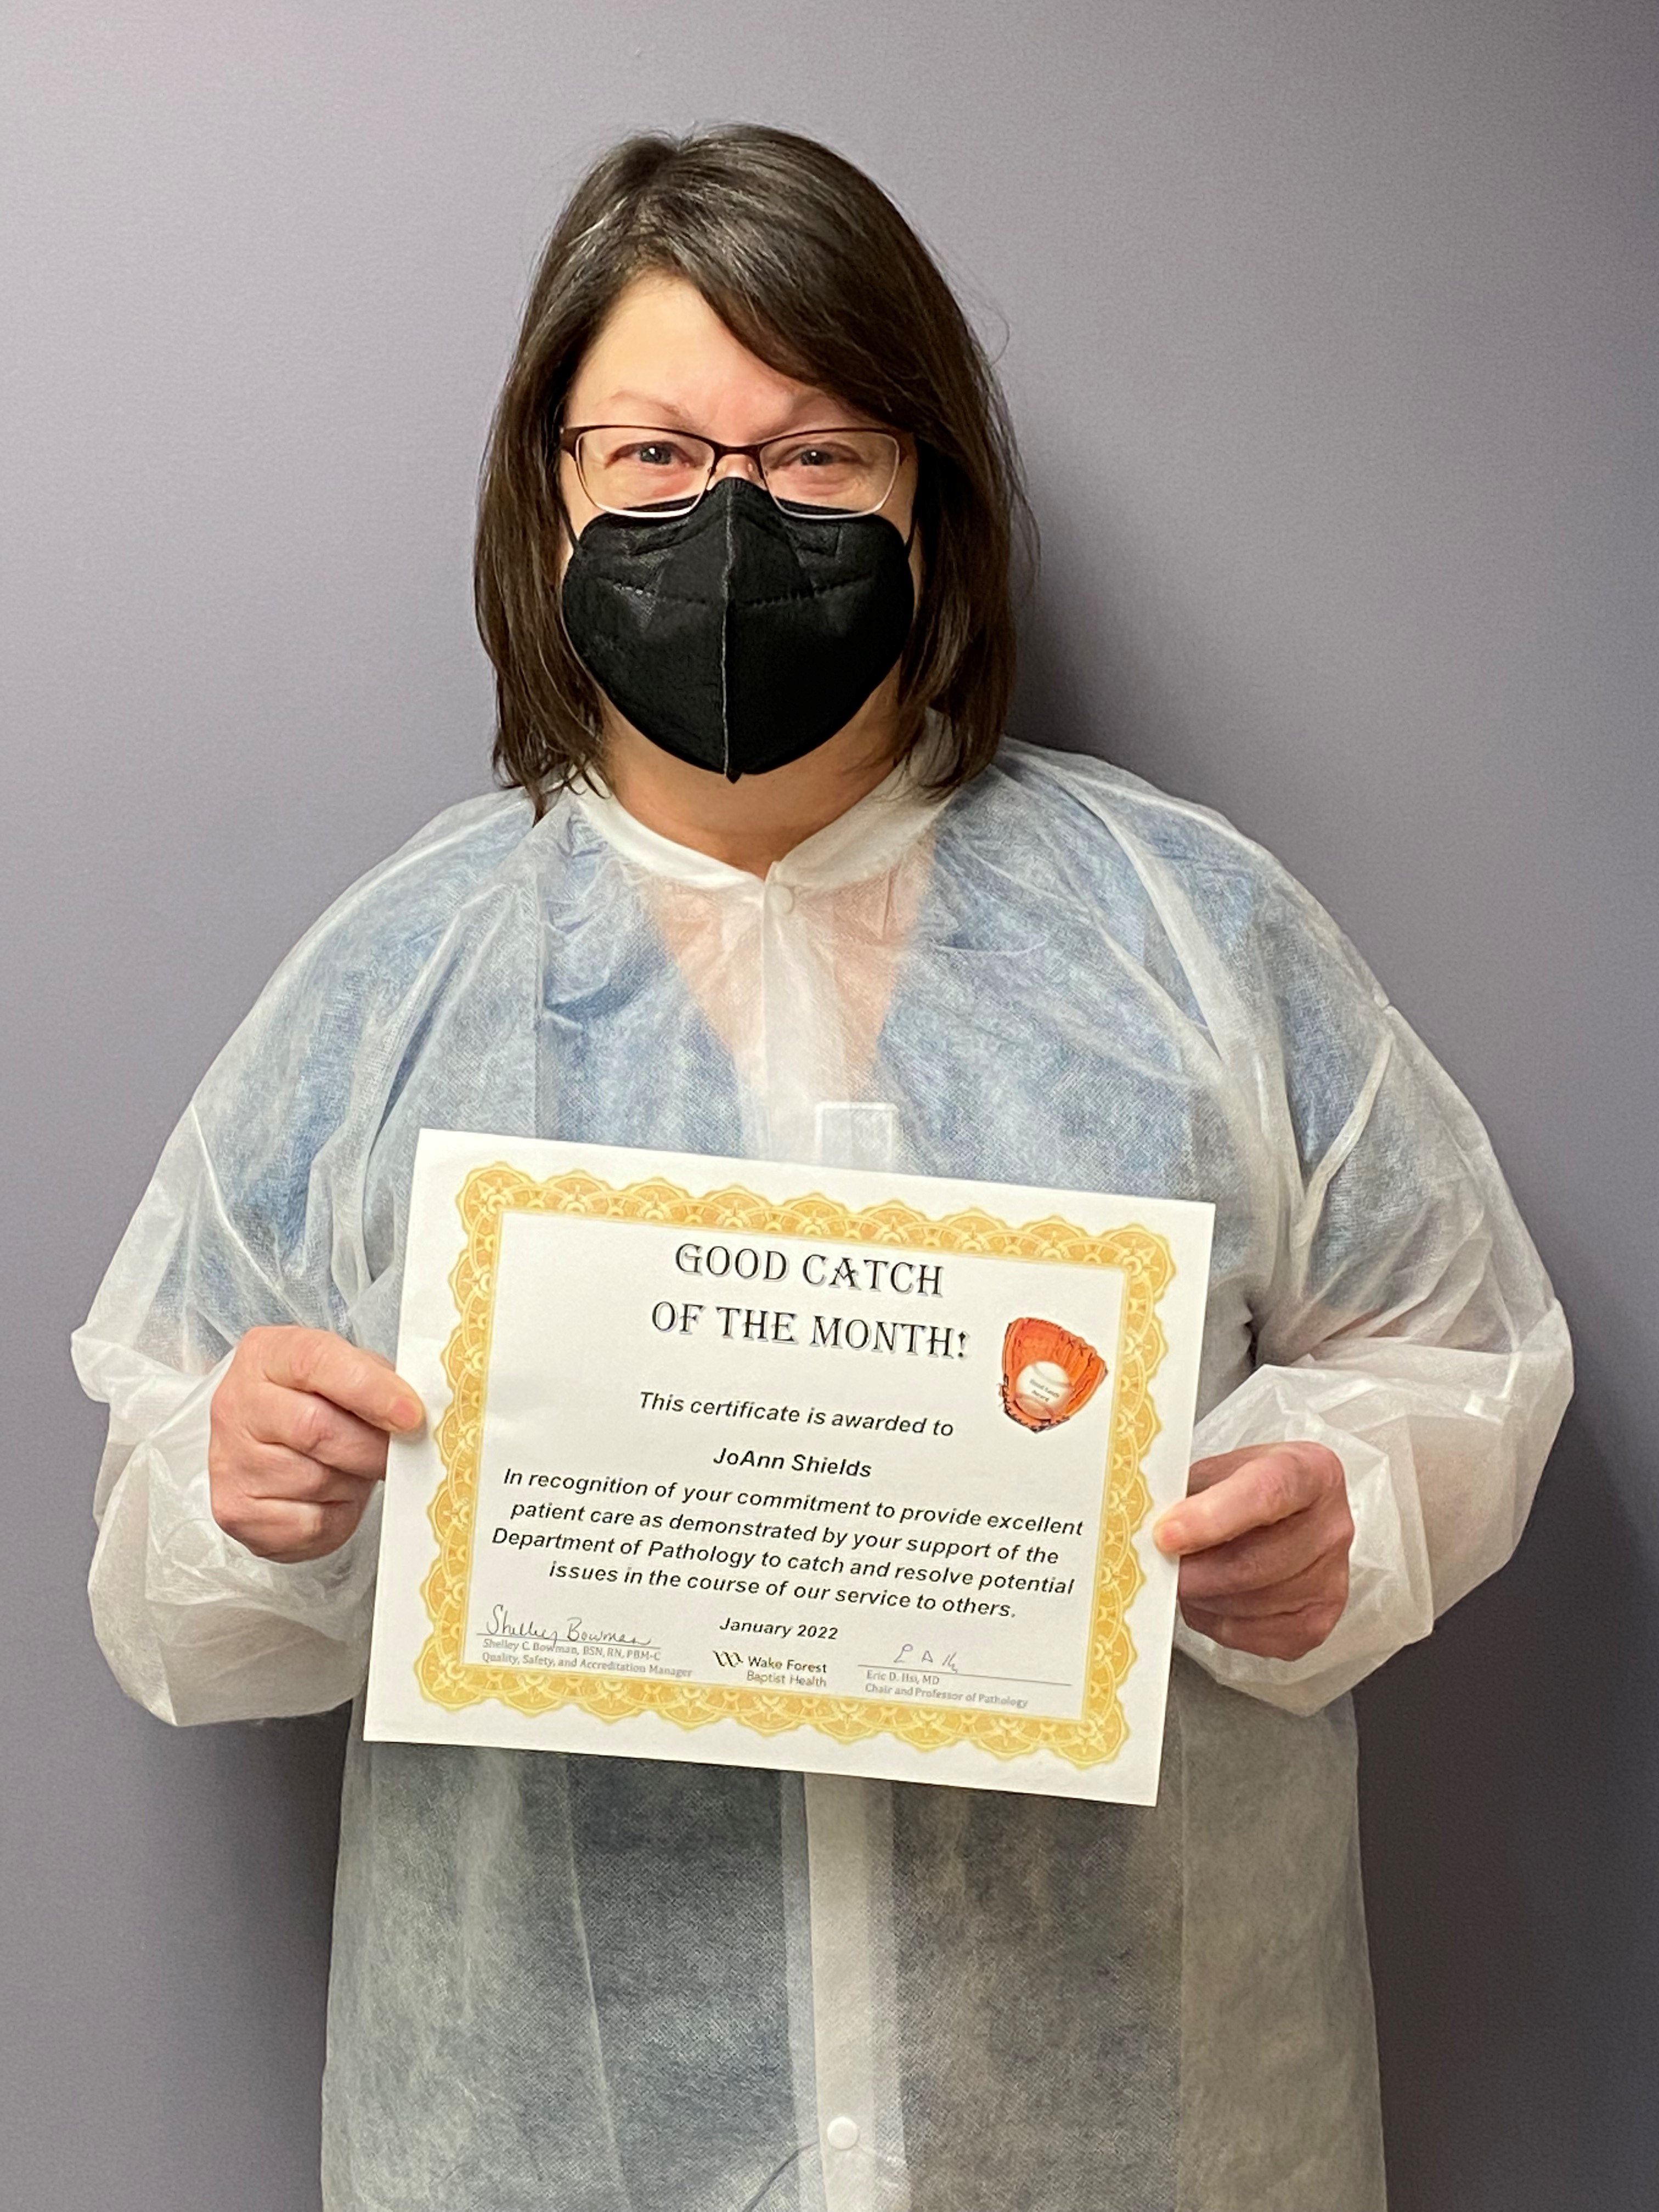
Good Catch Recipient for
January
JoAnn Shields
Central Processing

Slide 17
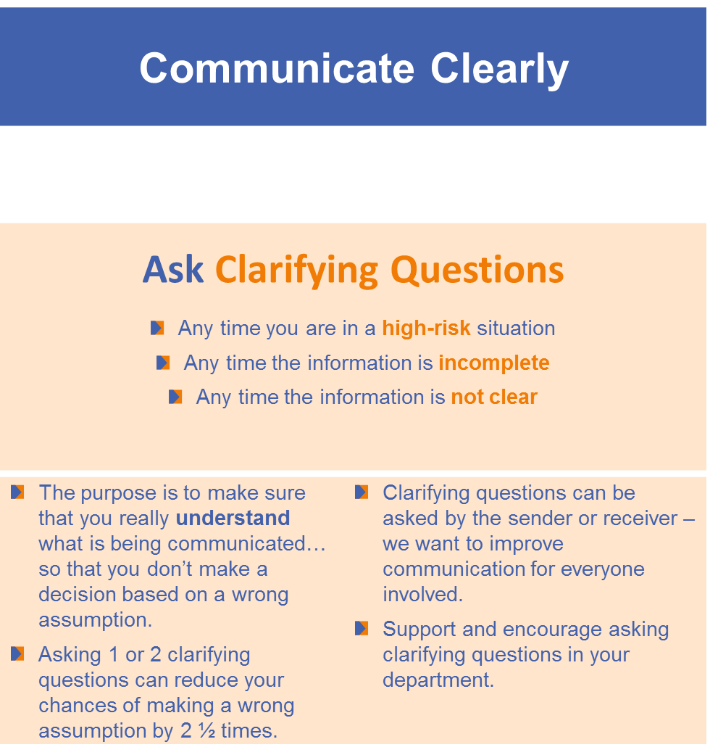
Safety Focus of the
Month

Slide 18
It’s Inspection Month

Slide 19
Questions, comments, concerns?

Slide 20
Roll Call

Slide 21
Thank you for your participation!

