Slide 1
Wilkes County EMS Coolers

Slide 2
Prepared by: Julie Simmons, MPH, MT(ASCP)SBB Bettina Turner, BSMT(ASCP)SBB
February 2022

Slide 3
At the end of this presentation, the learner will be able to
State the number of days a cooler is validated for in summer vs winter months
Identify the maximum and minimum allowable temperatures for the contents of the blood coolers
Properly interpret a Safe-T-Vue sticker
Request a new cooler when units are used in the field
Request a new cooler when cooler is nearing expiration

Slide 4
Validated Cooler
Canvas Coolers – (Tan or Blue) are validated by the Blood Bank
Coolers will maintain 1 to 6ºC for 4-5 days.
July through September:
Return every 4 days due to the hotter outside temperatures.
October through June:
Return every 5 days

Slide 5
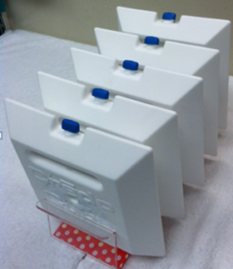
Cooler interior
Each canvas cooler will contain:
Styrofoam core
5 pre-conditioned, interlocking white panels to create the cooler’s inner storage chamber.

Slide 6
Blood Units – Back
Each unit in the cooler will have a temperature indicator (Safe-T-Vue) placed on it prior to placing in the cooler.
Should the temperature of the units reach >6°C, the Safe-T-Vue will turn red.

Slide 7
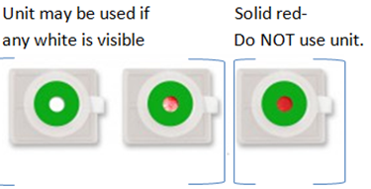
Safe-T-Vue
As long as there is some white visible in the central window of the Safe-T-Vue, one can be assured that the units have been maintained at <6°C
NOTE: There is NO COLOR CHANGE if the units get too cold, therefore care must be taken to monitor the temp displayed on the DataLogger

Slide 8
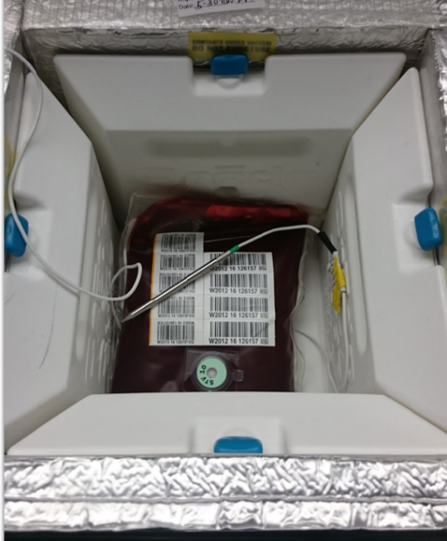
Placement of units in Cooler
Two (2) Group O units will be placed in the cooler
A temperature probe will be sandwiched between the two units.
Second unit is placed on top of or beside first unit with
temperature probe between the two units.

Slide 9
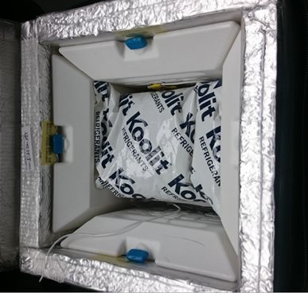
Cooler interior
A small gel pack placed on top of the units separates and protects the blood from becoming too cold, as the 6th, top panel is kept frozen
The top panel completes the interior storage chamber

Slide 10
Cooler interior
Once packed, the internal Styrofoam lid is closed
A Velcro strap secures the internal Styrofoam lid.

Slide 11
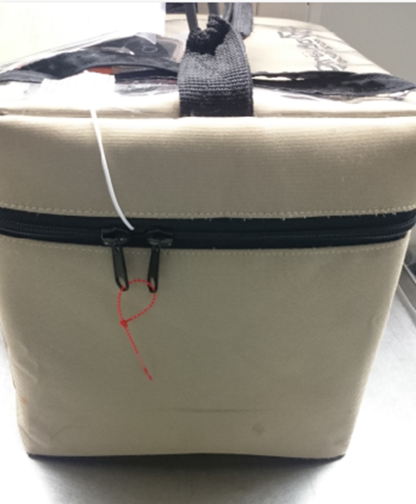
Closed Cooler
The canvas lid of the cooler will be closed with a zipper.
A red zip-tie will secure the contents of the cooler.

Slide 12
Top of Cooler
A Datalogger is placed on top of cooler to track and display the internal temperature of the units in the cooler.
A wire extends from the logger to a probe that is placed between the two units inside the cooler.

Slide 13
Top of Cooler
The temperature that is displayed on the logger needs to be documented periodically.
Recommend at least every 12 hours.
If the temperature reads less than 1.0ºC or greater than 6.0ºC:
Notify the WFBMC Blood Bank at 336-716-2618.
Datalogger pictured above is displaying a temperature of 4.9 º C.

Slide 14
Top of Cooler
Return date and time is recorded on a card that is placed in the plastic sleeve by the handle.

Slide 15
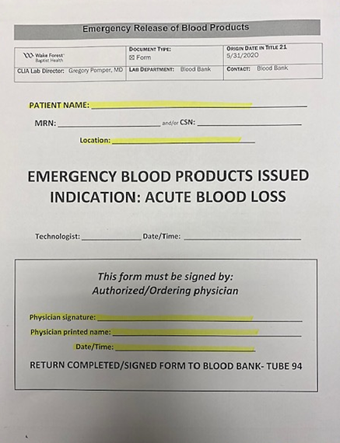
Emergency Release Documentation
An Emergency Release of Blood Products form will be placed in plastic pocket on top of cooler.
1 form per unit in cooler

Slide 16
Opening the cooler
When blood unit(s) are needed
Break the zip-tie by applying pressure or clipping the plastic tie.
Unzip the cooler and lift the canvas cover.

Slide 17
Removing the unit(s)
Remove internal container lid and gel pack
Remove blood unit(s) needed
If only ONE unit is removed:
Replace gel pack and internal lid
Close Styrofoam lid and Velcro straps
Close and zip canvas top
These steps will:
Help maintain the proper storage temperature
of 1° to 6°C.
Ensure that the top panel will not be lost.

Slide 18
Before Transfusion
The following information should be checked:
Unique unit number
ABO/Rh
Product name and description
Expiration Date
Document in the unique unit number and product name in patient’s medical record

Slide 19
When One or Both Blood Units are Used
Return a completed Emergency Release of Blood Products form for each unit transfused:
1. Patient information if available:
Name
MRN and/or CSN
2. Location: Wilkes EMS
3. Signatures with Date/Time:
Authorized Individual (Individual authorized by ordering physician)
Ordering Physician (Print name also)

Slide 20
Documentation of transfused units
Any time one or more units are transfused in the field,
Blood Bank must receive a copy of patient chart documenting the units that were transfused
This information should be passed on to the blood bank as soon as possible.

Slide 21
Units used / Cooler Approaching “return By Date”
OPTION 1:
Physically return cooler to Blood Bank at Wake Forest Baptist Medical Center.
Call WFBMC Blood Bank (336-716-2618) to notify that Wilkes EMS is coming in to exchange their cooler so preparation of a new one can begin.
The Blood Bank will prepare a new cooler with new blood units to be sent with the crew upon return of the used / expiring cooler.

Slide 22
Units used / Cooler Approaching “return By Date”
OPTION 2:
Call WFBMC Blood Bank (336-716-2618) to inform them that cooler is approaching expiration and a new cooler is needed for exchange.
The Blood Bank will prepare a new cooler with new blood units to be sent via courier to the Wilkes base.
Upon arrival at the base, the courier will pass off the new cooler for exchange of the old cooler.
The old cooler will then be returned via courier to the WFBH BB.

Slide 23
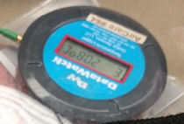
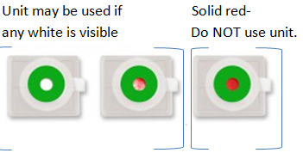
Safety Features
Coolers are validated to hold temperature.
Data logger constantly logs temperature and displays the internal temperature of the cooler.
Blood units have a temperature indicator (Safe-T-Vue) which will turn red if the units exceed a safe temperature.
Red zip-tie locking shows cooler contents secure.
Cut / No zip-tie - unsecured cooler

Slide 24
Important Notes
Do NOT store the canvas cooler with blood in any refrigerator or freezer.
Only blood products supplied by WFBMC Blood Bank may be stored in cooler.
The canvas cooler MUST be in the possession of Wilkes County EMS personnel at all times
Only Wilkes County EMS personnel successfully trained in the proper Blood Cooler procedures may handle blood units from the cooler.

Slide 25
Important Notes cont’d
Keep the cooler closed and secured until units are needed.
If only a single unit is needed:
Place the gel pack on the second unit that remains IN the cooler.
Place the white panel on top.
Close and Velcro the Styrofoam section.
Zip the canvas cover.

Slide 26
Trouble shooting
Datalogger displays a temperature that is outside of the acceptable 1° - 6°C range
Notify the Blood Bank
Do NOT open the cooler unless instructed to do so by the Blood Bank.
Potential causes:
Cooler has been compromised.
Probe has been pulled out of cooler.
Probe wire has shorted out.

Slide 27
The END

