Slide 1
March Lab Safety
Team Meeting

Slide 2
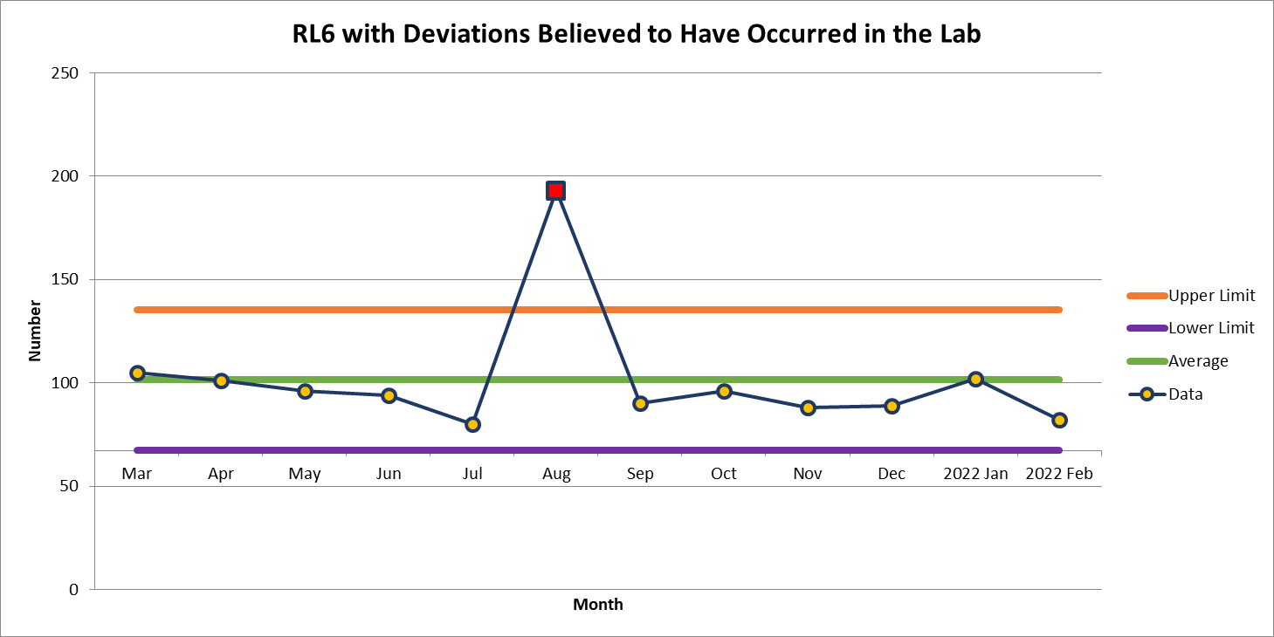
82 Deviations in February

Slide 3
Most common deviations in February
  Failure to Collect
  Delayed Results

Slide 4
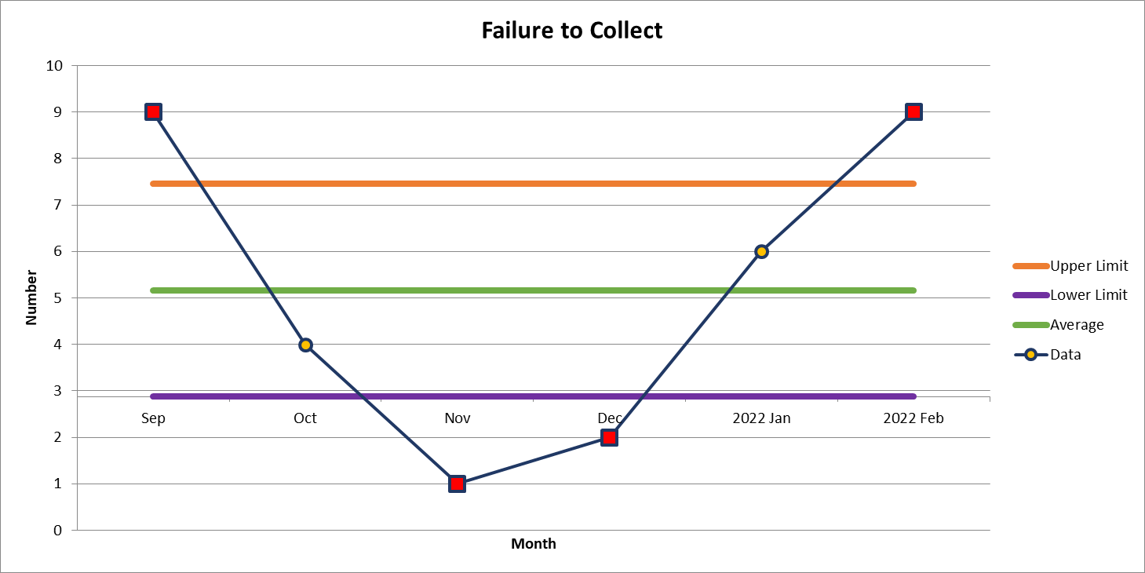
9 Deviations in February

Slide 5
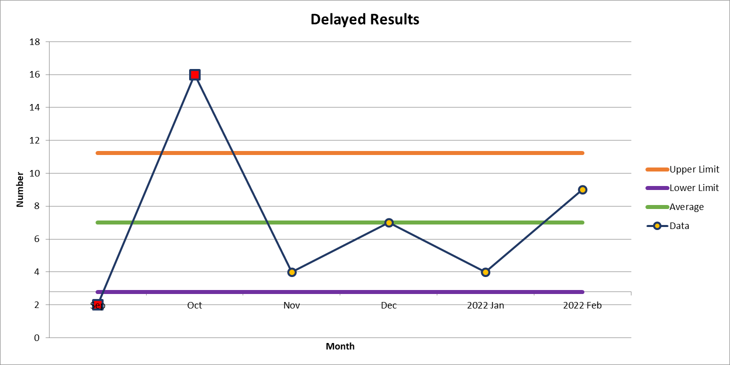
9 Deviations in February

Slide 6
2nd most common deviations

Slide 7
Inspection Results
Expired Products

Slide 8
Lab Employee Hazard Awareness
March’s Topic
– Hazard Pictograms

Slide 9


Slide 10

Pictograms for March

Slide 11


Slide 12
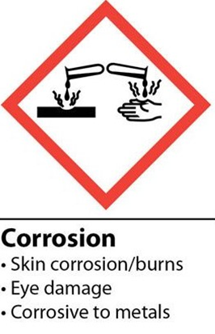

Slide 13


Slide 14
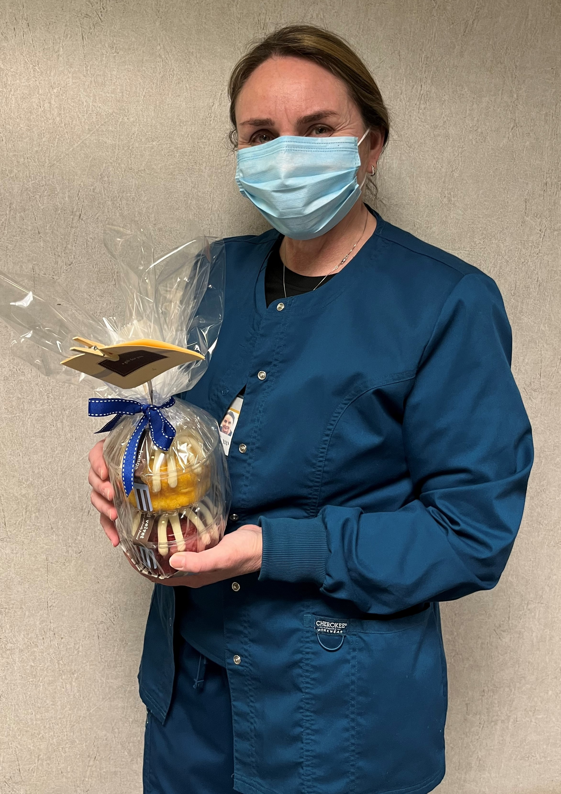
2022 Safety Initiative – Safety Topic of the Month Quiz
80 respondents for February’s quiz
50 people scored 100%
Winner of the drawing
  Lindsay Williams
  from Hematology Bone Marrow Lab

Slide 15



Slide 16
Good Catches in February

Slide 17
Good Catches in February

Slide 18
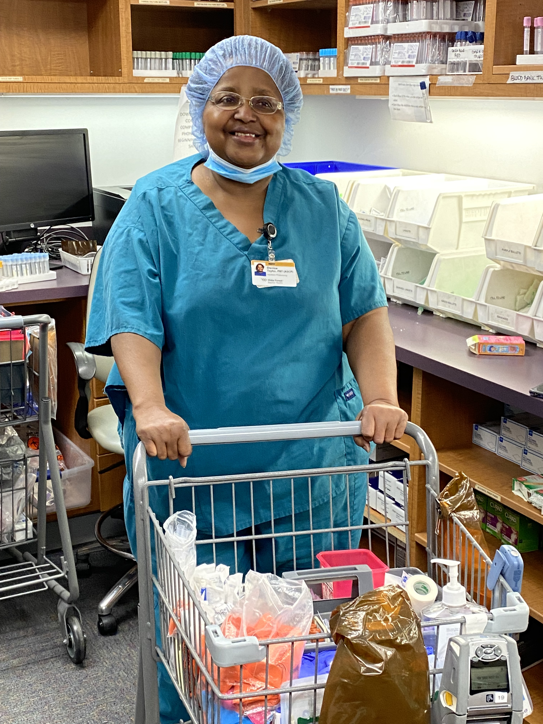
Good Catch Recipient for
February
Denise Taylor
IP Phlebotomy

Slide 19
Safety Focus of the Month
Patient Safety Awareness Week is March 13th – 19th, 2022.
This week serves as a dedicated time and platform for growing awareness about patient safety and recognizing the work already being done.
More information to come during that week!

Slide 20
Questions, comments, concerns?

Slide 21
Next meeting April 7th 1-2pm
In person for on campus team members
Garvin conference room
Webex for off campus team members

Slide 22
Roll Call

Slide 23
Thank you for your participation!

