Slide 1
April Lab Safety Team Meeting
If you are attending via Webex without a microphone, please also join by phone:
Call 1-415-655-0001
Meeting number (access code): 2424 838 2885

Slide 2
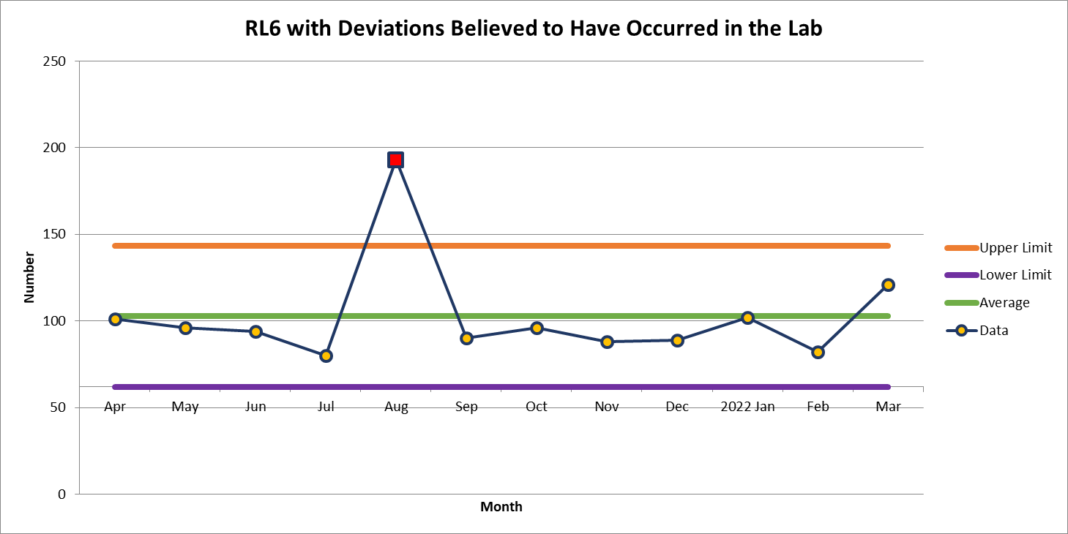
121 Deviations in March

Slide 3
2 most common deviations in March
  Incorrect Results Reported
  Wrong Tube

Slide 4
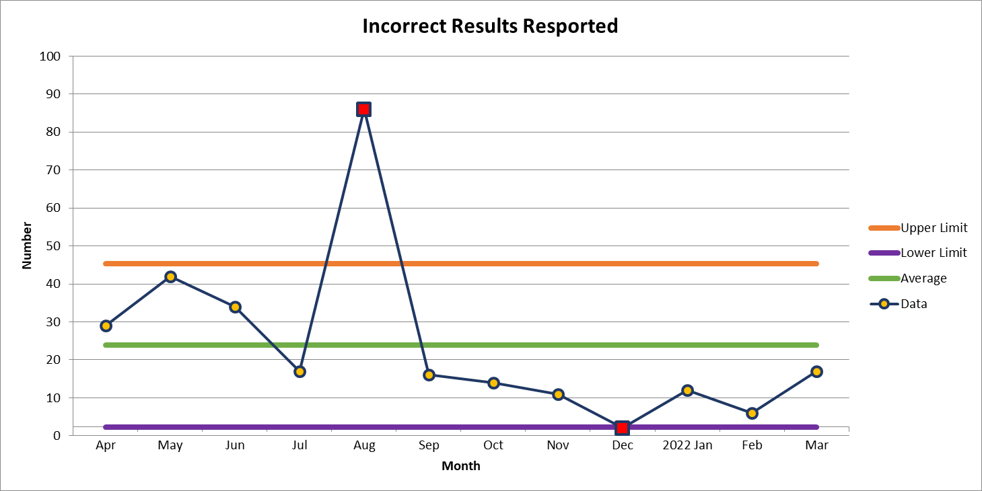
17 Deviations in March

Slide 5
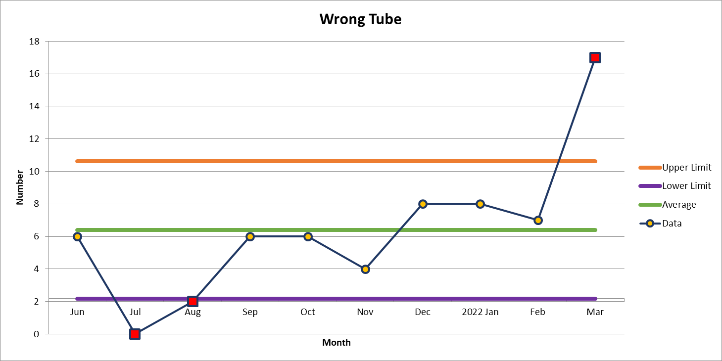
17 Deviations in March

Slide 6
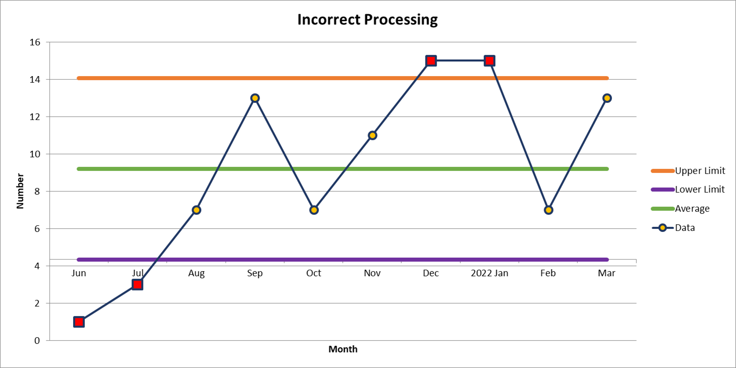
2nd most common deviation
13 Deviations in March

Slide 7
Lab Employee Hazard Awareness
April’s Topic
– Hazard Pictograms

Slide 8


Slide 9

Pictograms for April

Slide 10


Slide 11


Slide 12


Slide 13
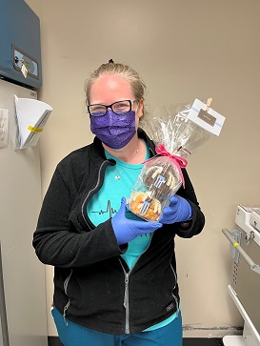
Safety Topic of the Month Quiz
62 respondents for March’s quiz
19 people scored 100%
Winner of the drawing
  Kelly Pugh
  from the Blood Bank

Slide 14
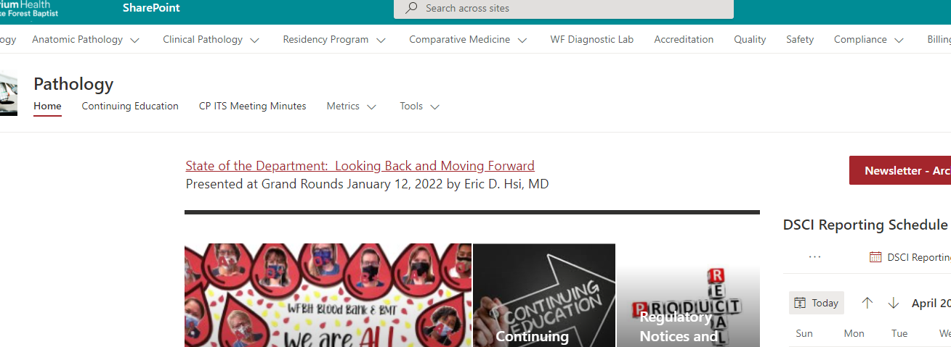
Lab Safety Team Sharepoint Site
How to get there

Slide 15
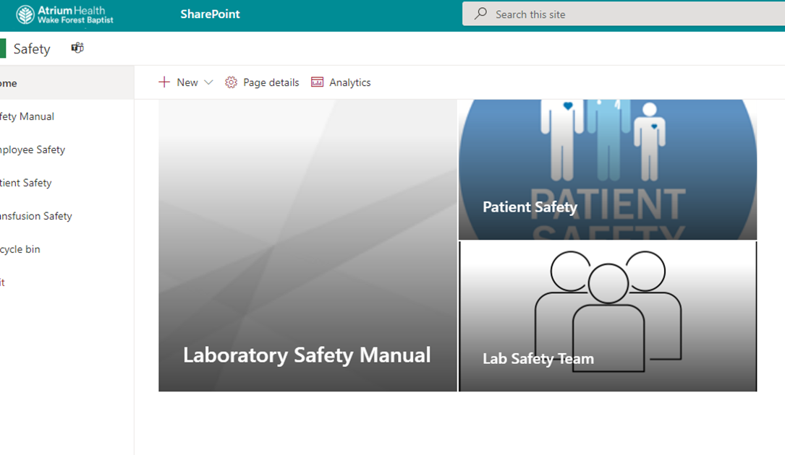
How to get there

Slide 16
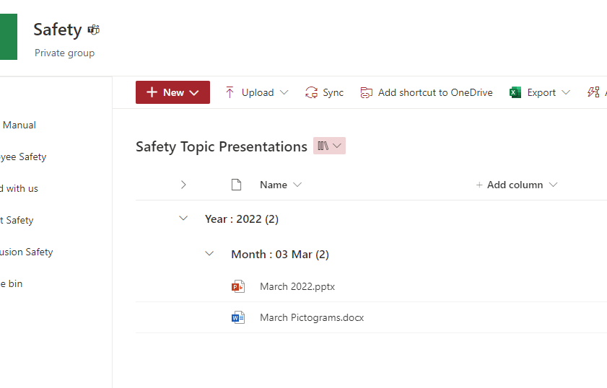
How to get there
Accessible to everyone

Slide 17



Slide 18
Good Catches in March
Great Work! Thank you!

Slide 19
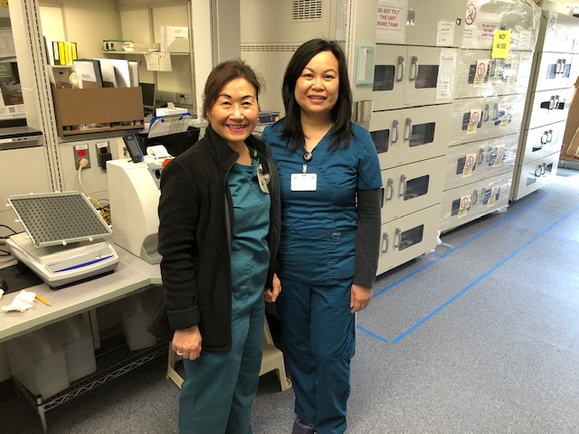
Good Catch Recipient for March
Kim Nguyen (L)
Misandra Quan (R)

Slide 20
Safety Focus of the Month
Numeric/Phonetic Clarifications
Numeric clarification is easy and saves lives. The best times to use numeric clarifications are room number, dose, rate, and result. When using numeric clarification – say the number and then say the digits.
Numeric Clarification
For 15 say “15, that’s one – five”
For 50 say “50, that’s five – zero”
For 0.9 say “0.9 that’s zero-point-nine”
For 3-4 say “the range of three to four”

Slide 21
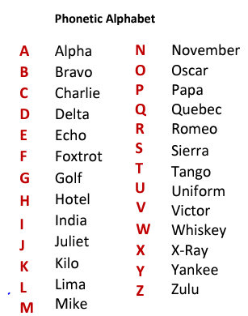
Safety Focus of the Month
Numeric/Phonetic Clarifications
Phonetic clarification was developed by military organizations for high reliability when communicating under difficult conditions.
Until 1957 each US military service had their own phonetic alphabet.
Now, each service uses the alphabet inset below.
When using phonetic clarification – say the name, then spell the name by saying the letter and the phonetic clarification for that letter.

Slide 22

Your turn
Issues
Concerns
Events

Slide 23
Roll Call

Slide 24
Next meeting May 5th 1-2pm
In person for on campus team members
Garvin conference room
Webex for off campus team members

Slide 25
Thank you for your participation!

