Slide 1
May Safety Presentation
5.2022 | Department of Lab & Pathology

Slide 2



Slide 3
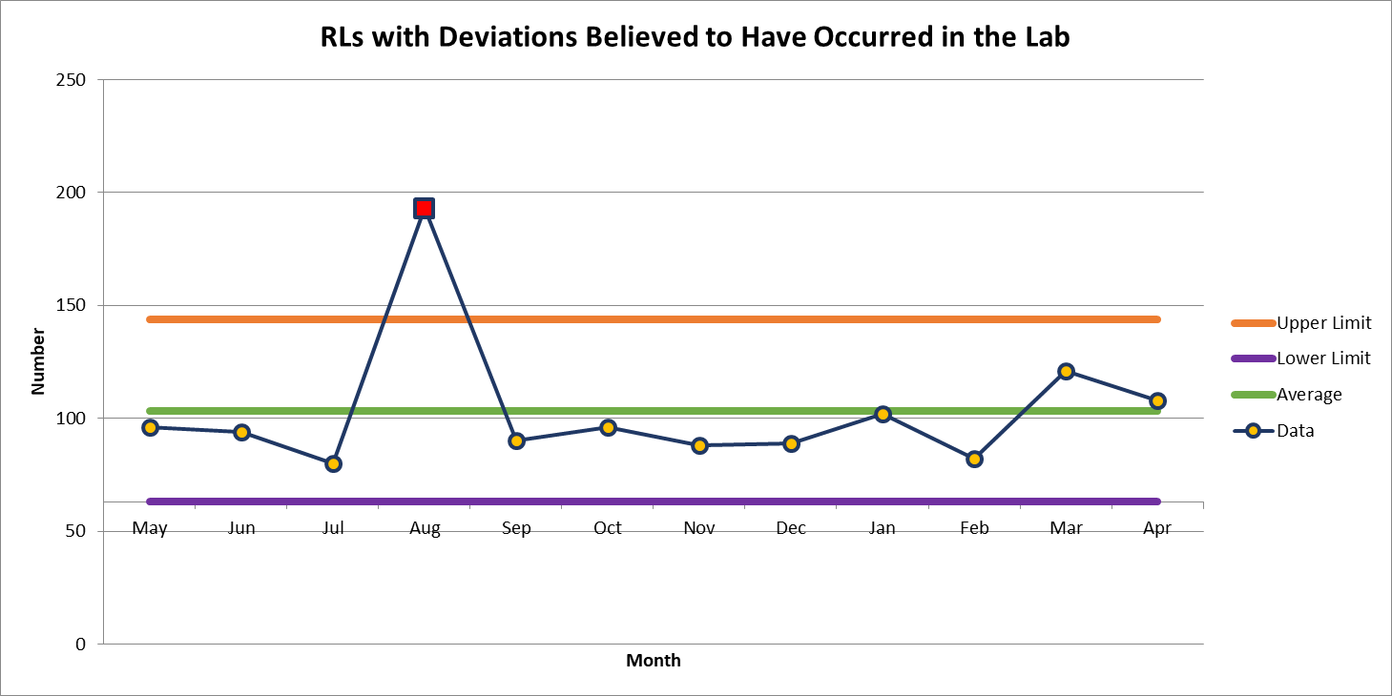
Deviations Reported via RLs
108 Deviations in April

Slide 4
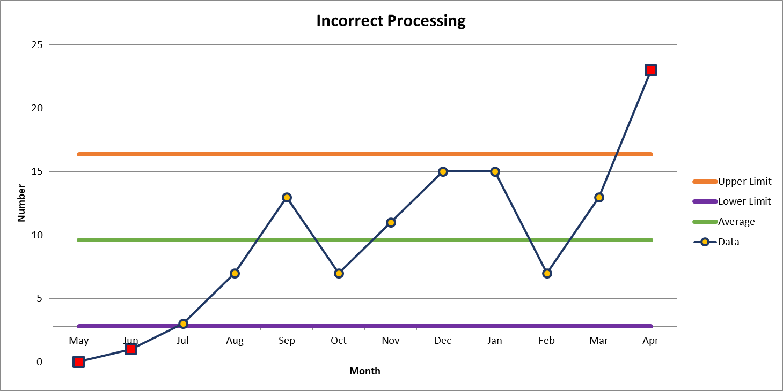
Most Common Deviation in April
23 Deviations in April

Slide 5
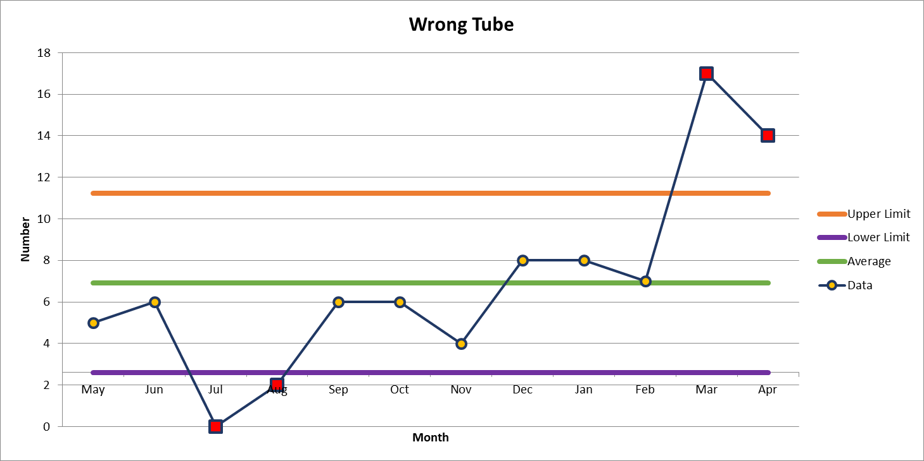
2nd Most Common Deviation
14 Deviations in April

Slide 6
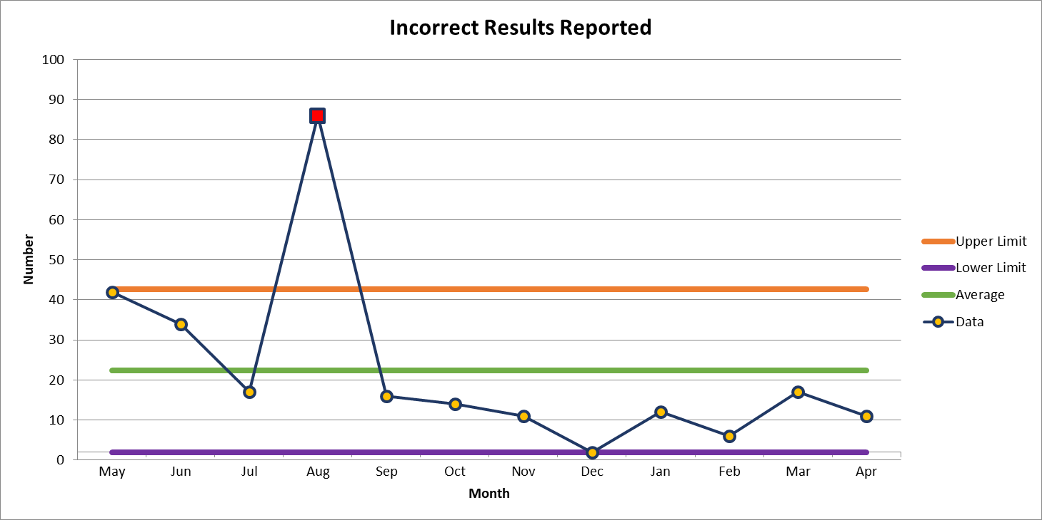
3rd Most Common Deviation
11 Deviations in April

Slide 7
Lab Employee Hazard Awareness
May’s Topic
– Emergency Eyewash

Slide 8
Why you need them?
Even with the best engineering controls, PPE and safety precautions, chemical/biohazard exposure can still happen
They give employees the ability to immediately wash hazardous substances from their eyes
          Preventing potential harm
          Particularly with…
            Corrosives

Slide 9
How to use them
After exposure it is important to reach the eyewash station within…
10-15 seconds
The exposed area needs to be flushed for no less than…
15 minutes
Call for immediate medical assistance

Slide 10
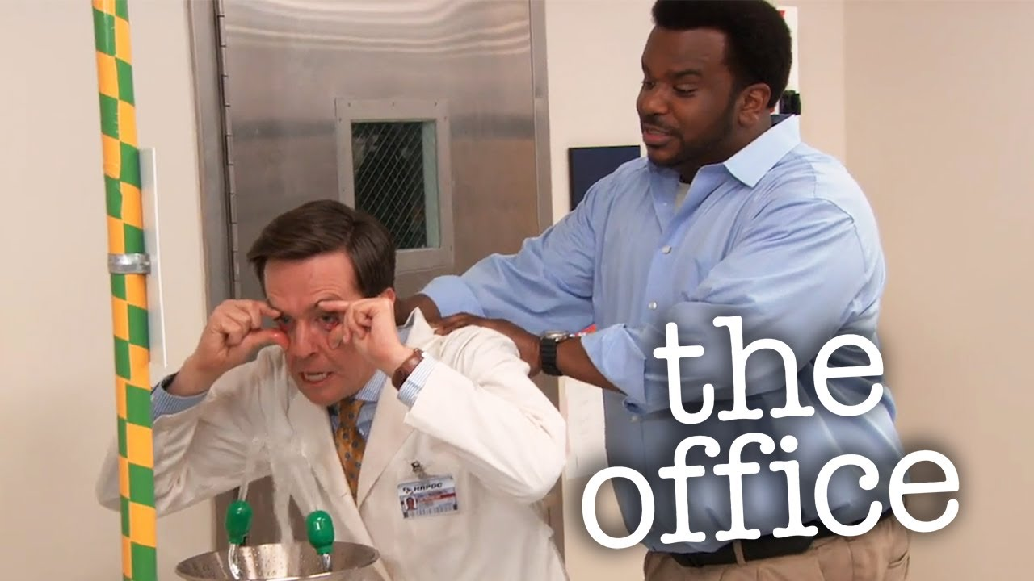
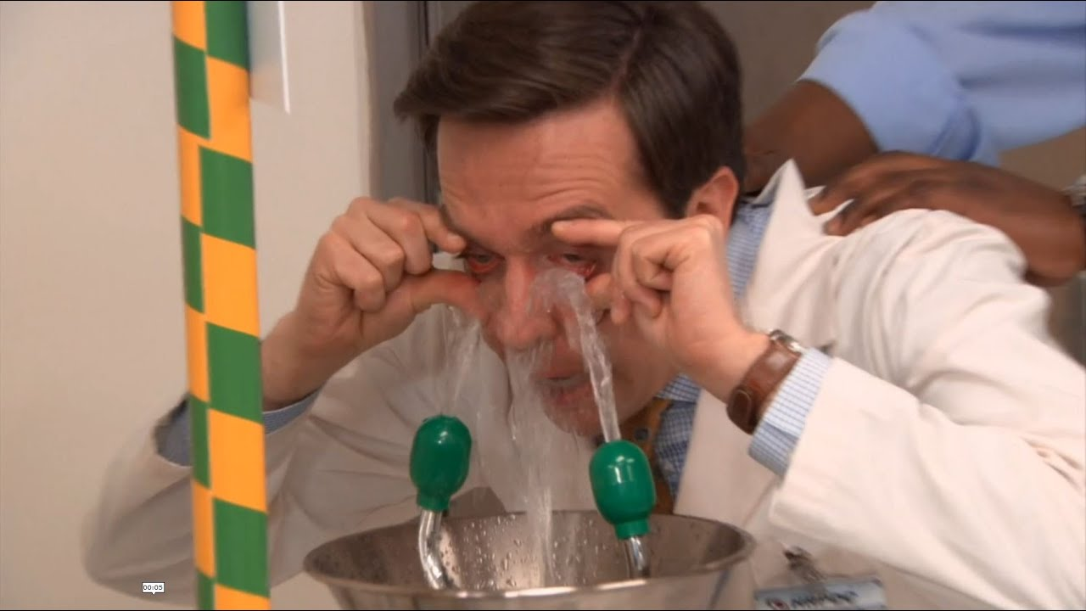
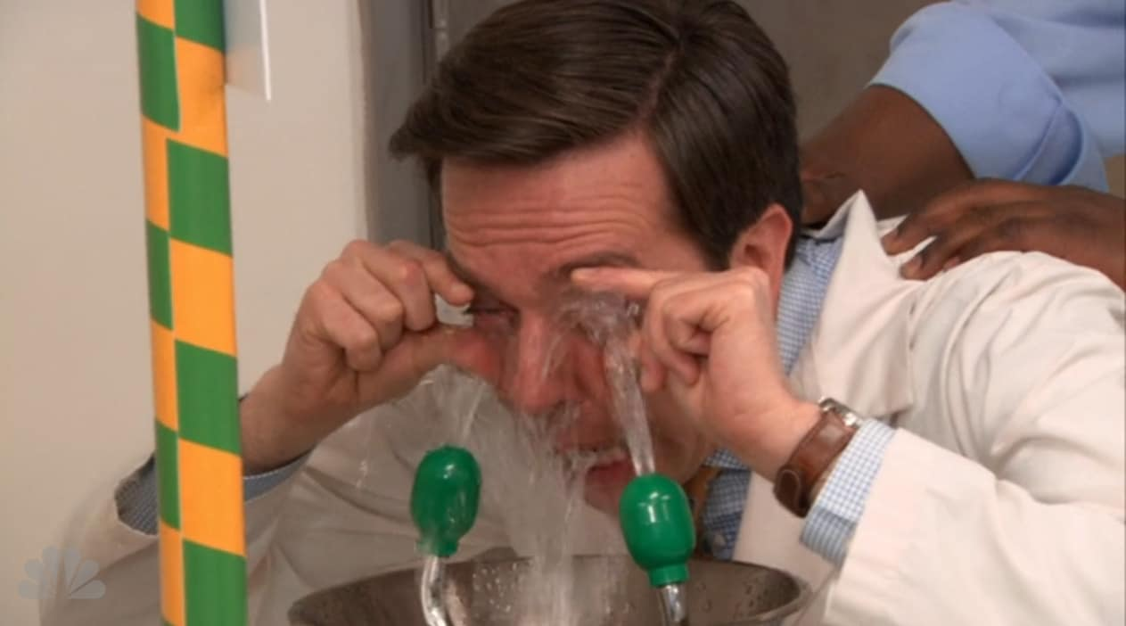
Hold eyes open when flushing
Remove contact lenses

Slide 11
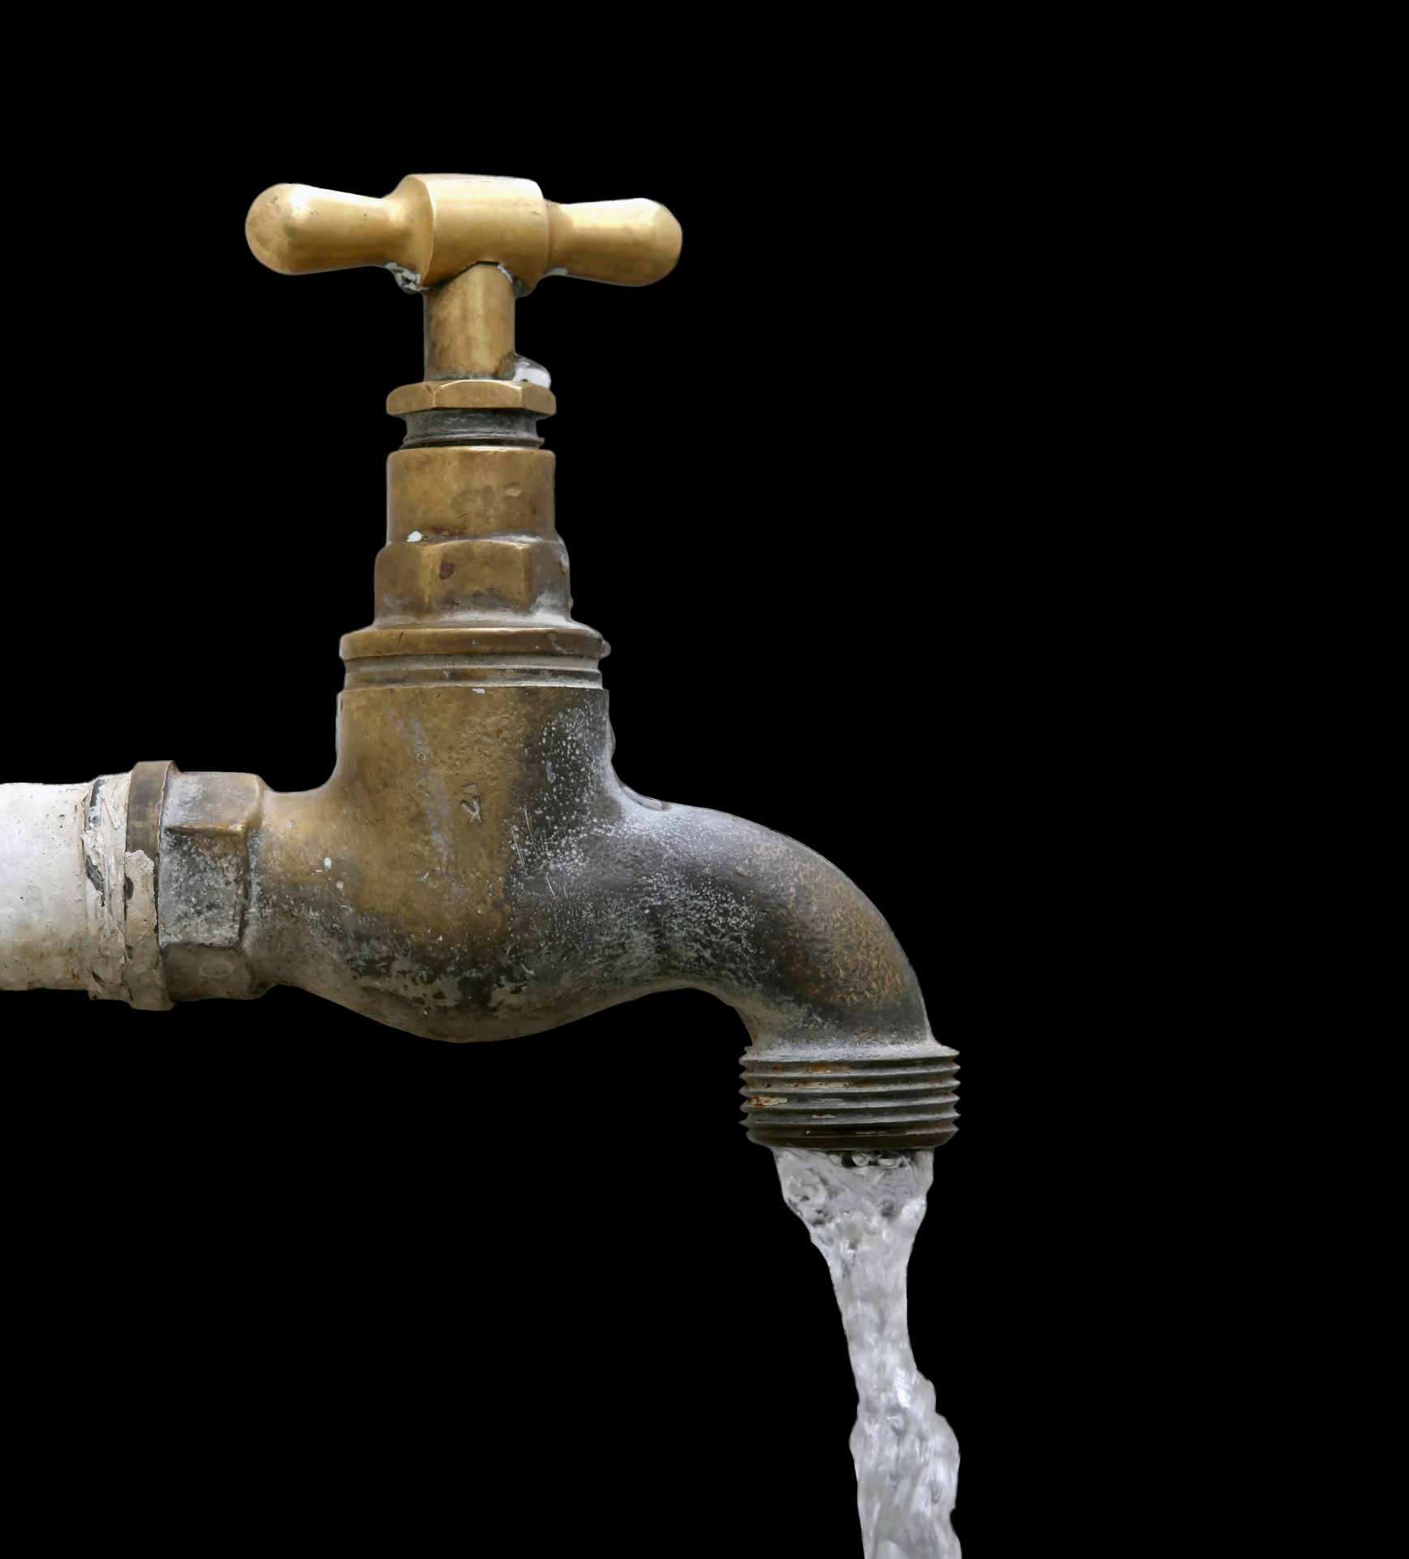
Eyewash QC
Eyewash should be activated weekly for a period long enough to verify operation and ensure that flushing fluid is available
Activating the eyewash weekly also clears sediment and bacteria from the stagnate water

Slide 12
Regulation
Eyewash stations need to be located such that an exposed employee could reach them within…
10 seconds
Or no more than 55 feet from location of exposure

Slide 13
Eyewash Bottles
Eyewash bottles are NOT to be used as a substitute for flushing your eyes after exposure
They are for immediate use while in transit to a stationary eyewash where you should then flush your eyes for 15 minutes

Slide 14
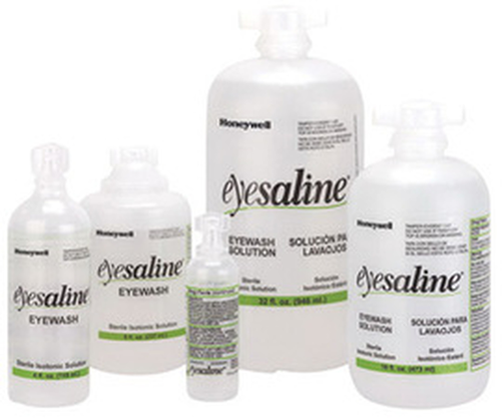
Eyewash Bottle QC
Eyewash bottles must be examined weekly and be discarded if...
  Seal is broken
  Expiration date is exceeded
  Solution is turbid
      - this could indicate bacterial growth
EH&S will provide replacements upon request

Slide 15
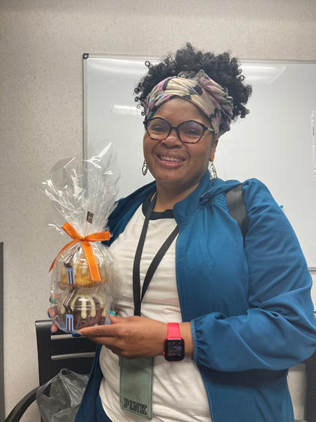
April Safety Topic of the Month Quiz
96 respondents
76 people scored 100%
Winner of the drawing
  Monique Patten
  from Central Processing

Slide 16
Good Catches in March
Great Work! Thank you!

Slide 17
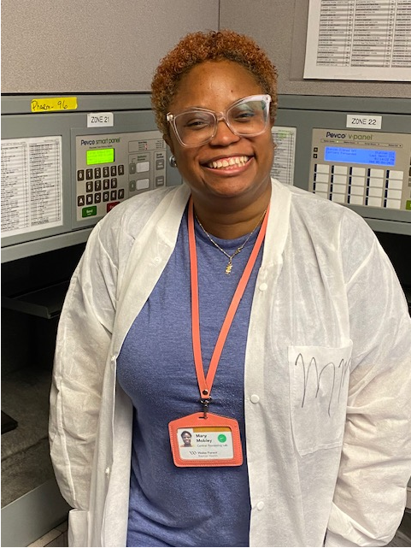
Good Catch Recipient for April
Mary Miller
Central Processing Lab

Slide 18
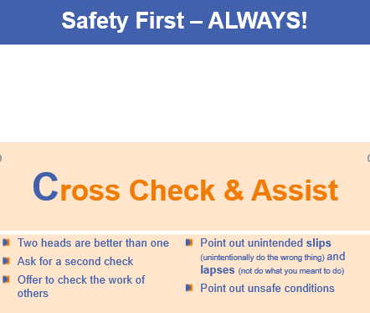
Cross Check & Assist

Slide 19
Thank you for your participation!

