Slide 1
Laboratory Safety Presentation
July 2022

Slide 2
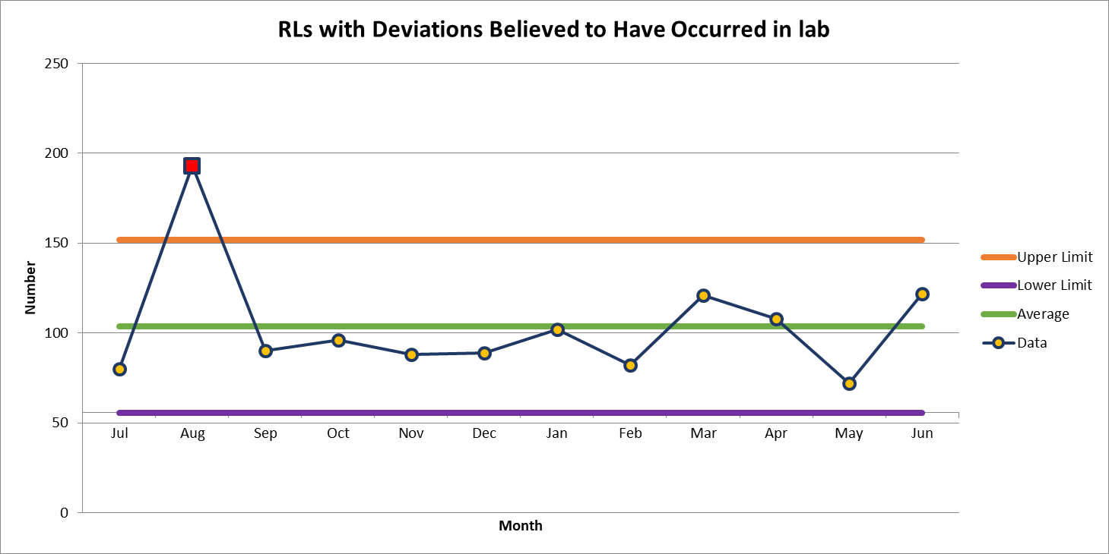
122 Deviations in June

Slide 3
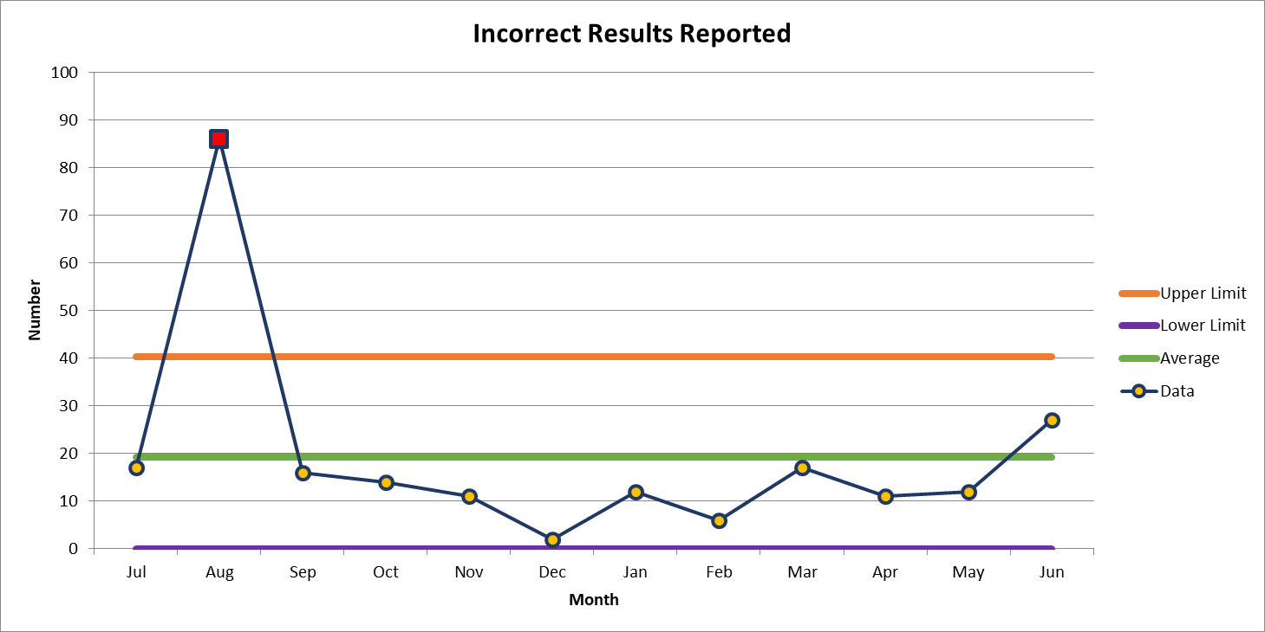
Most common deviation in June
27 Deviations in June

Slide 4
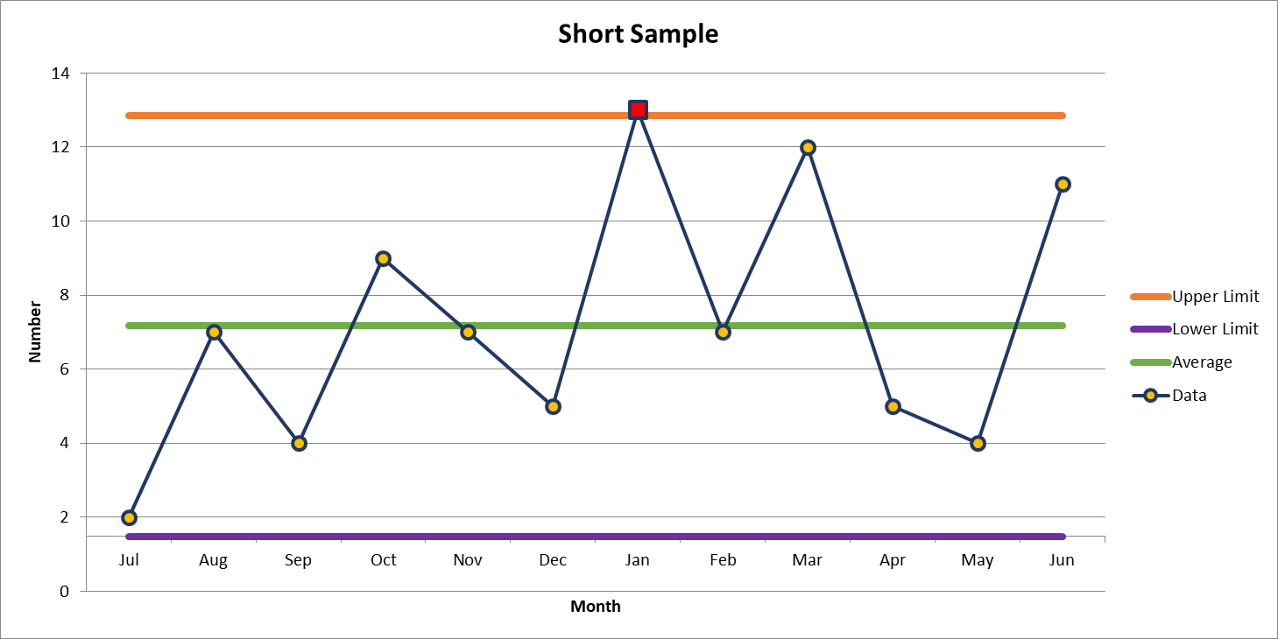
2nd most common deviation
11 Deviations in June

Slide 5
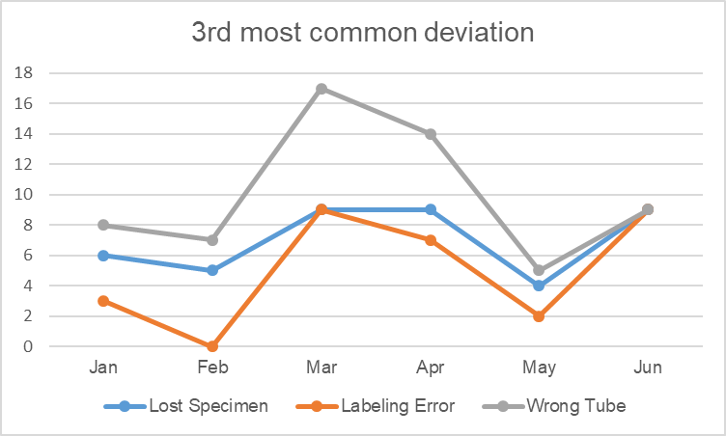

Slide 6
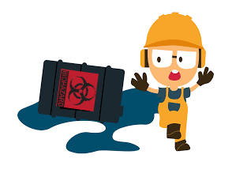
Lab Employee Hazard Awareness
July’s Topic – Chemical Spills
        >300 ml
        <300 ml
        Spill Kits

Slide 7
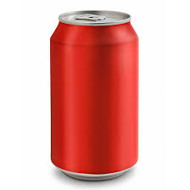
Chemical Spill Volume >300 ml
Do not attempt to clean it up
Call EH&S
How do I approximate spill volume?
      A can of soda contains 355 ml
      Picture what it would look like if you spilt a soda can
      How does your spill compare? Is it more or less?

Slide 8
Chemical Spill Volume <300 ml
If chemical is non-toxic clean it up using a spill kit and contact EH&S
While cleaning be sure to use the appropriate PPE for the chemical

Slide 9
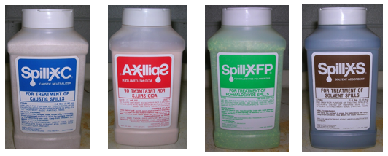
Spill Kits
Do you need one and what type?
  Types of chemicals
  Volume of chemical
  Blood and body fluid
    Phlebotomy

Slide 10
Spill Kits
EH&S will provide spill kits for your lab upon request
Periodically check that the contents is free flowing (not clumped) by shaking
Replace spill kit once opened

Slide 11
If the chemical is a Carcinogen, Reproductive Toxin or Highly Toxic: Evacuate immediately regardless of spilt volume and call EH&S

Slide 12
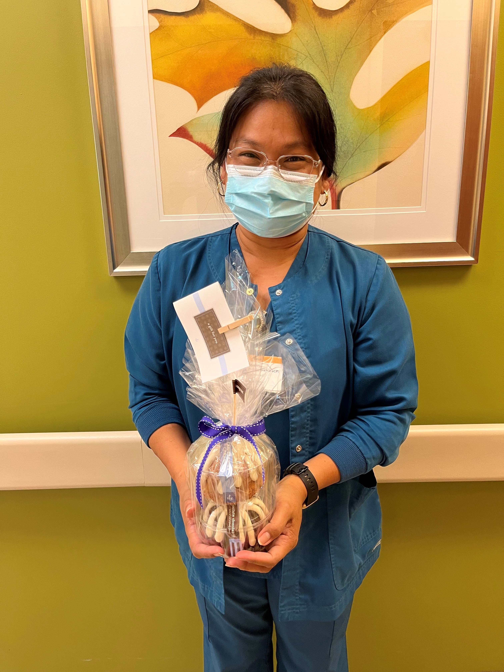
June Safety Topic of the Month Quiz
94 respondents
74 people scored 100%
Winner of the drawing
  Juanita Brown
  from Davie Medical Center Lab

Slide 13



Slide 14
Good Catches in June
Hematology | Kim Nguyen | Tech Kim Nguyen received a body fluid cell count order for paracentesis fluid. The sample that CP aliquoted for them was the biliary fluid sample (a different sample from the same patient) rather than the paracentesis fluid. Kim realized that the cell count they performed was not on paracentesis fluid, that it didn’t look right. Kim took the specimen back to CP and got the correct sample. Had she not, the counts would have been done on biliary and reported as paracentesis fluid
Clemmons |  | The wrong address in the patients chart. When I asked the patient his name, DOB and address, he gave me a Winston Salem, NC address. I looked, but I could not find a patient with his name and that address in the system. I told him that I have your name but not the address you gave me. I asked him if he has ever lived in Maryland because there is a patient under that name but the address is in Maryland. He said he has never lived there, but last year he was a victim of identity fraud from the exact city and state in his chart. He was worried that somehow his SSN was being used again, so I had someone from registration come to the lab and review his chart. She entered the correct address in his chart and flagged it for staff to always check his ID whenever there are changes made to it. He thanked everyone involved and said he felt better about the situation
Great Work!
Thank you ALL!

Slide 15

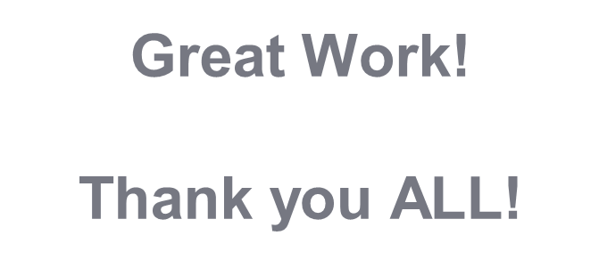

Slide 16
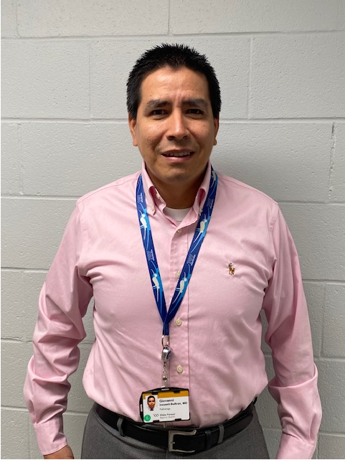
Good Catch Recipient for June
Giovanni Insuasti, MD

Slide 17
Safety Focus of the Month
CUS When you need to!
Here’s how you do it…
I am CONCERNED!
I am UNCOMFORTABLE!
Stop this is a SAFETY CONCERN!
Did you know we are highly reliable when we CUS? When you speak up using CUS you listen to your gut and stop the line until your concerns are addressed, including using the chain of command, when needed.

Slide 18
Reminder
Let Hannah Phillips or Shelley Bowman know about any employee injuries in your department!

Slide 19
Thank you for your participation!

