Slide 1
Lab Safety Presentation August 2022

Slide 2
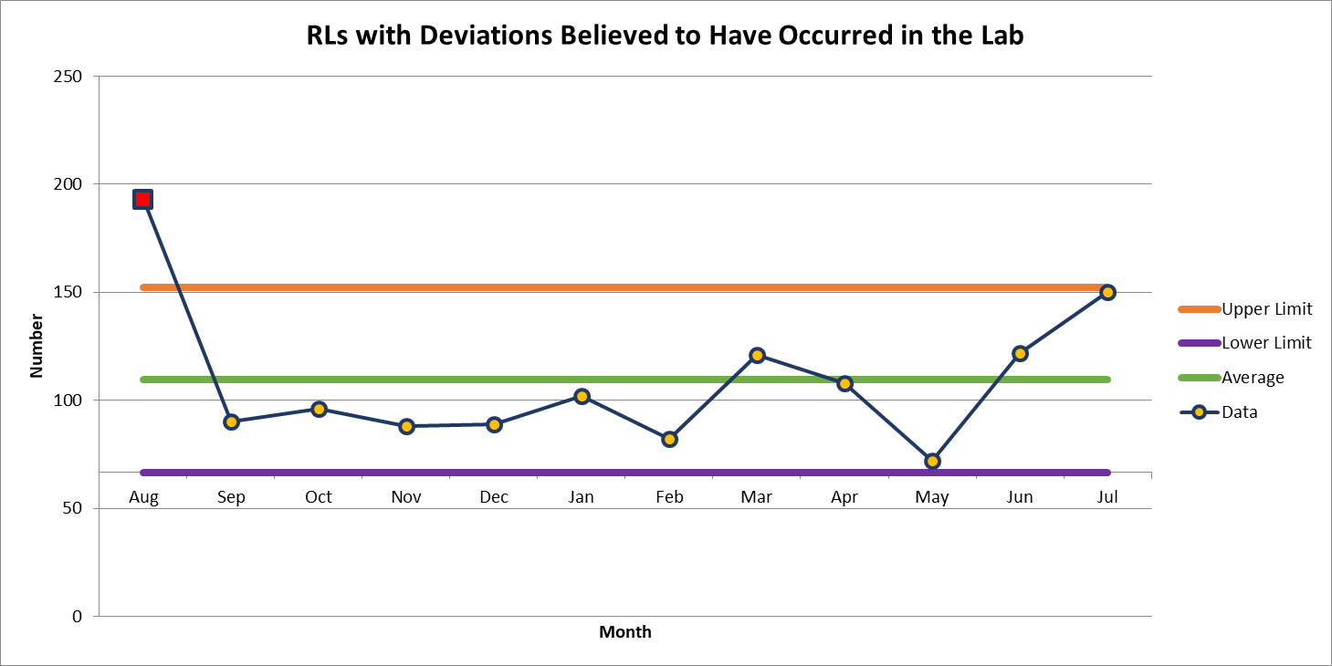
150 Deviations in July

Slide 3
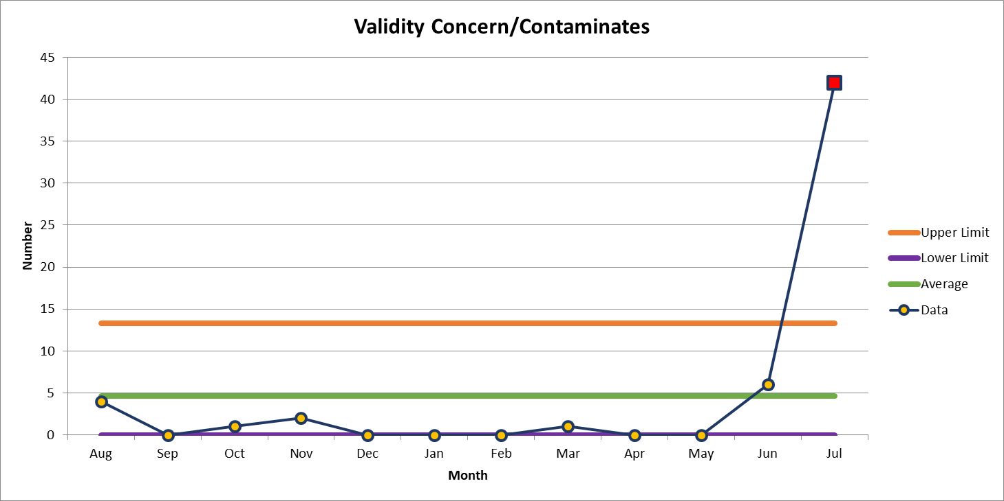
Most common deviation in July
42 Deviations in July

Slide 4
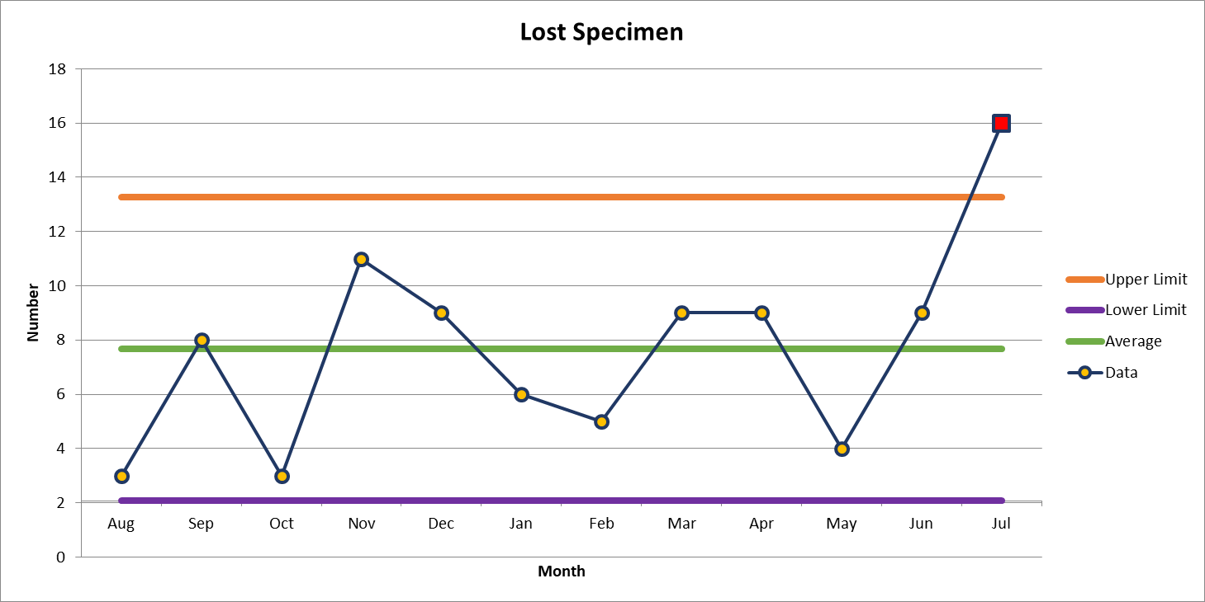
2nd most common deviation
16 Deviations in July

Slide 5
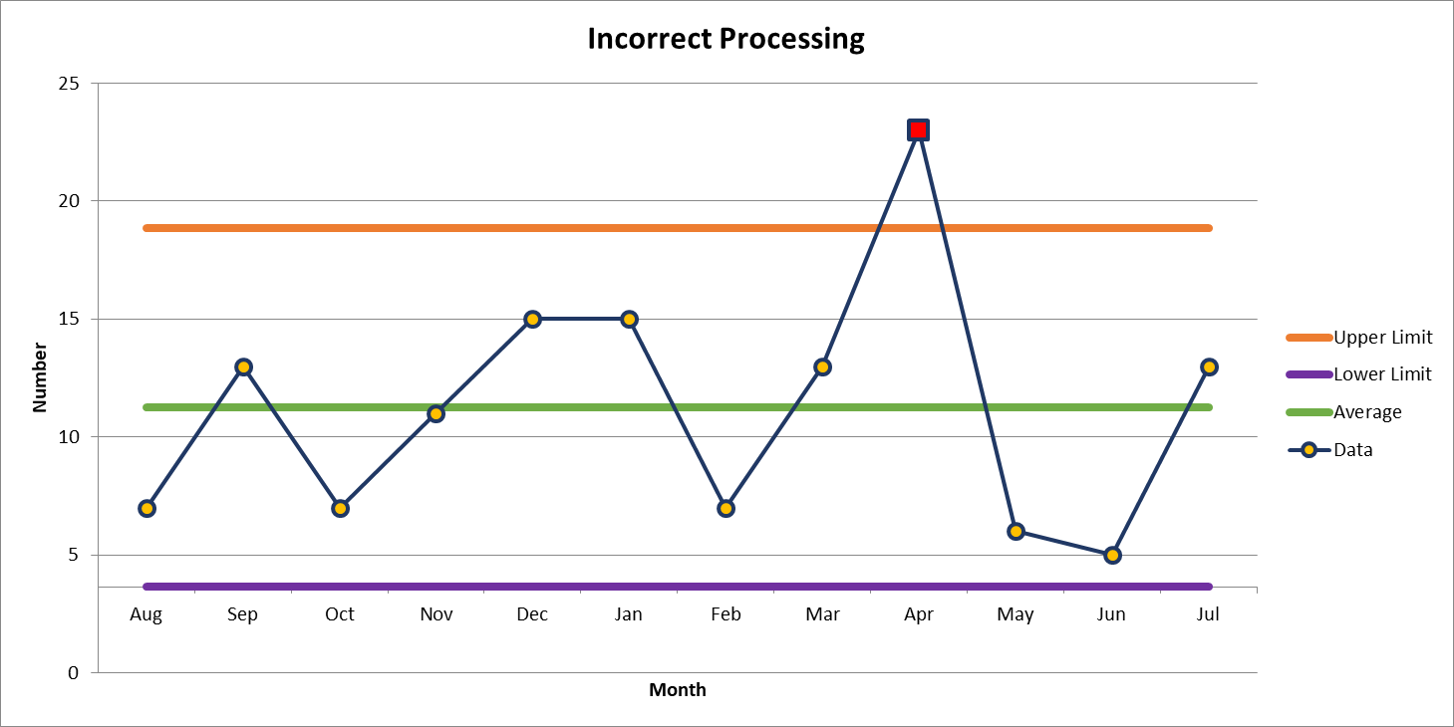
3rd most common deviation
13 Deviations in July

Slide 6
Lab Employee Hazard Awareness
August’s Topic:
Slips and Trips

Slide 7
Slips
Look out for small amounts of liquid on the floor that are not easily visible:
      Leaks – Sinks, equipment waste and reagent containers.
      Drips – Condensation drips, drips from moving containers of liquid or ice.
      Spills – When refilling equipment containers, transporting liquids.
      Completely dry areas of Leaks, Drips and Spills

Slide 8
Trips
Look out for:
      Cords – Equipment that is not against a wall may have cords stretched across walkways
      Raised Floor – Floor transitions, matts on the floor
      If trip hazard is unavoidable, create awareness with signage or barriers

Slide 9
Injured on the job
Report all job related injuries to:
Hannah Phillips – Lab Safety Coordinator
hkilpatr@wakehealth.edu 336-716-4347
Shelley Bowman – Lab Quality Safety and Accreditation Director
shportis@wakeheatlh.edu 336-713-4144

Slide 10
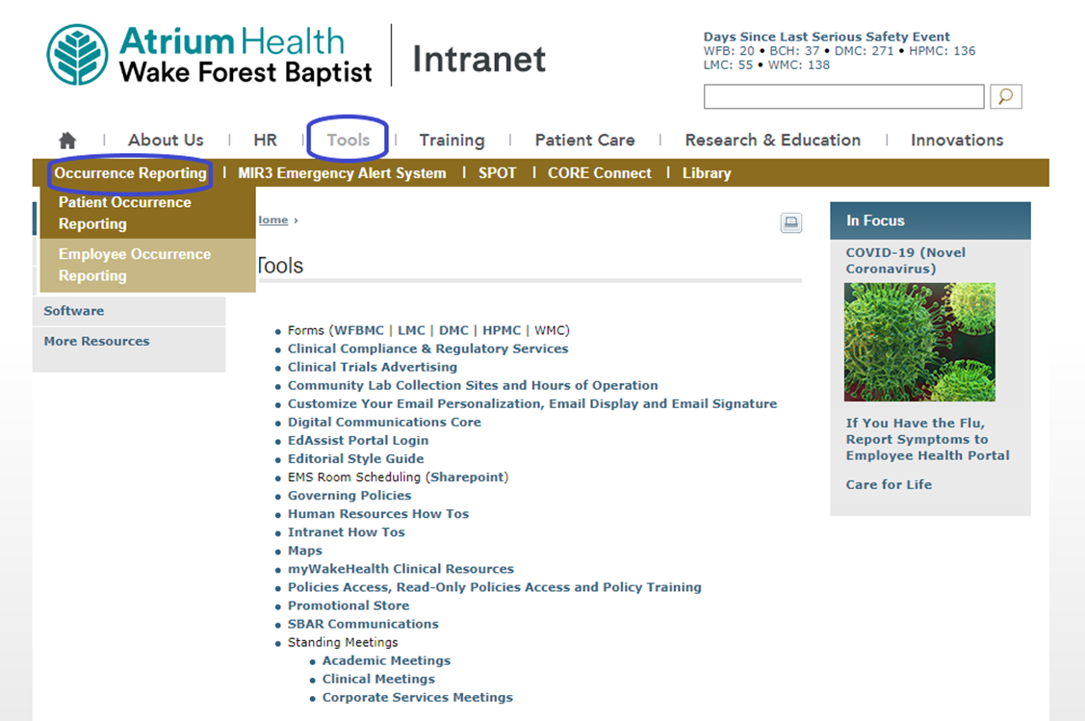
Injured on the job
Also report using the occurrence reporting form on the intranet

Slide 11
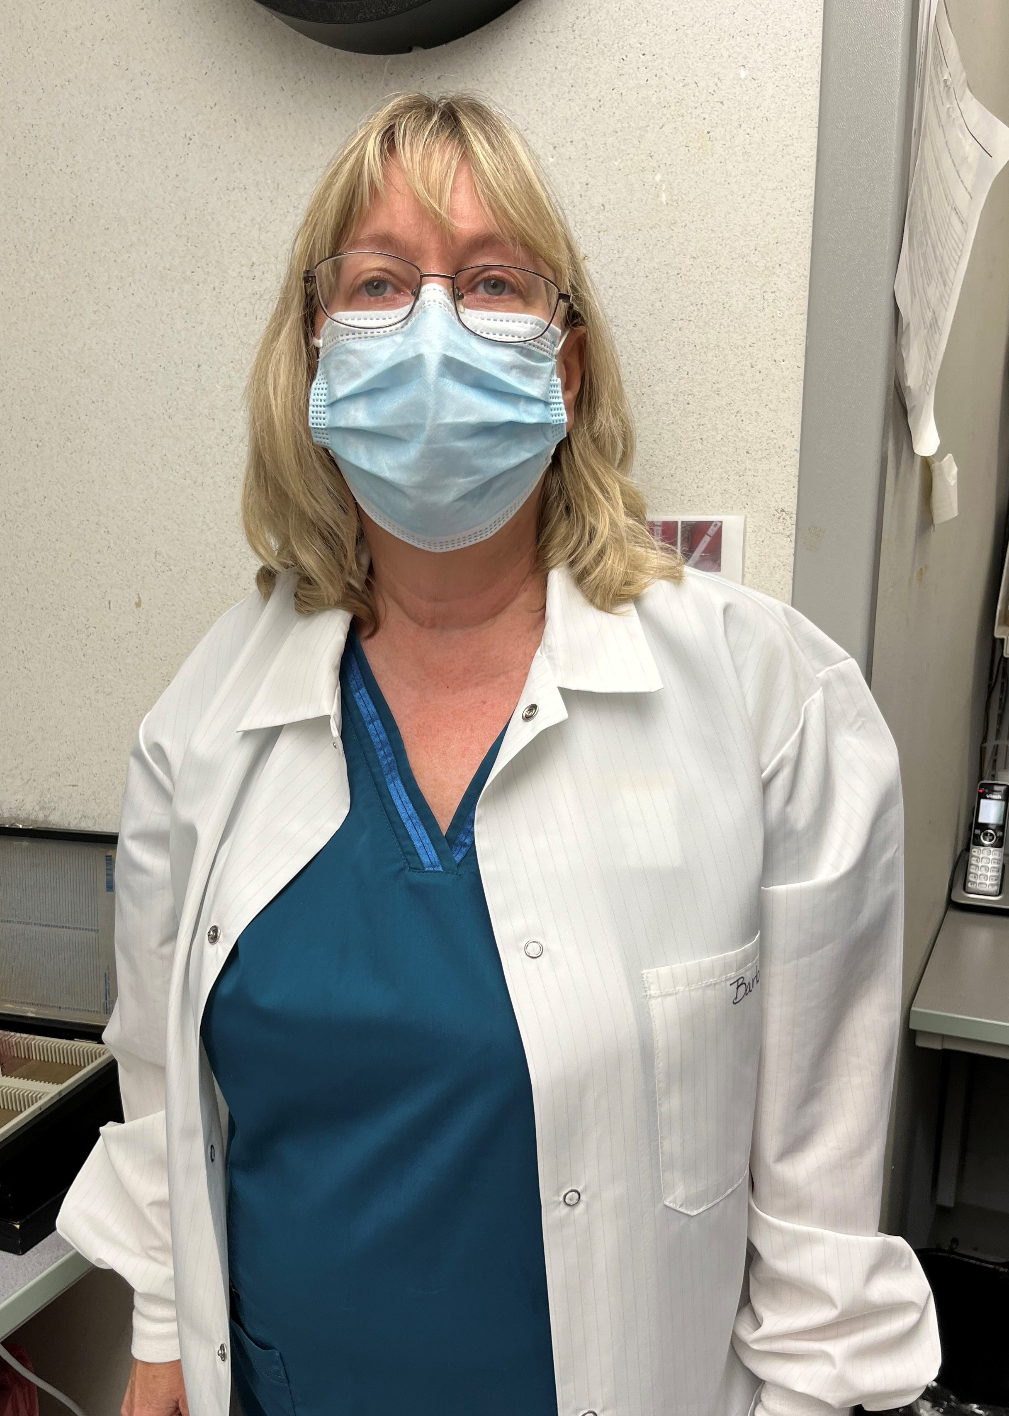
July Safety Topic of the Month Quiz
86 respondents
69 people scored 100%
Winner of the drawing
  Barbara Price
  from Microbiology

Slide 12



Slide 13
Good Catches in July
Great Work!
Thank you ALL!

Slide 14
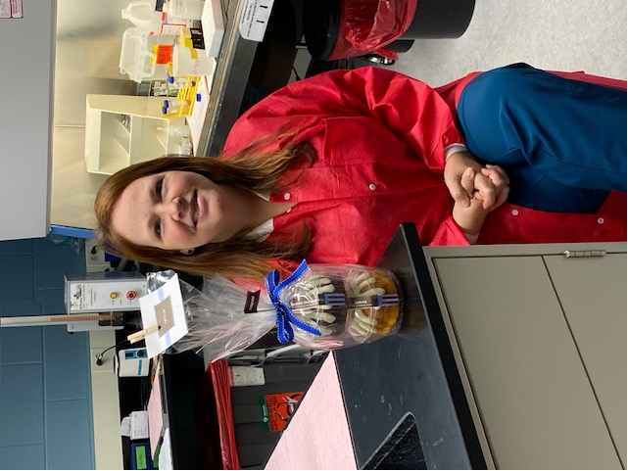
Good Catch Recipient for July
Karla Hackworth
Cytology Lab

Slide 15

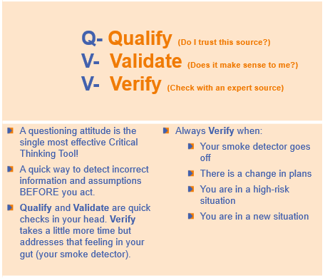
Safety Focus of the Month
If something doesn’t seem right, it probably isn’t.
Ask yourself:
Does it make sense to me?
Does it fit with what I know?
Is it what I expected to see?
To verify, check with an independent or expert source (such as: policy, reference, medical record, manager)

