Slide 1
Lab Meeting
August 24 6:30 and 2:00 pm
In attendance: 0630: BT, CSW, SB, DR, CW, LA, HO, PH, KP
1400: SA, AH, LW, RK, BS, SW, DB, JAB

Slide 2
THANKS!
September was the first schedule in over a year with no holes!
Largely in part to schedule changes adopted by several techs in the departments
Huge shout out and thanks to everyone for your help in covering these shifts for the past year.

Slide 3
Whole Blood Availability
September 1st
WB to all Adults for MTP trauma
Adults : ≥ 16 years OR ≥ 50kg (110 lbs)
New signs up in ED
New procedure in T21
You MUST do Read and Sign BEFORE Sept 1st.
MTP on NON-Trauma: Can get O pos WB if patient is O Pos
Patients with Anti-D should NOT get Rh Pos WB, RBCs or Plts!!
Acceptability for O pos packed RBCs mirrors WB policy starting Sept 1st.

Slide 4
NOTIFY PATH
In email (Fadeyi and mgmt.):
Anytime a female of childbearing age (<51 years old) receives WB
Anytime an RH negative patient (male or female) receives Rh pos RBCs or WB
In email include name/MRN
Till Sept 1, 2023
IRB approval
Immediately:
Use Path on call pager if after hours
Any patient with Anti-D who received Rh pos RBC products
Any patient with any allo-antibody who received antigen positive RBCs
Also send email to Fadeyi and mgmt!
Forever

Slide 5
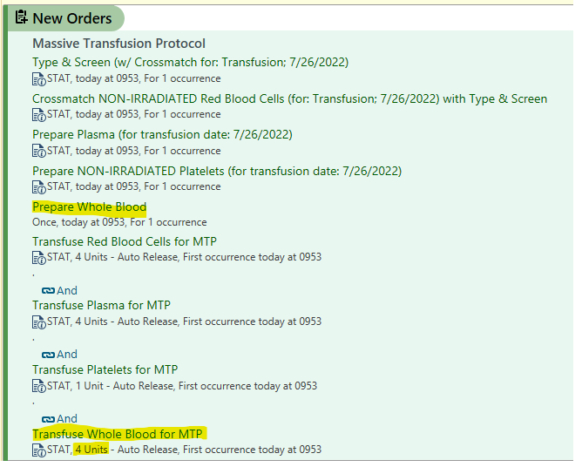
MTP Orders (Sept 1st)

Slide 6
SCC Changes
Rh pos to Rh negative patient: currently the exception is Green
Sept 1st the exception will be RED
There is no additional exception generated for when a patient with Anti-D is given Rh pos RBCs b/c the D antigen is not entered into SCC…it is built into the type. So SCC cannot look for the antibody /antigen mismatch the way it does with others.
Slow down and read the SCC exceptions
JJ is making a list of all SCC exceptions and what they mean. This should be out soon.
Never bypass an exception that you don’t understand!

Slide 7
TROOP Trial
MTP components vs. Whole Blood
Survival and Cost effectiveness (length of ICU stay, etc.)
Errors may happen, what cannot happen is delaying blood to patients

Slide 8
Inventory Changes
Decrease IPSM weekly order to 12 A / 4 AB
Cancelled 15 NLR WB from Texas
Sept 1st will begin getting 4 NLR WB from OneBlood on Tuesdays
Set this blood aside for the LIMB study
When new blood arrives, release the old 4 units for Trauma patients
Rotate out weekly
10 O pos and 10 A pos packed RBCs on Mondays from TBC
Considering decreasing our sickle neg order

Slide 9
Inventory
Try not order blood ad hoc (standing orders should be sufficient in most cases)
Count in the next day’s standing order before you order
Remember that third shift will release blood at midnight
MTP pack is back in Winston
Will evaluate decreasing inventory levels in the next few weeks
Cancel standing orders if inventory necessitates
Prioritize short dated units.
Transfer ALL units in blood hub when sending to a facility that has an ARC account.
Transfer in SCC only to facilities that do not have ARC accounts

Slide 10
Inventory Issues
When units come back, return them in SCC by scanning
Every shift MUST ensure all units issued on their shift, including on downtime are cleaned up before handing off to next shift!
Do not re-use plasma Xerox sheets. They must stay attached to downtime forms.
Do NOT throw anything away without discarding it in SCC first!
GOAL: NO more LOST UNITS!
FDA: Requires tracking of units from collection to disposition
6 QAs in one day about inventory discrepancies
Physical and Electronic inventory MUST match
Copies of liquid plasma MUST match
Issue units ASAP. Do NOT wait.

Slide 11
NO blank spaces!
“NA” for anything not done that day or not needed
Vision log: removing reagents from Vision at end of shift
QC sheets: Audits, processing, etc. Make sure all daily, weekly, monthly QC sheets are complete before end of shift
PPE only in “dirty areas”
Floor tape coming to help distinguish our ‘mixed’ areas.
More QAs coming
Any time mgmt. needs to communicate a deviation to SOP (missed QC log signatures, etc.)
QA will demonstrate documentation and tech knowledge of events
Compliance doesn’t like emails

Slide 12
NO overwrites!
Cannot make a 6 an 8
If error: line through, initial and date
We have been written up for this before by CAP…do not want to have this issue again
Pencil only for ruling in/out on antigrams
All reactions must be documented in PEN
NO whiteout in lab…EVER

Slide 13
Procedures
We have procedures…they must be followed. “I didn’t know we had a procedure or I don’t know where to find that in the procedure” are not acceptable reasons to do whatever you think is best.
Asking Charge/experienced techs should NOT be in place of consulting procedure except in STAT situations
Questions should be: “Charge tech, where can I find the procedure for sample rejections?”
Everyone MUST read the procedures every year in T21 and sign in Medtraining that they have read them
Inspectors will ask to see the procedure for the test/task you are performing…you HAVE to know where it is and follow it exactly!

Slide 14
You are the expert
Our procedures leave room for tech interpretation and decision making.
Use your education and knowledge to guide you on further steps
You can ALWAYS call me/BT if you need reassurance/guidance, etc. BUT…we don’t have the procedures in front of us so we may ask you to look it up first
Goal to be live with T21 by Oct 1st.
Any changes to procedures should come to me/BT. These will be prioritized accordingly based on the problem

Slide 15
Work Smarter…not harder
If patient DAT is positive: antigen type manually with monoclonal antisera
You must have a negative reaction for results to be valid. Question validity of testing if all results are positive
Before doing a kidney titer, you MUST know the patient’s ABO
Titers: repeats and previous results
Panel QC…you must tell us the panel number: A1, A2, etc.
You must check for QC within the past 24 ours on Vision before running antigen typing, or you have to do QC
Key operators: Do NOT reprogram Vision QC without printing the QC for the analyte you are reprograming (we lose the data)

Slide 16
Work Smarter…not harder
Maintenance logs: Every tech in BB has the ability to place a trimedx ticket. Do not place an out of use flag on a piece of equipment without filling out a maintenance log and placing it in the folder on the bridge.
Emails do not suffice
Anyone should be able to pull the maintenance folder down and track an instrument issue
Write “NC” (no charge) for antigen negative RBCs when we didn’t order the antigen to be negative. Example C,E,K, Jka neg unit on our standing order of sickle blood. Jka was not requested and is a freebie and should be marked “NC” on the blue card. This charge is not passes on to patients since we did not pay for it.

Slide 17
Work Smarter…not harder
If we have an overflow of sickle negative blood, cancel the standing order.
Keep units in order of expiration in the fridge…you may have to rearrange things and grab from overflow shelves.
If sickle blood supply is sufficient and freebie antigens arrive, place them on the regular inventory shelves for others to grab.
$$$ If you need a K negative unit, or an E negative unit, consider screening instead of using a sickle unit.
If blue cards are marked “held” then hold them in SCC.
If you rip off the held info…un-hold it in SCC
Think about who is following you. Set up your area for success.

Slide 18
What is your biggest weakness in the lab?
How can management help?
Training sessions?
Explain reason behind protocols?
Define Standards?
CE / quizzes?
Edited Forms?
Example: I always forgot to change the segment bag. Adding this as a task to the QC sheet served as a reminder.

Slide 19
AABB Inspection Window
October-December 2022
Last inspection: cited for:
ABO retypes (forward only)
No ABO confirmation before issuing type specific units (other than O)
They will focus on this. KNOW our policy for ABO2 like the back of your hand!
Lab ownership: This is OUR lab and we should all strive to make it the best blood bank possible.

