Slide 1
Lab Safety Presentation
September 2022

Slide 2
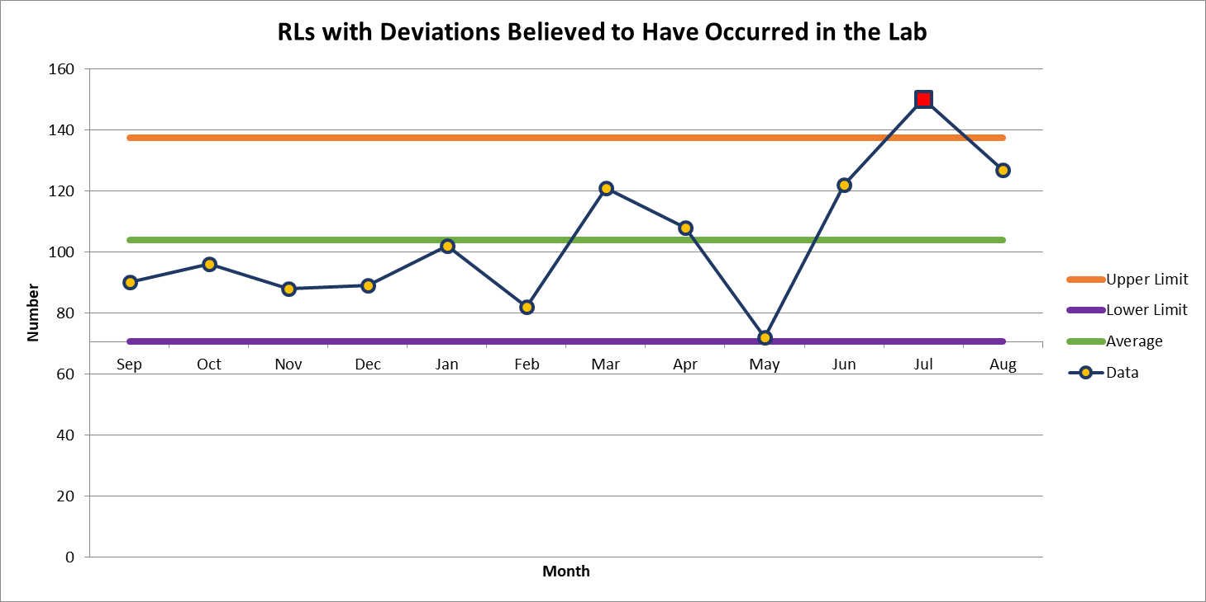
127 Deviations in August

Slide 3
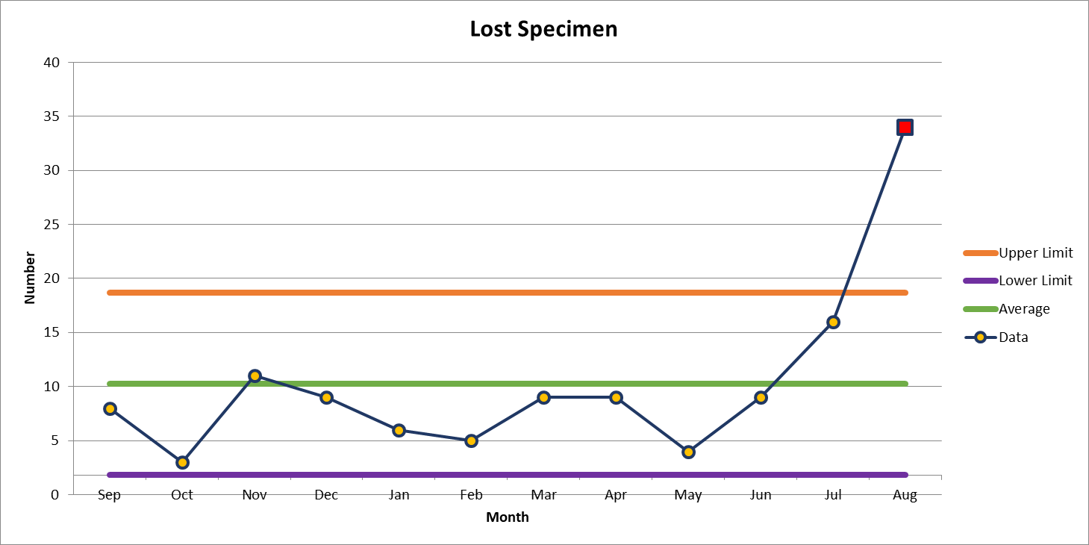
Most common deviation in August
34 Deviations in August

Slide 4
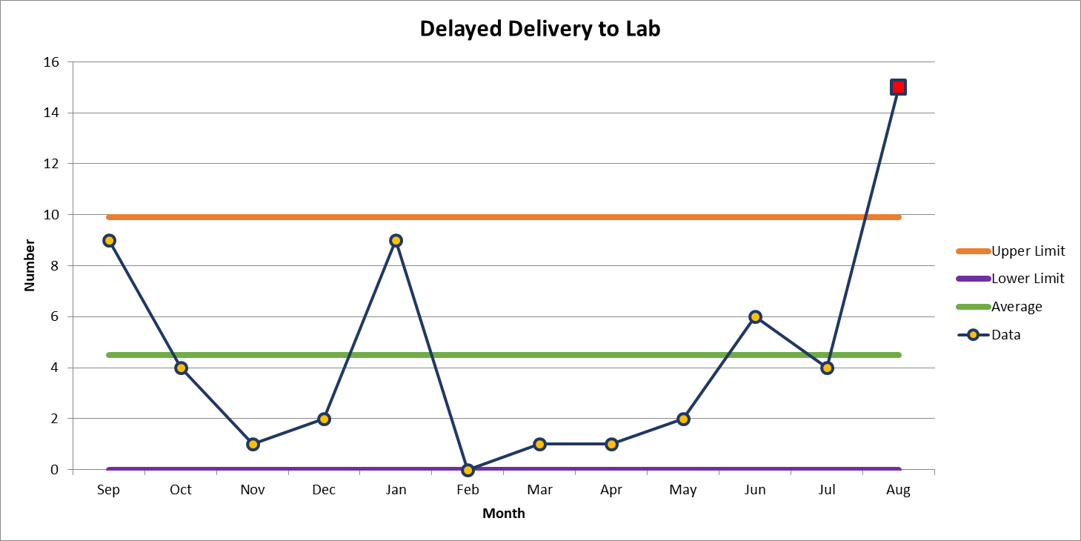
2nd most common deviation
15 Deviations in August

Slide 5
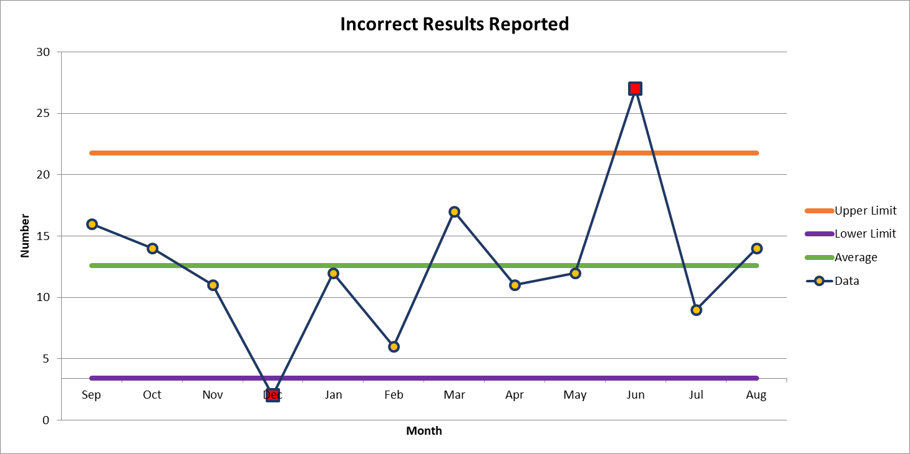
3rd most common deviation
14 Deviations in August

Slide 6
Lab Employee Hazard Awareness
September’s Topic:
Know Your Safety Rep

Slide 7
Know Your Safety Rep
What is a Safety Rep? They represent your lab on the Lab Safety Team
What is the Lab Safety Team? A group that meets monthly to discuss and resolve safety issues in the labs
What is my safety rep here for?
  Safety concerns
  Education about lab safety
  Encourage safe practices

Slide 8
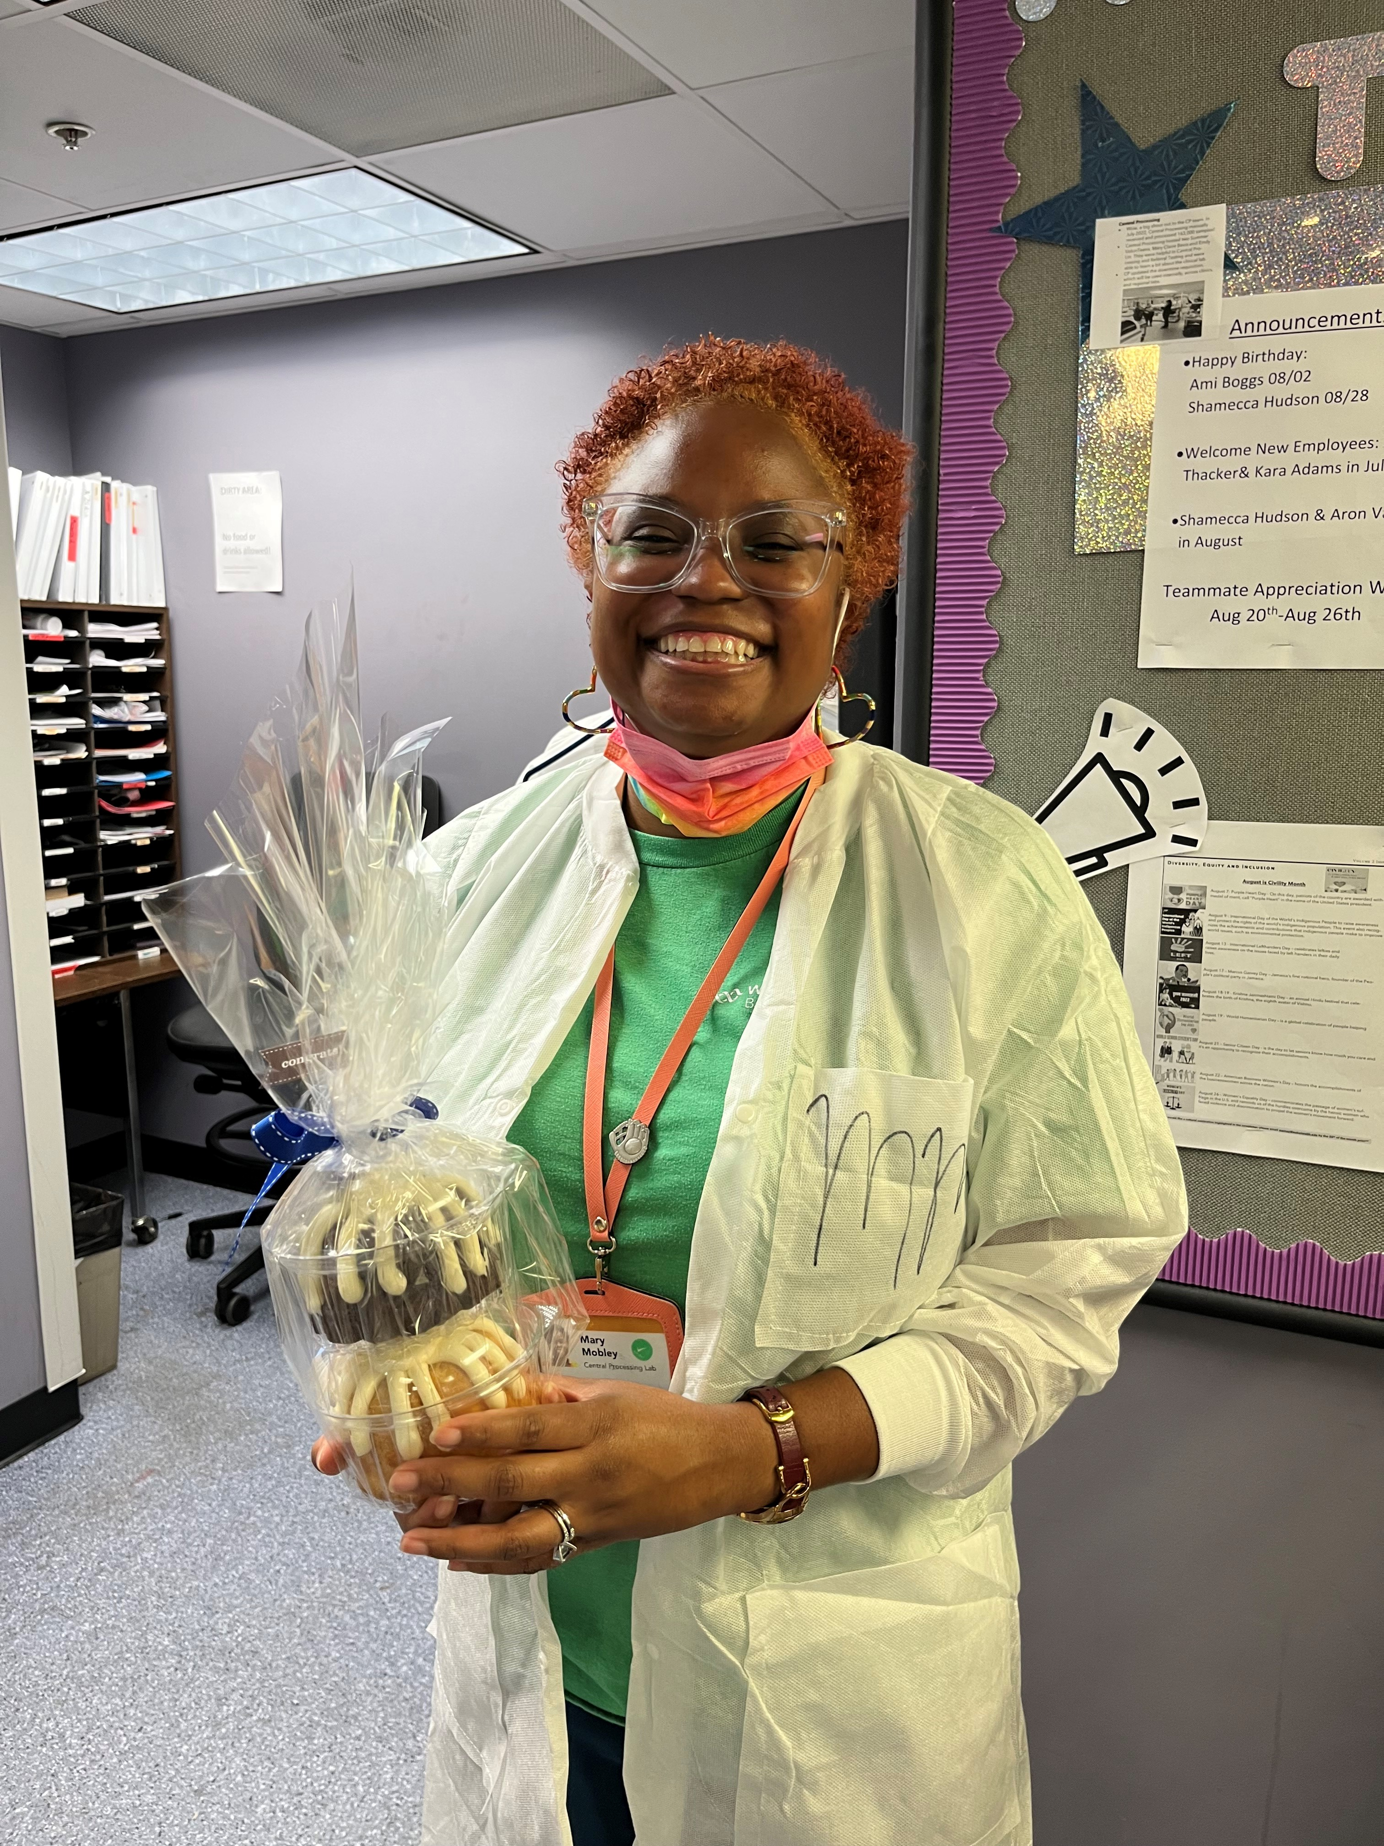
August Safety Topic of the Month Quiz
79 respondents
55 people scored 100%
Winner of the drawing
  Mary Miller
  from Central Processing

Slide 9



Slide 10
Good Catches in August
Great Work!
Thank you ALL!

Slide 11
Good Catch Recipient for August
Konya Harris
OR Path Lab

Slide 12
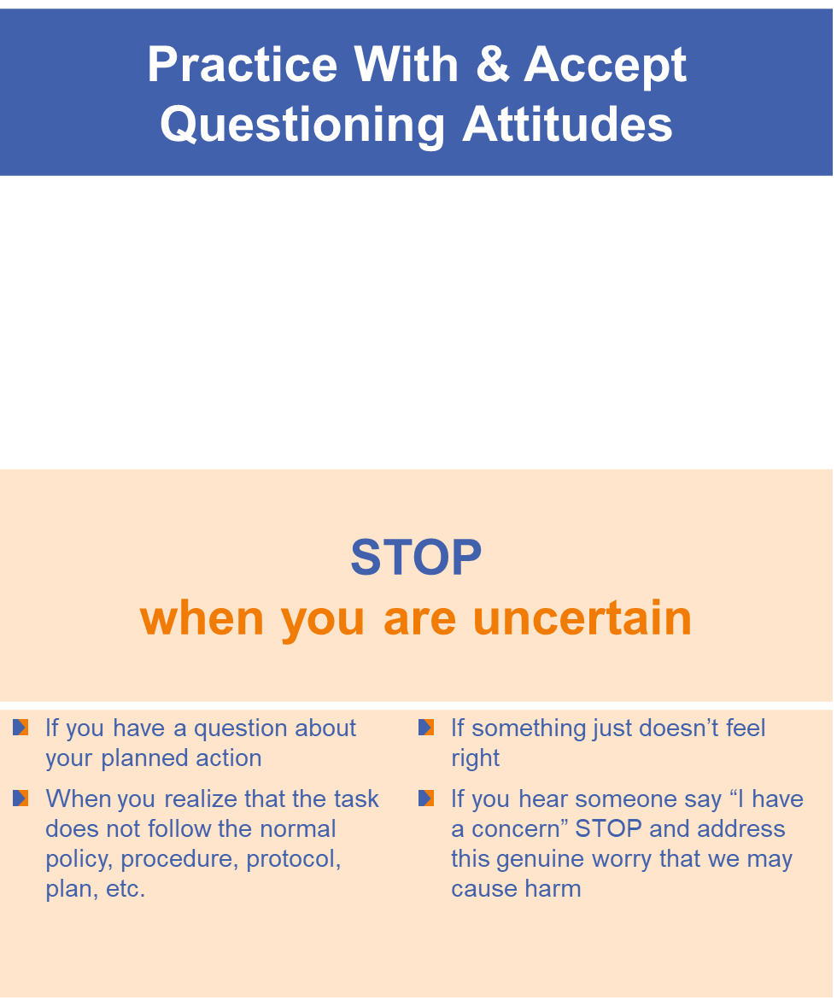

Safety Focus of the Month

