Slide 1
Lab Safety Presentation
October 2022

Slide 2
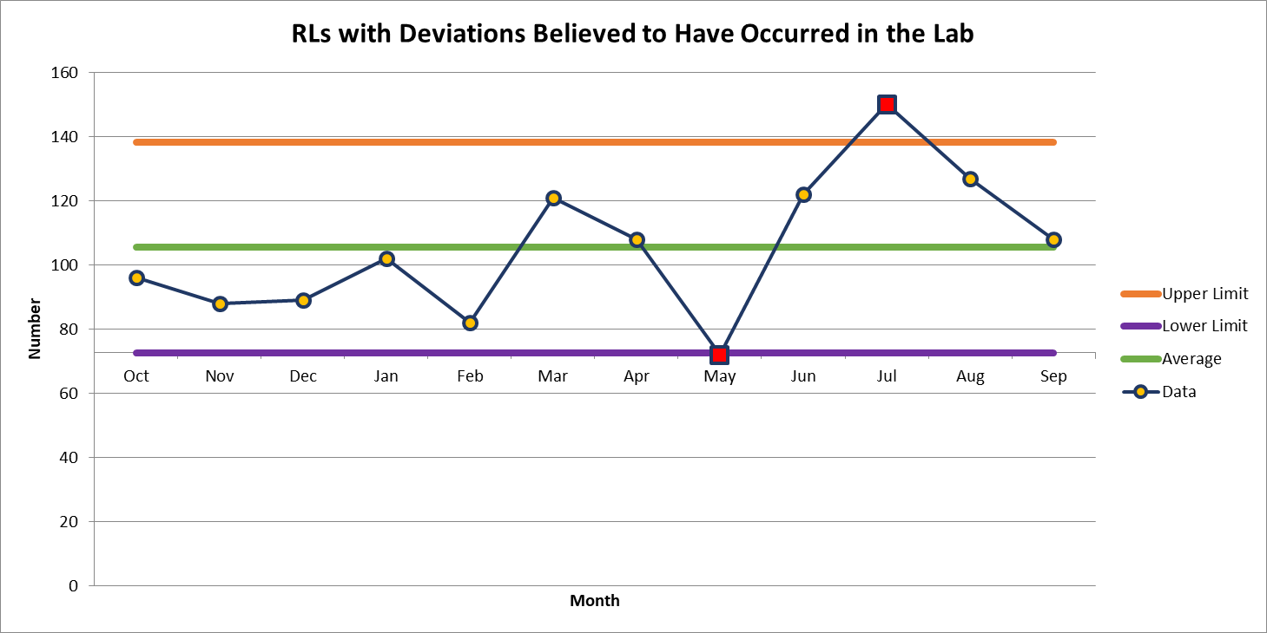
108 Deviations in September

Slide 3
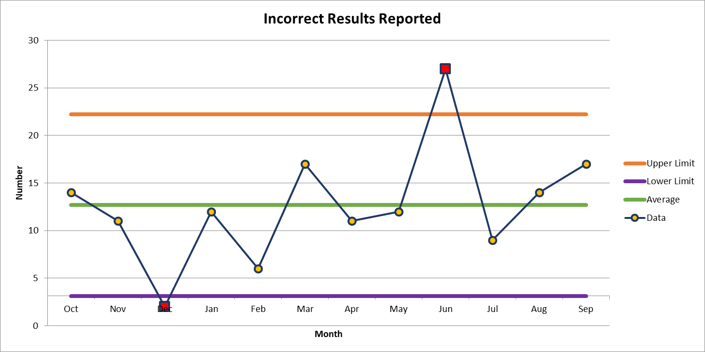
Most common deviation in September
17 Deviations in September

Slide 4
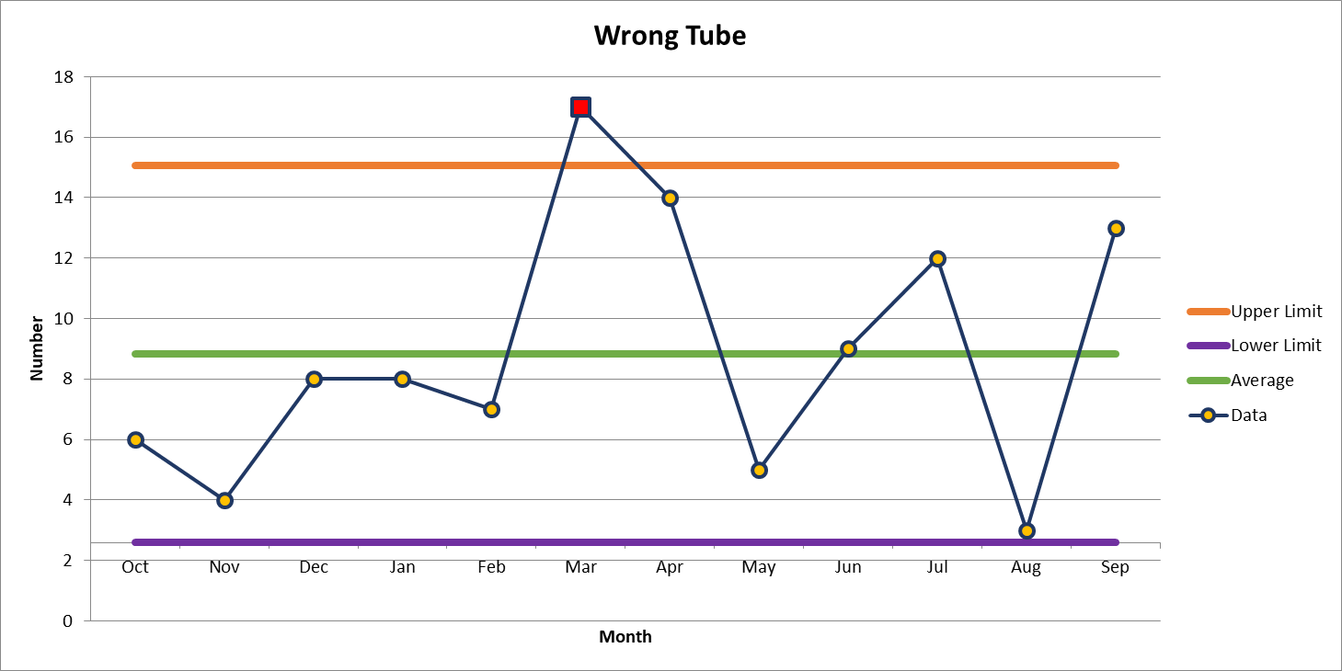
2nd most common deviation
13 Deviations in September

Slide 5
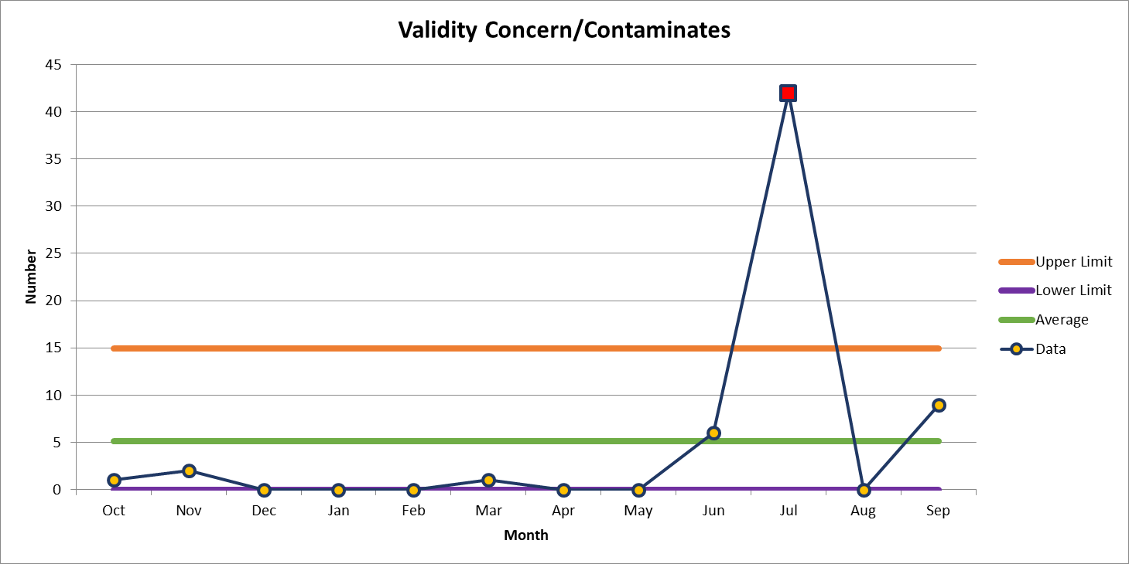
3rd most common deviation
9 Deviations in September

Slide 6
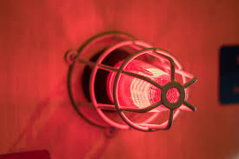
Lab Employee Hazard Awareness
    October’s Topic – Fire Alarm Response

Slide 7
Clinical Labs
Defend in place
    The clinical lab is designed for you to continue to provide patient care in the event of a fire

Slide 8
Non-clinical Labs
    Evacuate if possible
        If leaving could negatively affect patient testing two people can remain in the lab
        One person to preform the testing, another person to maintain outside communication and monitor surrounding areas for signs of a fire

Slide 9
Tests and Drills
Tests are performed annually
    Advanced notice will be provided
    Evacuation is not necessary
Drills are conducted annually
    Unannounced
    Respond as you would to any other fire alarm

Slide 10
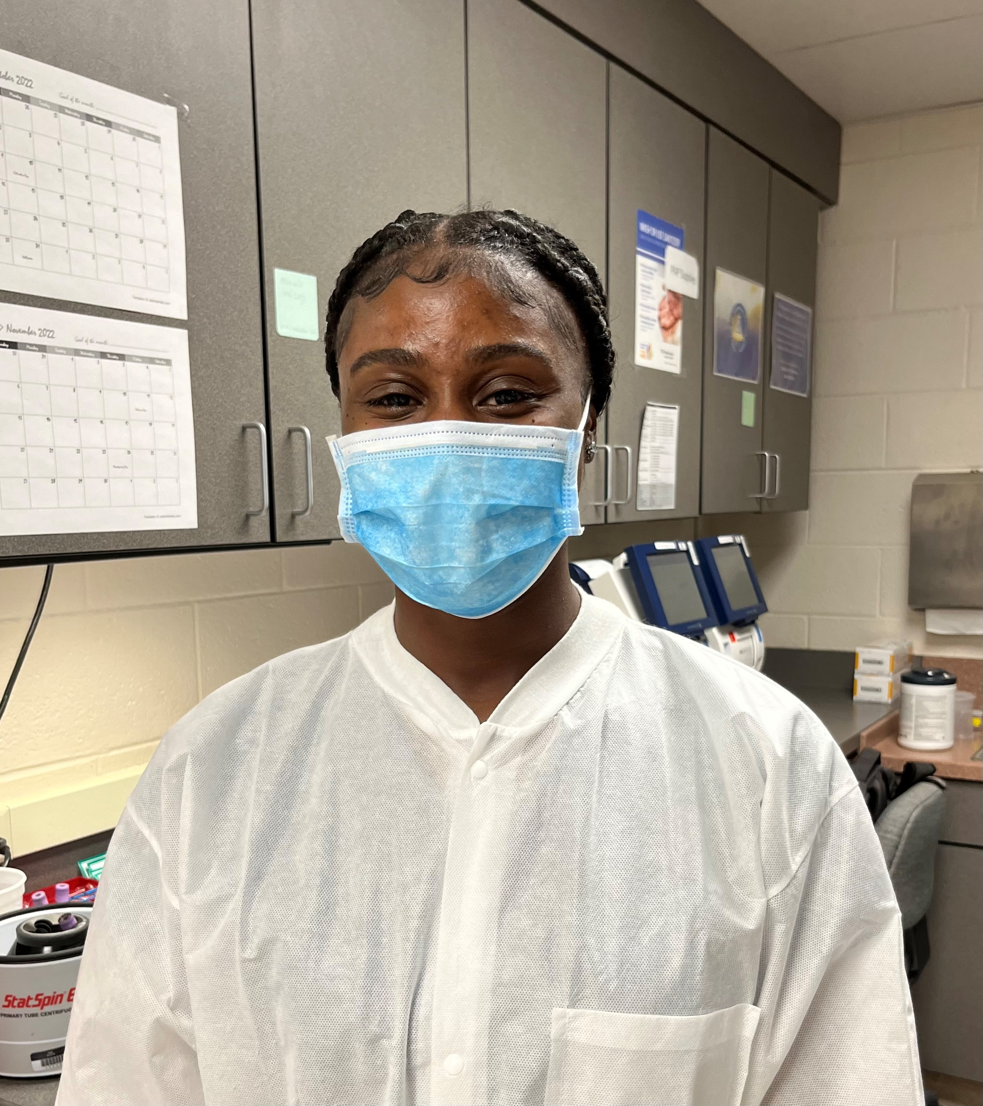
September Safety Topic Quiz
81 respondents
75 people scored 100%
Winner of the drawing
  Jyneasha Johnson
  from the Blood Gas Lab

Slide 11



Slide 12
Good Catches in September
Great Work!
Thank you ALL!

Slide 13
Good Catches in September
Great Work!
Thank you ALL!

Slide 14
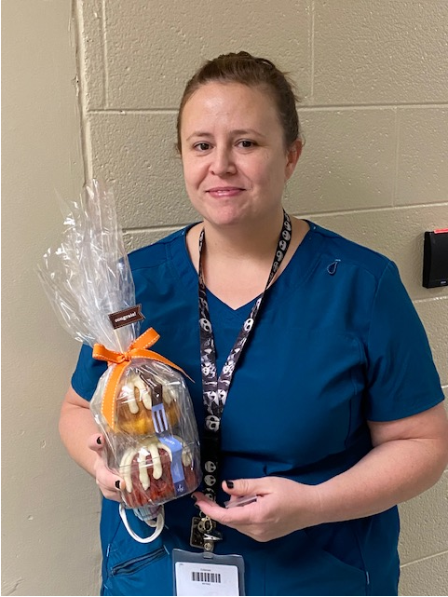
Good Catch Recipient for September
Tifany Coleman
OR Path Lab

Slide 15


Questioning Attitude:
It’s about the answers
Question the answer
Use critical-thinking skills
This helps reduce errors involving assumptions
STOP is the first step to avoid proceeding down the path of uncertainty

Slide 16
Corrections to Lab Records
GEN.20450
Correction of Laboratory Records
The laboratory makes corrections to laboratory records (eg, quality control data, temperature logs, and intermediate test results or worksheets) using appropriate techniques.
NOTE: The laboratory must have a written procedure that defines how to make corrections to both paper and electronic laboratory records. Laboratory records and changes to such records must be legible and indelible. The techniques used must meet the following criteria:
● Original (erroneous) entries must be visible (ie, erasures and correction fluid or tape are unacceptable) or accessible (eg, audit trail for electronic records).
● Corrected data, including the identity of the person changing the record and when the record was changed, must be accessible to audit.
Evidence of Compliance:
✓ Records of corrections to laboratory records AND
✓ Written procedure for correction of laboratory records

Slide 17
QUAL-POL-0004
Correction of Lab Records
Policy Guidelines:
  All changes to laboratory records must be legible and indelible (use of pencils are prohibited).
  Original (erroneous) entries must be visible (i.e., erasures, white and correction fluid are unacceptable) or accessible (example: audit trail for electronic records).
  Use of a single, horizontal line to strike through the original (erroneous) entry is preferred.
  Corrected data, including the identity of the person changing the record and when the record was changed, must be accessible to audit.
  Corrections or changes to records should be noted by the Section Manager/Section Medical Director during the monthly QA review process. If reason for correction/change was other than a minor error, implementation of a CAPA review may be necessary.

