Slide 1
BB / SCTCT Escape Routes
Larry Waldron MT(ASCP)^{CM}
BB Specialist Technologist and Education Coordinator
Georgia Kontos MS, MLS(ASCP) ^{CM}
Blood Bank/SCTCT Safety Representative

Slide 2
FIRE!!!
In Review:
In the event of a fire alarm:
Look for smoke or fire
Smell for smoke
Listen for information over public address system
Report All Fires
Call 6-9111
Activate the nearest pull station
Notify all BB / SCTCT staff
When evacuation required – XM1 person should grab schedule so all employees can be accounted for.

Slide 3
Fire Alarm Response Responses can be different depending on the lab you are in
Clinical Labs
Defend in place – Your lab is designed so that in the event of a fire outside the lab, you can continue to provide patient care
Non-clinical Labs
Evacuate!
Exception: If leaving could negatively affect patient testing - 2 people can remain in the lab
One to continue the testing and the other to maintain outside communication and monitor surrounding areas for signs of a fire

Slide 4
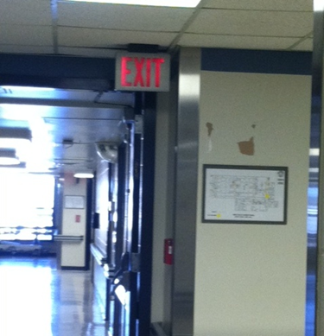
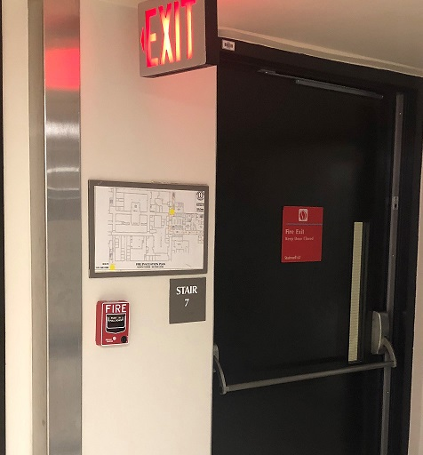
Fire Alarm Pull Stations
Locations of nearest Fire Alarm Pull Station
LOCATION BB:
Out main BB door
Turn right
At elevator well
Fire pull station is on right
directly under red EXIT sign
LOCATION SCTCT:
Out main SCTCT door
Turn Right
Fire pull station is straight ahead
directly under the red EXIT sign,
next to the stairwell
Elevators

Slide 5
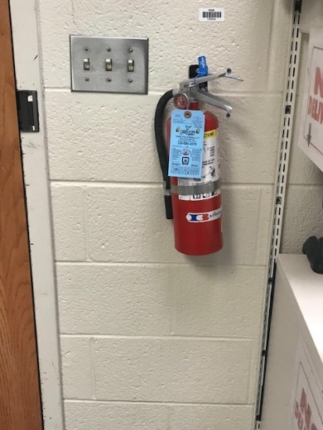
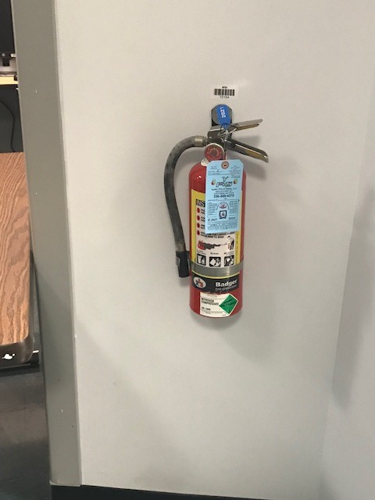
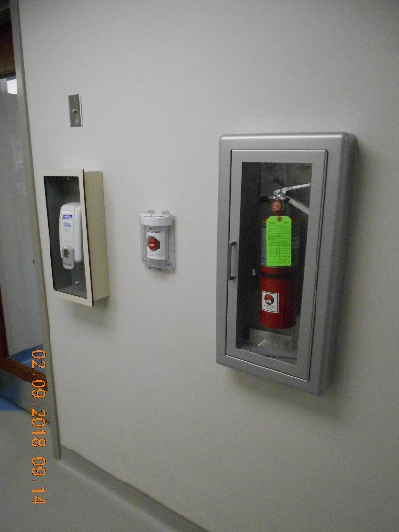
Extinguisher Locations
Fire Extinguisher Locations
In Blood Bank
On the wall next to the front door, under the outgoing mail basket
In the dance hall, across from the student lockers
In SCTCT Lab
In the processing room,
next to the specimen
receipt door
Blood Bank
SCTCT Lab

Slide 6
P.A.S.S.
P.A.S.S.
When using a fire extinguisher remember:
Pull extinguisher pin
Aim extinguisher at base of flames
Squeeze extinguisher handle
Sweep extinguisher from side to side until flames are extinguished

Slide 7
R. A. C. E.
Rescue any persons in immediate fire area without endangering yourself
Alarm: sound the alarm by calling 6-9111 or activating the nearest fire alarm box
Contain the fire by shutting doors and windows, and put wet towels under the door, etc.
Extinguish if the fire is small and localized, and you are familiar with the use of a fire extinguisher, use it to put out the fire – otherwise
Evacuate: use posted evacuation route.
Turn off gas, electrical machinery, close doors, windows as you leave.

Slide 8
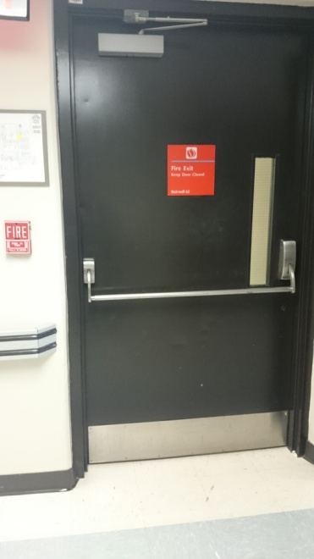
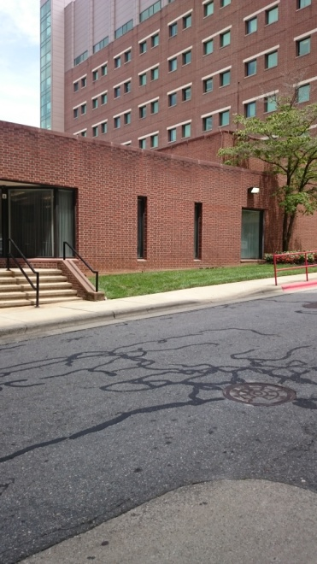
Blood Bank: Primary Escape Route
Exit main Blood Bank door, turn right
Continue down hallway past elevators to door at end
Open door, continue forward through 2 more doors to downward stairs.
Go down stairs to bottom
Exit door to outside
Meet in front of power plant

Slide 9
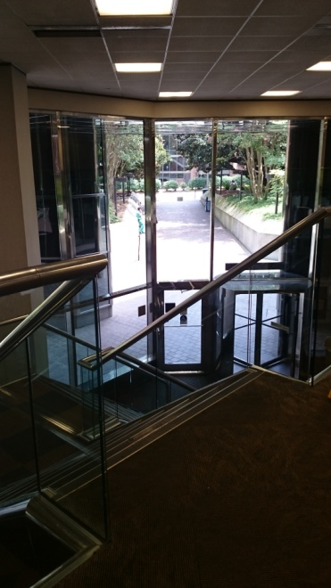
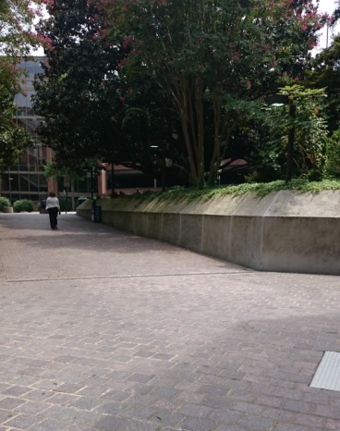
Blood Bank: Secondary Escape Route
Exit main Blood Bank door, turn left
At end of hallway, turn left
At end of hallway “Zig-Zag” right,
then left,
Continue down hallway – staying on the carpeted floor.
Enter Watlington Hall open area
Take steps down
Exit door in front of you
Meet outside Watlington Hall

Slide 10
Blood Bank Offices / Bathroom: Primary Escape Route
Exit door by bathroom
Take a few steps forward then turn left down hallway towards RT elevators
Continue down hallway – staying on the carpeted floor.
Enter Watlington Hall open area
Take steps down
Exit door in front of you
Meet outside Watlington Hall

Slide 11
Blood Bank Offices / Bathroom: Secondary Escape Route
Walk through the conference room to the Blood Bank
Continue as for Blood Bank primary escape route

Slide 12
SCTCT Evacuation Route
Primary
Exit SCTCT through either door. Turn right. Turn right again after the North tower elevators if you exited SCTCT from the cryo room. Go Down North tower stairway at the end of the hall. Exit to meet at the front of the power plant.
Secondary
Exit SCTCT lab through the cryo room. Turn Left. Proceed to Gray building. Turn right down first hallway. Go through double doors. Go down stairway on left and exit building.
BMT Evacuation Route
Second Floor North Tower
 |  |  |  |  |  |  |  |  |  |  |  | Stair Well
 |  |  |  | North Tower Elevators |  |  |  |  | BMT Office and Specimen Receipt |  |  | Service Elevators
 |  |  |  |  |  |  |  |  | BMT Processing and Cryo Rooms
 |  | Stair Well
Primary
Secondary

Slide 13
FAMILIARIZE YOURSELF WITH EVACUATION ROUTES AND LOCATIONS OF FIRE EXTINGUISHERS AND PULL STATIONS!
IF you are confused please ask before it is too late
YOU NEVER KNOW WHEN THIS INFORMATION COULD SAVE YOUR LIFE!

