Slide 1
Lab Safety Presentation
November 2022

Slide 2
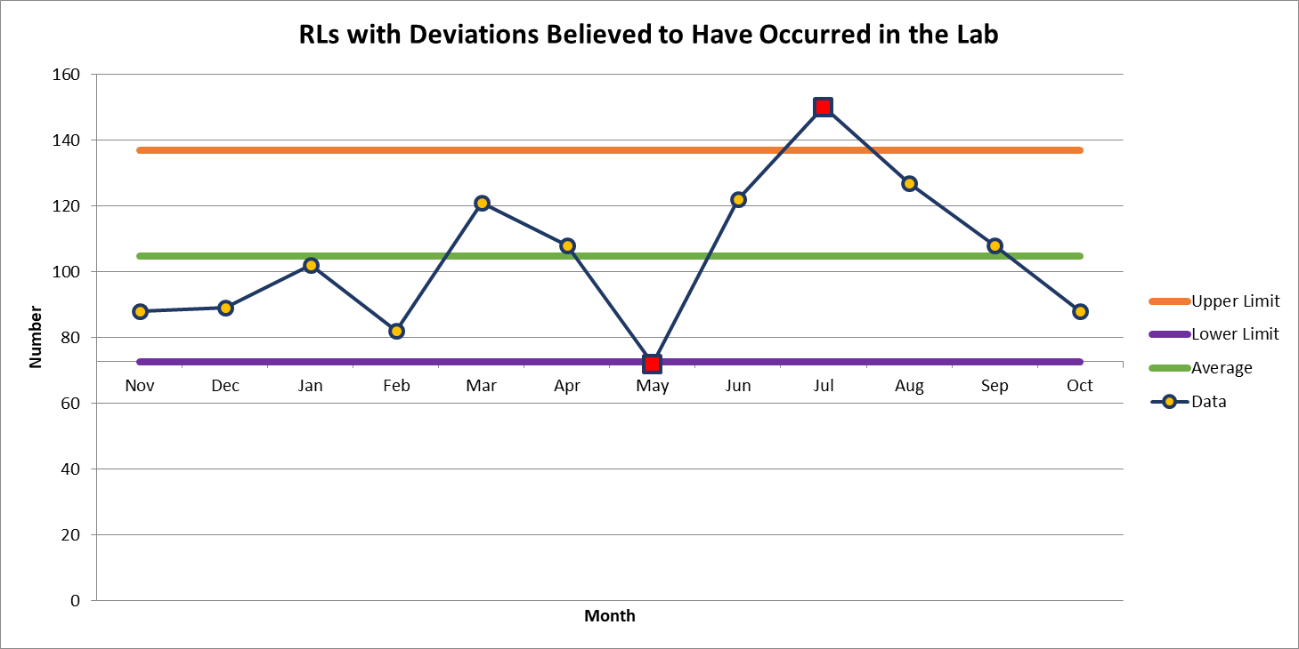
88 Deviations in October

Slide 3
Most Common Deviation in October
Incorrect Results Reported – 11
Labeling Error – 11

Slide 4
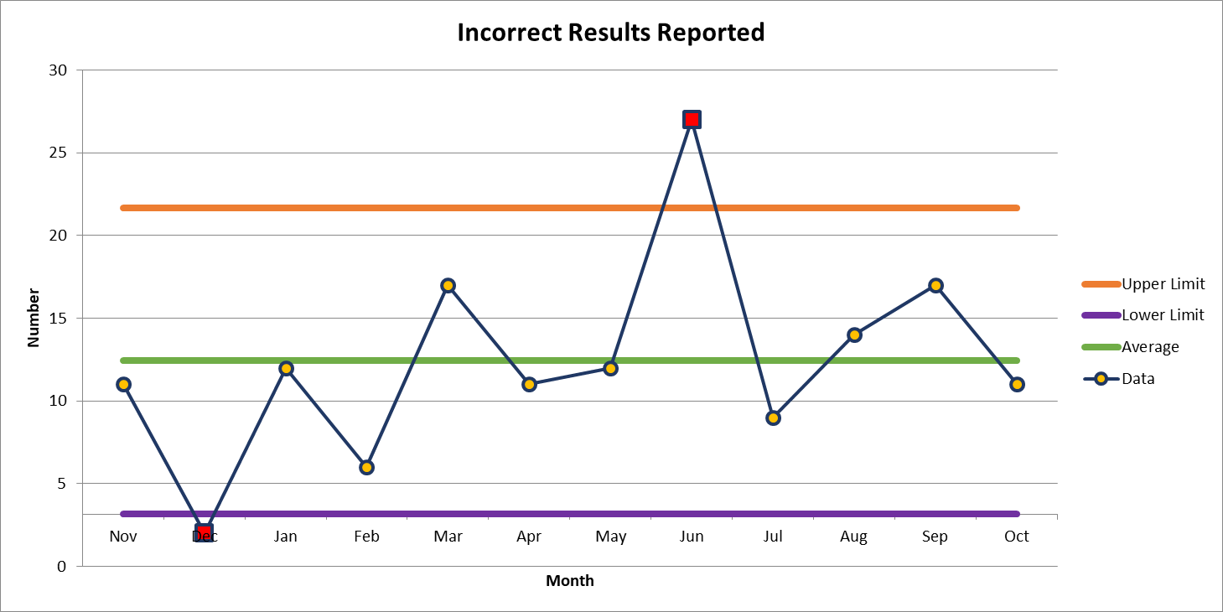
11 Deviations in October

Slide 5
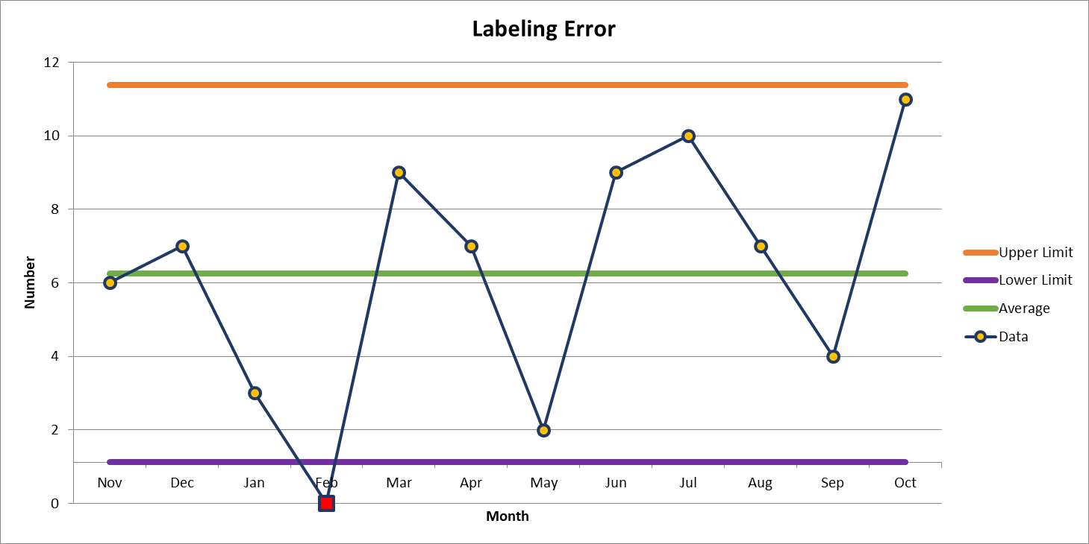
11 Deviations in October

Slide 6
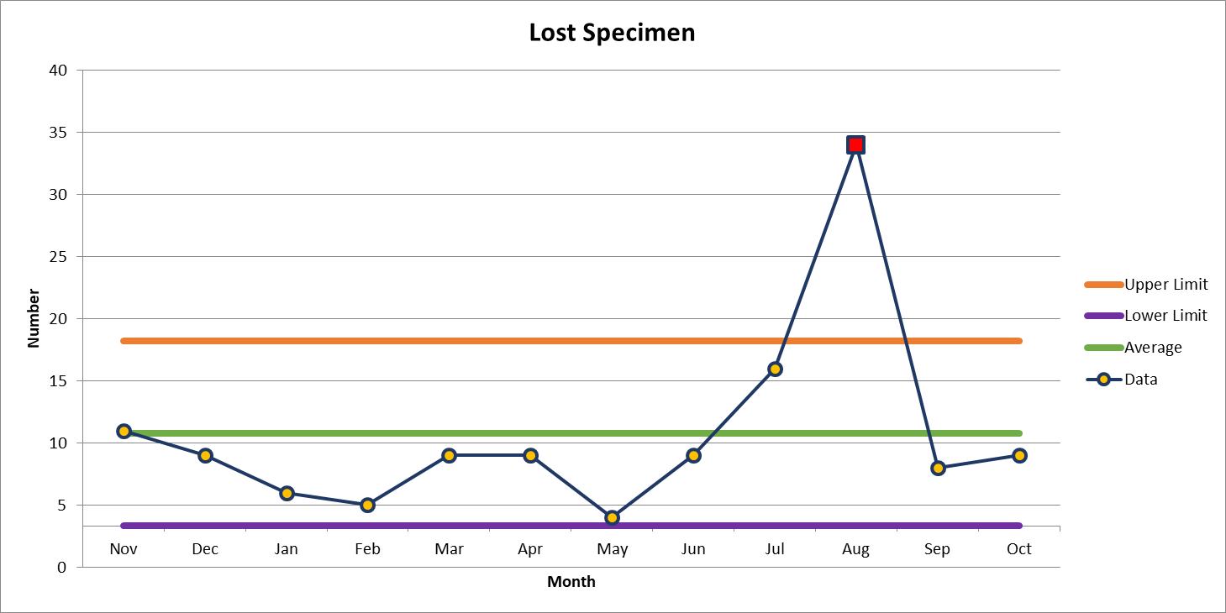
2nd most common deviation
9 Deviations in October

Slide 7
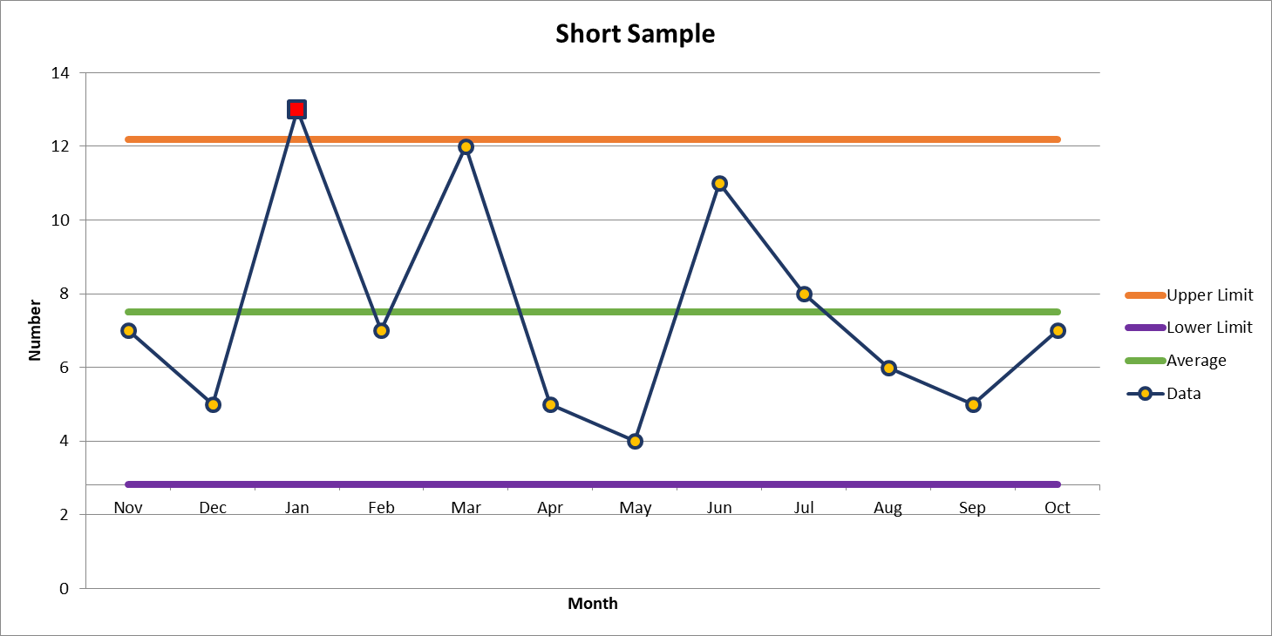
3rd most common deviation
7 Deviations in October

Slide 8

Lab Employee Hazard Awareness
    November’s Topic – Chemical Fumes
      PEL and STEL
      Xylene and Formaldehyde
      Exposure Monitoring
      Liquid Nitrogen

Slide 9
PEL and STEL
PEL
    – Permissible Exposure Limit
    Maximum chemical concentration in the air that an employee can be exposed to continuously for…
      8 hours
STEL
– Short Term Exposure Limit
    Maximum chemical concentration in the air that an employee can be exposed to for…
      15 minutes

Slide 10
Xylene
PEL - 100 ppm (parts per million of air)
STEL - 150 ppm
Symptoms of exposure
    Breathing in small amounts can cause headache, dizziness, drowsiness, and nausea
    Breathing in large amounts can cause sleepiness, stumbling, irregular heartbeat, fainting, or even death

Slide 11
Formaldehyde
Formaldehyde is a carcinogen
PEL - 0.75 ppm
STEL - 2 ppm
Symptoms of exposure
    Long term overexposure to low levels can cause respiratory difficulty and eczema
    Short term overexposure can be fatal

Slide 12
Exposure Monitoring
EH&S perform exposure monitoring
Ensuring that the PEL or STEL are not being exceeded
If it is discovered that the PEL or STEL is exceeded, or the individual is symptomatic, actions must be taken to decrease exposure
      Process changes
      Engineering controls
      Additional PPE

Slide 13
Liquid Nitrogen (LN2)
When vaporized, LN2 can expand to 695 times in volume
The expansion of the gas can replace the Oxygen in the room, causing Asphyxiation
LN2 gas has no color or odor

Slide 14
Liquid Nitrogen (LN2)
Oxygen Monitoring
    Safe Oxygen level in the air
      19-25%
    An Oxygen monitoring system must be installed in areas where LN2 is stored
        The system is to alert you when Oxygen levels in the room are less than the acceptable percentage
        If alarm is activated you should…
                Evacuate IMEDIATELY

Slide 15
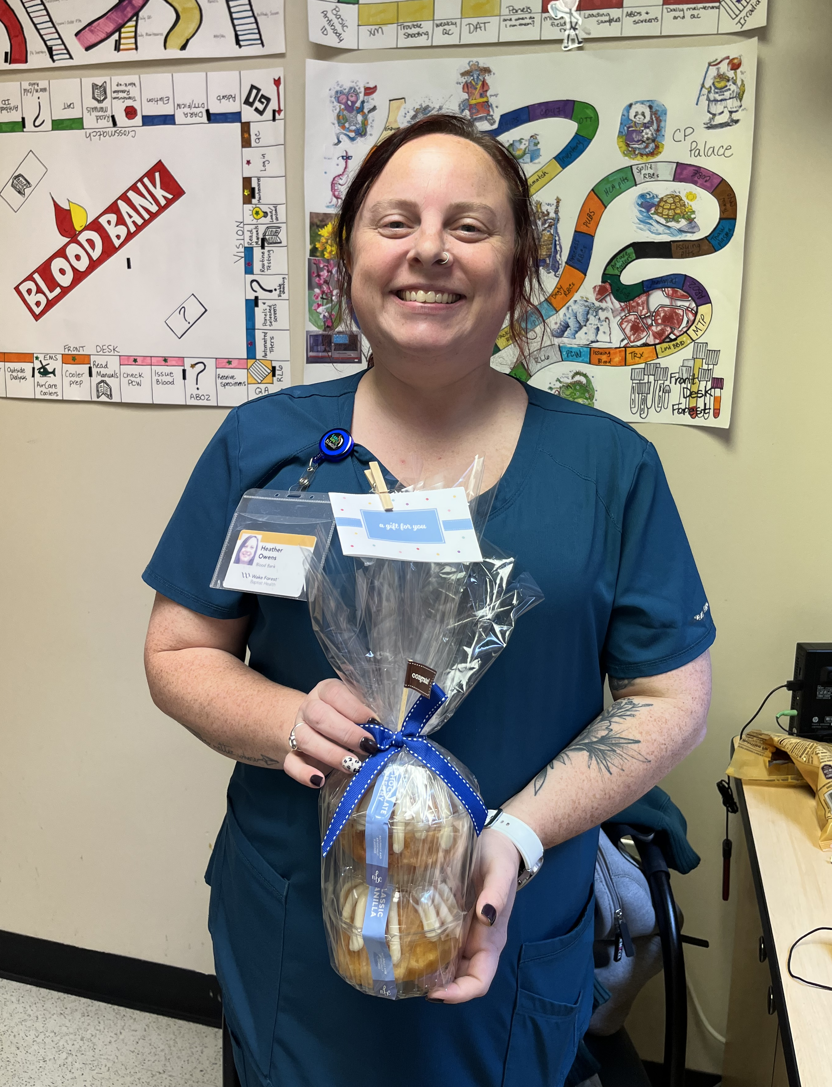
October Safety Topic Quiz
74 respondents
58 people scored 100%
Winner of the drawing
  Heather Owens
  from the Blood Bank

Slide 16



Slide 17
Good Catches in October
Blood Bank | Julie Jackson | Blood Bank was contacted about establishing a protocol for TAAA cases. The first case was set for 10/17. Blood Bank found the patient and while the patient had no antibody history in our system, Julie Jackson found a history of antibodies at an outside hospital while helping the team place their orders. Blood Bank was able to contact the team and alert them of this issue and get pre-op labs scheduled differently to prevent delay in patient care for this case expected to take a lot of blood products.
Blood Bank WMC | Ashley Billings | Ashley identified that when there is a RBC add-on the patient's BBID number is not being entered properly. Instead of entering the BBID number, the user is typing in all Xs.
Critical Care Lab | Beth Gallos | Blod gas results came back as K 1.40, Ca++ 0.62, hgb <4.8 , CO2 18.2, Repeated with same results on another analyzer. I compared to 0600 BMP and results were vastly different. Called to charge nurse, spoke with patient nurse. Drawn from A-line they didn’t think it was contamination but were willing to redraw due to absurd results. Redraw came in and all values within range.
Great Work!
Thank you ALL!

Slide 18
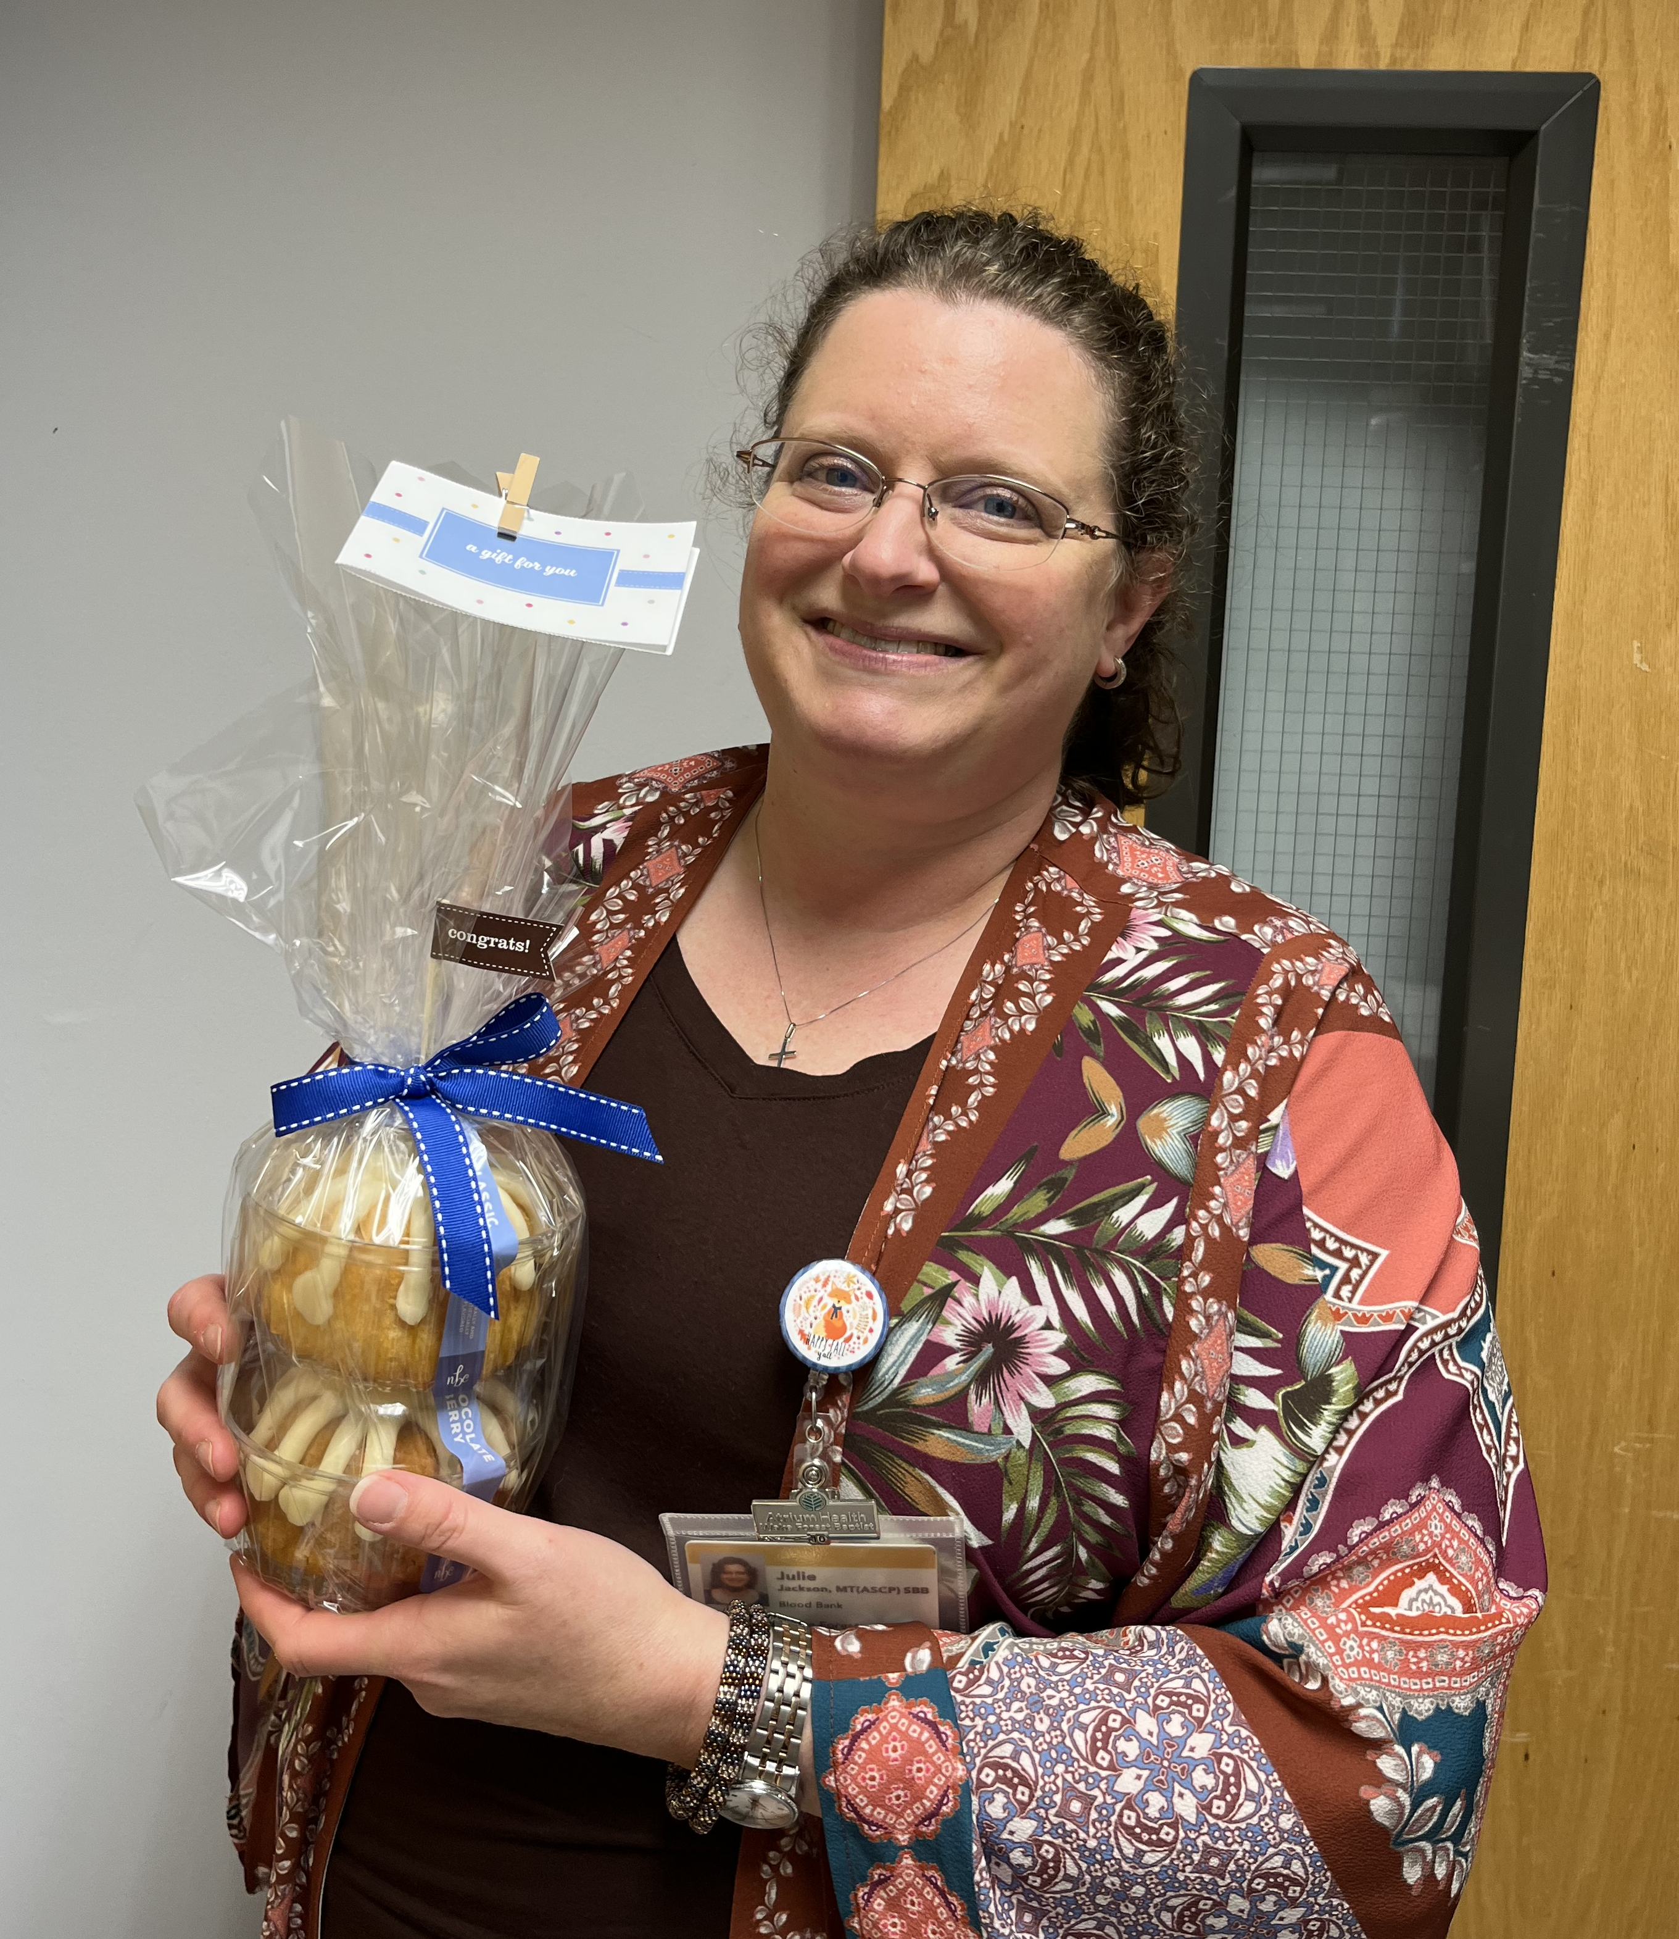
Good Catch Recipient for October
Julie Jackson
Blood Bank

Slide 19

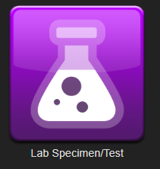
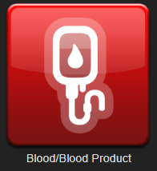
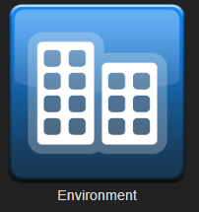
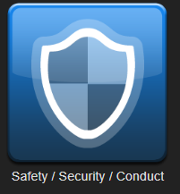

Safety First – ALWAYS!
Reporting
Who can report? Anyone! Anything that harms a patient or employee Anything that threatens to harm a patient or employee Anytime something unexpected happens | Celebrate our successes! Recognize great catches and reporting with a Good Catch report, Shout Out or e-card.
Notes:
Maybe November

