Slide 1
October Staff meeting
10/13/22
0630 & 1400

Slide 2
Agenda
Training
Inventory Management
Projects/Studies
CE Opportunites
Where are we?
Efforts to decrease wastage
In the works
Emails/webinars

Slide 3
Training
1st shift: Ryan, Shelli
2nd shift: Brad
3rd shift: Dina, Pia, Ysabelle, Haley

Slide 4
Focus on completion
Bradley—Fully signed off on FD and CP; XM and Vision pending…staffing
Ryan—Fully signed off on FD, CP: special order plts (sections flagged)/PUBS, Vision/XM 60%
Shelli—FD: WB/MTP/Biofridge/IPSM, CP: COBE, pool plasma. Vision/XM 40%
Dina—Fully signed off on FD, CP: COBE, Vision/XM: 80%
Pia—Fully signed off on FD, CP: special order plts, COBE; Vision/XM: 60%
Ysabelle & Haley– need to be 100% Vision and XM before going to third
2 full time positions open: 2nd and 3rd (looking for tech with BB experience)

Slide 5
Projects/ Studies
CHIPs
LIMB
TROOP—Adult WB vs. components (Spring/Summer 2023)
MATIC2—Peds WB vs. Components (2024)
IFC—see next slide
Antibody Exchange—nationwide database of patient antibody information
TAAA Cases

Slide 6
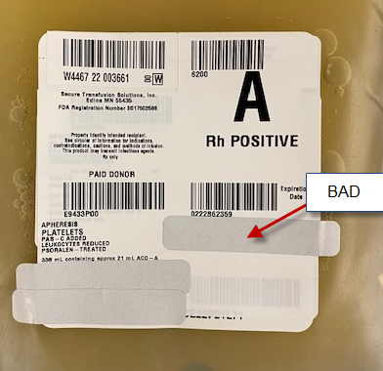
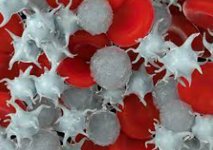
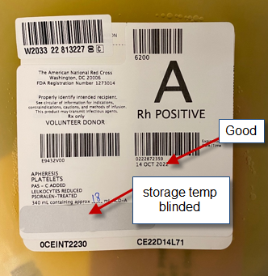
CHIPs
Receive Cold Plts from STS (W4467): collection site = w4545, then scan units. Easier in delivery/not batch delivery
Only blind storage temp area.
No need to blind Volunteer/Paid donor or Expiration date
Change expiration date to the next day at midnight AT SELECTION, not receipt (unless the plt outdates sooner.) If it is returned…change back to original outdate
Some plts come with blinded Expiration dates. This should not be issued blinded.
Give all shipping documents to mgmt. so we can add plts to the EDC
ALL PLATELETS SHOULD LOOK THE SAME!!

Slide 7
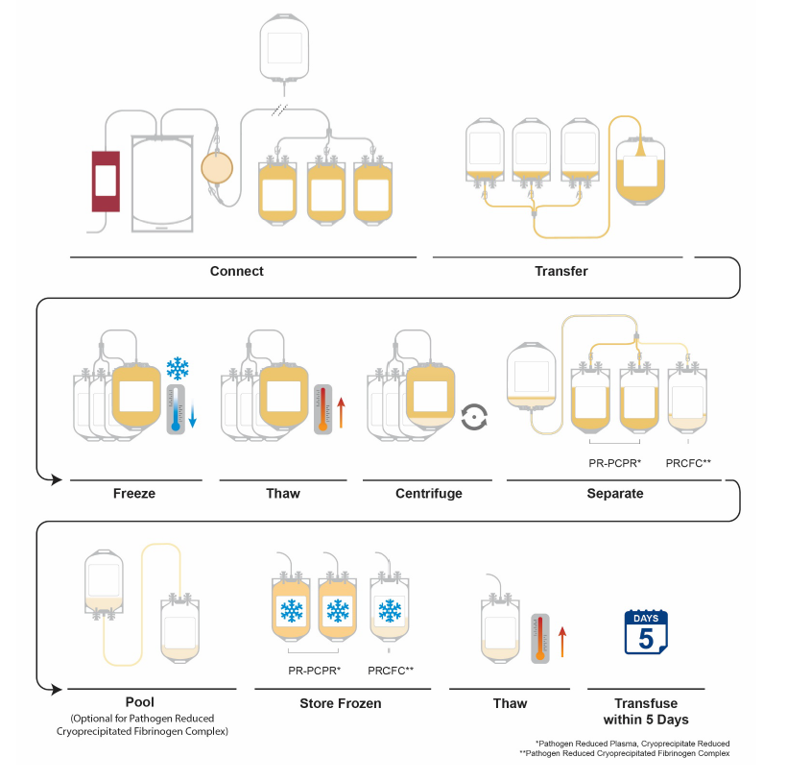
IFC
Intercept Fibrinogen Concentrate
Store frozen for 1 year
Store at RT for 5 days post thaw
EXPENSIVE—3.6x cost of Cryo AHF; aim for NO wastage
Plan: keep one thawed (similar to pedi AB FFP)
Retrospective study involving use of this product

Slide 8
IFC
AHF
$1030 for a 2 pool (equivalent to 5 pack)
Expires in 5 days
Longest time between 5 pack cryo issue in 2022 = 4 days
$285/5 pack
Expires in 6 hours
Cryo wastage is always high due to short expiration time

Slide 9
Inventory Management
Decrease Wastage
WB : keep NLR in house. Always use as first round of Adult MTP
RC : Don’t select short dated to OR. Use for HemeOnc, etc.
Plts : cut S.O. decreased inventory amounts. Added average daily usage information to inventory sheet. This will help you know how many to order and how many to cut based on inventory levels. We are running tighter to prevent wastage b/c usage is down. No more LVDS.
Plasma : Move 4 old AB liquid plasma to reg. liquid inventory on Tuesday when “fresh” plasma arrives. USE the AB thawed plasma
Platelet Orders MUST be filled with Expiration in mind FIRST, compatibility second

Slide 10
ABO Incompatible Plt Tx
Separate Adult and Peds policies
IF a patient has specific needs, it will be noted in their PCW; otherwise give shortest dated plt following protocol for type preference.
Secretors have blood group substance that will adsorb isohemagglutinins. 80% are secretors.
Body tissues will also adsorb isohemagglutinins
Plts are now only 35% plasma (65% PAS)

Slide 11
Missing Units
Doing much better!!!
Remember to clean up all units before your shift is over.

Slide 12
CE Opportunities
Websites
Webinars
Conferences
On demand
Lab Admin
Request time off
Success
Medtraining
Grifols
Ortho Clinical Diagnostics
Wednesday October 19, 2-3pm
Twists, Turns and Accelerations: The effect of Pneumatic Tube Specimen Transport on Clinical Laboratory Testing
NCABB
Virtual meeting opportunites for CAP, AABB, etc.

Slide 13
RL6 Review
October
October
September
Good Catch
Blood/Blood Product
Good Catch
1 good catch by JJ involving TAAA patient with antibodies
1 good catch by Pia involving WBIT
2 blood product availability
2 units would not flow

Slide 14
RL6: Plasma Availability
Investigation
Complaint
Recommendation
Order did print
BB Staff noted NOH on order
TSX received at 2215
ABO resulted at 2315
Type specific Plasma allocated at 2336
Burn patient with NOH and 4 units of FFP ordered at 2030
Nursing called to inquire about plasma at 2300 as it was not selected in EPIC
Blood Bank told Nursing “the order didn’t print”
Order was STAT
Note on all orders who you spoke with and what was said (briefly)
Don’t say “didn’t print”
Give Thawed A plasma when STAT
Always make sure you know what you are talking about before giving information!

Slide 15
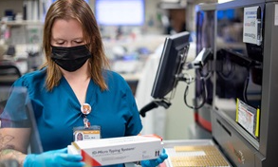
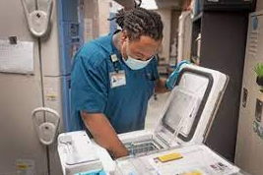
Communication
Document
Too much info = Bad
Name, Date/time
Key words: “ER offered”; “DAT pos”, etc.
Think from a nursing perspective.
They don’t use our language.
Speak in language they understand
Say as little as possible; be brief.
Leave the explaining to management

Slide 16
QAs—September
Wasted Units
Missing Units
Tech Errors
13
2—OUT (ED)
1—Trauma
1—Hole
Specimen
4
2

Slide 17
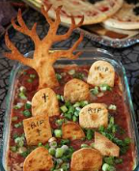
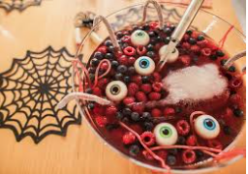
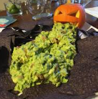
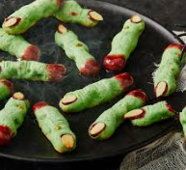
Halloween Party
October 31st
Halloween Themed Food
Sign up sheet out soon

