Slide 1
Lab Safety Presentation
December 2022

Slide 2
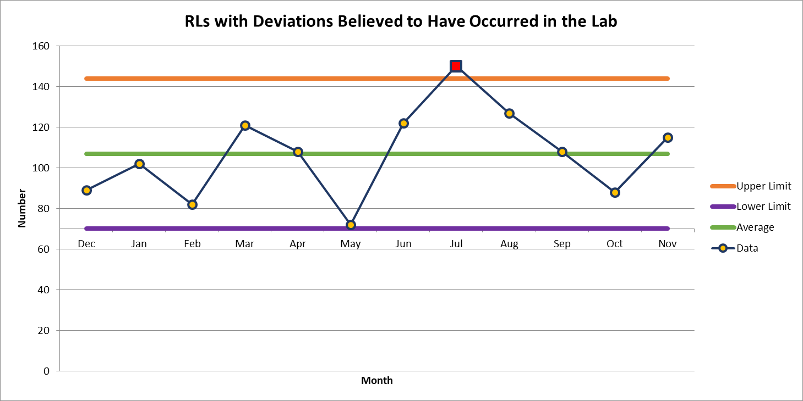
115 Deviations in November

Slide 3
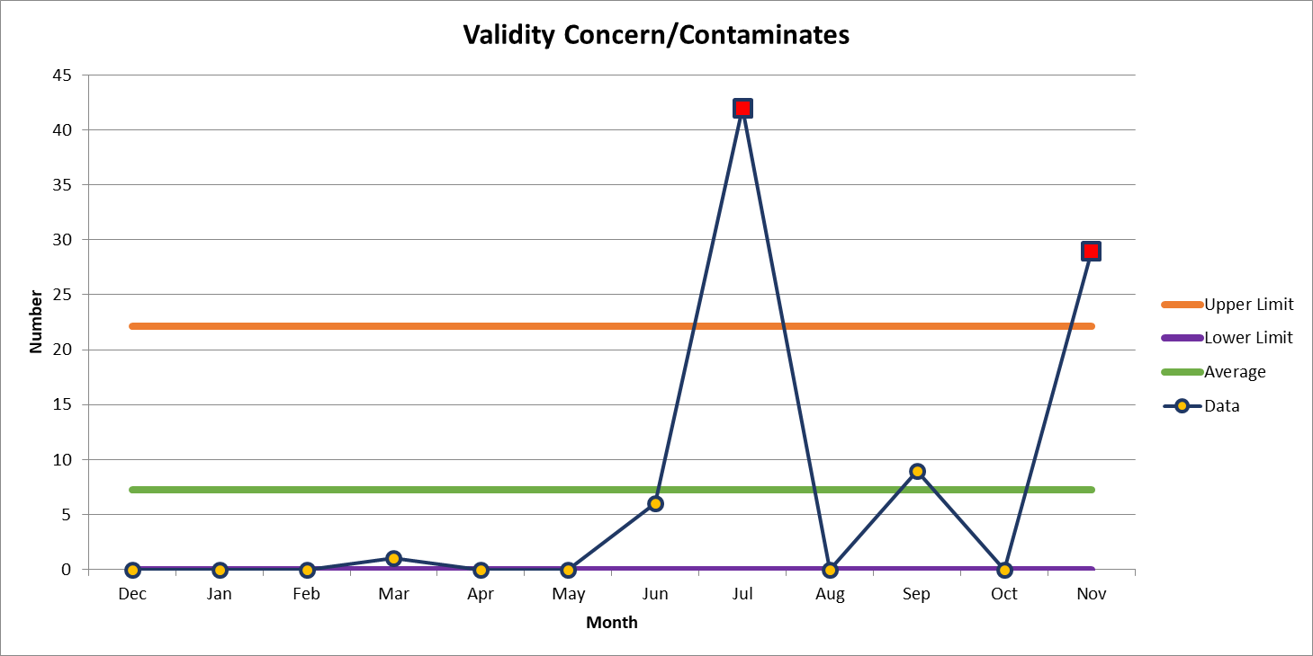
Most common deviation in November
29 Deviations in November

Slide 4
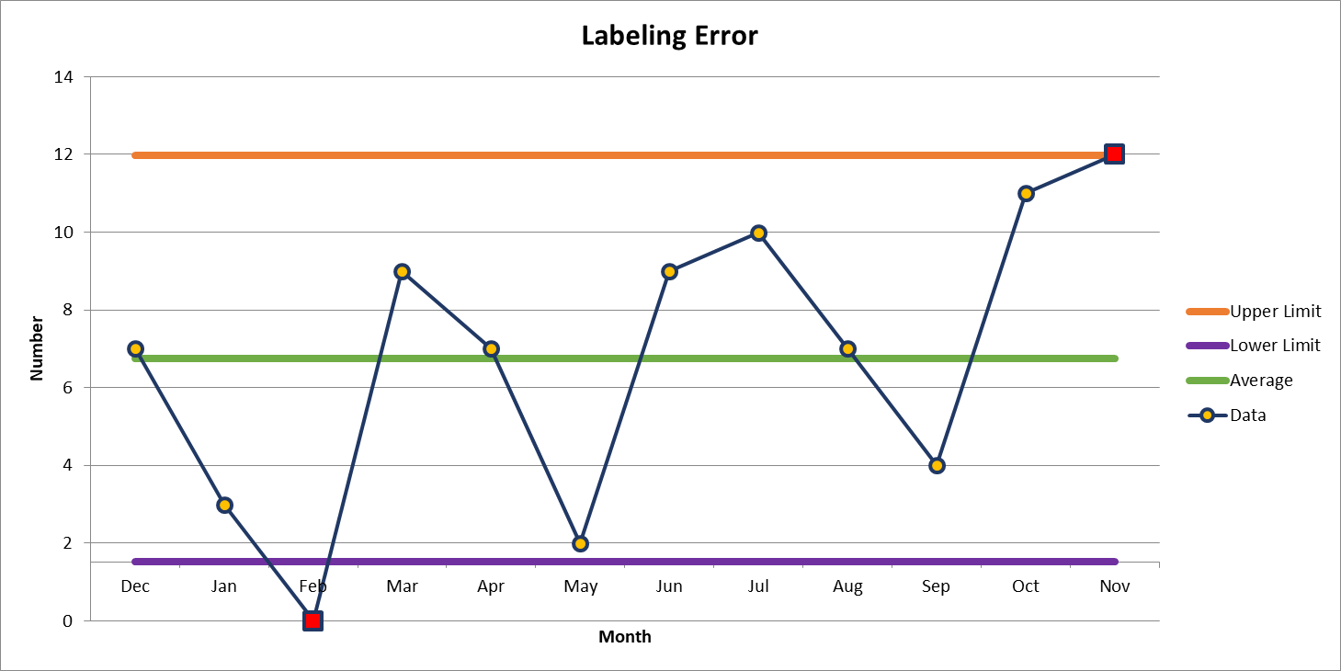
2nd most common deviation
12 Deviations in November

Slide 5
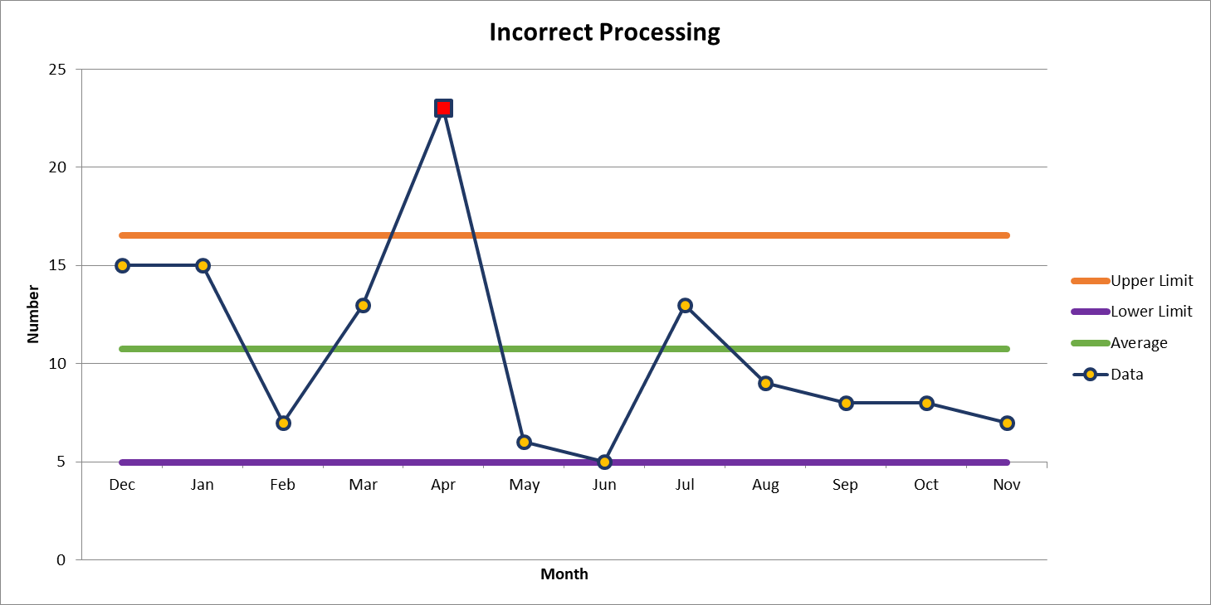
3rd most common deviation
7 Deviations in November

Slide 6
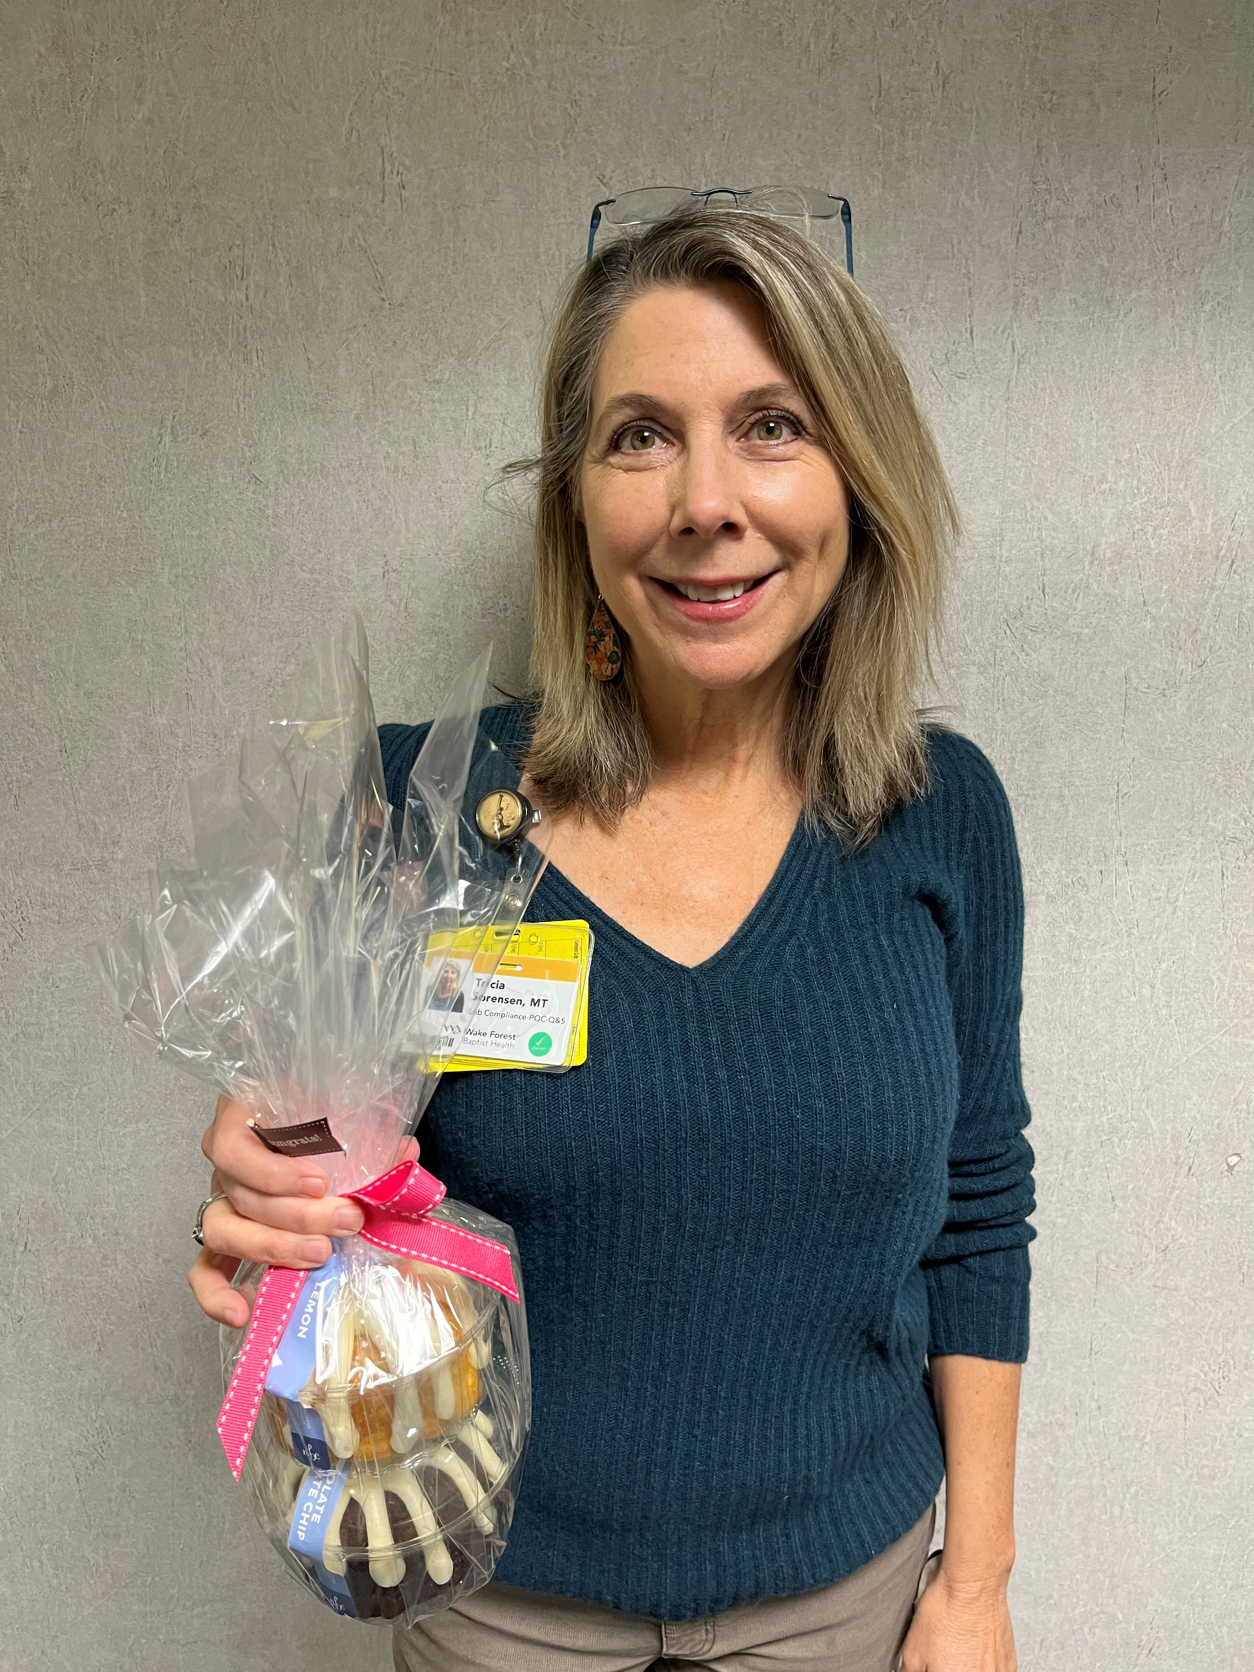
Safety Topic of the Month Quiz for November
45 respondents
37 people scored 100%
Winner of the drawing
  Patricia Sorensen
  from POCT

Slide 7



Slide 8
Good Catches in November
Great Work!
Thank you ALL!

Slide 9
Good Catches in November

Slide 10
Good Catches in November

Slide 11
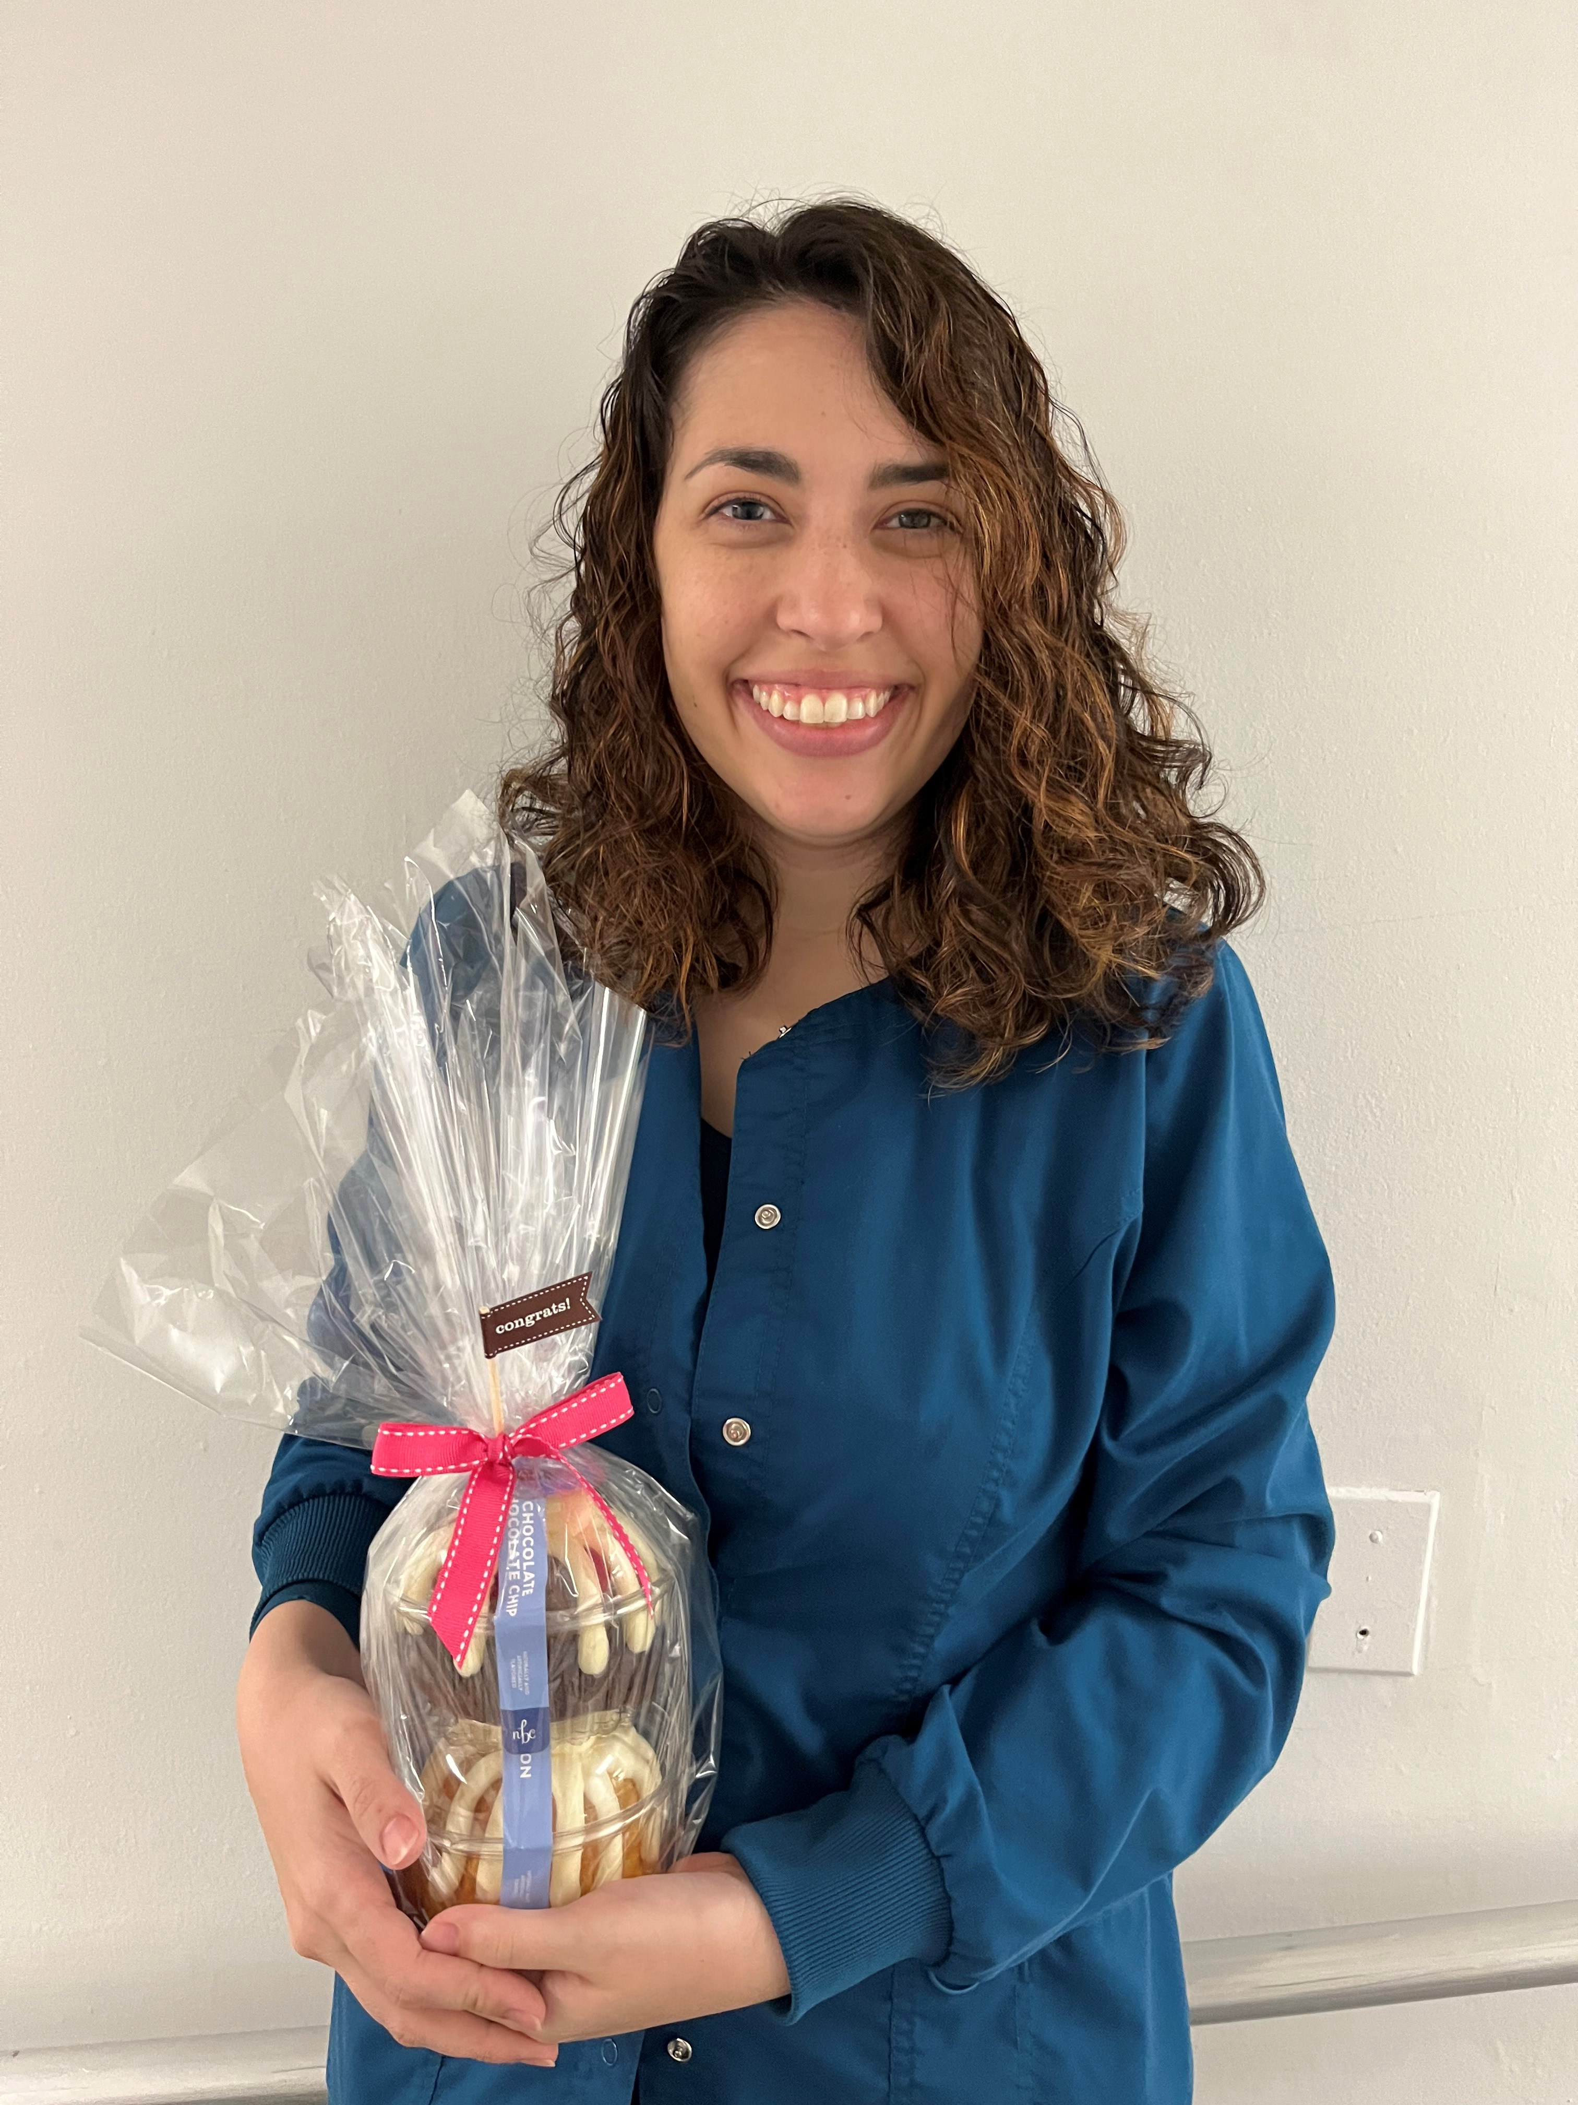
Good Catch Recipient for November
Cecily LaPradd
Hematology

Slide 12


STAR
Stop: pause for a second Think: think about the task at hand Act: perform the task Review: one last check, just to be sure
Using STAR will help us pay attention to detail. STAR will protect us, and our patients and co-workers, from errors caused by distractions. | As a team, we should respect one another’s workspace and not create distractions Many of our recurrent events could be prevented if we used STAR.
Examples of STAR: Stopping to make sure you have your keys, phone, wallet, and badge before leaving home Confirming the correct site is marked for a procedure Ensuring you are in the correct chart before documenting or scheduling Verifying that all energy has been isolated after lockout/tagout.
‘Tis the season for distractions

