Slide 1

Proficiency Testing (PT)
Department of Pathology
Quality Safety and Accreditation
QS_A@wakehealth.edu
December 2022

Slide 2
Objectives
  Define Proficiency Testing (PT)
  Understand the importance of PT
  Understand receiving, testing, handling, identifying and record retention of PT samples
  Understand severity of consequences if there is interlaboratory communication prior to deadline of submission.
  Understand severity of consequences for referring PT samples to another lab.
  Understand requirements for staff training
  Know the common PT samples used in the laboratory
  Understand Atrium Health Wake Forest Baptist Medical Center Proficiency Testing Policy: QUAL-POL-00121
  Understand PT regulations
  Complete the on-line test.

Slide 3
What is Proficiency Testing (PT)
  Proficiency testing or PT is the testing of unknown samples sent to a laboratory by a CMS approved PT program.
  Proficiency testing is required for any lab that performs testing on human specimen.
  Most PT samples are sent to participating laboratories two or three times per year by Centers for Medicare and Medicaid Services (CMS) approved PT program provider.
  CMS and accreditation organizations routinely monitor the laboratories’ PT performance.

Slide 4
Why is PT important?
PT is a tool that the laboratory can:
use to verify the accuracy and reliability of its testing.
use to validate the entire testing process, including competency of the testing personnel
alert to areas of testing that are not performing as expected
use to indicate subtle shifts and trends that, overtime, would affect the patient’s results

Slide 5
Receiving PT Samples in the Lab
Proficiency Kit: A complete set of materials (either physical or online) required to perform and report results for a PT program. Items may include specimens and kit instructions.
Open your kit as soon as possible upon receipt. Visually inspect the material for any damage and verify it has arrived at the appropriate temperature (see kit instructions).
Any problems identified with the PT sample, follow your lab policy and notify your supervisor.
Handle and store all PT samples according to PT provider instructions, your lab policy and procedure.

Slide 6
Testing PT Samples
Before you start testing, thoroughly read each kit instructions for the up-to-date information.
Do I test my PT samples any differently than I test patient specimens? NO
  PT samples must be tested in the same manner you test patient specimens.
    Test PT samples the same number of times, at the same time, by the same personnel that routinely test the patient specimens.
    Use the same test system that is routinely used for the patient specimens.
    Some PT sample may require preparation before testing. But, after preparation, PT samples must be treated in the same manner as patient specimens.
  PT samples should be rotated among the testing personnel.
  NEVER send PT samples out of your laboratory for any reason, even if you routinely send out patient specimens for additional or confirmatory testing.

Slide 7
Attestation Statement
An attestation statement is a page included in the result form attesting to the routine integration of the PT samples into the patient workload using the laboratory’s routine methods.
The individual testing or examining the PT samples and the Laboratory Director (or designee) must sign the attestation page.
Retain a copy of signed attestation page for your laboratory records and inspection documentation for the appropriate time. This document does not need to be returned to the CAP.

Slide 8
Retention of PT Results, Records and Data
All PT records must be retained according to the laboratory record retention policy.
  Examples of some records to retain (electronic or paper):
    QC and Calibration records
    Maintenance records
    Instrument printout, manual worksheets, logs
    All images
    PT results on the test result form
    Signed attestation statement
    Review of PT evaluation
    Records of unacceptable PT corrective action

Slide 9
Proper and Improper Handling of PT
Proper handling PT examples:
  No interlaboratory communication before the PT event cut-off date.
  No intentional or unintentional referral of PT sample to another laboratory.
  Identify PT samples that are sent to your lab from another lab.
Improper handling of PT examples:
  Interlaboratory communication before the PT event cut-off date
  Referring PT sample for any reason intentionally or unintentionally to another laboratory.
  Receiving and performing a test on a PT sample from another laboratory.
For more information: Refer to Atrium Health Wake Forest Baptist Proficiency Testing Policy QUAL-POL-00121

Slide 10
Interlaboratory Communication
May I discuss my PT results with another laboratory? NO
  NEVER discuss your PT results with another laboratory and NEVER enter into discussion with another laboratory about their PT results before the PT event cut-off date.
  Any laboratory that discusses results of PT, prior to the deadline for submission to the PT provider could cause loss of CLIA certificate coverage for at least 1 year.

Slide 11
PT Samples Referral
PT referral means any instance in which a PT sample, or a portion of a sample is referred, for any reason, to another laboratory for testing before the PT program event cut-off date.
What do I do if I receive PT samples from another test site?
  DO NOT TEST the samples.
  Immediately notify your manager
  Immediately notify the Laboratory Director listed on the CLIA certificate and the Quality, Safety and Accreditation director.
A laboratory may not accept a specimen for testing from another laboratory if the specimen appears to be a PT sample.
Laboratory must notify CMS and CAP if it receives an improperly referred PT specimen.
For more information: Refer to Atrium Health Wake Forest Baptist Proficiency Testing Policy QUAL-POL-00121
.

Slide 12
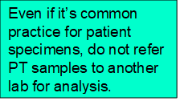
PT Samples Referral
May I send my PT samples to another laboratory? NO
  NEVER send your PT samples to another laboratory, even if you send your patients’ specimens to another laboratory for confirmation.
  Discussing results and/or sending PT samples to another laboratory for testing is considered PT referral and will cause serious actions or penalties against your laboratory.
  Even if a lab ­accident­ally sends a PT sample to another lab for test­ing, the lab may still be held ­accountable for referring PT sample.
  The penalties include:
    Loss of your laboratory’s CLIA certificate for at least one year
    Your director cannot direct a laboratory for two years
    Your laboratory owner may not own or operate a laboratory for two years.

Slide 13
Identifying PT Samples
How do I identify PT samples received from another laboratory?
  The PT samples are usually named with unusual combination of letters and numbers. In other words, the first name and last name are not usual patients’ name.
    Example:
      API, GLU-04
      CAP, UA-02
      CAP, CHM-05

Slide 14
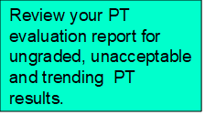
PT Results Evaluation
Review your evaluation and participant summary
  Look for any unacceptable results. Reasons for unacceptable results may include:
    Incorrect or incomplete method/instrument data
    Clerical error
    PT sample handling error
    Analytical error
  Remember, whatever the cause, all PT deficiencies must be documented, and corrective action must be taken to resolve the deficiency.
  All ungraded PT results (including educational challenge) must be evaluated for accuracy.

Slide 15
Unsuccessful PT Performance
If your laboratory has never had an unsuccessful performance for any PT analyte, subspecialty, or specialty, the CLIA regulations, under certain circumstances, permit technical assistance and training to take place, rather than a more serious sanction.
However, repeated unsuccessful PT performance for the same analyte, subspecialty or specialty may result in your laboratory no longer being allowed to perform the failed analyte testing.

Slide 16
Staff / Team Members Training
Are there requirements for training of staff regarding PT referral?
  Yes, checklist item COM.01900 requires laboratories have a policy prohibiting referral of PT to another laboratory or accepting PT from another laboratory.
  Proficiency testing specimens are not referred to other laboratories and are not accepted from other laboratories for analysis.
  Staff involved in the PT process should be trained to this policy, and documentation of this training is highly recommended.
  Regulations regarding the handling, testing, and reporting of PT are complex and can be violated unintentionally if not well understood.

Slide 17
CLIA APPROVED PROFICIENCY TESTING PROGRAMS
  CLIA provides a list of approved PT program providers.
    The two main PT program providers that are used through out the Atrium Health Wake Forest Baptist System are:
      The College of American Pathologists (CAP) and
      American Proficiency Institute (API)

Slide 18
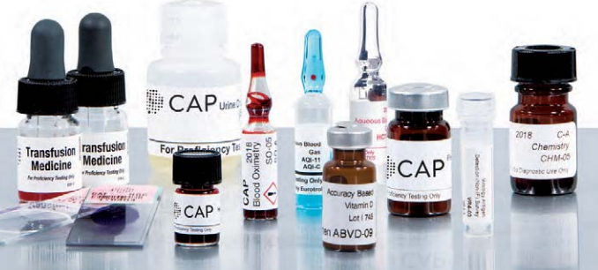
Example of PT Samples - From College of Americans Pathologists (CAP)

Slide 19
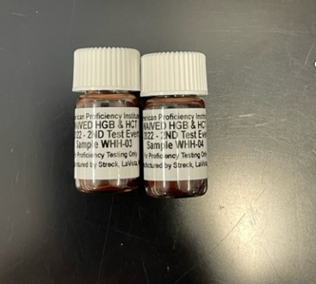
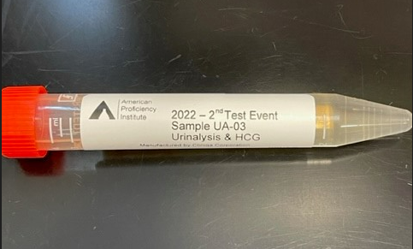
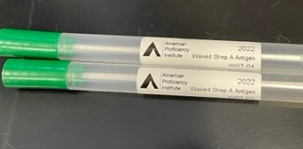
Example of PT Samples - From American Proficiency Institute (API)

Slide 20
Atrium Health Wake Forest Baptist Medical Center Proficiency Testing Policy: QUAL-POL-00121
On page 5 of the Proficiency Testing Policy, Section C, #2: PT Referral states “Do not refer PT specimen to another laboratory or accept PT specimen from another laboratory”.
  This policy strictly prohibits referral or acceptance of proficiency testing specimens for analysis from other laboratories. This prohibition takes precedence over the requirement that proficiency testing specimens be handled in the same manner as patient specimens.

Slide 21
CLIA PT Regulation
CLIA Federal Regulation (section 493.801)
The Clinical Laboratory Improvement Amendments (CLIA) law and regulations require that all laboratories enroll in approved proficiency testing programs.
In addition, the laboratory “must test [proficiency testing] samples in the same manner as [the laboratory] tests specimens”.
  This means that personnel who routinely perform the testing should test PT samples with the laboratory’s regular workload.
    As an example, if a laboratory tests a patient specimen only once before reporting, then PT specimens also must be run only one time, not in duplicate, before reporting.
    It also means that the testing of PT samples should be rotated among all staff members who routinely perform the patient testing.

Slide 22
CLIA PT Regulation
Condition: Enrollment and testing of samples
Laboratories that perform tests on proficiency testing samples must not engage in any inter-laboratory communications pertaining to the results of proficiency testing sample(s) until after the date by which the laboratory must report proficiency testing results to the program for the testing event in which the samples were sent.
Laboratories with multiple testing sites or separate locations must not participate in any communications or discussions across sites/locations concerning proficiency testing sample results until after the date by which the laboratory must report proficiency testing results to the program.

Slide 23
CLIA PT Regulation
Condition: Enrollment and testing of samples
The individual testing or examining the samples and the laboratory director must attest to the routine integration of the samples into the patient workload using the laboratory's routine methods.
The laboratory must test samples the same number of times that it routinely tests patient samples.

Slide 24
CLIA PT Regulation
Condition: Enrollment and testing of samples
The laboratory must not send PT samples or portions of samples to another laboratory for any analysis which it is certified to perform in its own laboratory
Any laboratory that CMS determines intentionally referred its proficiency testing samples to another laboratory for analysis will have its certification revoked for at least one year.
Any laboratory that receives proficiency testing samples from another laboratory for testing must notify CMS of the receipt of those samples.

Slide 25
CLIA PT Regulation
Condition: Enrollment and testing of samples
The laboratory must document the handling, preparation, processing, examination, and each step in the testing and reporting of results for all proficiency testing samples. The laboratory must test samples the same number of times that it routinely tests patient samples.
The laboratory must maintain a copy of all records, including:
  a copy of the proficiency testing program report forms used by the laboratory to record proficiency testing results.
  the attestation statement provided by the PT program, signed by the analyst and the laboratory director, documenting that proficiency testing samples were tested in the same manner as patient specimens.
  maintain records (according to the laboratory’s record retention policy) from the date of the proficiency testing event.

Slide 26
CLIA PT Regulation
Condition: Successful participation
Each laboratory performing testing on human sample must successfully participate in a proficiency testing program approved by CMS, if applicable, as described in subpart I of this part for each specialty, subspecialty, and analyte or test in which the laboratory is certified under CLIA.

Slide 27
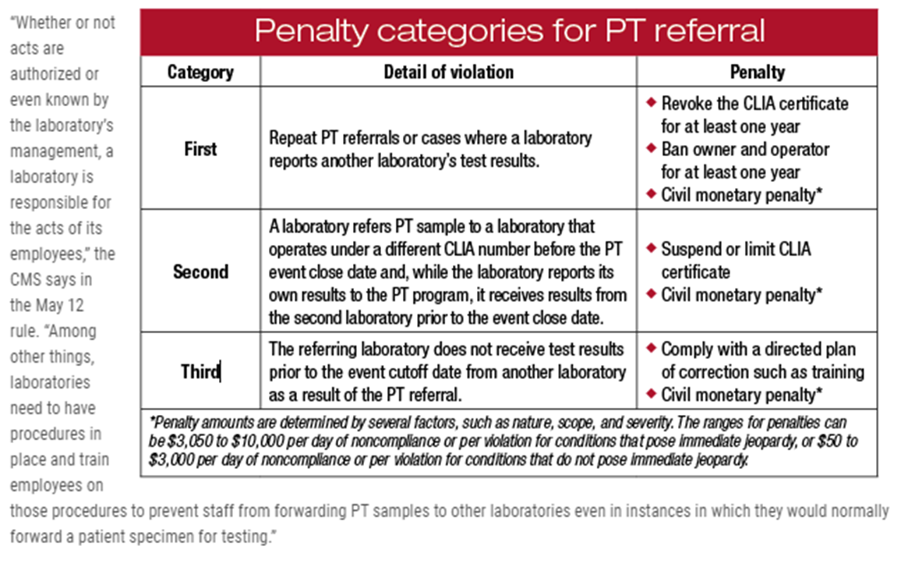
Penalty Categories for PT Referral
Source: https://www.captodayonline.com/pt-referral-rules-bring-regulatory-relief-for-labs/

Slide 28
Examples of PT Referral
Scenario One
Referral Test
A laboratory CLIA director works with two laboratories, one is a small community hospital laboratory (Lab A), and the other laboratory (Lab B) is a sister hospital that serves as a reference lab. Both are under the same ownership and operations between the two labs are standardized. However, the laboratories are at 2 different addresses and have different CAP/CLIA numbers. Components of tests and some reflex testing are performed at the two laboratories. For example, total serum protein is performed at Lab A and protein electrophoresis is performed by Lab B by using the total serum protein result from Lab A.

Slide 29
Examples of PT Referral
Scenario One Continued…
How to Treat a Patient Specimen
Lab A would report total serum protein and send the patient specimen to Lab B for the protein electrophoresis.

Slide 30
Examples of PT Referral
Scenario one continued…
How to Treat a PT Sample
Lab A would need to enroll in a proficiency testing product for total protein and report the total protein the laboratory performs.
Lab B would need to enroll in a proficiency testing product for protein electrophoresis and report the protein electrophoresis the laboratory performs.
PT samples and data generated from the PT samples cannot be shared between Lab A and Lab B.
Each site must be enrolled separately based on location and only for testing that is performed at the location of the laboratory.

Slide 31
Examples of PT Referral
Scenario Two
Reflex and Confirmatory Testing
Example:
  A positive GC/Chlamydia Amplification (in urine samples from pediatric patients) requires confirmation and will reflex to Molecular testing which is a send out test.
  A negative Strep screen result on a pediatric patient will reflex to Throat Culture which is referred to Atrium Health Wake Forest Baptist Medical Center Lab.

Slide 32
Examples of PT Referral
Scenario two continued…
How to Treat a Patient Specimen
If a laboratory does not perform the confirmatory or reflex test that is indicated and/or required as a result of an initial test result, the specimen would typically be sent to a different, referral laboratory for that testing.

Slide 33
Examples of PT Referral
Scenario Two Continued…
How to Treat a PT Sample
A laboratory should report PT results for the initial testing that is done in that laboratory. If the laboratory does not perform the confirmatory or reflex testing, then the laboratory should refer to the PT Provider kit instructions on how to record a result for a test not performed in the laboratory. The laboratory is prohibited from sending the PT sample to another laboratory.
All results and signatures must be confined to the site with the same CAP/CLIA number in which the PT sample was received.

Slide 34
Example of PT Referral
Scenario Three:
A tech from Laboratory A was using PT for competency assessment prior to the submission deadline. The tech questioned the result but didn’t want to ask the supervisor; instead, the tech contacted Laboratory B recognized that the specimen was a current PT sample and self-reported the inappropriate interlaboratory communication.

Slide 35
Example of PT Referral
Scenario three continued…
Prevention:
  Create policies and train staff that there can be no interlaboratory communication regarding PT samples between two laboratories with different CLIA numbers until after deadline for submission of data to the PT provider.
  Do not use PT samples for competency assessment before the due date.

Slide 36
Conclusion
  It is very important to know your policies and procedures regarding Proficiency Testing.
  It is very important to know your notification and escalation process in the event of PT Referral and Interlaboratory PT Communication.

Slide 37
Reference
Proficiency Testing (PT) Manual Available at: https://documents.cap.org/documents/cap-proficiency-testing-manual.pdf
Clinical Laboratory Improvement Amendments (CLIA).Centers for Medicare and Medicaid Services (CMS). Available at: https://www.cms.gov/Regulations-and-Guidance/Legislation/CLIA/index.html?redirect=/clia.
Clinical Laboratory Improvement Amendments (CLIA): Proficiency Testing. Centers for Medicare and Medicaid Services (CMS). Available at: https://www.cms.gov/Regulations-and-Guidance/Legislation/CLIA/downloads/cliabrochure8.pdf
Centers for Disease Control and Prevention—Subpart H—Participation in Proficiency Testing for Laboratories Performing Nonwaived Testing Available at: http://wwwn.cdc.gov/clia/regs/subpart_h.aspx
Atrium Health Wake Forest Baptist Medical Center Proficiency Testing Policy QUAL-POL-00121

