Slide 1
December Staff meeting
12/14/22
0630
1400

Slide 2
Agenda
Orders/CAPA
Being Inspection Ready
Education
Inventory Management
Blood and Components
AABB and CAP
BB Mini Rounds
Requires Everyone

Slide 3
Orders
Reviewed 3 times: FD, selection, and Issue

Slide 4
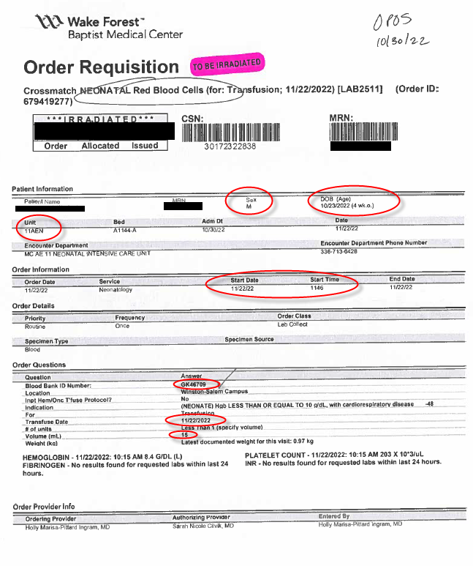
Attention to Detail Prevents Patient Harm
What we look for:
Name
MRN
Irradiation Needs
What we also need to look for:
Age and Sex of Patient
Location of Patient (Remember all NICU patients get Group O)
Start Date/Time
Last ABO (if components ordered)
BBID (if Red Cells)
Transfusion Date
Requested Volume

Slide 5
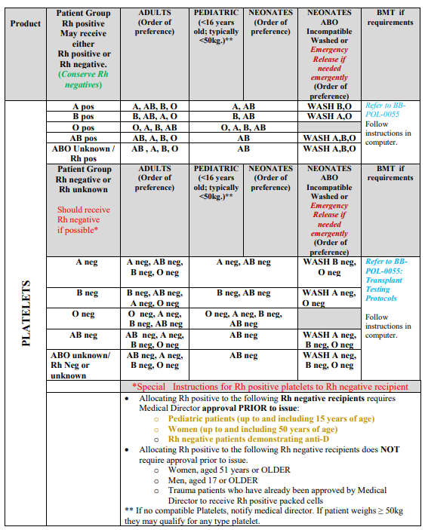
BB-POL-0018
Sections dedicated to:
Plt selection for Adults and Pediatric patients
Plt Inventory
Plt Attributes
Special Order plts
Storage of Plts
Manipulation of Plts
Compatibility of Plts
Other information

Slide 6
CAPA
Situation/Deviation:
8 y.o. B pos female received an A pos plt
Hgb. Prior to transfusion: 8g/dL
Hgb after transfusion: 6.8 g/dL
Subsequent TSX with XM for 1 unit RBCs required.

Slide 7
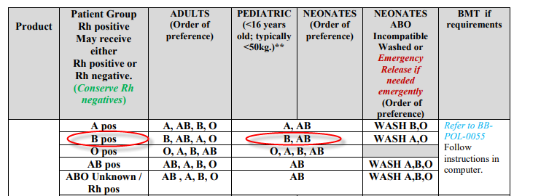
Root Cause
Failure to Follow SOP
This issue was found approx. one month post TX
Group B pediatric patient requires B or AB plts; washed A or O plts. Either we failed to
Note this was a pediatric patient OR we don’t know what the policy is.

Slide 8
Outcome: No Harm to Patient by Chance
Corrective Action
Patient has aplastic anemia with history of RBC transfusions
DAT on sample 3 weeks post incompatible plt transfusion revealed a weakly positive poly DAT and negative Eluate
DAT on sample 1 month post transfusion revealed a negative DAT
Unlikely incompatible plasma was the cause of the drop in Hgb; however, it probably didn’t help
SCC will not prevent these errors.
Staff must know and follow SOP for selecting and issuing all blood products.
Age/product needed should be checked
Irradiation box on plt orders will be changed…see next slide

Slide 9
Old:
New
With all inventory being PRT, irradiation sticker, and SCC flagging, this is redundant and no longer necessary for plt orders
Needs to be checked and initialed at selection (collect) AND issue

Slide 10
Other Relevant Issues
Mulitiple Rh positive units being issued to Rh negative patients in NON-Emergent situations
Attention to Detail is Key!
Everyone must know standard Blood Selection Guidelines AND Emergent guidelines AND how they differ.

Slide 11
Inventory Management
Plts/Plasma
Almost no plt wastage in November!!
RBC
Reagents
Short Dated Units
Reagent in use log
Releasing HLA plts
Proper storage of plts (RT and cold)
Shipping products
Follow up
Will be audited weekly
Wastage of reagents directly impacts hospital contribution to your Retirement/raises/etc.
Release when they are returned!!
Don’t select until they are here to pick-up product
Using Emergency Issue function in SCC

Slide 12
Reagents in Use
New Stickers to help you!
Management
Do Not use this Lot (Orange)
Next Lot (Yellow)
Will pinpoint those that need assistance to provide individual education of our inventory management system

Slide 13
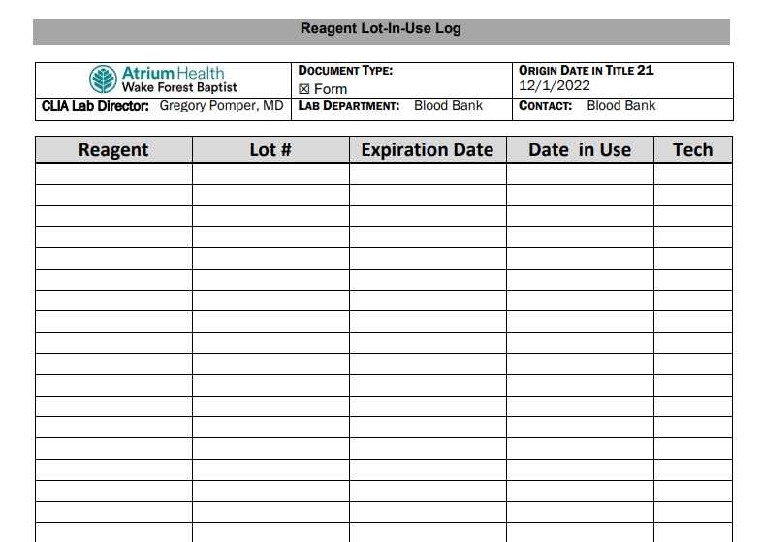

Slide 14
Inspection Ready
Everyone should follow SOP all the time. (not old emails.) This will keep us inspection ready. If emails you are following contradict SOPs, notify management. SOPs are the “source of truth”
New CAP standards require us to FOLLOW procedures, not just have them.
AABB:
Dec 15-16, 2022
CAP:
March 2023

Slide 15
BB Mini Rounds
Coming 2023
Optional
Open to BB and other departments
Monthly education with case review to cover interesting cases we have seen in the department
Earn CE
Planning for: 0700 and 1400 options
Pathology Residents may present cases as well

