Slide 1
i-STAT Testing: Blood Gas, Electrolyte, Hgb/Hct, Lactate, Creatinine, ACT & PT/INR
Prepared by Point of Care Testing Compliance
Updated December 2020

Slide 2
General Information
  Contact Information
  Policies/Procedures
  Training and Competency
  i-STAT Access
  Safety
  Components
  Testing Process Overview

Slide 3
i-STAT Support:
Contact Information
Trish Sorensen 713-4136
Liz Gregory 713-0377
Neha Jacobs 716-7248
Ray Dyer 713-4137
Site-specific preceptors
Refer to the i-STAT System Manual and medical center specific i-STAT policies
WFBMC POCT web site

Slide 4
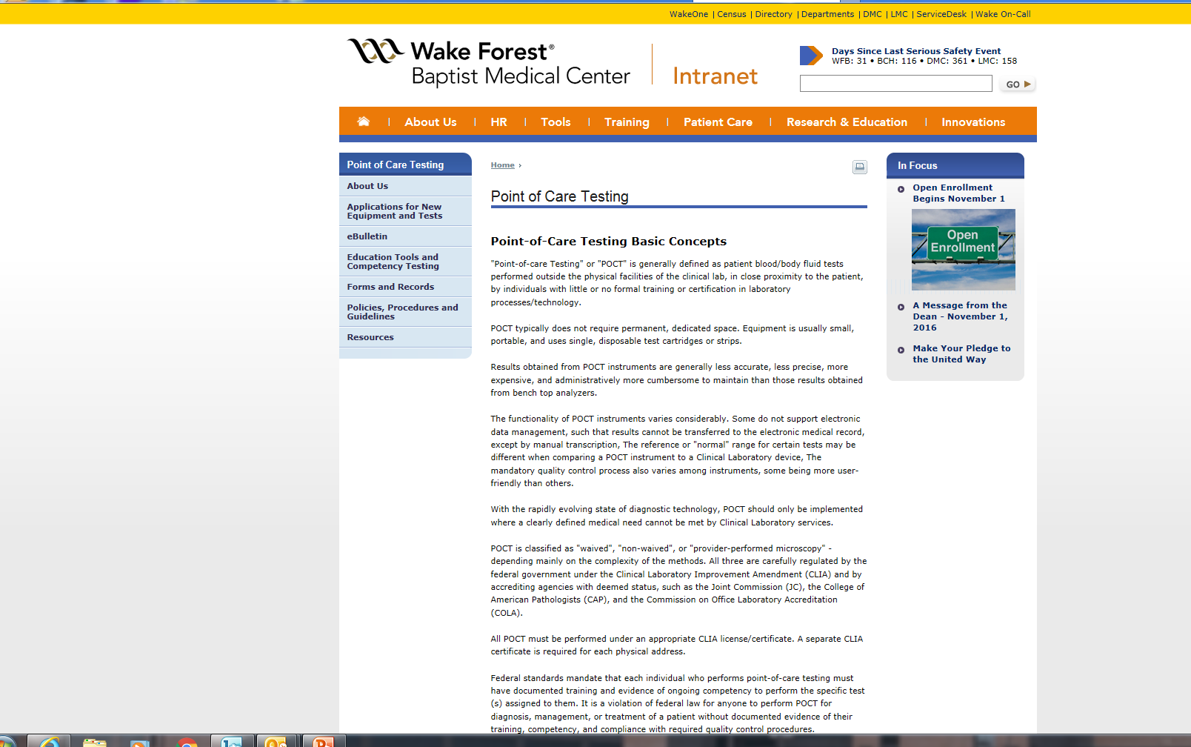
i-STAT Policies/Procedures/Guidelines
Posted on the WFBMC Intranet—Go to: Departments—Point of Care Testing—Policies/Procedures/Guidelines
The i-STAT System Manual (Abbott POC website) can be found under Resources-- Resource Links—Manuals

Slide 5
Only Authorized Users May Perform i-STAT Testing: Training and Competency Requirements
Initial training and evaluation for proper test performance
6 month competency assessment-NEW users
On-going Annual competency assessment
  Must meet all 6 points of competency assessment, as defined by CLIA— refer to page 1 of competency observation form
Failure to maintain competency will result in loss of testing privileges
Competency observation may only be completed by an authorized staff member
Written exams 80% correct or remediation will be required (All necessary exams must be complete PRIOR to competency observation)

Slide 6
i-STAT Access (Operator ID)
  Training=i-STAT access
Employee ID=operator ID
Do NOT share your employee/operator ID
Do NOT enter your ID into analyzer and allow testing by another individual

Slide 7
Safety
Always wear gloves
        Patient testing
        Performing/handling Quality Controls (QC)
        Disinfecting analyzer
Disinfect analyzers/printers
      When contaminated with blood AND
      Between EACH patient
      Follow medical center policies
DO NOT lean over the cartridge when filling
    A safety shield is recommended
Place gauze or tissue over snap when closing

Slide 8
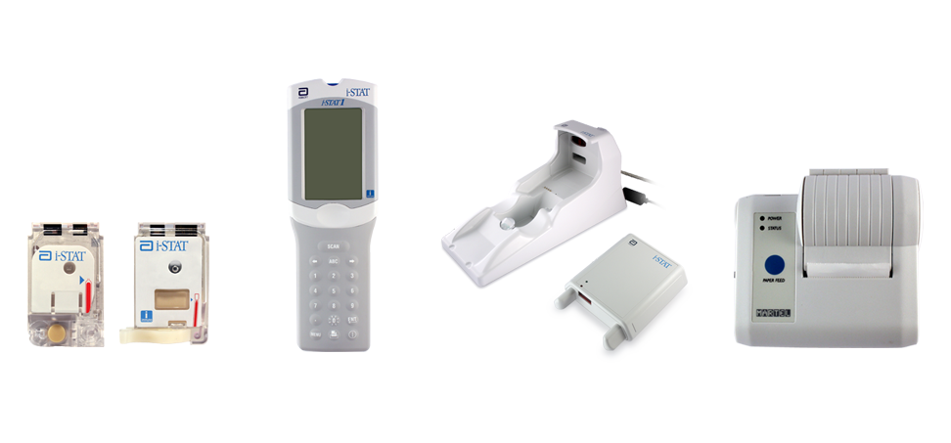
Components of the i-STAT System
Primary System Components
Cartridge
Handheld
Downloader
Printer

Slide 9
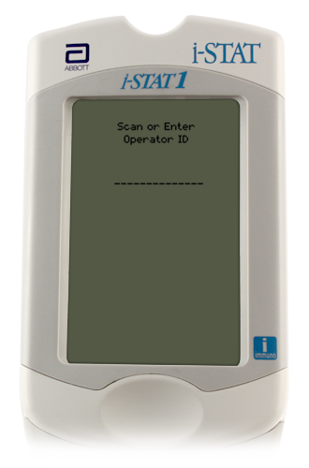
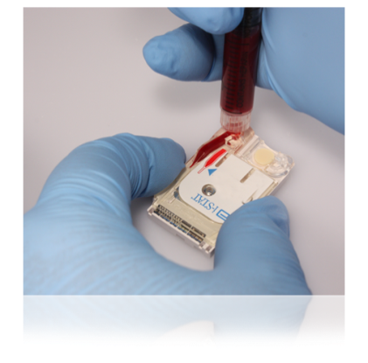
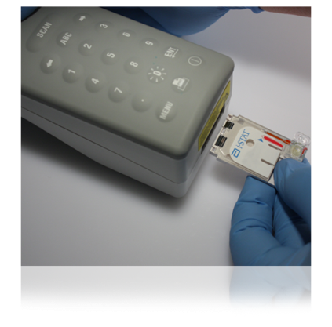
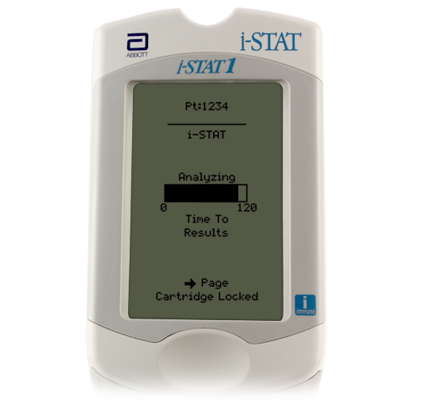
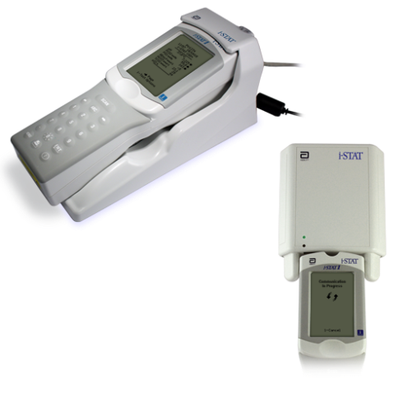
Quick Overview:
The i-STAT System Testing Process
Enter information into handheld
Obtain the blood specimen and fill cartridge
Insert cartridge; results will appear within minutes
Download results

Slide 10
The i-STAT Analyzer
External Components
Battery Replacement/Charging
Barcode Scanner
Test Menu
Menu Options

Slide 11
i-STAT Analyzer
Turns off after 2 minutes of non-use
Can be turned on by pressing the on/off keypad—circle with line—Show on/off keypad
If operator, patient, and cartridge information has been entered, the analyzer will remain on for 15 minutes

Slide 12
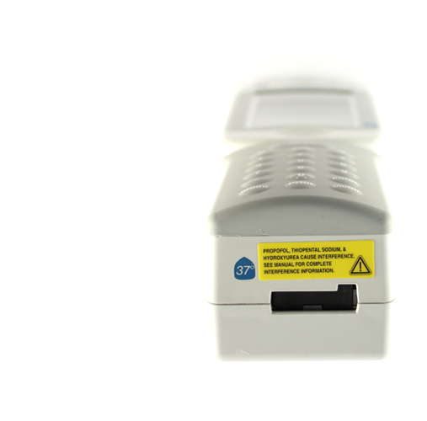
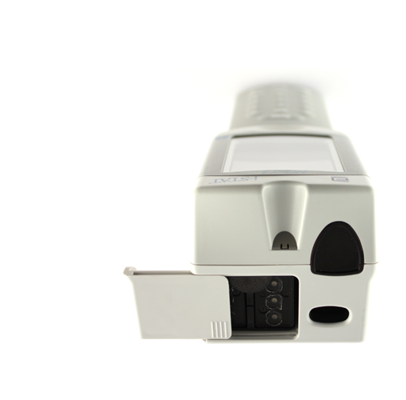
Handheld External Components
Infrared eye
Cartridge port
Battery
compartment
Barcode scanner

Slide 13
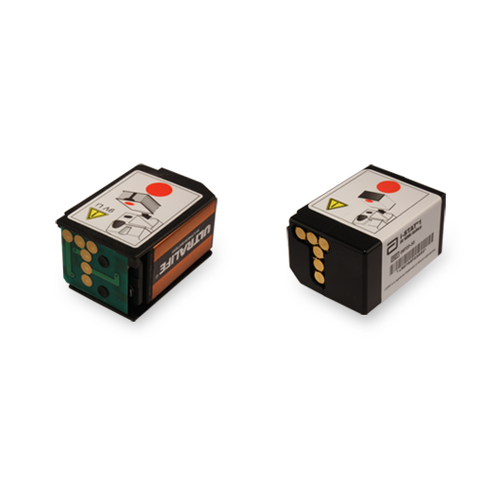
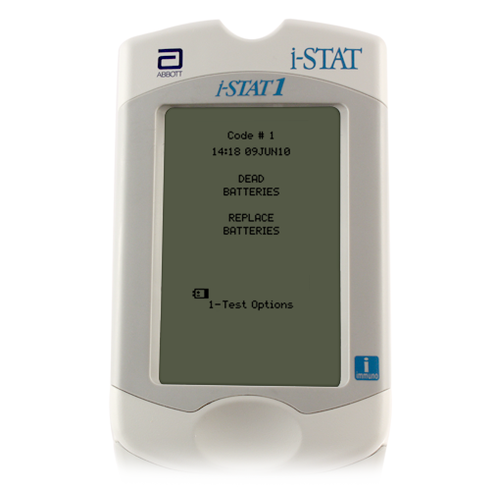
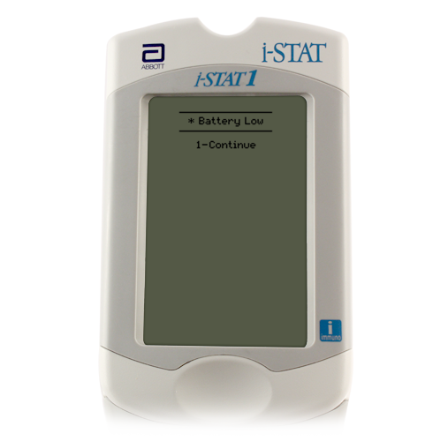
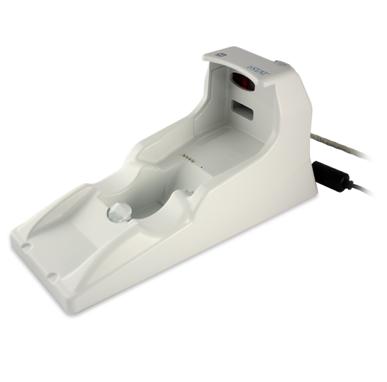
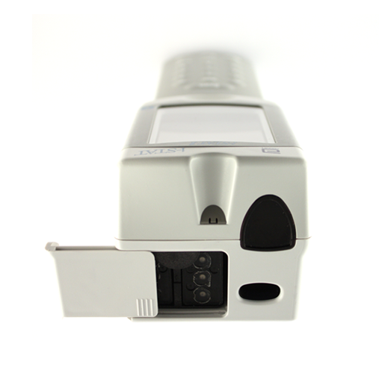
Batteries: Hands On
9-volt lithium disposable batteries
9-volt lithium disposable batteries or battery pack
  Main campus sites use the Abbott rechargeable battery pack
Change/charge the batteries:
Flashing battery icon
“Battery Low ” message
Do not discard rechargeable batteries
Green light will be on if battery in compartment is seated properly and charging
Abbott rechargeable battery pack
Battery
compartment
Battery
compartment

Slide 14
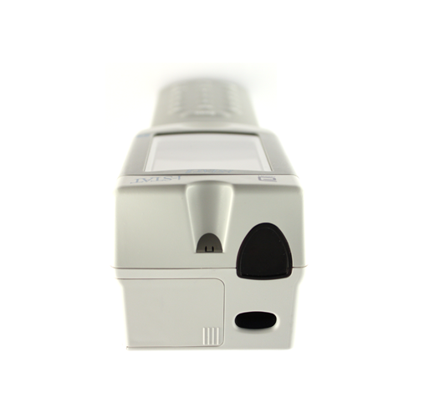
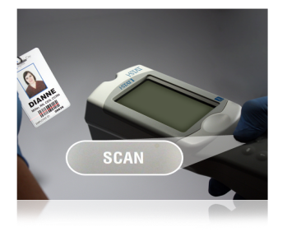
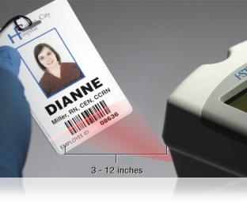
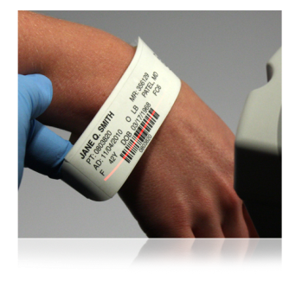
The Barcode Scanner
To scan
Hold 3 to 12 inches away from the barcode
Press and hold down the SCAN key
Laser beam must cover the entire length of the barcode
Wait for the beep or for laser beam to disappear
Release the SCAN key
Barcode scanner
The barcode scanner is a class II laser device. Momentary exposure is not known to be harmful—however you should never point the scanner at anyone or look into the laser beam.

Slide 15
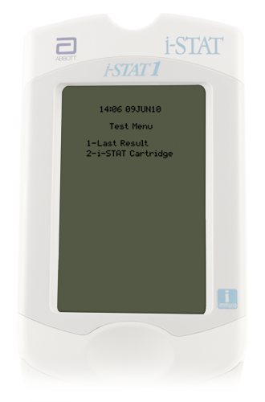
Handheld Test Menu—Hands On
Test Menu
First menu to appear
Important Note:
This menu is used for patient
tests only!
Cartridge Test Menu options
1 = Last Result
2 = i-STAT Cartridge (for a patient test)

Slide 16
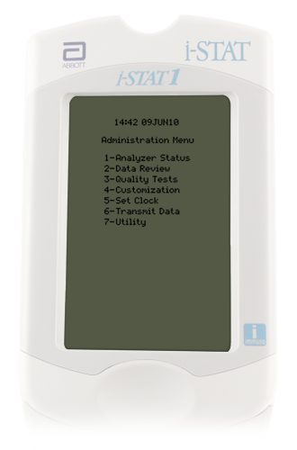
Administration Menu Options
Hands On
1--Analyzer Status
      Battery voltage
          Maintain charge above 8 volts
      Shows Total records and Unsent records
2--Data Review
      Review/print stored data
      #7 – List All Results
3--Quality Tests
      Quality control checks

Slide 17
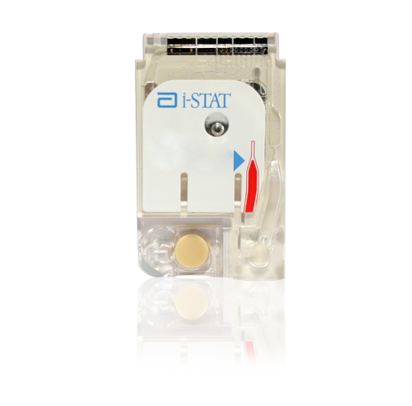
Cartridges
  i-STAT Supplies
  General Information
  Labeling
  Storage
  Handling

Slide 18
i-STAT Supplies
Main campus sites obtain cartridges and paper from Lab Admin M South
  The site is responsible for room temperature dating of the cartridges
NEVER take cartridges that are marked with “Do Not Use”
  Do not use any cartridges BEHIND this “Do Not Use” sign
Accurately complete i-STAT cartridge sign-out log
Only take the amount of cartridges that will be used within the room temperature expiration dating period
Replacement analyzers/printers-- obtain from the POCT office

Slide 19
General Cartridge Information
Self-contained lab analyzers
Analysis, sample manipulation, and waste are confined within the cartridge
Single use
24 or 25 per box
Use IMMEDIATELY after opening
Requires only a few drops of blood
Cartridges contain biosensors that “measure” the analytes being tested.
Abbott offers different i-STAT cartridge configurations.
  Only use cartridges authorized for your test site.

Slide 20

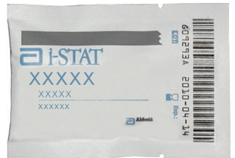
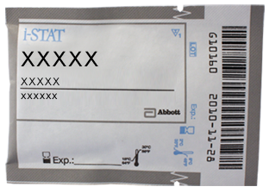
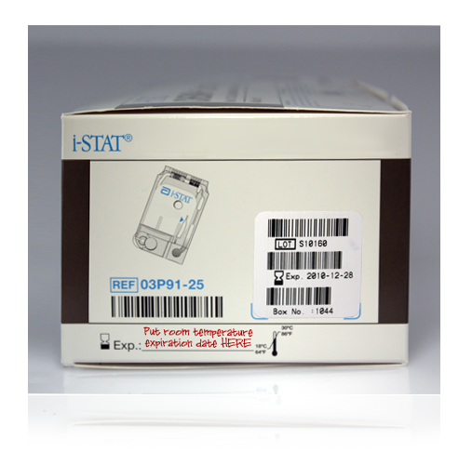

i-STAT Cartridge Labeling
Lot number
Cartridge barcode
Panel name
Measured
Analytes
Calculated
Room temperature storage expiration date
Refrigerated expiration date
Cartridges MUST be brought to room temperature
5 minutes for a single cartridge
1 hour for a box of cartridges
Do NOT manipulate the cartridge in any way to bring it to room temperature more quickly.

Slide 21
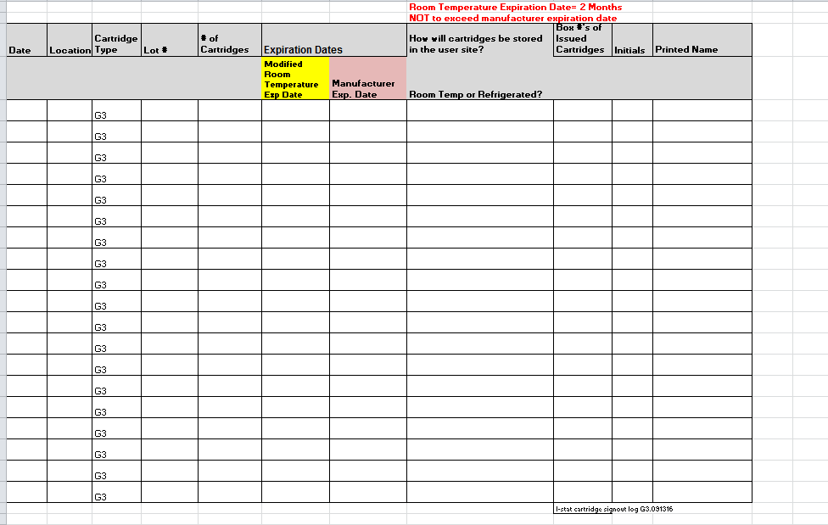
i-STAT Supplies:
Cartridge Sign-Out Log

Slide 22
i-STAT Sites and Cartridges Used
Brenner Respiratory Therapy (Peds ED, Birth Center L&D, NICU, PICU, Transport): EG7
Cancer Center Radiology: Creatinine
Cath Lab: ACT-CELITE, PT/INR, EG7
CV-OR (Perfusion): ACT-Kaolin
ECMO: EG7, ACT-CELITE
EP Lab: ACT-CELITE, PT/INR
Interventional Radiology: ACT-CELITE
OR Blood Gas Lab: ACT-CELITE
Other:

Slide 23
Cartridge Storage
ALL refrigerated cartridges must be stored 2- 8˚C
  Storage environment MUST BE MAINTAINED and monitored 24/7/365
    Monitored by SPOT
If temperature is ever outside of 2 to 8˚C, contact the POCT office for assistance.
  Do NOT use the cartridges for patient testing, until consulting the POCT office.
Cartridges should NOT be returned to refrigerated storage once they reach temperatures above 8˚C.
Do NOT store or expose cartridges to extreme cold or heat such as freezing or stored above lights or computers

Slide 24
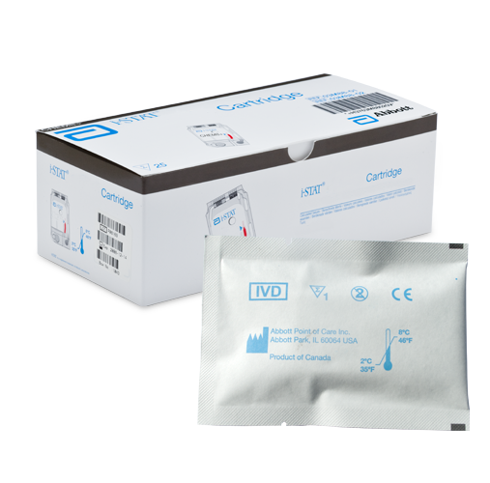
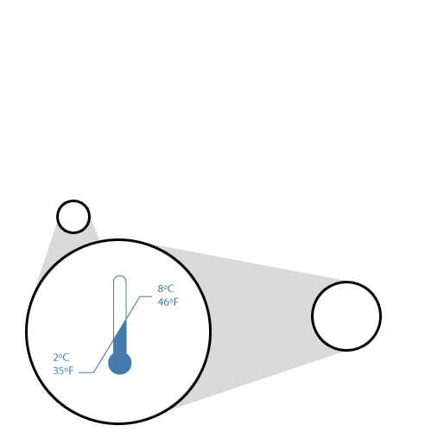
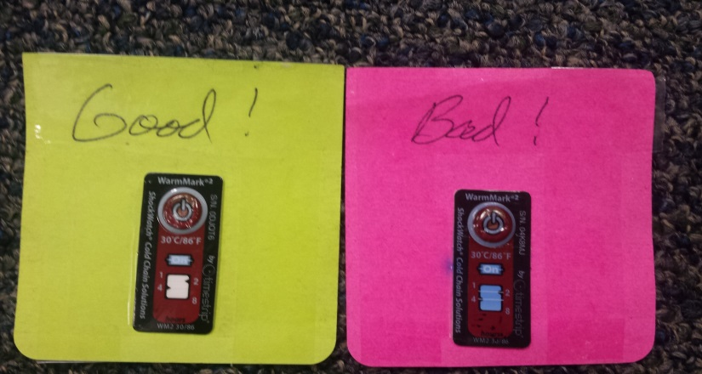
Cartridge Storage (continued)
Room temperature (RT) storage
14 days or 2 months, depending upon cartridge type
Room temperature expiration should NEVER exceed manufacturer expiration date
RT 18°C - 30°C (64-86°F)
Monitored by color change indicators
Do NOT use past manufacturer’s expiration date or past room temperature expiration date.
Good
Bad

Slide 25

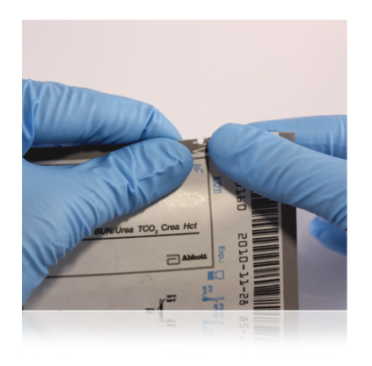
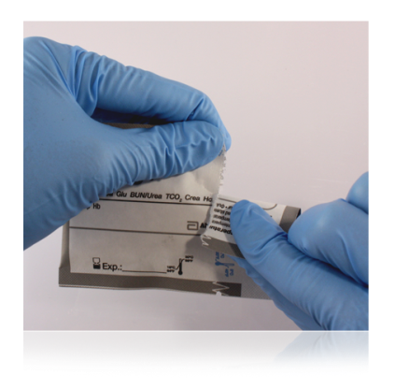
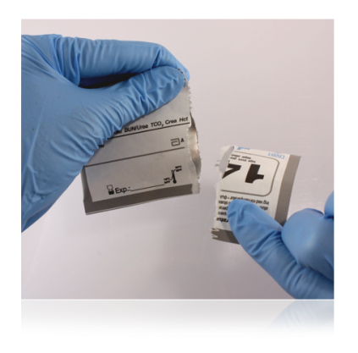
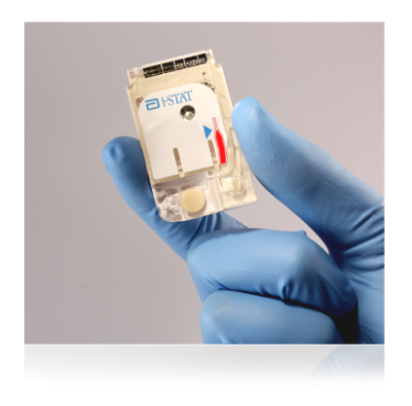

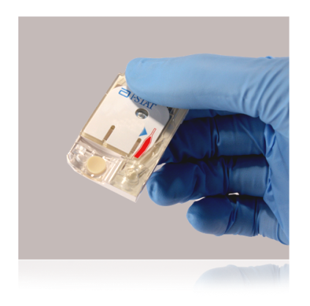
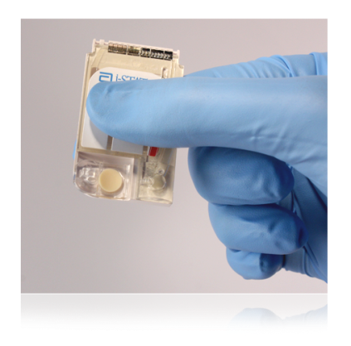
i-STAT Cartridge Handling
Do NOT reuse cartridges
Open cartridge IMMEDIATELY prior to use.
Carefully tear open the cartridge pouch where indicated (do NOT leave cartridges exposed to air or moisture)
Hold the cartridge by the sides or the bottom
Do not touch the sensors or apply pressure to the center of the cartridge (be careful when putting room temperature expiration date on cartridges – write or apply sticker at line on bottom – not in the middle)

Slide 26
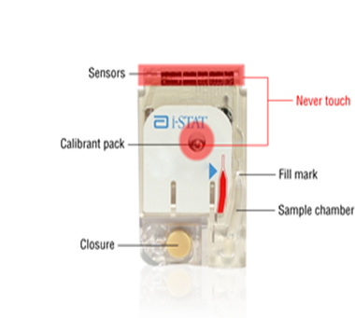
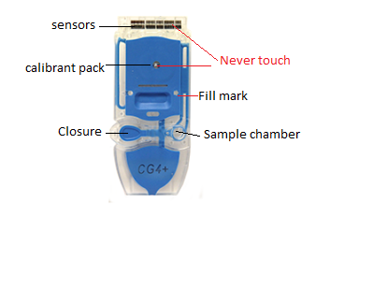
i-STAT Cartridge Components

Slide 27
Quality Controls (QC)
  Simulators
  Liquid QC

Slide 28
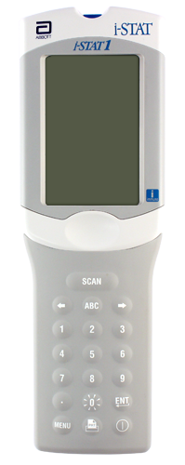
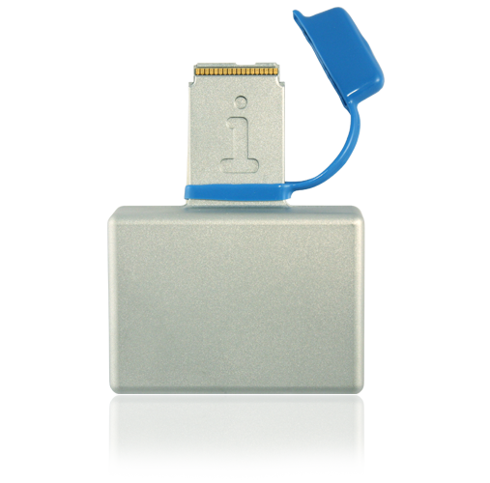
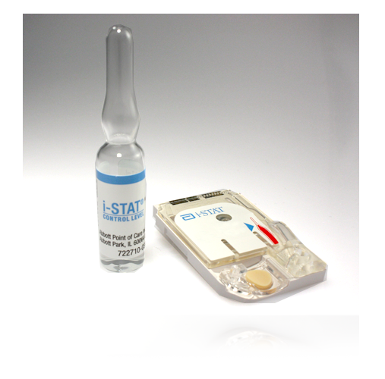
i-STAT System Quality Control
i-STAT System Quality Control
Internal Electronic Simulator
External Electronic Simulator
Liquid Quality Controls

Slide 29
Simulators
Electronic Quality Control
  Validates i-STAT analyzer
  Pass or Fail
QC results automatically documented when analyzer downloaded

Slide 30

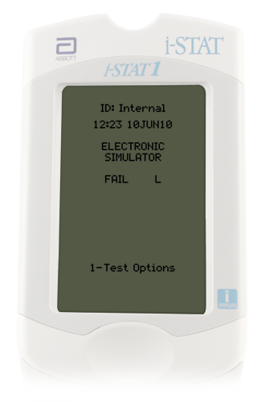
Internal Electronic Simulator
Internal checks ensure proper and accurate functioning
Performed automatically
  Every 8 hours of patient use
  With each cartridge type
If simulator passes, testing proceeds/patient results will be displayed
Results will not be given if the simulator fails.
If the “Electronic Simulator Fail” message appears,
  Do Not proceed with patient testing until issue is resolved.
  Test external electronic simulator

Slide 31
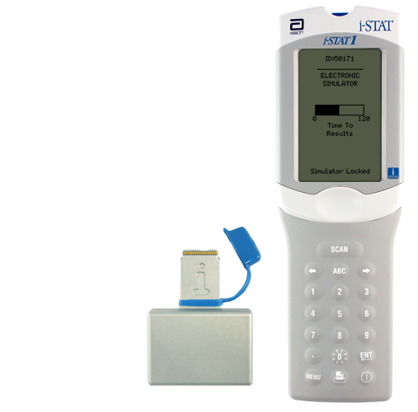
External Electronic Simulator--Hands On
Same as the internal simulator but is an external device and can be tested upon demand.
Simulator is performed if:
Handheld is dropped
Internal Electronic Simulator failure
Error code occurs that indicates the simulator should be tested
Questionable analyzer performance
Ceramic cartridge cleaning procedure
External Electronic Simulator
Do not remove simulator when “Simulator Locked” is displayed

Slide 32
Liquid Quality Control
Validates performance of test cartridges
Consists of multiple levels—test specific
Should be performed:
      Each new cartridge shipment, per cartridge type, per cartridge lot #, PRIOR to patient use—by Clinical Lab staff
      Monthly—by testing site staff
      Questionable performance cartridges/analyzer

Slide 33
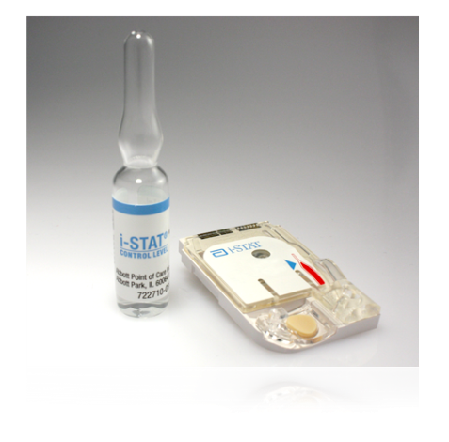
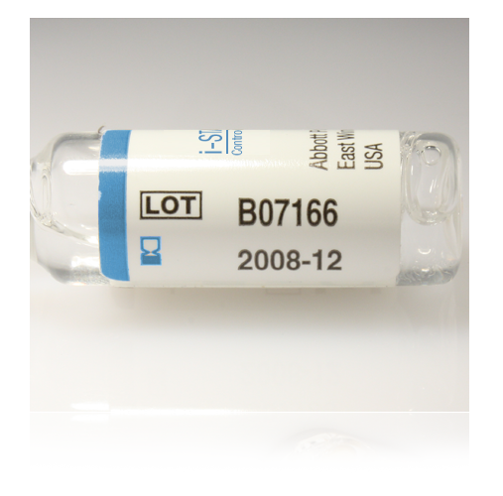
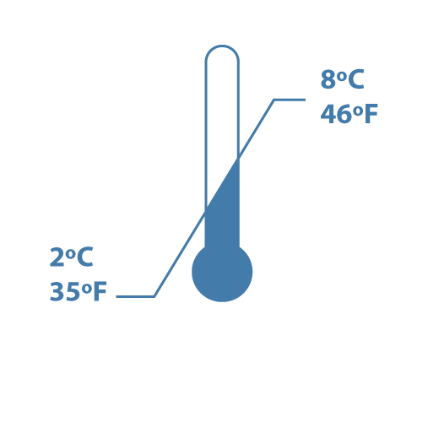
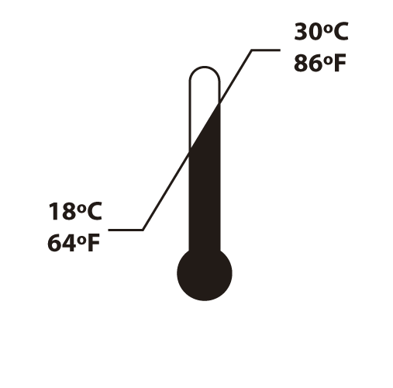

Liquid Quality Controls for
CG4, EG7, Creatinine (area specific)
3 levels
Monitors cartridge performance
Store 2°C to 8°C
Room temperature for 4 hours
(CG4, EG7)
Room temperature for 30 minutes (Creatinine)
Expiration Date

Slide 34
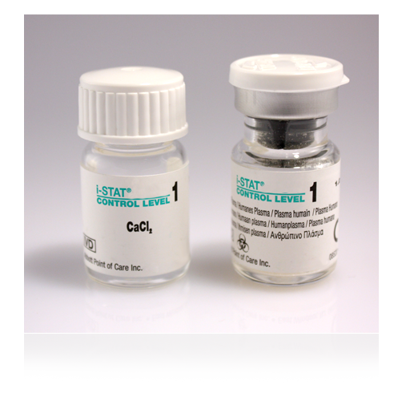
Liquid Quality Control
ACT and PT/INR (area specific)
2 levels
Monitors cartridge performance
Each level must be reconstituted from:
  One vial dry lyophilized human plasma
  One vial diluent
  Handle using Standard Precautions
    Always wear gloves
Store 2°C to 8°C
Must be left at room temperature for 45 minutes prior to reconstitution

Slide 35
Liquid QC Important Notes/Reminders
Analyzers programmed with QC ranges for the liquid QC.
  Pass or Fail will display
If liquid QC fails, a comment code and corrective action is required:
      Use comment code 5—recheck/confirm
      Repeat liquid QC
      Creates a STOP point for the testing staff member
      Patient testing lockout does NOT occur
Staff MUST ensure QC results are within acceptable limits PRIOR to proceeding with patient testing.

Slide 36
Patient Identification
  Process Flow
  Patient Identity

Slide 37
Process Flow
Ensure documented physician order or documented protocol before performing i-STAT testing.
Patient ID:
  CSN for that specific date of service or current admission CSN
After testing is completed, analyzer should be downloaded.
If ID match is found, results post to Wake One and billing occurs, regardless of provider order

Slide 38
Patient identity
Follow medical center policy for verification of patient identity—
  2 patient identifiers at the patient side (name and Date of Birth (DOB))
Scan patient ID DIRECTLY from the patient armband attached to the patient
If an ID barcode is scanned that is not physically attached to the patient, 4 identifiers (name, DOB, MRN, CSN) MUST be verified.
  Include label/armband verification in the procedure time-out.
Ensure sample identity throughout entire testing and reporting process.
  Verify patient ID again on analyzer display.

Slide 39
Sample Information
  Sample Collection/Sample Considerations
  Filling the cartridge
  Running a patient test

Slide 40
Sample Collection/Considerations:
ONLY whole blood should be tested on the i-STAT
  Arterial
  Venous
  Capillary
    Use a SINGLE-use auto-disabling skin puncture device that provides free-flowing blood
    Use a heparinized capillary tube
    NOTE: Capillary tubes are NOT acceptable for use when testing ACT or PT/INR cartridges
Important notes:
  Make sure to follow medical center procedures for proper sample collection.
  Always correlate results with the status of the patient!
Consult Intended Use Statements for
APOC Products in the Cartridge
  and Test Information (CTI) sheets at:
www.abbottpointofcare.com
Within the i-STAT 1 System Manual

Slide 41
In-Dwelling Line
  Adequately ‘clear’ line
    Inaccurate results will be given if samples are contaminated.
      Saline Contamination can cause:
        Falsely elevated sodium
        Falsely decreased potassium, hemoglobin, hematocrit, pCO2,
      Contamination with potassium-containing fluids can cause:
        Falsely elevated potassium
  i-STAT Recommendation:
    Five to six times the volume of the catheter, connectors, and needle should be collected as ‘waste’
  ACT cartridges:
    To avoid possible heparin contamination and specimen dilution, the line should be flushed with 5mL of saline and the first 5mL of blood or six dead space volumes of the catheter should be discarded

Slide 42
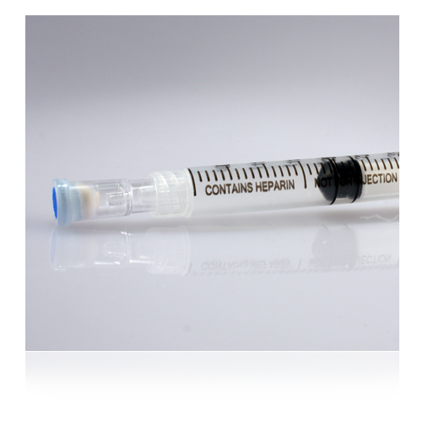

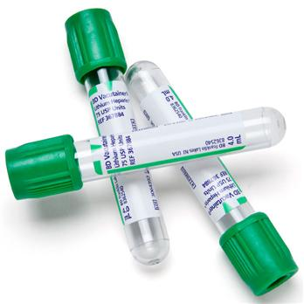
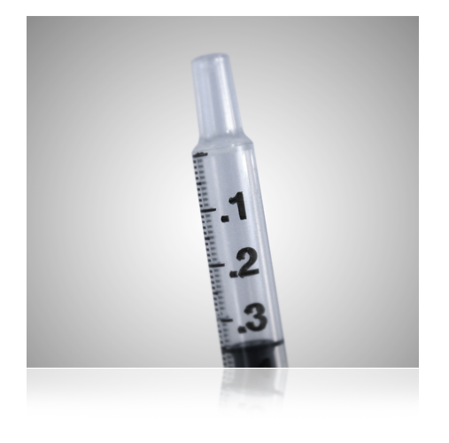

Chemistry Cartridges—
Creatinine
Creatinine ONLY
Whole blood sample
  a. 4 ml Lithium Heparin green-top tube—MUST be filled to capacity
  b. Heparinized syringe
  c. Non-heparinized syringe
For heparinized samples, test within 30 minutes
For non-heparinized samples, test Immediately

Slide 43

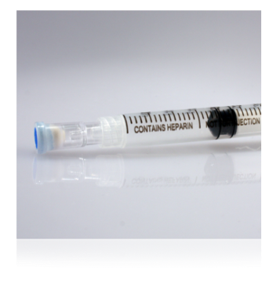


Blood Gas Cartridges—
CG4, EG7
Use a syringe
Seal sample with cap IMMEDIATELY after collection.
  Do not contaminate with air
    pO2 will be falsely increased if air contamination occurs
Heparinized samples, test within 10 minutes
Non-heparinized samples, test immediately
  EG7 (ionized calcium) use balanced heparin
ALWAYS test CG4 cartridge immediately after collection--lactate will be falsely increased if testing is delayed

Slide 44

PT/INR Cartridge
Capillary or venous sample
Filling a PT/INR Cartridge
  Gently squeeze finger to obtain hanging drop of blood
  Avoid milking the finger as this factor may impact results
  Bring the cartridge sample well up to the bottom of drop of blood until they touch
Do NOT use a filling device/transfer device/capillary tube.
  Preferred method: Fill cartridge DIRECTLY from finger
Use the FIRST drop of blood to test
Venous sample: collect in a plastic syringe without anti-coagulant. Metal needles should not be used when filling an i-STAT cartridge.
Test Immediately!
If sample testing is delayed, falsely decreased results will be obtained

Slide 45
ACT Cartridges :
IMPORTANT Information
ENSURE the correct ACT cartridge is used for your test site. ACT methods are NOT interchangeable.
There are multiple ACT methodologies in use at WFBMC, which may yield different results

Slide 46

ACT Cartridges
NON-heparinized Whole blood sample
  Use a plain, plastic syringe
Do NOT fill cartridge with a metal needle
Test Immediately!
  NO DELAY IN TESTING or results will be falsely decreased
Wait until the final ACT result displays
Contamination may be indicated by:
  Falsely prolonged ACT results

Slide 47



Cartridge Filling Overview
Mix the sample thoroughly and gently for 15 seconds
  Hematocrit is most affected by an improperly mixed sample
Discard first few drops to check for clots and to get rid of any micro air bubbles
  NEVER test a sample that has or has had a clot. Inaccurate results may be obtained.
Fill to the fill mark and close the closure to seal
Insert IMMEDIATELY into the analyzer
Do not move analyzer after cartridge has been inserted
Fill mark
closure is closed

Slide 48




Using a Capillary Tube to Fill a Cartridge
(Do NOT use with ACT or PT/INR cartridges)
Fill mark
Test Immediately!
Direct one end of capillary tube into sample well
Fill to fill mark
Close the closure
closure is closed

Slide 49


Running a Patient Test:
Using the Test Select Function
Used to view and report selected results
Refer to list of analytes displayed
Press corresponding numbers on keypad
Press again to deselect
Only select tests that the clinical provider has ordered or the documented protocol indicates

Slide 50

Running a Patient Test:
Overview of the Chart Page
Allows entry of patient data
  Sample type
    Enter the number next to the sample type
    Press the ENT key
  Patient temperature
    ONLY if requested by provider
  FIO₂
  Free fields for additional info
    Free fields do not populate the electronic medical record

Slide 51
Citrate Dialysis Testing: only applies to Respiratory Therapy in PICU (iCa on EG7 cartridge)
When testing Dialysis Circuit sample,
  Enter C in field 1 of the i-STAT analyzer
  C causes results to post in Wake One with the comment: Whole Blood Dialysis Circuit
If you forget to enter C in field 1, Wake One enter/edit will have to be used to add the comment, “Whole Blood Dialysis Circuit”

Slide 52
Results
  Interpreting Results
  Comment Codes
  Result Considerations
  Quality Check Codes
  Printing Results
  Transmitting Results
  Enter/Edit of Results – Wake One
  Supporting Documents

Slide 53


Interpreting Test Results:
The Results Screen
Patient ID
Time and date of test
Type of cartridge
Test results
  EG7 and Chem 8 results appear on 2 pages
  Use right Arrow key to navigate

Slide 54

Interpreting Test Results:
Critical Value Alerts
Indicated by up or down arrows
Evaluate with patient’s clinical symptoms
  As appropriate, perform repeat testing
    Values not consistent with patient symptoms --repeat and validate by an alternate test method
      Use ICU Blood Gas Lab (except Creatinine – use Main Lab)
Follow medical center policy for handling critical results

Slide 55

Critical Values – found in i-STAT procedure on POCT website
The patient provider must be notified of critical values:
Documentation must include:
  Result
  Date/Time of notification
  Name of provider notified
  Name of notifying staff member
  Critical values must be notified within 15 minutes

Slide 56
Estimated Glomerular Filtration Rate (eGFR)
Estimated Glomerular Filtration Rate (eGFR) values will be reported when Creatinine results are downloaded into the electronic medical record.
The values may be accessed via Wake One.
The i-STAT handheld will NOT report eGFR values.
May use online calculator in POCT website (under Resources - Resource Links)

Slide 57

Interpreting Test Results: Out of Reportable Range Flags
Out of Reportable Range flag
Indicated with a <xxx or >xxx
Suppressed Result Flag <>
Result dependent on the out of reportable range result

Slide 58

Interpreting Test Results:
Star Outs (***)
*** appears in place of the test result
  Sensor on the cartridge is unable to report a result
Use comment code 0 (zero) to prevent result from posting to the patient record
  Failure to enter comment code 0 into the i-STAT handheld at the time of testing=results post to Wake One
    The star out result will report as INSTRUMENT ERROR.
ACTION REQUIRED:
  Retest the sample
  If star out values continue, send the sample to the Clinical lab for testing.

Slide 59

Responding to Patient Tests:
Comment Codes
Numeric codes
      ‘Automates’ result hold or posting of result to the patient record
      Affects patient billing for testing
Comment field--top of the first page of the results screen
  MUST be entered at the time of testing AND before the analyzer powers down
  Question: What can you do if you realize that you have misidentified a patient sample immediately after inserting the cartridge?
Code | Translation | Result Post to Wake One | Allows charge to patient | Use
0 (zero) | Procedure Error | NO | NO | Star out Questionable Results Error in testing
5 | Recheck/Confirm | Yes | NO | Result may be accurate and test will be repeated
6 | To Notify Provider | Yes | Yes | Documents intent to notify provider of result
123 | Lab Confirmation to Follow | Yes | NO | Use when sending repeat testing to the laboratory

Slide 60

Result Considerations:
Factors That May Affect Results
Avoid factors that may affect the sample prior to analysis
Always correlate results with the status of the patient
Do NOT Move/Carry the analyzer during sample testing
  NO Vibration or tilting analyzer
References:
Cartridge and Test Information Sheets (CTI Sheets)
  i‑STAT 1 System Manual
  www.abbottpointofcare.com

Slide 61


Result Considerations:
Cartridge and Test Information Sheet

Slide 62
Result Considerations: i-STAT INR
Consideration | Action
Error Code 19 | Draw venous sample and send to Core Lab for testing
INR >=4.0 | Use comment code 123 Draw venous sample and send to Core Lab for testing
Chlorhexidine Gluconate | i-STAT PT/INR may be falsely elevated in samples contaminated with Chlorhexidine Gluconate. This chemical can be found in some skin cleansing solutions.

Slide 63
Result Considerations:
Effects of Hemolysis on Potassium Result
(Hemolysis is the destruction of red blood cells, caused by disruption of the cell membrane, and results in the release of hemoglobin)
i-STAT tests whole blood. Hemolysis can NOT be determined.
          Potassium values will be falsely increased
DO NOT report/treat high potassium results until verified via an alternate method.
  If asked to do so, OR/ICU Blood Gas Labs will spin down sample to check for hemolysis

Slide 64


Result Considerations:
Factors That May Affect Creatinine Results
Avoid affecting creatinine results:
Use another testing method if the patient has been administered hydroxyurea (Droxia®, Hydrea®)
  Send sample to Main Lab
    Do NOT use Blood Gas Lab
i-STAT creatinine results will be falsely elevated

Slide 65

Quality Check Codes:
i-STAT Quality System
Numerous quality checks during patient test cycle
Failed quality check
  Cause message— pay attention to the code number
  Action message
  Quality Check Code
      Do NOT continue with testing until the cause of the error is clearly understood
      If the same error code occurs multiple times with no apparent cause, notify the Clinical Laboratory POCT office
      Consider using a different analyzer and a different batch of test cartridges

Slide 66






Quality Check Codes

Slide 67


Quality Check Codes

Slide 68

Printing Results with the i-STAT Portable Printer
Used in NICU, PICU, Cath Lab, Peds ED, other
Display results and align the infrared eyes of each device
Press the printer icon key on the handheld
Printer uses rechargeable batteries—MUST remain plugged into outlet and turned off when not in use
Verify patient ID on printout against patient sample ID

Slide 69

Transmitting Results: Downloader
Transmit results after each test/case:
Turn handheld off
Place handheld in the Downloader
Look for display screen to show arrows and the message “Communication in Progress”
When transmission is complete:
Screen goes blank
Handheld turns off

Slide 70
Transmitting Results: Troubleshooting
If the downloader does Not display “Communication in Progress” or an error message appears
      Check for a green power light
      Check all cord/cable connections to the down loader
      Try unplugging and re-plugging the cables
      If troubleshooting does not resolve problem, report problem to the Help Desk (Call 6-HELP)

Slide 71
Editing of results once posted to Wake One
Refer to i-STAT Procedure or “Tips and Tricks: Procedure to correct i-STAT results in Wake One”
Situations that require editing of results:
  Sample Misidentification
    Also requires i-STAT resolution requisition found on POCT web site
  Erroneous temperature corrected blood gas
  Questionable i-STAT results if posted to Wake One
  Tests performed but not ordered by the physician
  Documentation of critical value notification if not done in another section of Wake One
  Adding comment to citrate dialysis samples, where C was not used in Field 1 at the time of testing

Slide 72

Supporting Document(s)
i-STAT Resolution Requisition
  (Located on POCT website – Forms and Records)

Slide 73
Congratulations
This concludes the i-STAT education module.
Please note that this power point does not replace the i-STAT policies and procedures.
The presentation only gives highlights of i-STAT information.
Please complete the on-line i-STAT exams within 1 week of training.

Slide 74
Hands On Experience
Change batteries and check battery voltage
Discuss Menu Options
Test External electronic simulator
Test/Discuss Liquid QC
Test sample as a patient
Recall results
Download of results
        i-STATtrainingRevDec2016 120716

