Slide 1
i-STAT Testing:
Blood gas, Electrolyte, Hgb/Hct, Lactate, Creatinine, ACT & PT/INR
Point of Care Testing Department Updated - 12.15.2022

Slide 2
General Information
Contact Information
Policies/Procedures
Training and Competency
i-STAT Access
Safety
Components
Testing Process Overview

Slide 3
i-STAT Support: Contact Information
Liz Gregory 713-0377
Neha Jacobs 716-7248
Trish Sorensen 713-4136
John Quigley 713-1393
Site-specific preceptors
Refer to the i-STAT System Manual and medical center specific i-STAT policies
POCT web site : https://intranet.wakehealth.edu/Departments/Pathology/Laboratory/POCT/Resources/Procedures-and-Guidelines

Slide 4
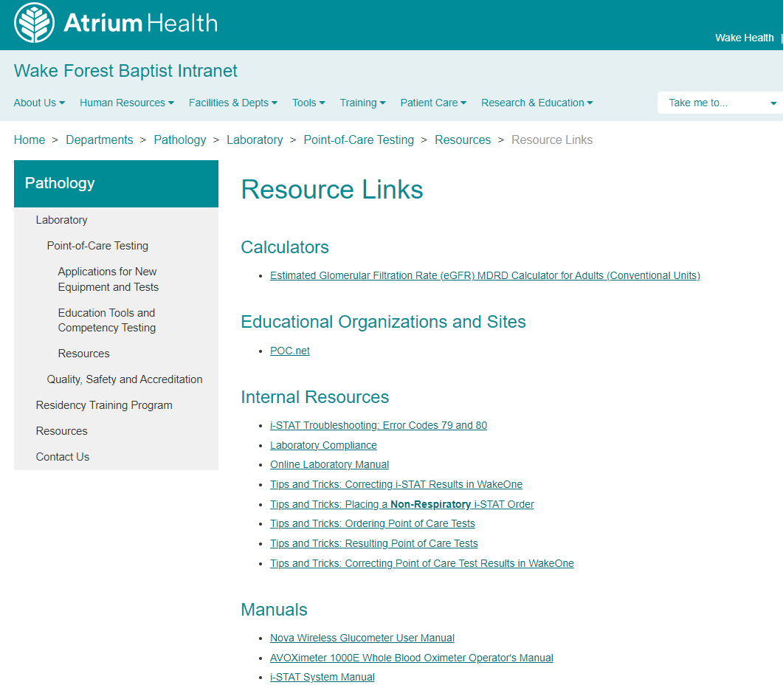
i-STAT Policies/Procedures/Guidelines
Posted on the Intranet—Go to: Departments—Point of Care Testing—Policies/Procedures/Guidelines
The i-STAT System Manual (Abbott POC website) can be found under Resources-- Resource Links— Manuals

Slide 5
Training and Competency Requirements
ONLY authorized users may perform i-STAT testing.
Initial training and MTS exams are required.
6 month competency assessment for all NEW users.
Written exams (online using MTS) 80% correct or remediation will be required.
All necessary exams must be complete PRIOR to competency observation.
On-going Annual competency assessment
Must meet all 6 points of competency assessment, as defined by CLIA— refer to page 1 of competency observation form.
Failure to maintain competency will result in loss of testing privileges.
Competency observation may only be completed by an authorized staff member.

Slide 6
i-STAT Access (Operator ID)
Training=i-STAT access
Employee ID=operator ID
Do NOT share your employee/operator ID
Do NOT enter your ID into analyzer and allow testing by another individual

Slide 7
Safety
Always wear gloves
Patient testing
Performing/handling Quality Controls (QC)
Disinfecting analyzer
Disinfect analyzers/printers
When contaminated with blood AND
Between EACH patient
Follow medical center policies
DO NOT lean over the cartridge when filling
A safety shield is recommended
Place gauze or tissue over snap when closing

Slide 8
Component of the i-STAT system
Primary System Components
Downloader and/or charger
Cartridge
Handheld i-STAT
Printer

Slide 9
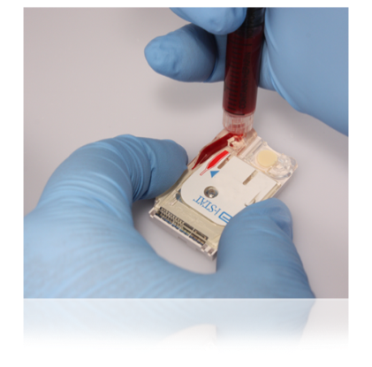
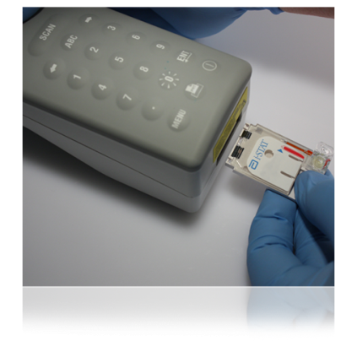
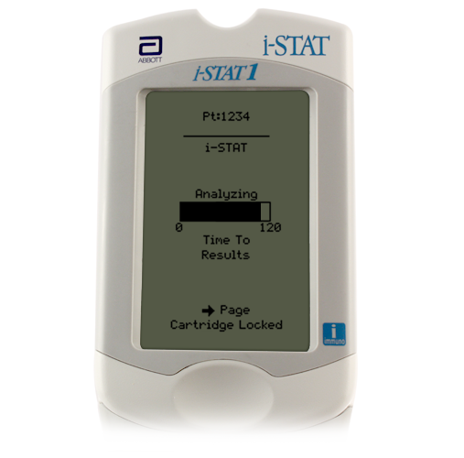
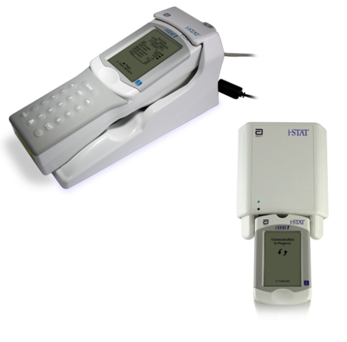
Quick Overview: The i-STAT System Testing Process
Enter information into handheld
Obtain the blood specimen and fill cartridge
Insert cartridge; results will appear within minutes
Download results

Slide 10
The i-STAT Analyzer
External Components
Battery Replacement/Charging
Barcode Scanner
Test Menu
Menu Options

Slide 11
i-STAT Analyzer
Turns off after 2 minutes of non-use
Can be turned on by pressing the on/off keypad—circle with line—Show on/off keypad
If operator, patient, and cartridge information has been entered, the analyzer will remain on for 15 minutes

Slide 12
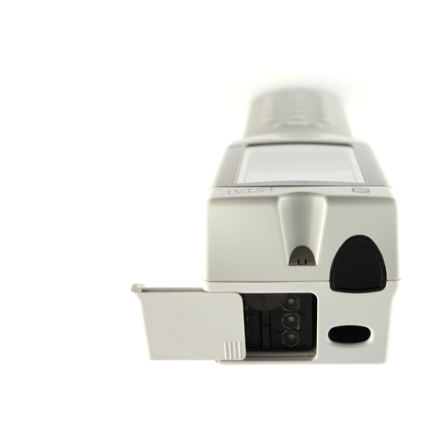
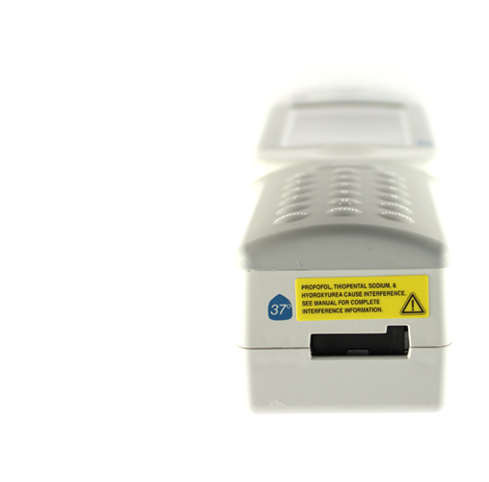
Handheld External Components
Infrared eye
Cartridge port
Battery compartment
Barcode scanner

Slide 13
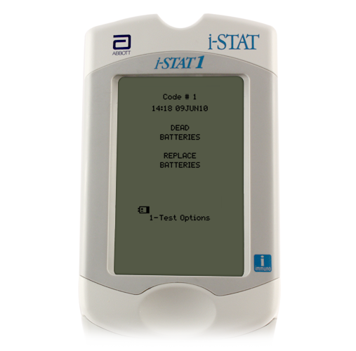
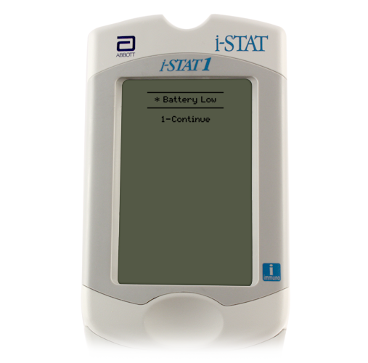
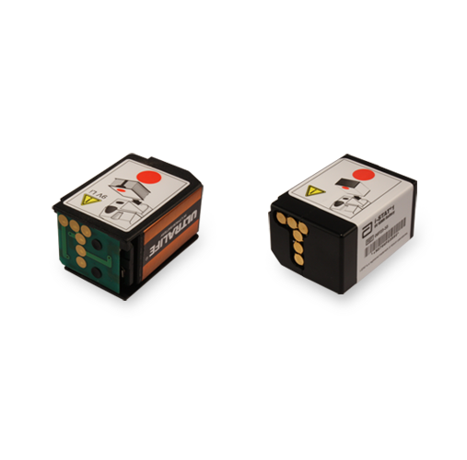
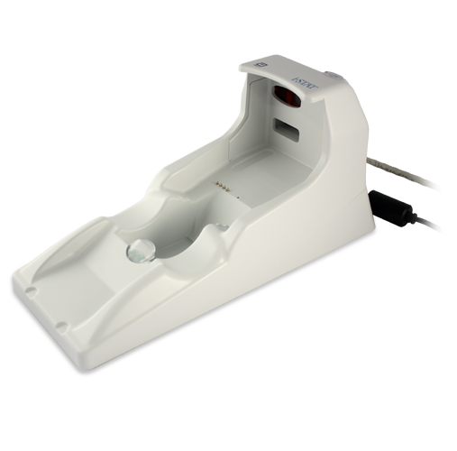
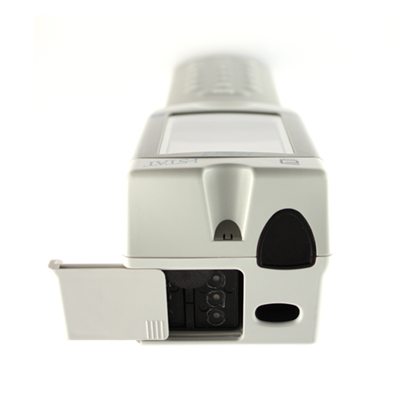
Batteries: Hands On
There are two types of batteries available for i-STAT :
9-volt lithium disposable batteries
Rechargeable batteries. Winston campus sites use the Abbott rechargeable battery.
Change/charge the batteries:
Flashing battery icon
“Battery Low ” message
Do not discard rechargeable batteries. Contact POCT office please.
Green light will be on if battery in compartment is seated properly and charging on the downloader/charger
9-volt lithium disposable batteries
Abbott rechargeable battery
Battery compartment to charge spare battery.
Battery compartment

Slide 14
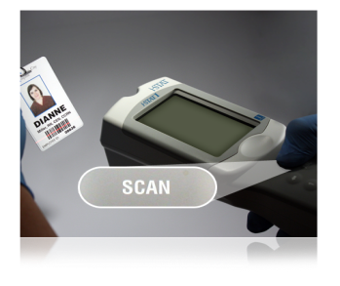
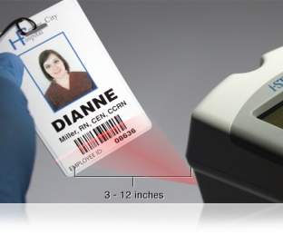
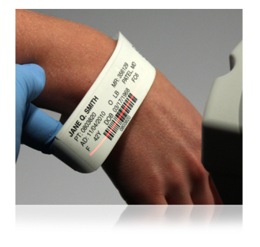
The Barcode Scanner
To scan
Hold 3 to 12 inches away from the barcode
Press and hold down the SCAN key
Laser beam must cover the entire length of the barcode
Wait for the beep or for laser beam to disappear
Release the SCAN key
Barcode scanner
The barcode scanner is a class II laser device. Momentary exposure is not known to be harmful—however you should never point the scanner at anyone or look into the laser beam.

Slide 15
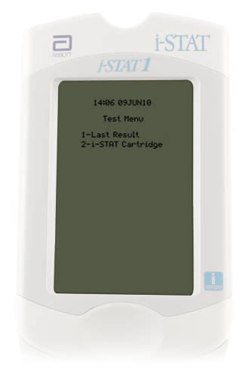
Handheld Test Menu—Hands On
Test Menu
First menu to appear
Important Note: This menu is used for patient tests only!
Cartridge Test Menu options
1 = Last Result
2 = i-STAT Cartridge (for a patient test)

Slide 16
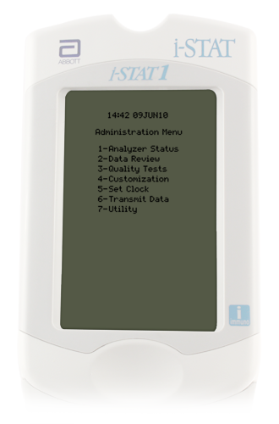
Administration Menu Options—Hands On
1--Analyzer Status
Battery voltage
Maintain charge above 8 volts
Shows unsent and total patient records
2--Data Review
Review/print stored data
#7 – List All Results
3--Quality Tests
Controls (liquid QC)
Simulator (EQC)

Slide 17
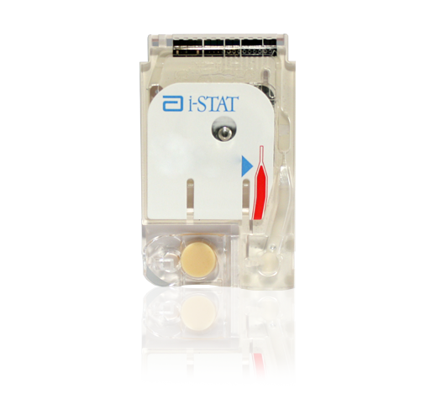
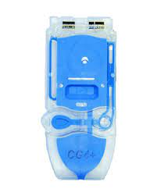
Cartridges
i-STAT Supplies
General Information
Labeling
Storage
Handling

Slide 18
i-STAT Supplies
Winston campus sites obtain cartridges and paper from POCT office (lab admin offices) on M South
The site is responsible for room temperature dating of the cartridges
NEVER take cartridges that are marked with “Do Not Use”
Do not use any cartridges BEHIND this “Do Not Use” sign
Accurately complete i-STAT cartridge sign-out log
Only take the amount of cartridges that will be used within the room temperature expiration dating period
Replacement analyzers/printers -- contact POCT office

Slide 19
General Cartridge Information
Self-contained lab analyzers
Analysis, sample manipulation, and waste are confined within the cartridge
Single use
24 or 25 per box
Use IMMEDIATELY after opening
Requires only a few drops of blood
Cartridges contain biosensors that “measure” the analytes being tested.
Abbott offers different i-STAT cartridge configurations.
Only use cartridges authorized for your test site.

Slide 20
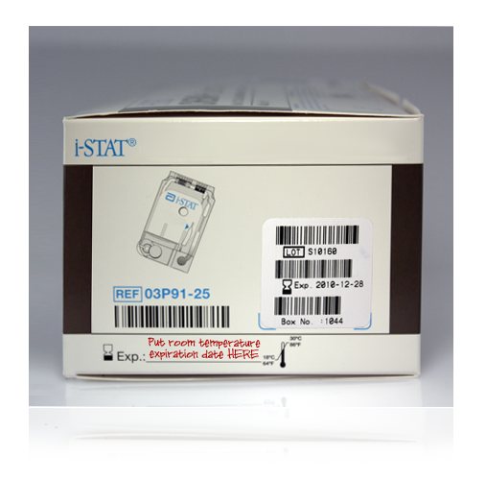
i-STAT Cartridge Labeling
Lot number
Cartridge barcode
Measured
Panel name
Calculated
Analytes
Room temperature storage expiration date
Refrigerated expiration date
Cartridges MUST be brought to room temperature
5 minutes for a single cartridge
1 hour for a box of cartridges
Do NOT manipulate the cartridge in any way to bring it to room temperature more quickly.

Slide 21
i-STAT Supplies: Cartridge Sign-Out Log

Slide 22
i-STAT Sites and Cartridges Used
Brenner Respiratory Therapy (Peds ED, Birth Center L&D, NICU, PICU, Transport): EG7
Cancer Center Radiology: Creatinine
Cath Lab: ACT-Celite, PT/INR, EG7, CG4
CV-OR (Perfusion): ACT-Kaolin
EP Lab: ACT-Celite, PT/INR
Interventional Radiology: ACT-Celite
Critical Care Lab (OR/ICU) : ACT-Celite

Slide 23
Cartridge Storage
ALL refrigerated cartridges must be stored 2- 8˚C
Storage environment MUST BE MAINTAINED and monitored 24/7/365
Monitored by SPOT
If temperature is ever outside of 2 to 8˚C, contact the POCT office for assistance.
Do NOT use the cartridges for patient testing, until consulting the POCT office.
Cartridges should NOT be returned to refrigerated storage once they reach temperatures above 8˚C.
Do NOT store or expose cartridges to extreme cold or heat such as freezing or stored above lights or computers

Slide 24
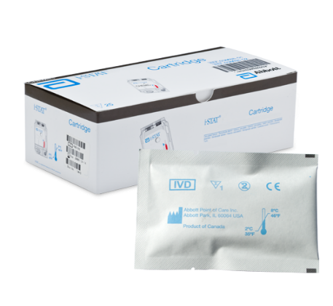
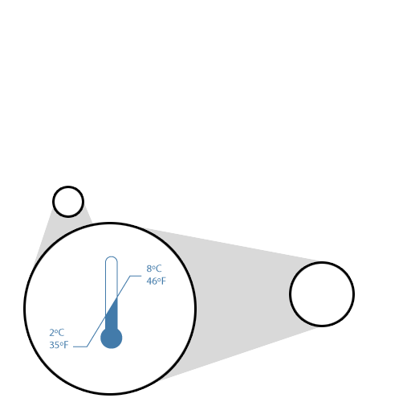
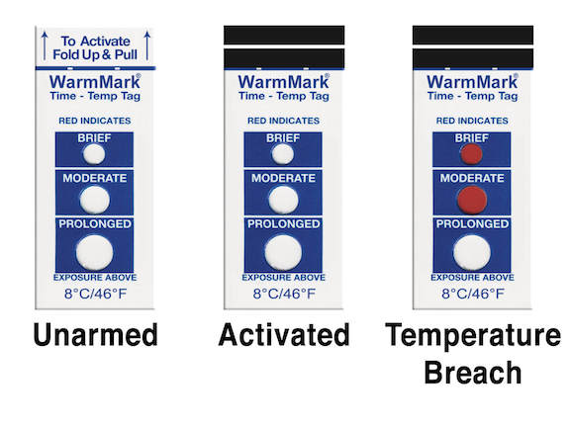
Cartridge Storage (continued)
Room temperature (RT) storage
14 days or 2 months, depending upon cartridge type
Do NOT use past manufacturer’s expiration date or past room temperature expiration date.
Room temperature expiration should NEVER exceed manufacturer expiration date
RT 18°C - 30°C (64-86°F)
WarmMark temp tag are placed near RT cartridges, that indicates temperature changes by color change. Contact POCT office if color changes to reddish pink.

Slide 25
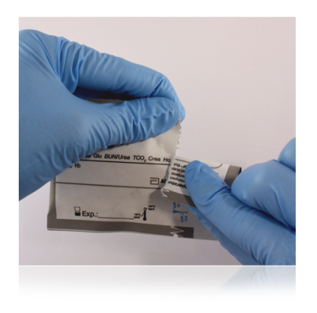
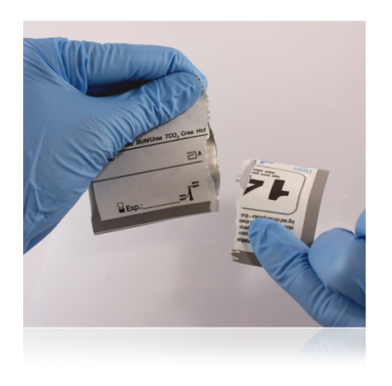
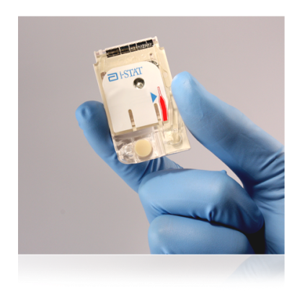
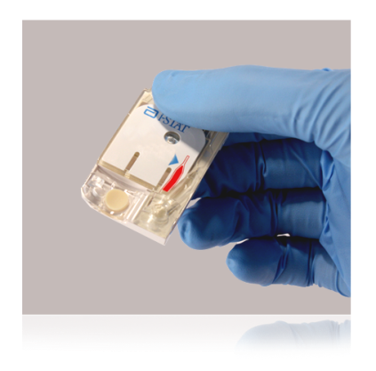
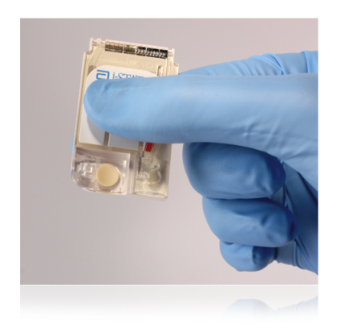
i-STAT Cartridge Handling
Do NOT reuse cartridges
Open cartridge IMMEDIATELY prior to use.
Carefully tear open the cartridge pouch where indicated (do NOT leave cartridges exposed to air or moisture)
Hold the cartridge by the sides or the bottom
Do not touch the sensors or apply pressure to the center of the cartridge (be careful when putting room temperature expiration date on cartridges – write or apply sticker at line on bottom – not in the middle)

Slide 26
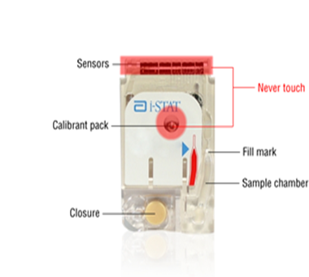
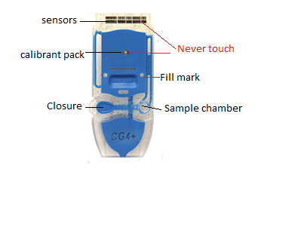
i-STAT Cartridge Components

Slide 27
Quality Controls (QC)
Simulators (EQC)
Liquid QC (LQC)

Slide 28
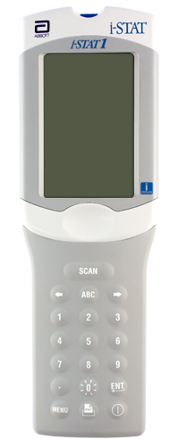
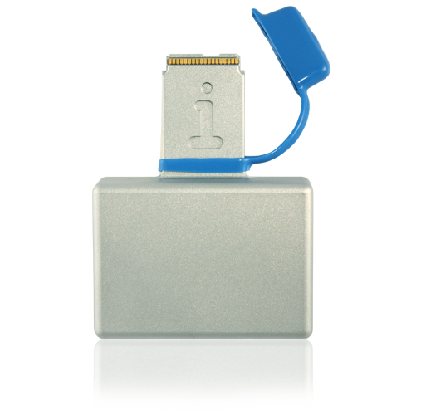
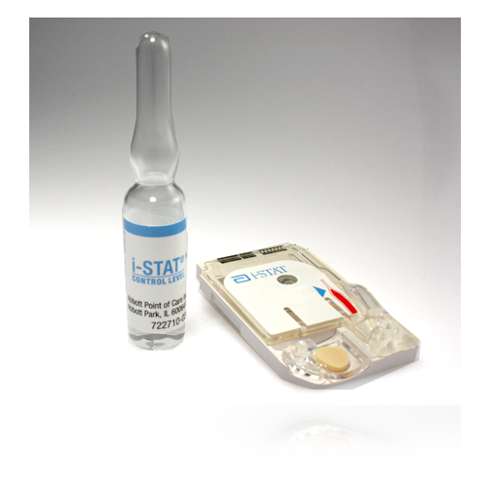
i-STAT System Quality Control
Internal Electronic Simulator
External Electronic Simulator
Liquid Quality Controls

Slide 29
Simulators
Electronic Quality Control
Validates i-STAT analyzer
Pass or Fail
QC results automatically documented when analyzer downloaded

Slide 30
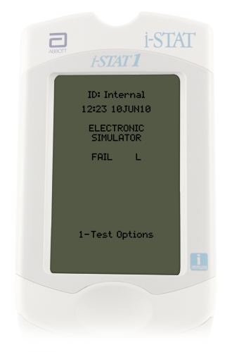
Internal Electronic Simulator
Internal checks ensure proper and accurate functioning
Performed automatically
Every 8 hours of patient use
With each cartridge type
If simulator passes, testing proceeds/patient results will be displayed
Results will not be given if the simulator fails.
If the “Electronic Simulator Fail” message appears,
Do Not proceed with patient testing until issue is resolved.
Test external electronic simulator

Slide 31
External Electronic Simulator--Hands On
Same as the internal simulator but is an external device and can be tested upon demand.
Simulator is performed if:
Handheld is dropped
Internal Electronic Simulator failure
Error code occurs that indicates the simulator should be tested
Questionable analyzer performance
Ceramic cartridge cleaning procedure
External Electronic Simulator
Do not remove simulator when “Simulator Locked” is displayed

Slide 32
Liquid Quality Control
Validates performance of test cartridges
Consists of multiple levels—test specific
Should be performed:
Each new cartridge shipment, per cartridge type, per cartridge lot #, PRIOR to patient use—by Clinical Lab staff
Monthly—by testing site staff
Questionable performance cartridges/analyzer

Slide 33
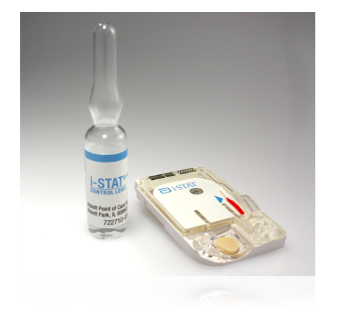
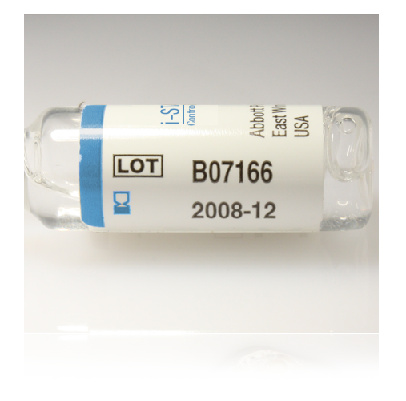
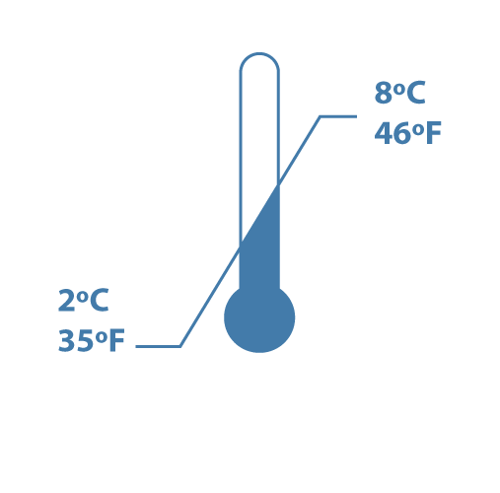
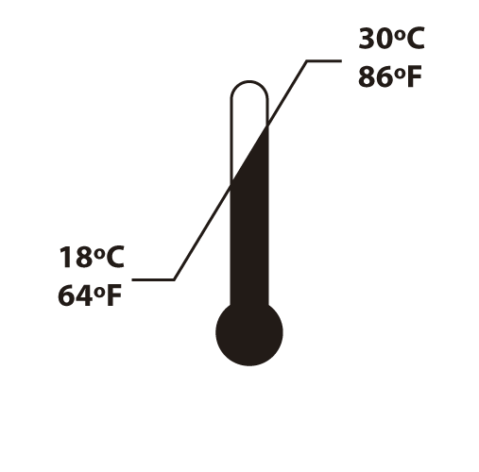
Liquid Quality Controls for CG4, EG7, Creatinine (area specific)
3 levels
Monitors cartridge performance
Store 2°C to 8°C
Room temperature for 4 hours (CG4, EG7)
Room temperature for 30 minutes (Creatinine)
Expiration Date

Slide 34
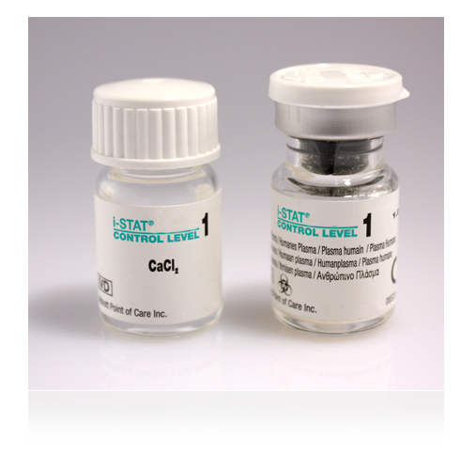
Liquid Quality Control ACT and PT/INR (area specific)
2 levels
Monitors cartridge performance
Each level must be reconstituted from:
One vial dry lyophilized human plasma
One vial diluent
Handle using Standard Precautions
Always wear gloves
Store 2°C to 8°C
Must be left at room temperature for 45 minutes prior to reconstitution

Slide 35
Liquid QC Important Notes/Reminders
Analyzers programmed with QC ranges for the liquid QC.
Pass or Fail will display
If liquid QC fails, a comment code and corrective action is required:
Use comment code 5—recheck/confirm
Repeat liquid QC
Creates a STOP point for the testing staff member
Patient testing lockout does NOT occur
Staff MUST ensure QC results are within acceptable limits PRIOR to proceeding with patient testing.

Slide 36
Patient Identification
Process Flow
Patient Identity

Slide 37
Process Flow
Ensure documented physician order or documented protocol before performing i-STAT testing.
Patient ID:
CSN for that specific date of service or current admission CSN
After testing is completed, analyzer should be downloaded.
If ID match is found, results post to Wake One and billing occurs, regardless of provider order

Slide 38
Patient identity
Follow medical center policy for verification of patient identity—
2 patient identifiers at the patient side (name and Date of Birth (DOB))
Scan patient ID DIRECTLY from the patient armband attached to the patient
If an ID barcode is scanned that is not physically attached to the patient, 4 identifiers (name, DOB, MRN, CSN) MUST be verified.
Include label/armband verification in the procedure time-out.
Ensure sample identity throughout entire testing and reporting process.
Verify patient ID (CSN#) again on analyzer display.

Slide 39
Sample Information
Sample Collection/Sample Considerations
Filling the cartridge
Running a patient test

Slide 40
Sample Collection/Considerations:
ONLY whole blood should be tested on the i-STAT
Arterial
Venous
Capillary
Use a SINGLE-use auto-disabling skin puncture device that provides free-flowing blood
Use a heparinized capillary tube
NOTE: Capillary tubes are NOT acceptable for use when testing CG4, ACT or PT/INR cartridges
Important notes:
Make sure to follow medical center procedures for proper sample collection.
Always correlate results with the status of the patient!
Consult Intended Use Statements for
APOC Products in the Cartridge
and Test Information (CTI) sheets at:
www.abbottpointofcare.com
Within the i-STAT 1 System Manual

Slide 41
In-Dwelling Line
Adequately ‘clear’ line
Inaccurate results will be given if samples are contaminated.
Saline Contamination can cause:
Falsely elevated sodium
Falsely decreased potassium, hemoglobin, hematocrit, pCO2,
Contamination with potassium-containing fluids can cause:
Falsely elevated potassium
i-STAT Recommendation:
Five to six times the volume of the catheter, connectors, and needle should be collected as ‘waste’
ACT cartridges:
To avoid possible heparin contamination and specimen dilution, the line should be flushed with 5mL of saline and the first 5mL of blood or six dead space volumes of the catheter should be discarded

Slide 42
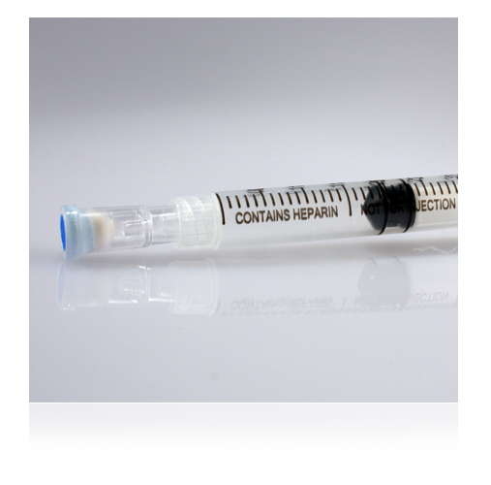
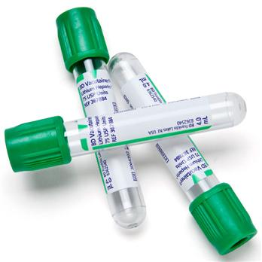
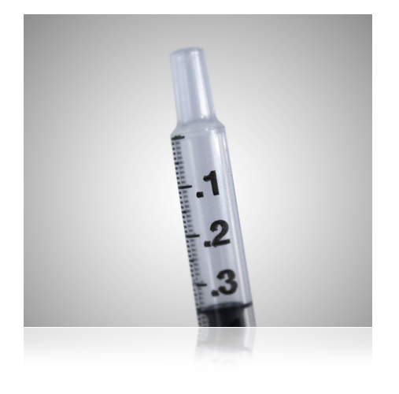
Chemistry Cartridges— Creatinine
Creatinine ONLY
Whole blood sample
a. 4 ml Lithium Heparin green-top tube—MUST be filled to capacity
b. Heparinized syringe
c. Non-heparinized syringe
For heparinized samples, test within 30 minutes
For non-heparinized samples, test Immediately

Slide 43
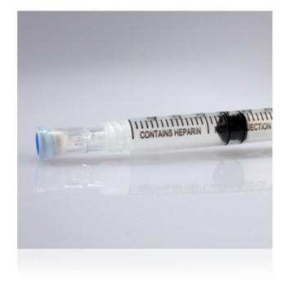
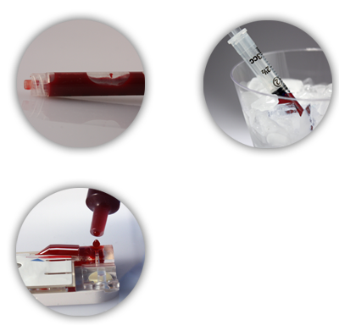
Blood Gas Cartridges—CG4, EG7
Use a syringe
Seal sample with cap IMMEDIATELY after collection.
Do not contaminate with air
pO2 will be falsely increased if air contamination occurs
Heparinized samples, test within 10 minutes
Non-heparinized samples, test immediately
EG7 (ionized calcium) use balanced heparin
ALWAYS test CG4 cartridge immediately after collection--lactate will be falsely increased if testing is delayed

Slide 44
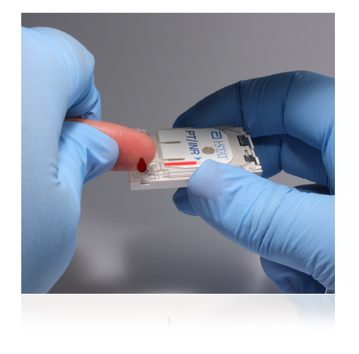
PT/INR Cartridge
Capillary or venous sample
Filling a PT/INR Cartridge
Gently squeeze finger to obtain hanging drop of blood
Avoid milking the finger as this factor may impact results
Bring the cartridge sample well up to the bottom of drop of blood until they touch
Do NOT use a filling device/transfer device/capillary tube.
Preferred method: Fill cartridge DIRECTLY from finger
Use the FIRST drop of blood to test
Venous sample: collect in a plastic syringe without anti-coagulant. Metal needles should not be used when filling an i-STAT cartridge.
Test Immediately!
If sample testing is delayed, falsely decreased results will be obtained

Slide 45
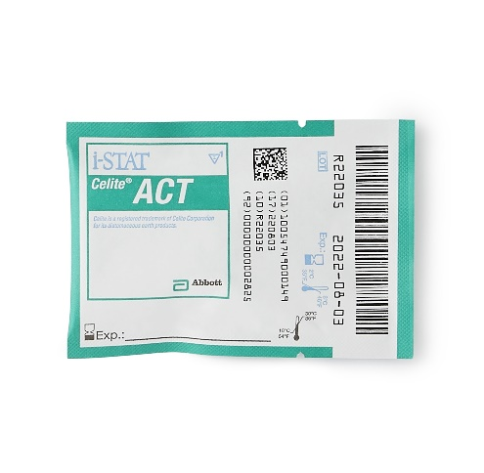
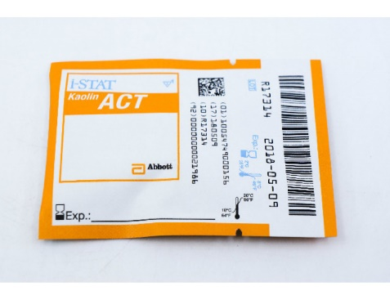
ACT Cartridges : IMPORTANT Information
ENSURE the correct ACT cartridge is used for your test site. ACT methods are NOT interchangeable.
There are multiple ACT methodologies in use at WFBMC, which may yield different results

Slide 46
ACT Cartridges (cont)
NON-heparinized Whole blood sample
Use a plain, plastic syringe
Do NOT fill cartridge with a metal needle
Test Immediately!
NO DELAY IN TESTING or results will be falsely decreased
Wait until the final ACT result displays
Contamination may be indicated by:
Falsely prolonged ACT results

Slide 47
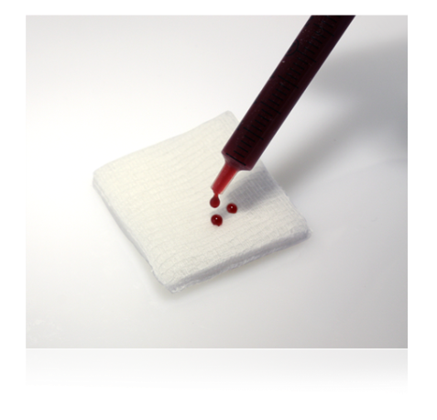
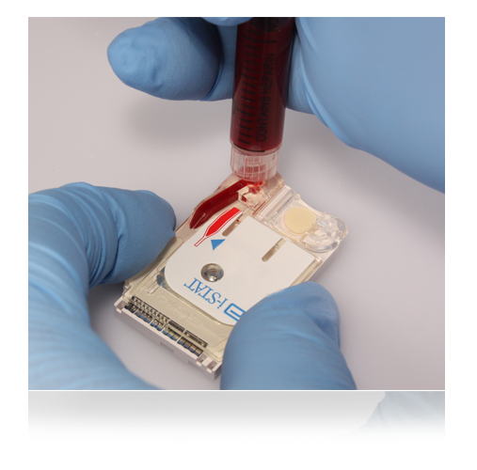
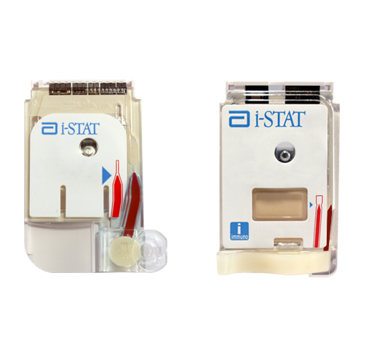
Cartridge Filling Overview
Mix the sample thoroughly and gently for 15 seconds
Hematocrit is most affected by an improperly mixed sample
Discard first few drops to check for clots and to get rid of any micro air bubbles
NEVER test a sample that has or has had a clot. Inaccurate results may be obtained.
Fill to the fill mark and close the closure to seal
Insert IMMEDIATELY into the analyzer
Do not move analyzer after cartridge has been inserted
Fill mark
closure is closed

Slide 48
Using a Capillary Tube to Fill a Cartridge (Do NOT use with ACT or PT/INR cartridges)
Test Immediately!
Direct one end of capillary tube into sample well
Fill to fill mark
Close the closure
Fill mark
closure is closed

Slide 49
Running a Patient Test: Using the Test Select function
Used to view and report selected results
Refer to list of analytes displayed
Press corresponding numbers on keypad
Press again to deselect
Only select tests that the clinical provider has ordered or the documented protocol indicates

Slide 50
Running a Patient Test: Overview of the Chart Page
Allows entry of patient data
Sample type
Enter the number next to the sample type
Press the ENT key
Patient temperature
ONLY if requested by provider
FIO₂
Free fields for additional info
Free fields do not populate the electronic medical record

Slide 51
Citrate Dialysis Testing: Only applies to Respiratory Therapy in PICU (iCa on EG7 cartridge)
When testing Dialysis Circuit sample,
Enter C in field 1 of the i-STAT analyzer
C causes results to post in Wake One with the comment: Whole Blood Dialysis Circuit
If you forget to enter C in field 1, Wake One enter/edit will have to be used to add the comment, “Whole Blood Dialysis Circuit”

Slide 52
Results
Interpreting Results
Comment Codes
Result Considerations
Quality Check Codes
Printing Results
Transmitting Results
Enter/Edit of Results – Wake One
Supporting Documents

Slide 53
Interpreting Test Results: The Results Screen
Patient ID
Time and date of test
Type of cartridge
Test results
EG7 results appear on 2 pages
Use right Arrow key to navigate

Slide 54
Interpreting Test Results: Critical Value Alerts
Indicated by up or down arrows
Evaluate with patient’s clinical symptoms
As appropriate, perform repeat testing
Values not consistent with patient symptoms --repeat and validate by an alternate test method
Use ICU Blood Gas Lab (except Creatinine – use Main Lab)
Follow medical center policy for handling critical results

Slide 55
Critical Values – found in i-STAT procedure on POCT website
The patient provider must be notified of critical values:
Documentation must include:
Result
Date/Time of notification
Name of provider notified
Name of notifying staff member
Critical values must be notified within 15 minutes

Slide 56
Estimated Glomerular Filtration Rate (eGFR)
Estimated Glomerular Filtration Rate (eGFR) values will be reported when Creatinine results are downloaded into the electronic medical record.
The values may be accessed via Wake One.
The i-STAT handheld will NOT report eGFR values.
May use online calculator in POCT website (under Resources - Resource Links)

Slide 57
Interpreting Test Results: Out of Reportable Range Flags
Out of Reportable Range flag
Indicated with a <xxx or >xxx
Suppressed Result Flag <>
Result dependent on the out of reportable range result

Slide 58
Interpreting Test Results: Star Outs (***)
*** appears in place of the test result
Sensor on the cartridge is unable to report a result
Use comment code 0 (zero) to prevent result from posting to the patient record
Failure to enter comment code 0 into the i-STAT handheld at the time of testing=results post to Wake One
The star out result will report as INSTRUMENT ERROR.
ACTION REQUIRED:
Retest the sample
If star out values continue, send the sample to the Clinical lab for testing.

Slide 59
Responding to Patient Tests: Comment Codes
Numeric codes
‘Automates’ result hold or posting of result to the patient record
Affects patient billing for testing
Comment field--top of the first page of the results screen
MUST be entered at the time of testing AND before the analyzer powers down
Question: What can you do if you realize that you have misidentified a patient sample immediately after inserting the cartridge?
Code | Translation | Result Post to Wake One | Allows charge to patient | Use
0 (zero) | Procedure Error | NO | NO | Star out Questionable Results Error in testing
5 | Recheck/Confirm | Yes | NO | Result may be accurate and test will be repeated
6 | To Notify Provider | Yes | Yes | Documents intent to notify provider of result
123 | Lab Confirmation to Follow | Yes | NO | Use when sending repeat testing to the laboratory

Slide 60
Result Considerations : Factors That May Affect Results
Avoid factors that may affect the sample prior to analysis
Always correlate results with the status of the patient
DO NOT move/carry the analyzer during sample testing
NO Vibration or tilting analyzer
References:
Cartridge and Test Information Sheets (CTI Sheets)
i‑STAT 1 System Manual
www.abbottpointofcare.com

Slide 61
Result Considerations: Cartridge and Test Information Sheet

Slide 62
Result Considerations: i-STAT INR
Consideration | Action
Error Code 19 | Draw venous sample and send to Core Lab for testing
INR >=4.0 | Use comment code 123 Draw venous sample and send to Core Lab for testing
Chlorhexidine Gluconate | i-STAT PT/INR may be falsely elevated in samples contaminated with Chlorhexidine Gluconate. This chemical can be found in some skin cleansing solutions.

Slide 63
Result Considerations: Effects of Hemolysis on Potassium Result
Hemolysis is the destruction of red blood cells, caused by disruption of the cell membrane, and results in the release of hemoglobin
i-STAT tests whole blood. Hemolysis can NOT be determined.
Potassium values will be falsely increased
DO NOT report/treat high potassium results until verified via an alternate method.
If asked to do so, OR/ICU Blood Gas Labs will spin down sample to check for hemolysis

Slide 64
Result Considerations: Factors That May Affect Creatinine Results
Avoid affecting creatinine results:
Use another testing method if the patient has been administered hydroxyurea (Droxia®, Hydrea®)
Send sample to Main Lab
Do NOT use Blood Gas Lab
i-STAT creatinine results will be falsely elevated

Slide 65
Quality Check Codes:
i-STAT Quality System
Numerous quality checks during patient test cycle
Failed quality check
Cause message— pay attention to the code number
Action message
Quality Check Code
Do NOT continue with testing until the cause of the error is clearly understood
If the same error code occurs multiple times with no apparent cause, notify the Clinical Laboratory POCT office
Consider using a different analyzer and a different batch of test cartridges

Slide 66
Quality Check Codes

Slide 67
Quality Check Codes

Slide 68
Printing Results with the i-STAT Portable Printer
Used in NICU, PICU, Cath Lab, Peds ED, other
Display results and align the infrared eyes of each device
Press the printer icon key on the handheld
Printer uses rechargeable batteries—MUST remain plugged into outlet and turned off when not in use
Verify patient ID on printout against patient sample ID

Slide 69
Transmitting Results: Downloader
Transmit results after each test/case:
Turn handheld off
Place handheld in the Downloader
Look for display screen to show arrows and the message “Communication in Progress”
When transmission is complete:
Screen goes blank
Handheld turns off

Slide 70
Transmitting Results: Troubleshooting
If the downloader does Not display “Communication in Progress” or an error message appears
Check for a green power light
Check all cord/cable connections to the down loader
Try unplugging and re-plugging the cables
If troubleshooting does not resolve problem, report problem to the Help Desk (Call 6-HELP)

Slide 71
Editing of results once posted to Wake One
Refer to i-STAT Procedure or “Tips and Tricks: Procedure to correct i-STAT results in Wake One”
Situations that require editing of results:
Sample Misidentification
Also requires i-STAT resolution requisition found on POCT web site
Erroneous temperature corrected blood gas
Questionable i-STAT results if posted to Wake One
Tests performed but not ordered by the physician
Documentation of critical value notification if not done in another section of Wake One
Adding comment to citrate dialysis samples, where C was not used in Field 1 at the time of testing

Slide 72
Supporting Document(s)
i-STAT Resolution Requisition
(Located on POCT website – Forms and Records)

Slide 73
Congratulations
This concludes the i-stat education module.
Please note that this power point does not replace the i-stat policies and procedures.
The presentation only gives highlights of i-stat information.
Please complete the on-line i-stat exams(on MTS) within 1 week of training.

Slide 74
Hands On Experience
Change batteries and check battery voltage
Discuss menu options
Test external electronic simulator
Test/discuss liquid QC
Test sample as a patient
Recall results
Download of results

