Slide 1
Lab Safety Presentation
January 2023

Slide 2
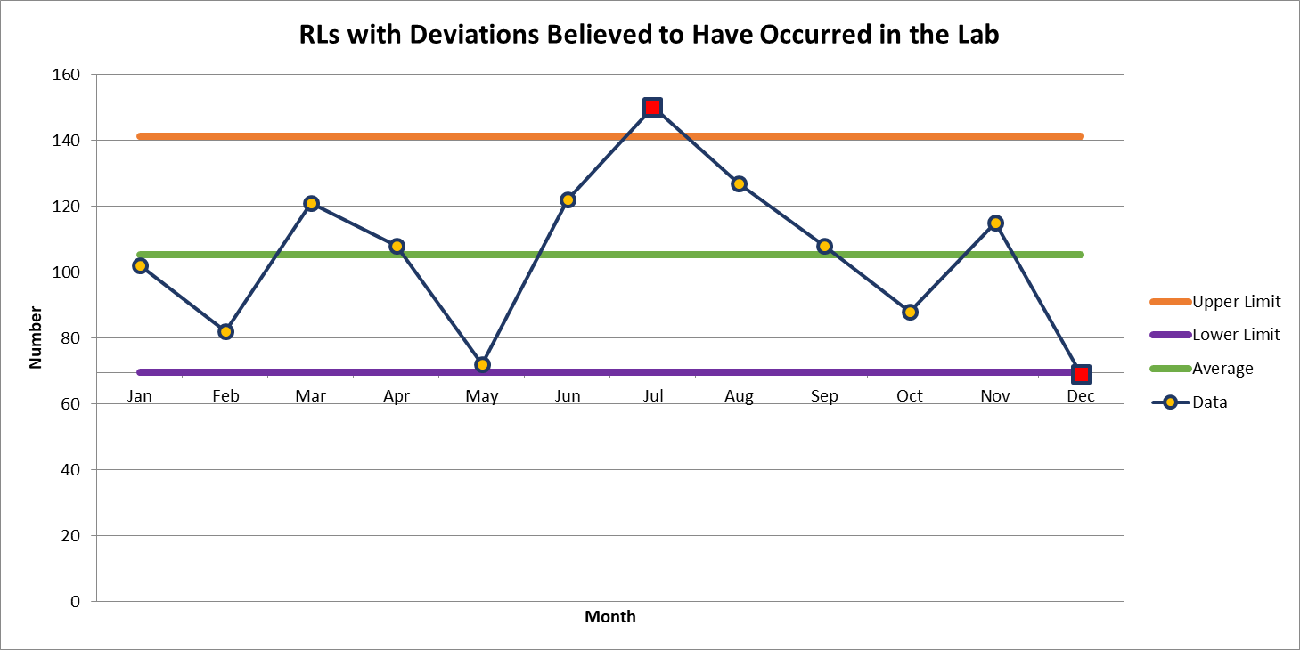
69 Deviations in December

Slide 3
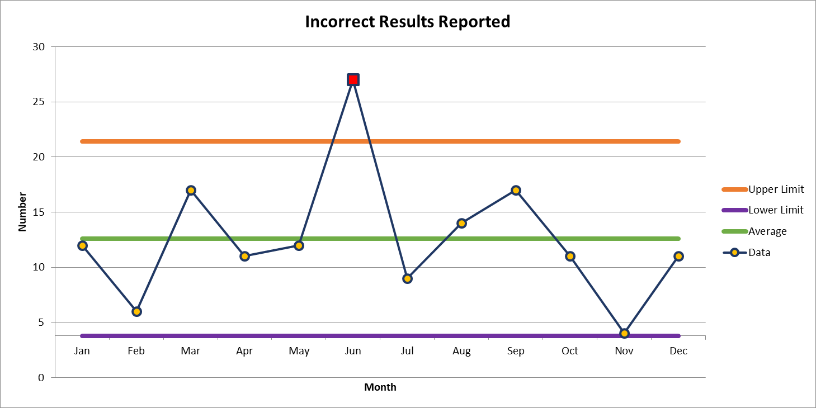
Most common deviation in December
11 Deviations in December

Slide 4
2nd most common deviation
Lost Specimen – 5
Labeling Error – 5
Delayed Result – 5

Slide 5
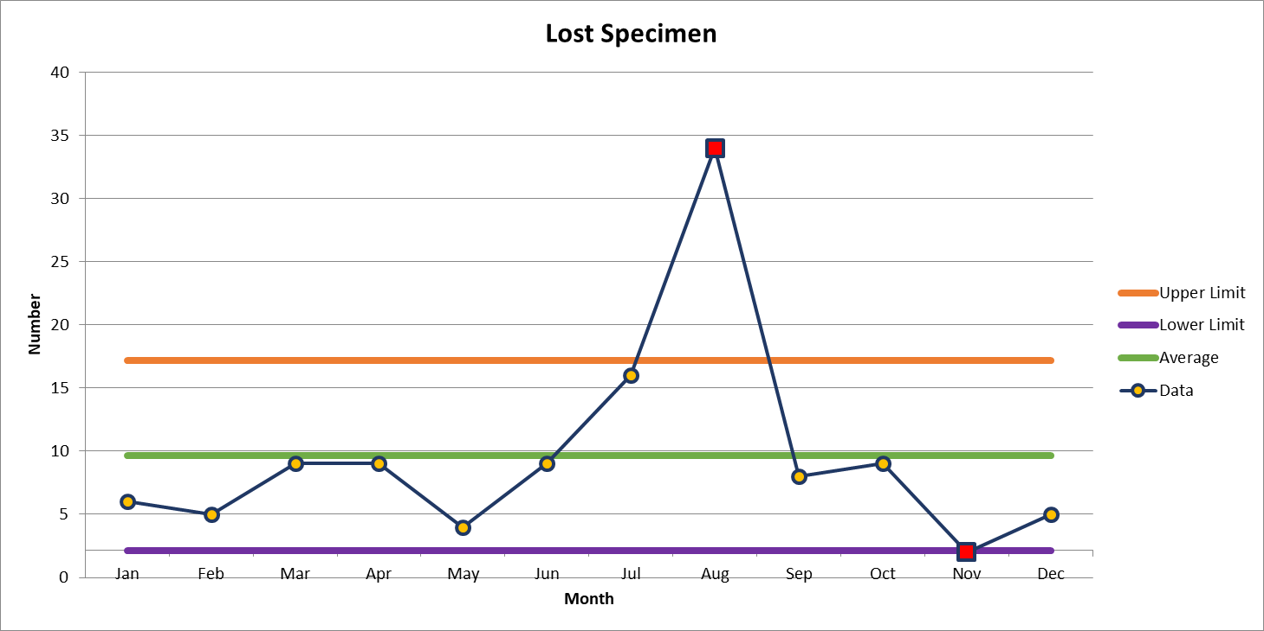
5 Deviations in December

Slide 6
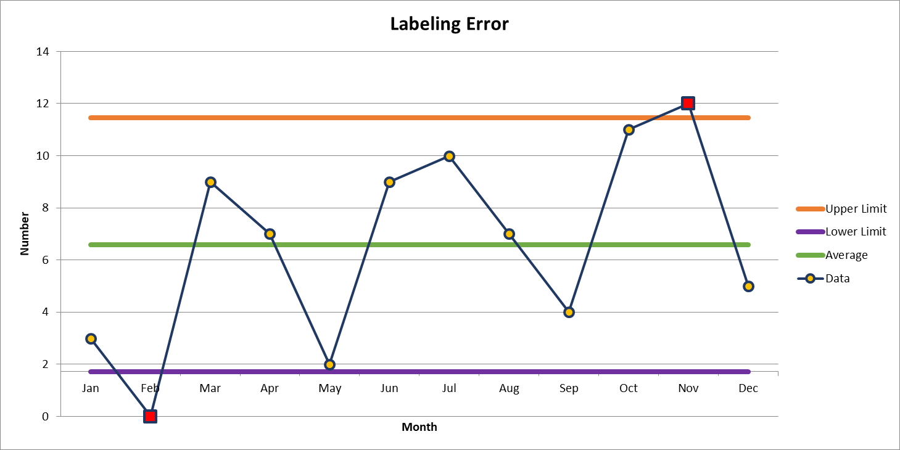
5 Deviations in December

Slide 7
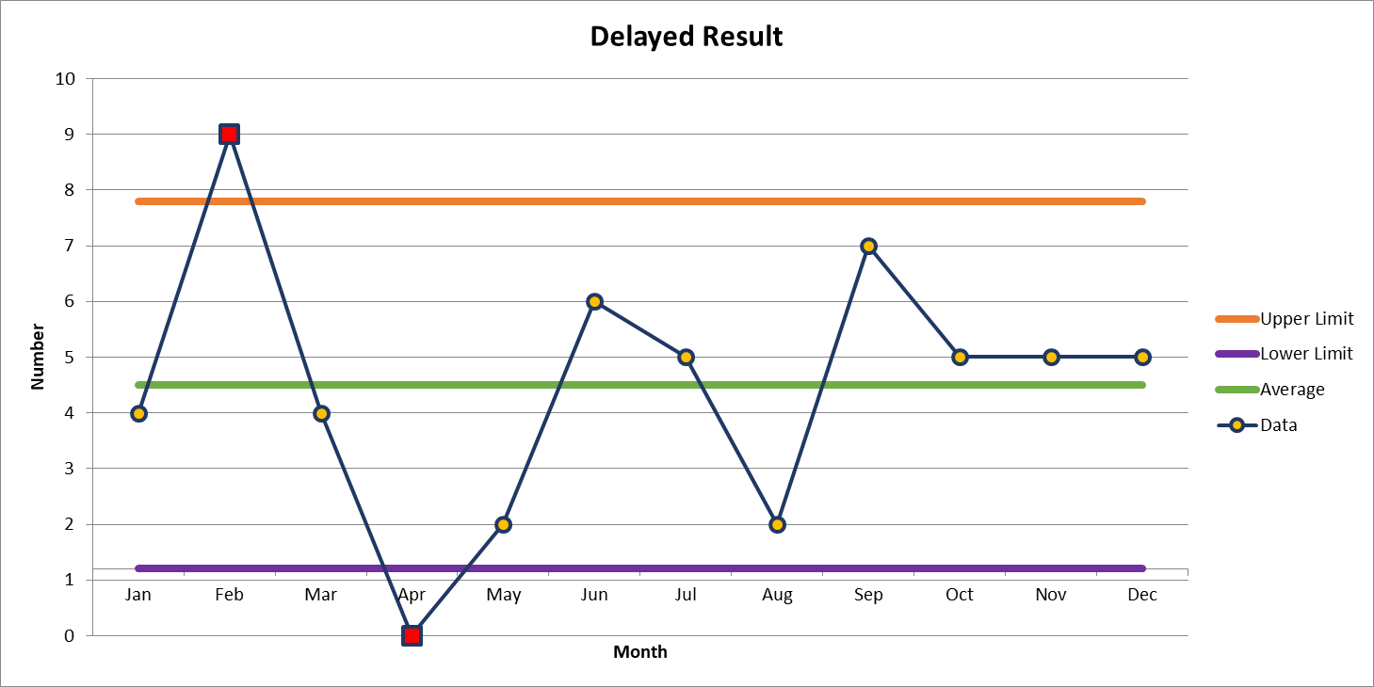
5 Deviations in December

Slide 8

Lab Employee Hazard Awareness
January’s Topic
– Handwashing

Slide 9




How to wash your hands
CDC handwashing guidelines
Wet Lather Scrub (20 Seconds) Rinse Dry

Slide 10
When to wash your hands
After removing gloves
Before leaving the lab
After patient contact

Slide 11
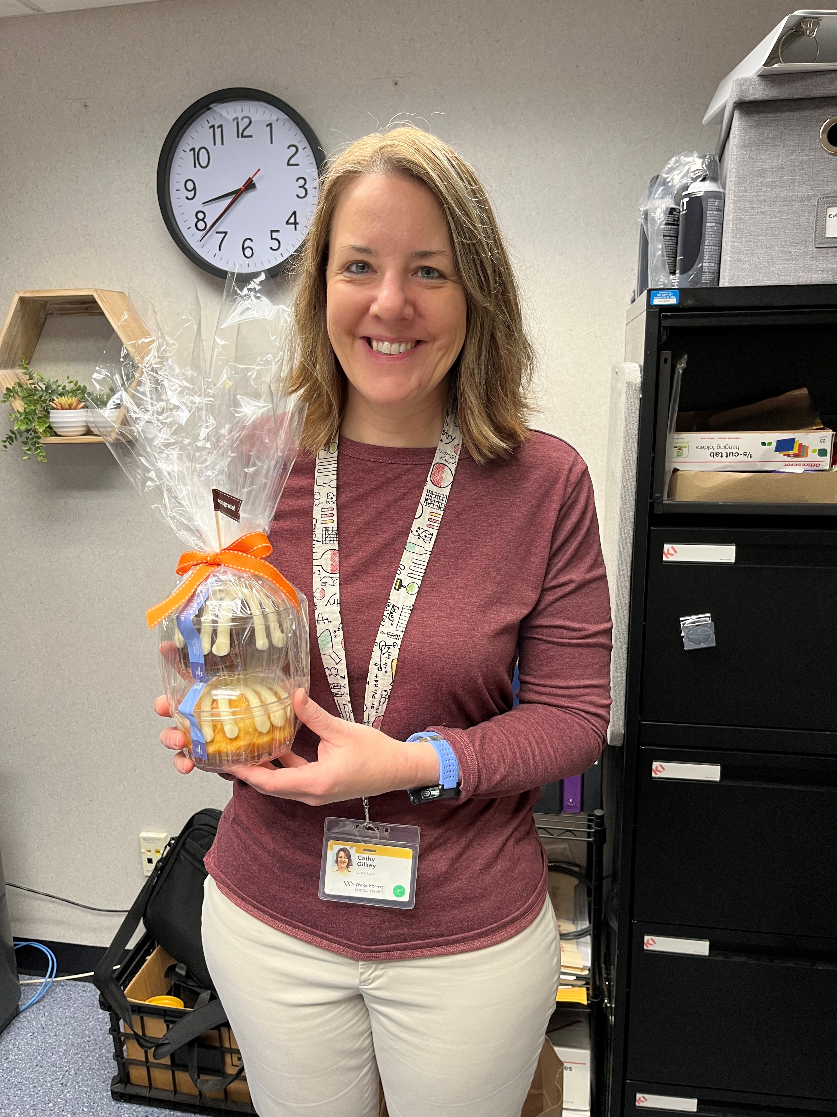
December Safety Topic of the Month Quiz
77 respondents
25 people scored 100%
Winner of the drawing
  Cathy Gilkey
  Hematology Manager

Slide 12



Slide 13
Good Catches in December
Great Work!
Thank you ALL!

Slide 14
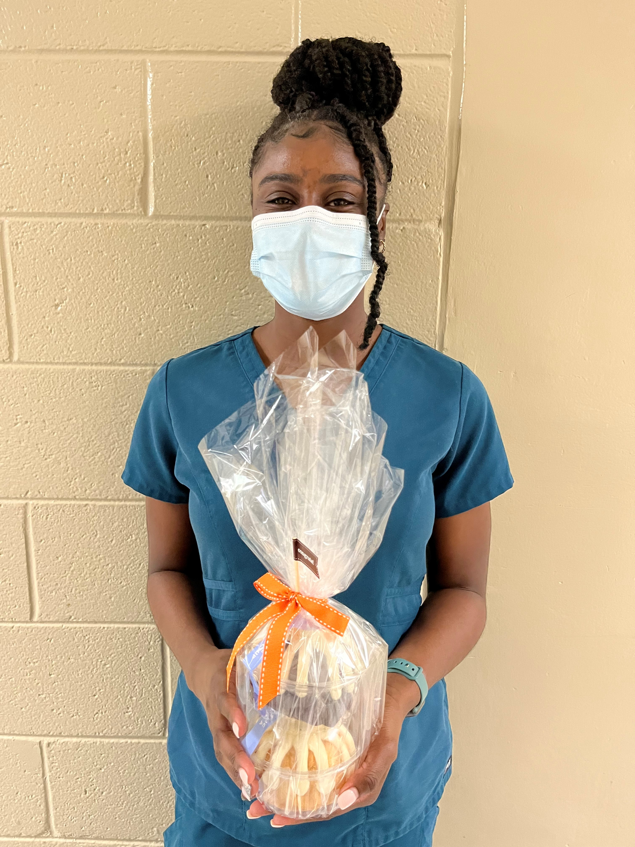
Good Catch Recipient for December
Jyneasha Johnson
Critical Care Lab

Slide 15

Safety Focus of the Month
The Danger of Distraction
Have you ever been driving and been distracted by a police car stopping another car on the side of the road or maybe a text on your phone? You glance away for a second… and then you slam on the brakes and barely avoid hitting the car in front of you. Your heart stops as you think about what could have happened
Distraction is everywhere, including at work in the hospital. It is a common source of potential error that is well appreciated in human factor analysis. A recent study showed that distraction most commonly contributes to medication errors, closely followed by errors in procedures, tests and treatments. Not surprisingly, distraction comes from phones, computers and other technology.
Consider the lab where you work and all the potential distractions. We work in a high-risk, high consequence industry. It is important to recognize this and change the way we behave in these situations.
Here are some moments to focus on minimizing distractions to reduce the risk of committing an error:
Manually entering lab results
Manually processing samples
Anytime the work you are doing could impact lab results
Stay focused on reducing distractions during these high-risk times and use the safety tools, including STAR, stopping and crosschecking each other to ensure all are paying attention and focused on the task at hand. It is through this teamwork that we will achieve Zero Harm for All.
This Photo by Unknon Author is licensed under CC BY

