Slide 1
January Staff meeting
1/13/23
0630
1400

Slide 2
Agenda
Competency
ER/MTP
Review
Education
2022 and 2023
Crossmatch Requirements
Lots in Use Protocol and Platelet orders
BB Mini Rounds Sign up

Slide 3
Competency
2022
All tasks should be complete.
Sign and return summary sheet to Bettina.
Complete all incomplete tasks ASAP. Details and deadlines have been emailed to individuals.

Slide 4
2023
Competency sent out
Similar requirements to 2022
New: ABID manual and automated
New: COBE functions
Other requirements may have been adjusted
New form to help you keep track
Preceptor vs. “trainer”
Preceptor has a General Supervisor (GS) CLIA delegation (BT, CSW, LW, EW (BMT), GK, DB, AM)
Trainer has been employed in BB for a minimum of 2 years and has demonstrated understanding and competency of SOPs.
Preceptors: we will have a meeting to go over things in January to establish expectations

Slide 5
Review:
Audits of compliance with usage of new special needs form:
Average of 50%
QA’s addressing non-compliance
This is CAPA derived and part of our preventative action. Proper use of this has prevented incorrect plts from being issued. It will work if it is used!

Slide 6
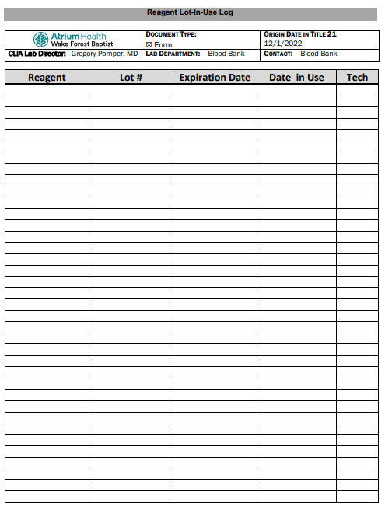
Lots in Use
New Policy: BB-SOP-0169
Document all New lots in use on Log hanging on Ref #10.
Required to be able to track when lots were put into use and what testing could be affected if lots are recalled.
Prevent wastage from using lot numbers out of order

Slide 7
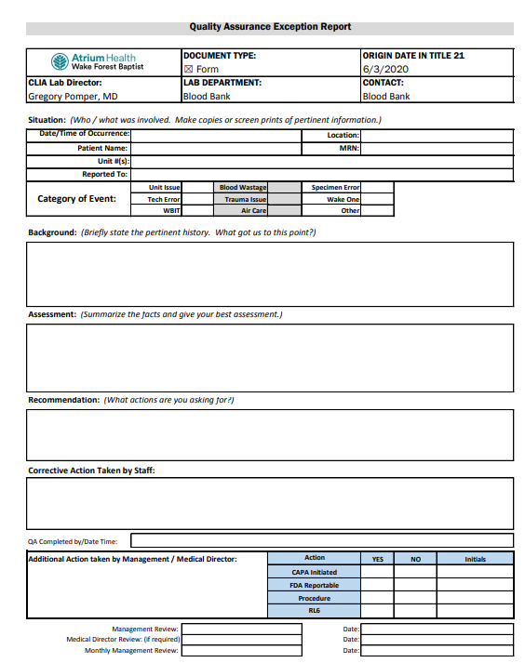
QAs
Quality Assurance Exception Forms are critical parts of our Quality Management Program. It details issues and understanding among staff as well as documents issues so management can assess trends and take action. This is all in an effort to prevent patient harm. QMP programs are REQUIRED by CAP/AABB/etc.

Slide 8
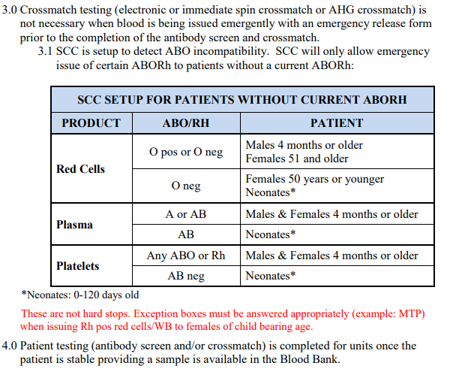
ER/MTP
Failure to Follow SOP
SOP never tells us to cancel crossmatches
AABB Standards state:
5.6.1.1 “…at a minimum, detection of ABO incompatibility shall be performed.”
5.27.5 “compatibility testing shall be completed expeditiously using a patient sample collected before the beginning of the transfusion sequence, when possible.”

Slide 9
Pulling Segments
Clean up vs. wait
Recommend pulling segments on all units issued on ER/MTP
Daily bucket for segments?
Bag of segments in biofridges?
Expectation is that a sample will arrive in BB within 15 minutes
If sample has not arrived, RL6 the delay in sample receipt and clean up the units. Completing ISXMs with segments.
If sample arrives, EXM after completion of patient testing (and ABOEO if ABO2 not complete).

Slide 10
Other:
ABO2 only required for samples where red cell containing components are possible (TSX). Not required for prenatal, GTX, DAT, etc.
FD History Check: Must look up by Name AND MRN. Best to look up by name and check for multiple MRNs associated with patient with same/similar name and DOB. Some patients have aliases and may have clinically significant data under a separate file.
Do not place ABO confirmation labels so that they cover ABO/Rh barcode!!
STS: closed

Slide 11
Mini BB Round #1
Jan 31st 0700
Must sign up to attend.
Passenger Lymphocyte Syndrome and case presentations
1 hour of CE with completion of post course questions
Larry Waldron

